Slide 1
Line Marking in Fixed Gear Fisheries Update Heather Hall (WDFW) Caren Braby (ODFW) Sonke Mastrup (CDFW) Korie Schaeffer (NOAA Fisheries)
August 22, 2022

Slide 2
Tri-State goals for line marking
May 13, 2020 Tri-State line marking coordination discussion
~50% unattributed/unidentifiable gear in confirmed entanglements
Barrier to solutions, burden on crab fisheries
Agreed upon goals for current and future line marking regulations:
Identifiable and accurate
Visible (primarily in photographs)
Reasonable and cost-effective
Coordinated across West Coast Dungeness crab fisheries and expandable to other fixed gear fisheries, as desired
Environmentally friendly
Notes:
West Coast D. crab management is unique
It’s a highly valuable fishery that operates in federal waters, but is managed by the states
PSMFC has an import role in facilitating coordination
This Tri-State coordination is key!
We established line marking goals early on for the West Coast crab fishery

Slide 3
NMFS line marking analysis: Summary conclusions (April 2022)
With sufficiently marked gear including line marking in fixed fisheries, it could be possible to pursue “negative attribution” for those fisheries with at least some reported entanglements
Line marking success will likely depend on having multiple marks present to increase the probability of detection
More (and probably much larger) marks than currently required in WA Dungeness crab fishery would be necessary to provide a high likelihood for the detection of marks (or the potential for negative attributions)
The top and upper portion of the gear is the most frequently documented part of the gear during entanglements (surface gear, including trailer buoy lines, up to 5 fm of vertical line)
However, when buoys are not present to assist with identification, other portions of the gear (line) may be more commonly documented and will likely be necessary to mark to create a high likelihood for the detection of marks
Marking line at least every few fathoms, especially in the “top half” of the gear, would give you the best chance to detect a line marking and/or determine negative attribution for reported entanglements
Notes:
We are using NMFS line marking analysis as guidance

Slide 4
WA Line Marking Requirement WAC 220-340-430
Commercial crab fishery–Gear requirements.
(6) Coastal commercial crab fishery line requirements
“…(b)(i) It is unlawful for a coastal Dungeness crab fishery license holder to use line that connects the main buoy to the crab pot that is not marked sufficiently to identify it as gear used in the Washington coastal Dungeness crab fishery.
(ii) For each shellfish pot used in the Washington coastal commercial Dungeness crab fishery and rigged with line, that line must be marked with 12 inches of red in at least two places. At a minimum, 12 inches of line must be marked in red, no more than one fathom from the main buoy and no more than one fathom from the pot.”
Notes:
WDFW implemented rules for line marking in the coastal D. crab fishery at the start of the 2020-2021 season
We used the year prior for outreach and encouraged line marking on a voluntary basis
The rule purposely did not specify how to mark the line, we wanted to encourage experimentation and utilize fishers' expertise to reduce cost and support efficiencies
We knew the rule was only a first step and that additional changes were likely

Slide 5
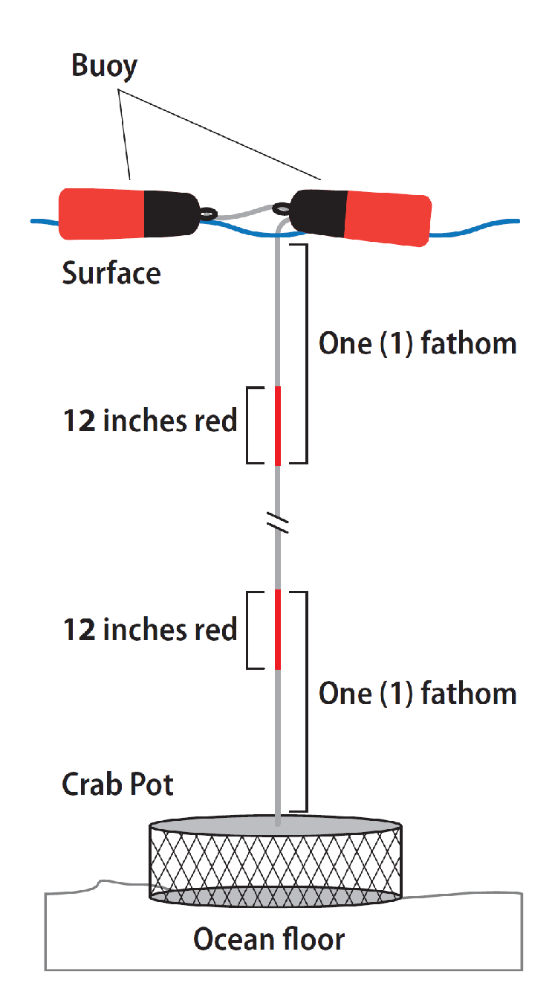
WA Line Marking
2 red markings total; methods of marking not specified

Slide 6
OR line marking prohibition OAR 635-005-0480
Dungeness Crab Buoy Tag and Gear Marking Requirements
“It is unlawful for commercial purposes to:
…(3) Use commercial Dungeness crab gear in the Columbia River or Pacific Ocean with a line mark that is required for any state or federal fishery, other than the Oregon Dungeness crab fishery, operating in the U.S. West Coast EEZ, or the state waters of Washington, Oregon, or California.”
Notes:
We also realized that for line marking to be effective, WA specific line marking can’t be used in other fisheries, ODFW implemented a rule to help us with that.
This would be useful to have in CA rule, in WA rule, and in federal rule.

Slide 7
OR Line Marking Requirement
In development…
Fall 2022 industry meetings
Spring 2023 commission rule-making proposal
Planned implementation 2023-2024 season
Other Oregon fixed gear fisheries of note
Sablefish (federal rules in development)
Nearshore groundfish
Hagfish
Spot prawn
Others
Notes:
ODFW views line marking as an essential part of fully understanding the problems and solutions for whale entanglements in fishing gear, and mitigating negative impacts on fisheries without cause.
We have been developing our ideas about an OR-Dungeness mark over the last 2-3 years and are ready to implement, with some finishing work with industry on how best to shape the state requirement.
Oregon fixed gear fisheries that might also get marked

Slide 8
CDFW
Public process
Implementation timeline
Other CA fixed gear fisheries of note

Slide 9
Tri-State Line Marking Workgroup
Building on goals from 2020
Interest in working toward negative attribution
Expanding line marking to other state managed fisheries
Coordination with federal fixed gear fisheries
Evolution of line marking to fishery specific line
Multi-color marking system needed
Funding support likely necessary

Slide 10
Line Marking Design
Size
Larger marks at surface increase likelihood that marks can be seen from platforms of opportunity (vessels, small planes, etc.)
Smaller marks along body of main line reduce the burden (materials + labor) for fishers
Color
Distinct state colors improve likelihood that state of origin can be distinguished, or a negative attribution can be made
Number, frequency, and placement
Marks in the surface system and upper portion of main line cover the portion of gear set that has been most likely to be documented and available for potential detection of marks historically
Marks along body of main line provide identification information when surface gear is not present
Marks in/near the surface system and along body of main line provide opportunities for negative attribution
Minimal space between marks increases likelihood that marks are seen together
Solid marks
Solid marks increase likelihood that marks can be seen from platforms of opportunity

Slide 11
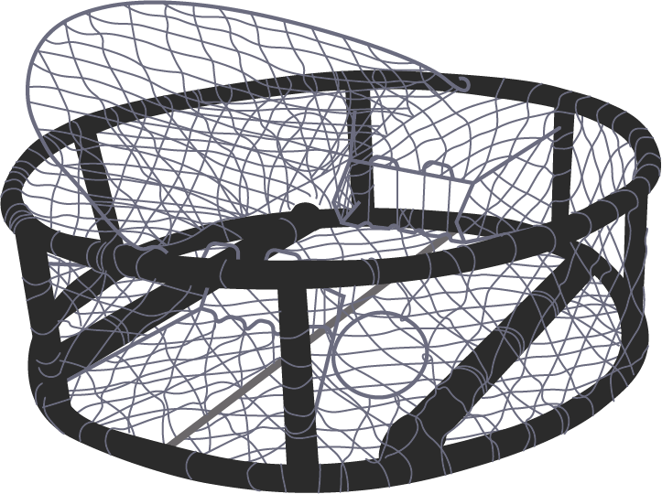
Examples for West Coast Commercial Crab Fisheries
Just to get the discussion started…
Washington
Oregon
California
Trailer buoy(s)
Trailer buoy(s)
Trailer buoy(s)
2 ft
2 ft
Main buoy
2 ft
2 ft
Main buoy
2 ft
2 ft
Main buoy
One set of marks in the surface system
AND
within the top 2 fathoms of the main line
One set of marks in the surface system
AND
within the top 2 fathoms of the main line
One set of marks in the surface system
AND
within the top 2 fathoms of the main line
2 ft
2 ft
2 ft
2 ft
2 ft
2 ft
One set of marks every 20 fathoms along the body of the main line
One set of marks every 20 fathoms along the body of the main line
One set of marks every 20 fathoms along the body of the main line
1 ft
1 ft
1 ft
1 ft
1 ft
1 ft
*Space between different colored marks should be ≤6 in within each set
Notes:
In this example, West Coast Dungeness crab gear is purple – Red is WA, Yellow is OR, Black is CA

Slide 12
Examples for Other State-Managed Fixed Gear Fisheries
Just to get the discussion started…
Hagfish
Spot and Coonstripe Shrimp
Poly ball (or bullet buoy)
Poly ball (or bullet buoy)
High flyer
High flyer
2 ft
2 ft
2 ft
2 ft
One set of marks in the surface system
AND
within the top 2 fathoms of the main line
One set of marks within the top 2 fathoms of the main line
One set of marks in the surface system
AND
within the top 2 fathoms of the main line
One set of marks within the top 2 fathoms of the main line
2 ft
2 ft
2 ft
2 ft
2 ft
OR
2 ft
2 ft
OR
2 ft
One set of marks every 20 fathoms along the body of the main line
One set of marks every 20 fathoms along the body of the main line
1 ft
1 ft
1 ft
1 ft
1 ft
1 ft
1 ft
1 ft
*Space between different colored marks should be ≤6 in within each set
Notes:
Building off D. crab, using Oregon as an example, this is what marking in other state managed fisheries could look like

Slide 13
NOAA Fisheries
Sablefish fixed gear line marking workshop, winter 2022-2023

Slide 14
West Coast Fixed Gear Coordination
State manager participation in NOAA fixed gear workshop(s)
Other West Coast gear marking workshops?
Funding for fishery transition costs?
Centralized databases for registration of…
Line marks? (it will be needed for observers)
Buoy color?
Buoy brand/number?

