Slide 1
2022 Federal Appropriations & Election Report
PSMFC Annual Meeting
Sebastian O’Kelly

Slide 2
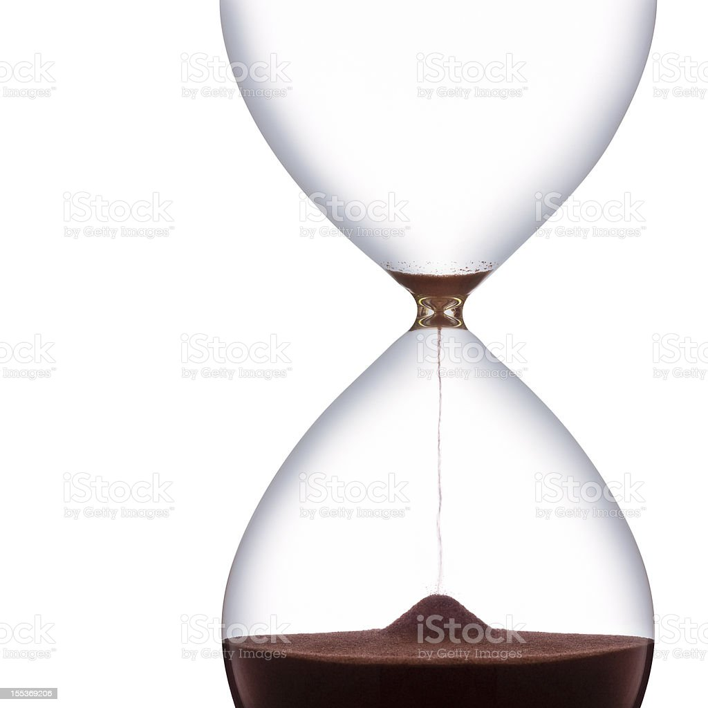
FY 2023 Appropriations
Late
Short-term CR
Post Election Lame Duck
Omnibus (Q4/Q1 2023)
Long-term CR or Govt. Shutdown Unlikely But Never Say Never

Slide 3
FY 2023 Appropriations
NMFS Funding Lines | FY 2022 Final Approps | FY 2023 Budget Req | FY 2023 House CJS | FY 2023 Senate CJS
Regional Councils/Commissions | 42,902,000 | 44,297,000 | 44,500,000 | 46,297,000
IJFA | 3,372,000 | 3,377,000 | 3,377,000 | 3,500,000
Fisheries Data, Coll, Surv, Assess | 187,500,000 | 212,095,000 | 213,768,000 | 213,238,000
Fisheries Management Program & Services | 129,400,000 | 149,081,000 | 141,369,000 | 139,464,000
Salmon Management | 63,050,000 | 62,762,000 | 65,000,000 | 67,150,000
Pacific Coastal Salmon Rec Fund | 65,000,000 | 65,000,000 | 65,000,000 | 65,000,000
Habitat Conservation/Restor | 55,000,000 | 61,353,000 | 57,500,000 | 58,684,000
ESA Salmon (Pac & Atl) | 73,500,000 | 80,060,000 | 80,000,000 | 79,000,000
NMFS | 1,015,955,000 | 1,106,389,000 | 1,099,964,000 | 1,110,076,000
 | Notes |  | Notes

Slide 4
FY 2023 Approps – House
Annual Funding Support Letter Led By Rep. Huffman (D-CA) + 37 Members
$25 million for the Mitchell Act hatcheries;
$39.5 million for Pacific Salmon Treaty Implementation;
$24 million for the Fishery Information Networks;
$600,000 for video review of West Coast electronic monitoring data;
$40 million to continue the Administration’s efforts in promoting wind energy;
$7 million to support climate-ready fisheries;
$1 million increase in research above FY ’22 levels for the Southern Resident Killer Whale population;
$6.5 million to implement Hatchery and Genetic Management Plans for Pacific Salmon. There is also report language recommending the development of a civilian conservation corps to develop a dedicated workforce to conduct salmon habitat restoration projects.
$6.2 million for the Seafood Import Monitoring Program, an increase of $1 million over FY ’22 levels. Report language also encourages NOAA to identify and bar fish products produced with convict, child, forced, or indentured labor.
Report language is included to direct NOAA and NMFS, in collaboration with the Army Corps, to resolve delays in the permitting of in-water construction in the Pacific Northwest.

Slide 5
FY 2023 Approps – Senate
Annual Funding Support Letter Led By Senator Wyden (D-OR) & 4 West Coast Senators.
$23 million for the Mitchell Act hatcheries.
$43.5 million for Pacific Salmon Treaty Implementation.
$25 million for the Fishery Information Networks.
$600,000 for video review of West Coast electronic monitoring data.
$16.5 million above FY 2022 level for wind energy.
$1 million for climate-ready fisheries. Report on ability of States to trade quota as fisheries move.
North Pacific Observers -- $8.5 M (+1 M over FY 2022).
Surveys – 4 vessels WC groundfish; at least 6 for GOA trawl fisheries.
Report on creation of National Seafood Council.
Directive Continue King Salmon Production At Little Port Walter Hatchery.
SIMP – + $4 M above enacted level.

Slide 6
FY 2023 Community/CDS Projects
House -- NOAA
$5 M Upper Columbia United Tribes – Salmon Reintroduction
$1 M Univ of WA Center for Urban Water – Protecting Salmon from Toxic Chemicals
$294 K Noyo Center for Marine Science, CA – Climate-Driven Collapse In Coastal
Habitats
$1.5 M Univ of WA Regents – Equity & Ecosystem Health
$1.5 M UC-San Diego Regents – Aerosolized Coastal Waters Pollution Study
Senate – NOAA
$5 M Upper Columbia United Tribes – Salmon Reintroduction
$3 M Northwest Straits Commission – Marine Conservation Initiative
$6 M Scripps Oceanography – SOCAL Bight Demonstration Project
$750 K Coquille Tribe – Salmon Conservation
$785 K Portland State Univ – Microplastics
$625 K Tillamook Estuaries Partnership – Local Climate Change
$250 St. Paul Aleut Community – Fisheries & Ecosystem Monitoring
$2.75 M Bering Sea Fisheries Research Foundation – Fisheries Monitoring
$2.7 M North Slope Borough – Marine Mammal Co-Management
$1.75 M Univ of Alaska – Baseline Fisheries Surveys
$825 K Yukon River Drainage Fisheries Assoc – Research, Surveys & Community Engagement

Slide 7
Bipartisan Infrastructure Law
Fisheries-Related Funding (FY 2022-26)
$2.6 billion NOAA.
$172 million to PCSRF.
$492 million to NOAA for a partnership with the National Fish & Wildlife Foundation for the National Coastal Resilience Fund to support ecosystem restoration program projects that have flood protection and coastal erosion protection.
$491 million to NOAA for community-based projects focused on shoreline protection.
$200 million over five years for NOAA’s marine debris program.
For fish passage culverts, in-stream barrier and dam removal--$1 billion USFWS grants to state and local governments; $115 million to the Army Corps; $400 million over five years to NOAA; $200 million to the USFWS National Fish Passage Program; and $75 million to FEMA for dam removal projects.
$79 million for Columbia River Basin.
$162 million for Klamath Basin infrastructure.
$17 million for Lake Tahoe to fund invasive species inspection stations.
$56 million Regional Ocean Partnerships.
$20 million NOAA Permitting.

Slide 8
NOAA FY 2022 BIL Grant Opportunities ($294 M)
-- Fish Passage Grants ($77 million, includes $12 million for tribes)
-- Transformational Habitat Restoration and Coastal Resilience Grants ($85 million)
-- Coastal Habitat Restoration and Resilience Grants for Underserved Communities ($10 million)
-- Coastal Zone Management Habitat Protection and Restoration Grants ($35 million)
-- National Estuarine Research Reserve System Habitat Protection and Restoration Grants ($12 million)
-- Marine Debris Removal ($56 million)
-- Marine Debris Challenge Competition ($16 million)
-- Marine Debris Community Action Coalitions ($3 million)
-- Senate Appropriations Committee – “Disappointed” at NOAA’s spending pace

Slide 9
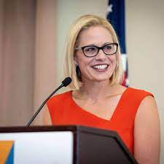
-- Build Back Better 3.0 – Inflation Reduction Act
Schumer-Manchin –Sinema Deal: $369 B Clean Energy/Climate Change Investments
NOAA $2.6 B approps over 5 years protection of coastal & marine habitats and fisheries (incl Pac Salmon)
NOAA Facilities -- $150 M
NOAA Marine Sanctuaries Facilities -- $50 M
NOAA Permitting -- $20 M
USFWS -- $125 M ESA Recovery Plans
USFWS -- $121 M Protection Of NWR & State Wildlife Management Areas (including invasives)
BIA -- $10 M Fish Hatcheries

Slide 10
Fisheries Disaster Relief – Recent Secretarial Determinations & Allocations
Upper Cook Inlet East Side Set Net (2018) & Upper Cook Inlet salmon (2020)--$9.4 M
Copper River and Prince William Sound salmon fisheries (2018 & 2020)--$34.4 M
Eastern Bering Sea Tanner crab (2019/2020)--$12.9 M
Pacific cod in the Gulf of Alaska (2020)--$17.8 M
Alaska Norton Sound, Yukon River, Chignik, Kuskokwim River, and Southeast Alaska salmon fisheries (2020 and 2021)--$56 M
Norton Sound Red king crab fishery (2019) -- $1.4 M
Fisheries Disaster Relief – Requests Under Secretarial Review (7/22)
Twenty-One Fisheries!!

Slide 11
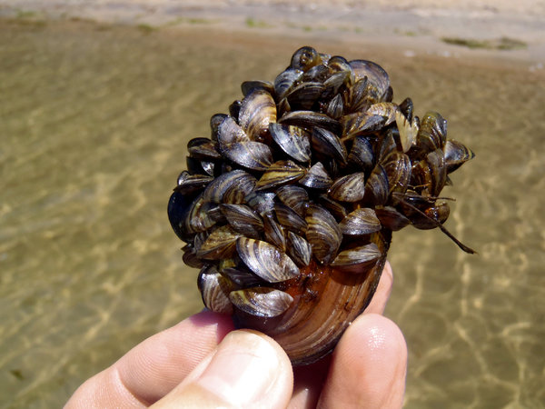
Aquatic Invasive Species – FY 2023 Funding
FY 2023 House Appropriations
$17.9 M USFWS Invasives Strike Teams
$44.7 N USFWS AIS
$5.6 M Lake Tahoe
$3.5 M USFWS Western Zebra/Quagga Mussels
$16 M ACOE Columbia River Watercraft Inspection
$3 M for AIS Monitoring Western Upper River Basins
$3 M NOAA Coastal AIS Grants
FY 2023 Senate Appropriations
$48.2 M USFWS AIS
$4.4 M Lake Tahoe
$3.5 M Zebra/Quagga Mussel Eradication
$1.5 M Upper MS River AIS
Report Language USFWS/NOAA Cooperation European Green Crab
$16 M ACOE Columbia River Watercraft Inspection (plus $3 M for “related monitoring”)
Directive To NOAA Establish AIS Grant Program

Slide 12
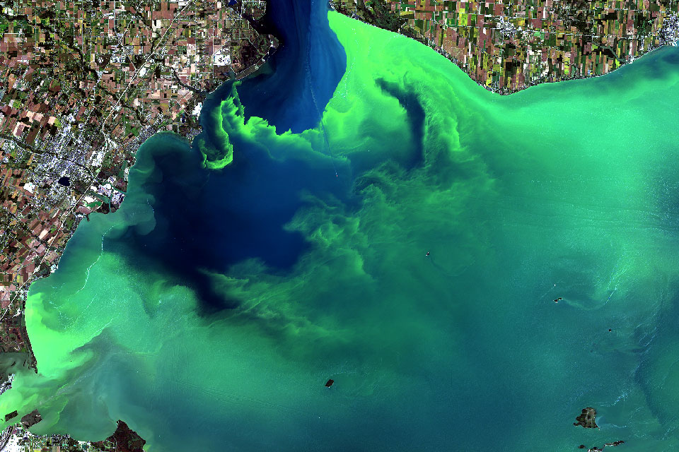
Harmful Algal Blooms (HABs)
1. GAO Report -- Agencies Should Take More Actions to Manage Risks from Harmful Algal Blooms and Hypoxia (June 15). Recommends that NOAA and EPA define a national HAB and hypoxia program. 11 Congressional Requesters including Rep. Bonamici (D-OR)
2. South Florida Clean Coastal Waters Act of 2021 (enacted June 16). Interagency Taskforce to submit plan for HAB reduction in South Florida within 3 years.
3. FY 2023 House Appropriations
-- $4.5 M NOAA Integrated Ocean Observing System
-- $15 M NOAA Research (nitrogen & phospherous)
-- $1 M NOAA Domoic Acid Assistance To States
-- $13.5 M EPA Toxic Health Effects
-- $2 M EPA Research
-- $8 M ACOE Research & Control
-- $5 M ACOE HABs Demonstration Program
FY 2023 Senate Appropriations
-- $3 M USDA Aquaculture Impact
-- $1 M NOAA IOOS
-- $17.5 M NOAA Monitoring & Research
-- $20 ACOE Research & Control

Slide 13
2022 Mid-Term Elections

Slide 14
Senate
50
50

Slide 15
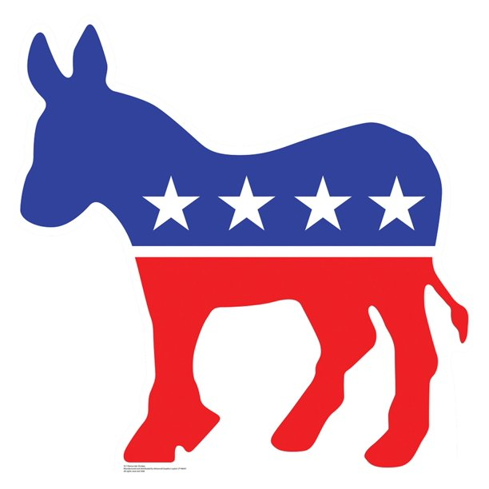
House
220
211

Slide 16
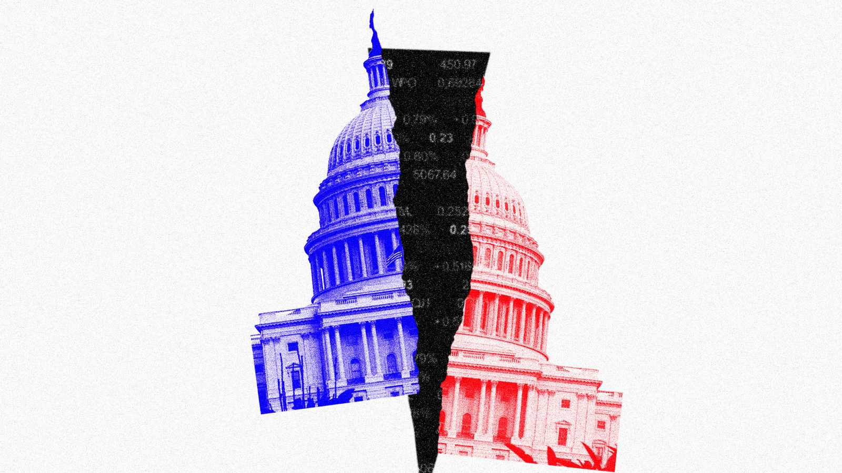
Mid-Term Precedent
40 + Years Of Mid-Term Election History
-- Congressional Mid-Terms Favor Presidential Out Of Power Party
** 2018, 2014, 2010, 2006, 1994, 1990, 1986, 1982. Anomalies: 1998, 2002
-- Americans Like Divided Government!!
** Since 1980, 29.5 years divided govt, 12.5 years same party control (mostly in first 2 years of new Presidency)

Slide 17
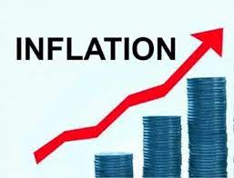
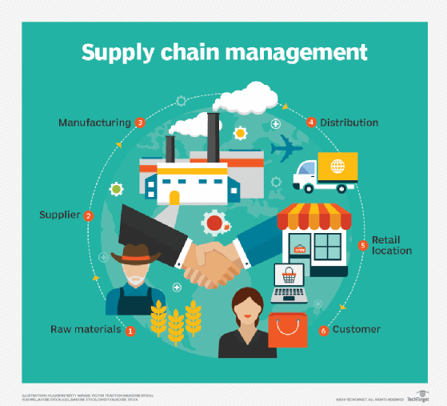
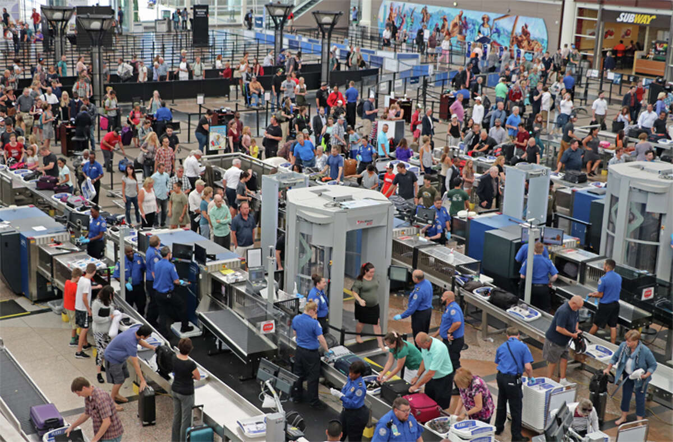
2022 Election Issues & Indicators

Slide 18
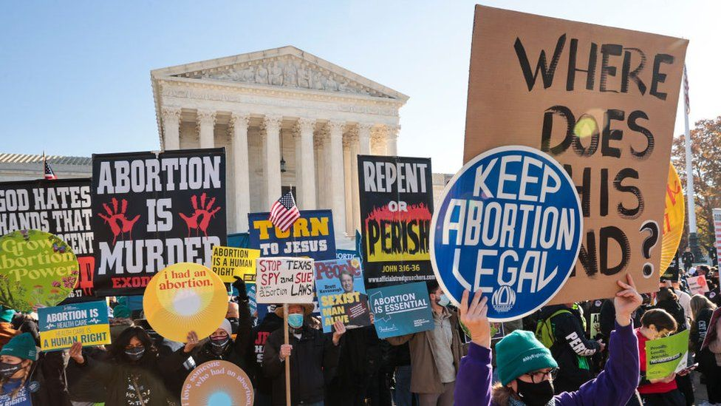
Wild Cards

Slide 19
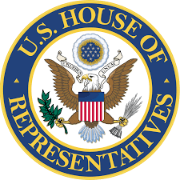
2022 House Election
Democratic Seats “In-Play” – 30 to 50
Republican Seats “In-Play” – 5 to 15
Democratic Retirements (32) Republican Retirements (19)
Most Political Analysts – Likely Republican Takeover

Slide 20
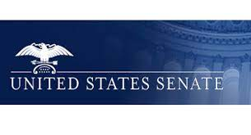
2022 Senate Election
Democratic Seats “In-Play” – 4 to 5. AZ, NH, GA, NV. Longer Shot – CO
Republican Seats “In-Play” – 2 to 4. PA, WI. Longer Shot – OH & NC
Most Political Analysts – Hedging Bets At This Point

