Slide 1
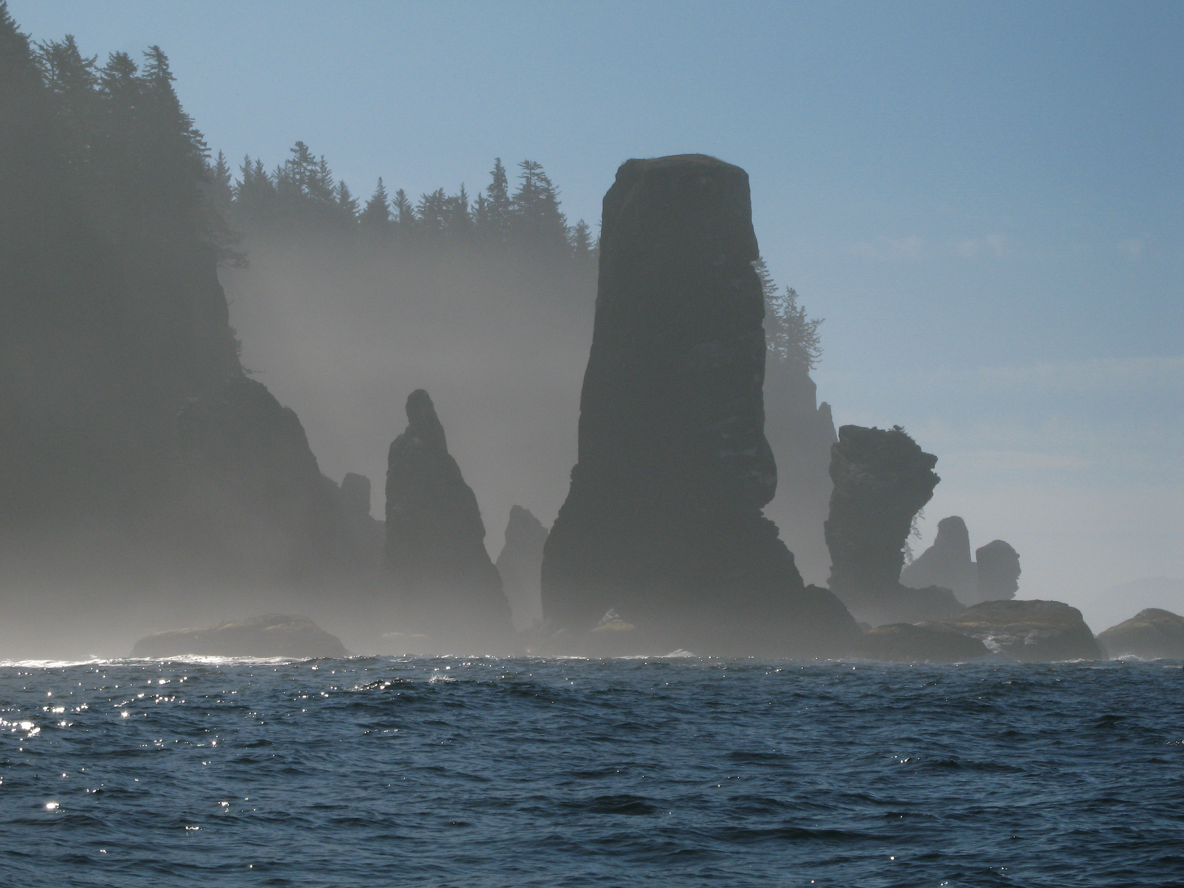
WDFW Update to PSMFC
Nate Pamplin, Director of External Affairs
Washington Department of Fish and Wildlife
August 2022

Slide 2
WDFW Overview
FTEs: 1,900
$611M Operating Budget for 2021-23 Biennium
Governor-Appointed F&W Commission
9 Members
Policy Body
Appointing Authority for the Director
Strategic Plan—25 years
Proactively address conservation challenges
Engage communities through recreation and stewardship
Deliver science that informs Washington’s most pressing F&W questions
Model operational and environmental excellence

Slide 3
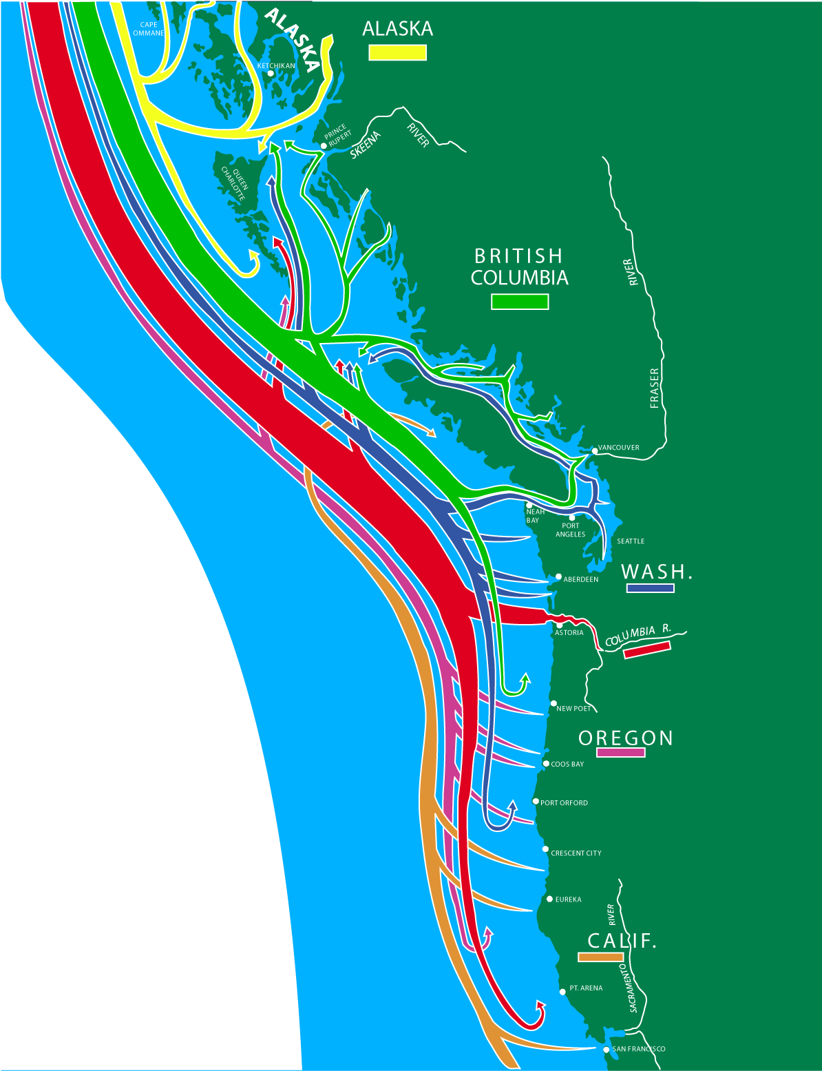
Complex, multi-jurisdictional processes
Pacific Salmon Treaty
Pacific Fishery Management Council
U.S. v Washington
U.S. v Oregon

Slide 4
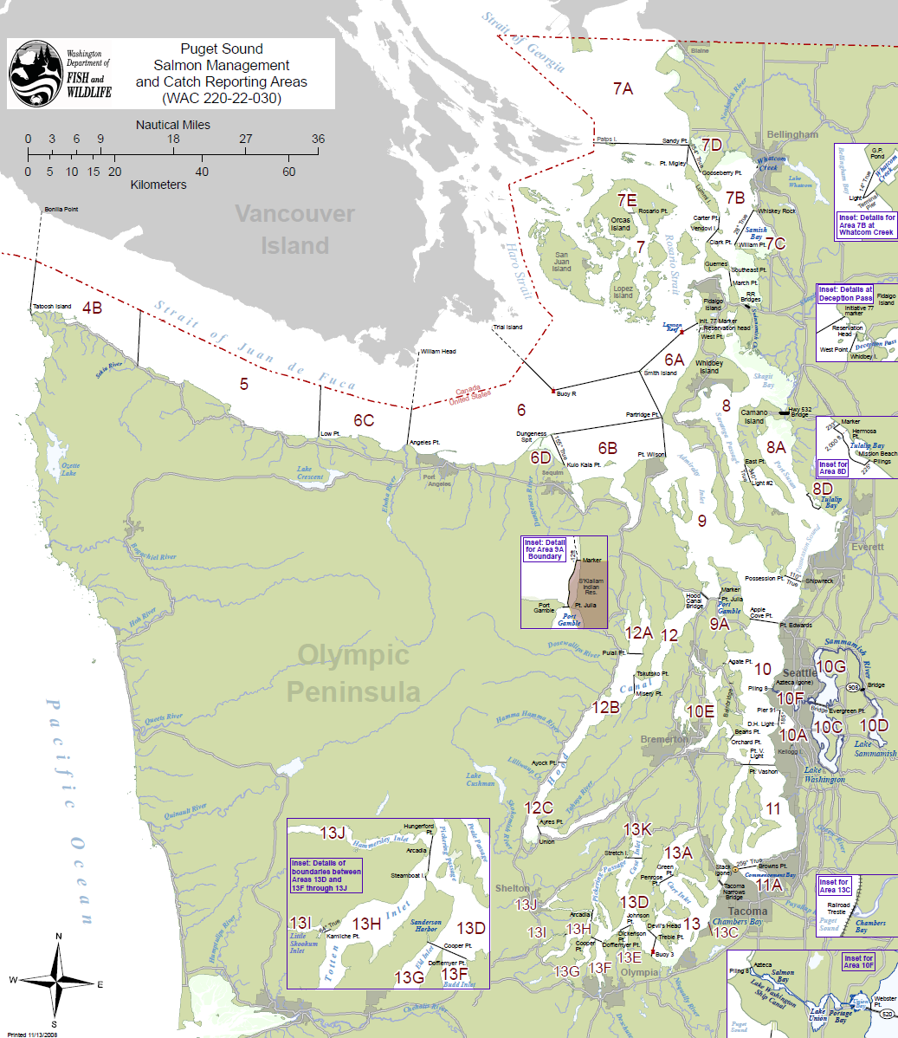
Puget Sound Chinook Harvest Management Plan
WDFW and Puget Sound Tribes submitted Resource Management Plan to NOAA in February, 2022
If approved, the Plan will provide ESA coverage for Puget Sound and Strait of Juan de Fuca marine and freshwater fisheries for 10 years

Slide 5
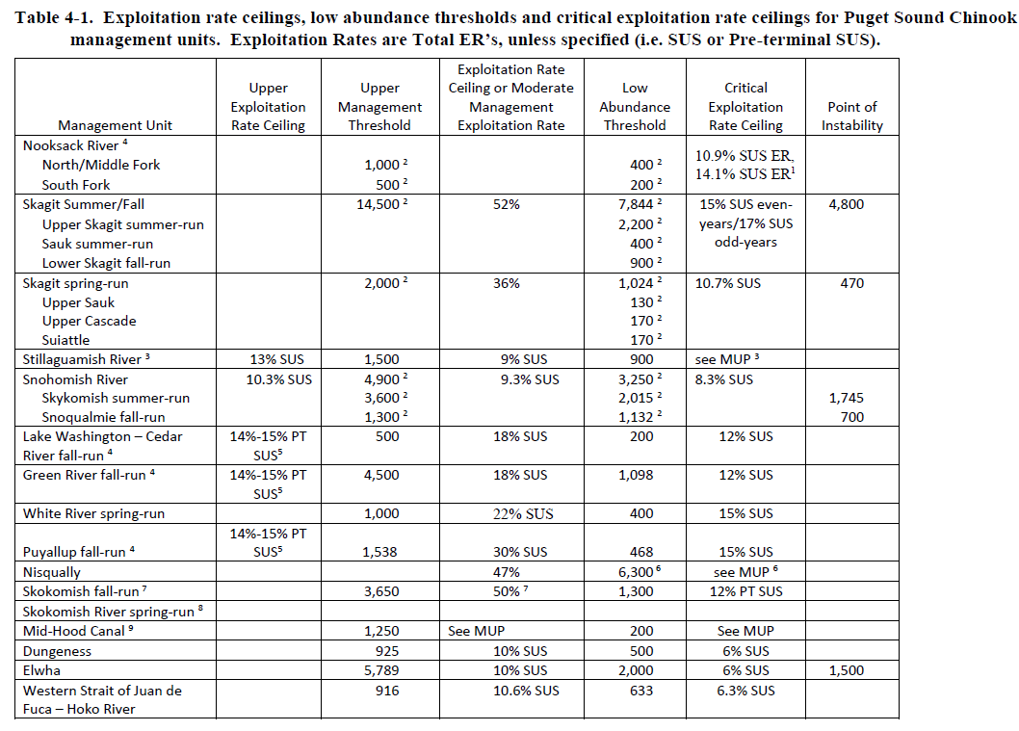
Puget Sound Chinook Harvest Management Plan
Detailed information about each of the 16 Chinook ‘Management Unit Profiles’ within Puget Sound
Plan contains abundance thresholds and exploitation rate limits for each of the Management Units
Allowable fishery exploitation rates are based on unit-specific abundance and productivity

Slide 6
Puget Sound Chinook Harvest Management Plan
Plan is currently under review by NOAA, co-managers will provide additional information as needed during that review
NOAA’s administrative process likely to take 15+ months, including NEPA review
Co-managers used objectives from the RMP for planning 2022 fisheries, ESA authorization was obtained through a one-year Section 7 consultation
The plan is available on the WDFW website at https://wdfw.wa.gov/fishing/management/puget-sound-management-plan

Slide 7




“A commercial whale watching license is required...”
2019 Legislation:
Defined fees per operator and per vessel (including kayak tour operations)
Required WDFW to adopt rules for license-holders by 1/1/21
Required WDFW to convene an independent panel of scientists to review disturbance and noise impacts on SRKW from small vessels and commercial whale watching
Requires WDFW to report on the effectiveness and recommended changes to the rules November 2022, 2024, and 2026.
Implementing
Orca Task Force recommendations, 2019 legislation created a Commercial Whale Watching License and directed WDFW to make rules for viewing Southern Resident orcas in the inland waters of Washington State.
(2SSB 5577)
Notes:
See notes on slide.
“The department must adopt rules for holders of a commercial whale watching license established in RCW 77.65.615 for the viewing of southern resident orca whales for the inland waters of Washington by January 1, 2021...”
“The department must use the best available science in the establishment of the southern resident orca whale watching rules and continue to adaptively manage the program using the most current and best available science.”
Links if anyone is curious/wants to learn more:
https://wdfw.wa.gov/species-habitats/at-risk/species-recovery/orca
https://wdfw.wa.gov/sites/default/files/2021-10/sb5577amoverview.pdf
https://wdfw.wa.gov/sites/default/files/2021-10/scientificassessmentguidance.pdf
https://wdfw.wa.gov/sites/default/files/2021-10/srkwmonitoringfactsheet2021.pdf
https://wdfw.wa.gov/sites/default/files/2020-09/wsasadaptivemanagementfinal.pdf

Slide 8
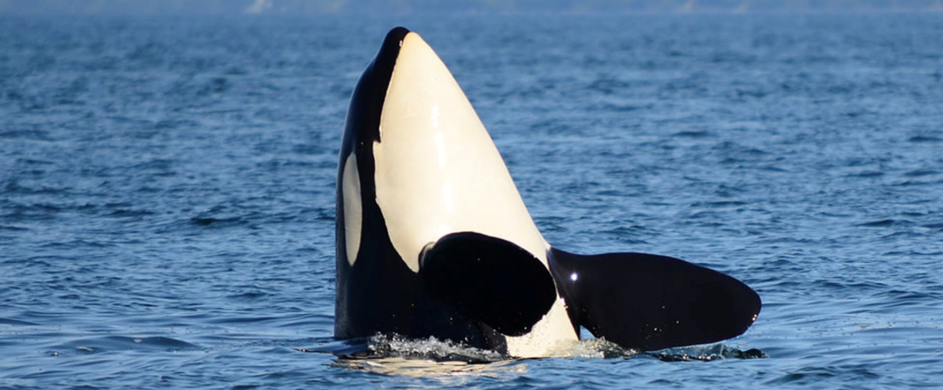
Commercial Whale Watching Licensing Program (CWWLP)
Successes and Challenges
CWWL initiated in 2021
  DocuSign license applications
  Calves and vulnerable whales
  Communication and dialogue
  AIS cost-share grants
Reoriented to a 2021 bill: ESB 5330
  Modified the license structure
  Waived the license fees in 2021 and 2022
  Modified requirements for Canadian businesses and individuals
Rulemaking in 2020
  Completed before 1/1/21 despite challenges of a public process during COVID lockdowns
Notes:
See notes on slides
As of 8/16/2022 (2022 license stats)
36 licensed businesses…. Of those:
22 Washington; 14 B
4 kayak-only, 2 are both motorized + kayak (all WA)
98 motorized CWW vessels
158 operators/guides…. Of those:
45 kayak guides
103 operators
10 both kayak guides and operators

Slide 9
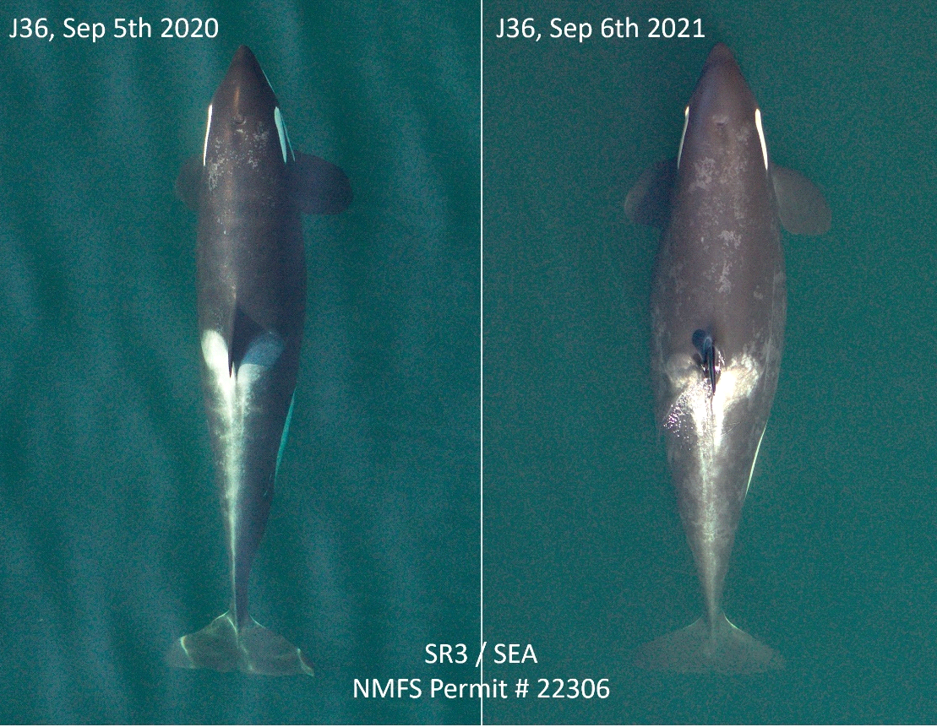
2021
K21 – 7/30/21
poor condition
J56 – 9/2/21
poor condition
J19, J36, J37 – 9/13/21
late-stage pregnancy
2022
J27, J36, J44, J49, J56, L54, L83, L90, L94, L110, L116 – 6/30/22
poor condition
L72 – 6/30/22
late-stage pregnancy
Vulnerable Whales
Notes:
Criteria:
Lowest 20% body condition for age/sex (associated with a 2-3x higher risk of mortality in the near-term)
Late-stage pregnancy (picture shows J36, who unfortunately did not return with a calf after being documented as pregnant in September 2021)
Illness/injury/etc.
In 2021 the rulemaking was based on ad-hoc reports, but in 2022 we had a research group (SR3) that does overhead photogrammetry and body condition analysis provide us a report in June on the best available information about whale condition for the whole SRKW population.
Note: Calves under the age of 1 already can’t be approached by CWW closer than ½ NM per the WAC– no additional rulemaking needed. There were three calves in 2021 and 2 more in 2022 (as of August 16) who fell in this designation.

Slide 10
Columbia River Pinniped Management
Since new authorization granted in August 2020 under MMPA 120(f):
  53 Steller sea lions and 46 California sea lions removed (WA/OR)
  Estimated cumulative >11,000 salmon will be “saved” by one year of removals under new authorization (2020-2021)
Immediate future:
  Continued removals at Bonneville Dam in partnership with ODFW, IDFG, CRITFC
  Updated equipment and protocols to better handle Steller SLs
  Expansion into Washington’s tributaries (monitoring, removals)
Slated to receive $892,000 in one-time Community Project Funding routed through NOAA to begin in October 2022
BUT, concern about loss of annual $300,000 from NOAA (split with ODFW, $150,000 to WDFW) historically routed through PSMFC
Future of state funding unknown, currently ends June 2023

Slide 11
WDFW Puget Sound Pinniped Work
Harbor seal diet studies:
  Major, year-round harbor seal diet in Southern Puget Sound
  New method for estimating Chinook length from vertebra size
  Improving genetic techniques for improvement of diet studies
Aerial surveys (harbor seals, Steller sea lions)
  Abundance estimates for WA’s four harbor seal stocks, Steller SLs
  Will update NOAA’s stock assessments; research paper forthcoming
Stillaguamish Chinook predator project
  Investigating pinniped/avian predation on Chinook in river/estuary
  Seasonal changes in predator abundance and distribution
  Predator mark/scar rate on adult Chinook collected for hatchery
  Satellite tagging of harbor seals to assess seasonal movements, river use, foraging behavior
Partnership with Oceans Initiative, Acoustic Startle Device
  Deschutes River, Olympia

Slide 12
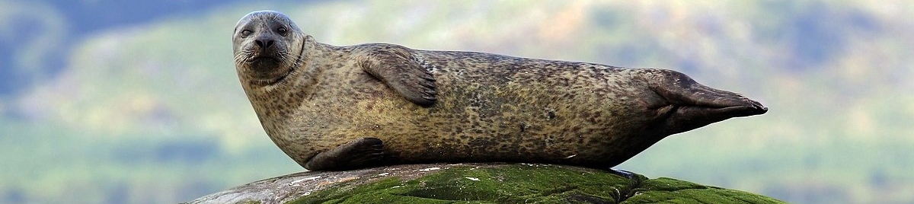
WSAS Pinniped Predation Report
Washington State Academy of Sciences contracted to assemble a panel to assess pinniped predation on salmonids in Washington
Panel convened workshops with state and tribal, researchers, other stakeholders
Literature review and summary of current state of knowledge
Report due Nov. 2022 including evaluation of potential management actions, recommendations for future research

Slide 13
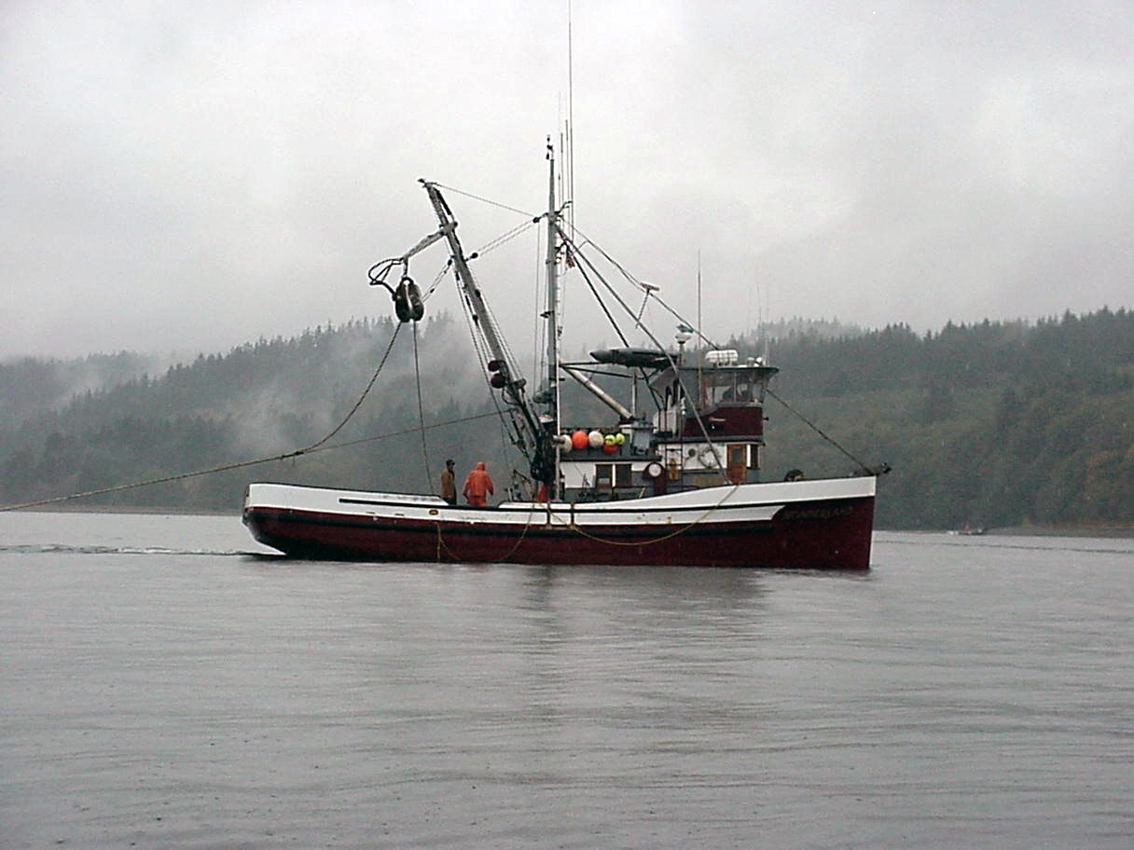
SEAFOOD MARKETING INITIATIVE
Objectives
Instill a sense of pride
in Washington caught seafood products and sustainably managed fisheries
Improve understanding of fisheries management
Increase consumer awareness of where and how to purchase Washington caught seafood

Slide 14
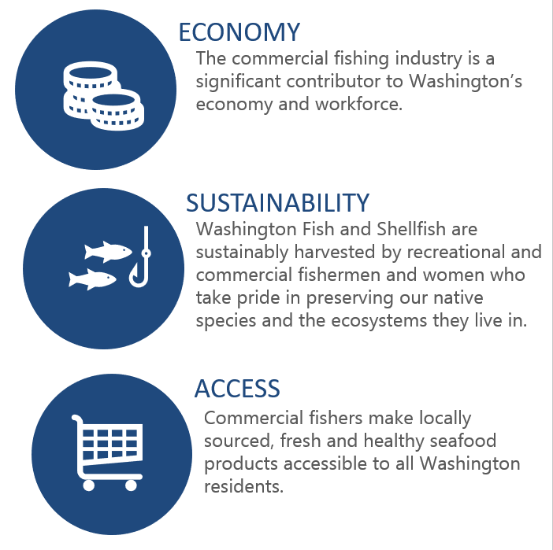
APPROACH
Audience
General Public
Seafood buyers and retailers
Restaurants and chefs
Partners
Industry - harvesters, seafood processors, retailers
Local governments, ports
Non-governmental Organizations (NGOs)
State, federal, tribal government representatives

Slide 15
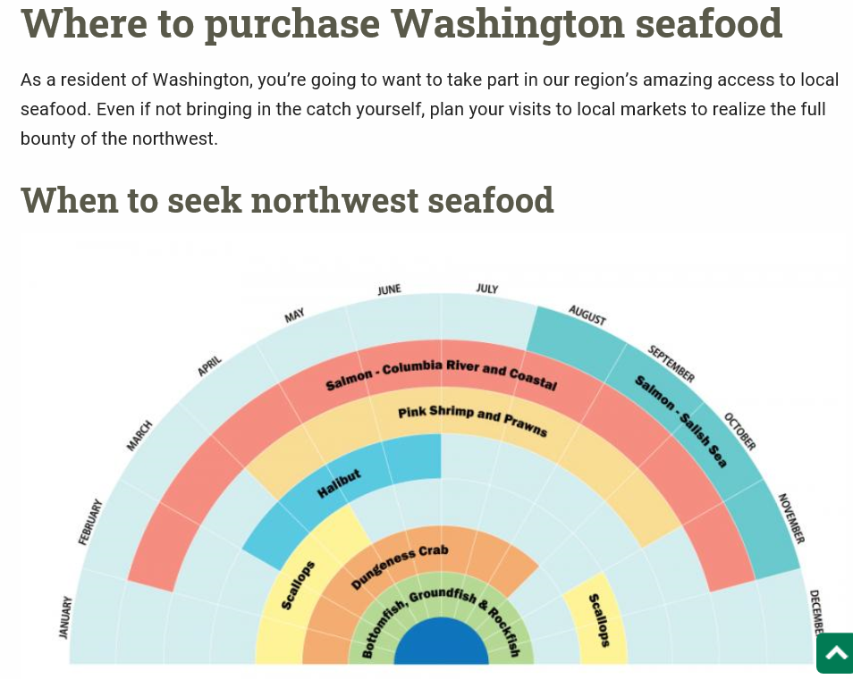
https://wdfw.wa.gov/fishing/where-to-buy-local-seafood

Slide 16
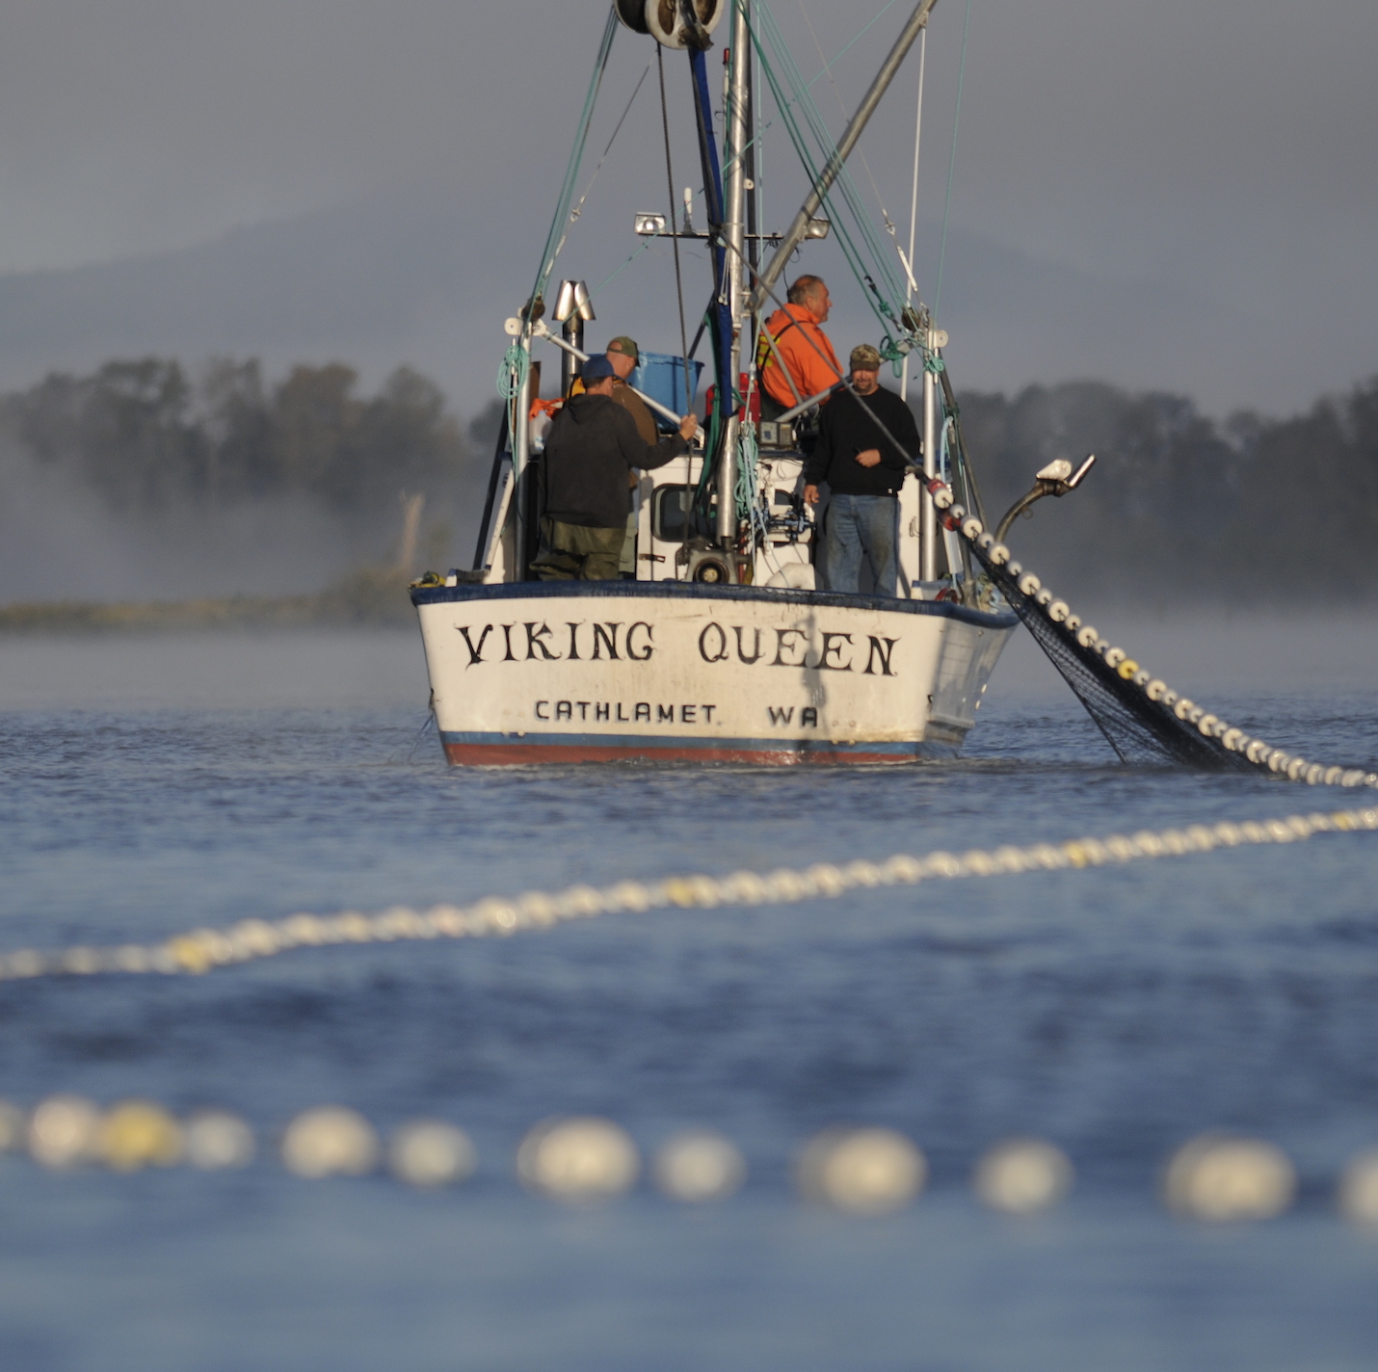
COLUMBIA RIVER SALMON GILLNET LICENSE REDUCTION PROGRAM STRUCTURE
240 Columbia River-Willapa Bay, Columbia River-Grays Harbor salmon gillnet licenses
179 active license holders, defined as activated license at least one year since 2019
61 inactive license holders, defined as having a license in waiver status every year since 2019

Slide 17
COLUMBIA RIVER SALMON GILLNET LICENSE REDUCTION PROGRAM
  2022 Proviso
  $14.4M appropriated in SFY23 to reduce gillnet licenses through voluntary buy-back program
  Thru Nov. pay up to $25K for inactive licenses and up to $120K for active licenses.
  After Nov, pay up to $20K for inactive and up to $96K for active licenses
  Legislature indicated this will be last appropriation for this buyback
  Department must:
  Calculate reduced impacts and reserve for escapement or mark selective fisheries
  Make recommendations for necessary changes to transition to alternative, selected fishing gears.

Slide 18
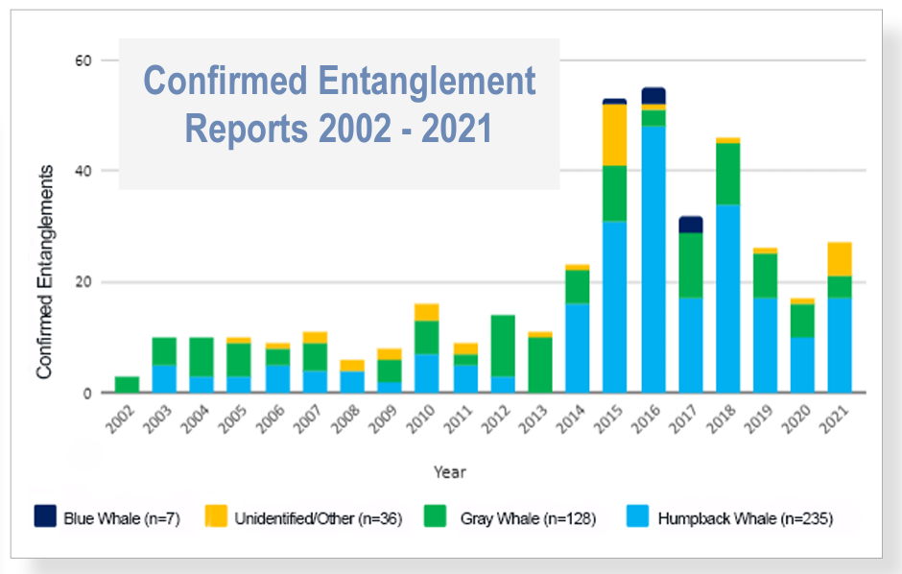
NOAA 2022. Number of confirmed entanglements by species reported to the West Coast Region each year from 2002 to 2021.
Notes:
In recent years, there has been an increase in entanglements off the U.S. West Coast, including off Washington, with coastal commercial Dungeness crab gear and marine life protected under the Endangered Species Act (ESA) and/or the Marine Mammal Protection Act (MMPA). Humpback and blue whales are ESA-listed, most gray whales along the west coast are not. This recent spike, as you can see, is largely driven by interactions with humpback whales. However, it’s worth noting that the “unidentified/other” category depicted here includes killer whale entanglements, a relatively uncommon occurrence, but three of these were reported last year in WA, and another has been reported off OR this year. These are high-profile species that include some endangered or even critically endangered populations.
To be clear, this means that the fishery currently operates in violation of the Endangered Species Act; every entanglement of an ESA-listed animal without an incidental take permit from National Marine Fisheries Service is illegal. These violations leave the Department vulnerable to lawsuits that can end up shutting the fishery down. So the urgency of the situation cannot be understated. And it’s important we maintain some level of focus on this, even in the face of offshore wind and all these other issues the fishery is facing.

Slide 19
Background – Conservation Plan/Incidental Take Permit
To bring the fishery into compliance with the Endangered Species Act (ESA), WDFW has begun to take steps to apply for an incidental take permit (ITP) under Section 10 of the ESA.
A conservation plan (CP) must describe the fishery and quantify the risks it poses to covered species and include:
Management measures that reduce the risk of entanglement (e.g., reduced pot limit, expanded gear recovery)
A monitoring program for compliance and assessing the effectiveness of the management approach
An adaptive management plan that clearly describes what we will do to maintain compliance with the terms of the permit (when implemented measures alone fall short of expectations)
Notes:
A conservation plan (CP) is required to apply for an Incidental Take Permit. Permit application and issuance is a long process – estimated to take from 3-5 years.
This is the first step in our process.
But it is NOT a check-the-box exercise.
It is an applicant-driven process, WDFW is the applicant.
Minimum requirements under ESA statutes are that the impacts to listed species are FULLY OFFSET or that impacts are minimized and mitigated TO THE MAXIMUM EXTENT PRACTICABLE. These are really high bars.
And most examples of these types of plans are large-scale, regional habitat conservation plans to support development and long-term land use planning at the county level, for example, Thurston County recently released a habitat conservation plan that is rather comprehensive.
An ITP has never been issued for ESA listed marine mammals
What we do and don’t do could have ramifications on the national scale for fishery permitting, so we’re proceeding with caution

Slide 20
WDFW’s CP Status, Focused Efforts, and Timeline
To date:
Primary management measures implemented, additional measures under development
Preliminary (not yet published) research by NWFSC indicates success of primary management measures
Currently:
Learning from ODFW and CDFW
Focused on Monitoring Program
Timeline:
Some uncertainty
Targeting late-fall for public release of draft
Notes:
Acknowledge significant work done so far.
Three primary management measures implemented: 1/3 pot limit reduction, gear recovery program expansion, and elimination of replacement buoy tags.
Additional management measures continue to supplement these core efforts to reduce risk of entanglement, and we’ll talk about some of those in a bit.
Preliminary study by NWFSC suggests main management measures have been successful at reducing risk of entanglement while maintaining little, if any, economic impacts to the fleet.
Learning from ODFW and CDFW's processes regarding the release of their public drafts last summer prior our to public release, rolling lessons learned into our plan before releasing it. We want our public draft plan to be close to what ends up getting submitted to NMFS.
Currently focused on monitoring, see next slide

Slide 21
Monitoring Program Required Elements
Improve the reporting and documentation of entanglements using standardized protocols.
Improve the ability of NMFS and the States to identify the origins of reported entanglements.
Estimate the number or level of takes that occur but are not observed or reported.
Get more eyes on the water, improve reporting rate.
Improve gear identification.
Develop co-occurrence models, scar accumulation rate info, and a statistically robust method for estimating unobserved take.
Notes:
We recently received guidance from NMFS about expectations for our CP’s Monitoring Program (left) and have translated these into action items (right).
Two of these items require your help to be successful.

Slide 22
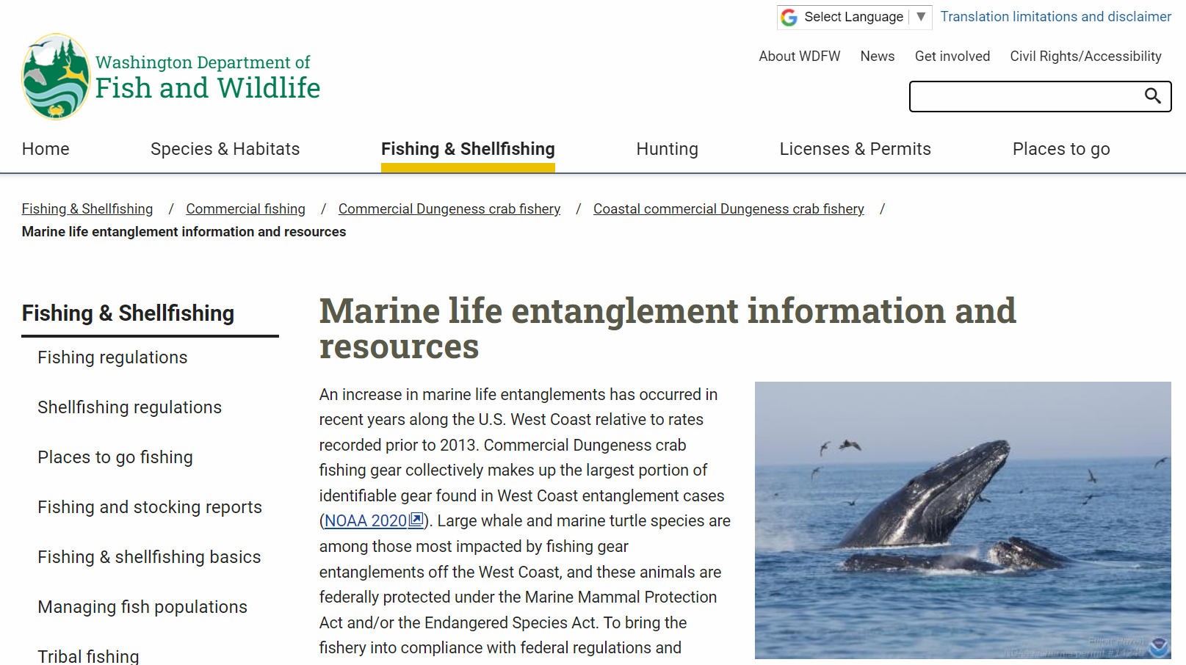
Stay up-to-date:
url: https://wdfw.wa.gov/fishing/commercial/crab/coastal/marine-entanglements
Notes:
More information and materials are available on WDFW’s Marine Life and Entanglement Information webpage.
And you can always contact us with questions, comments, concerns.
Heather.Hall@dfw.wa.gov
Victoria.Knorr@dfw.wa.gov

Slide 23
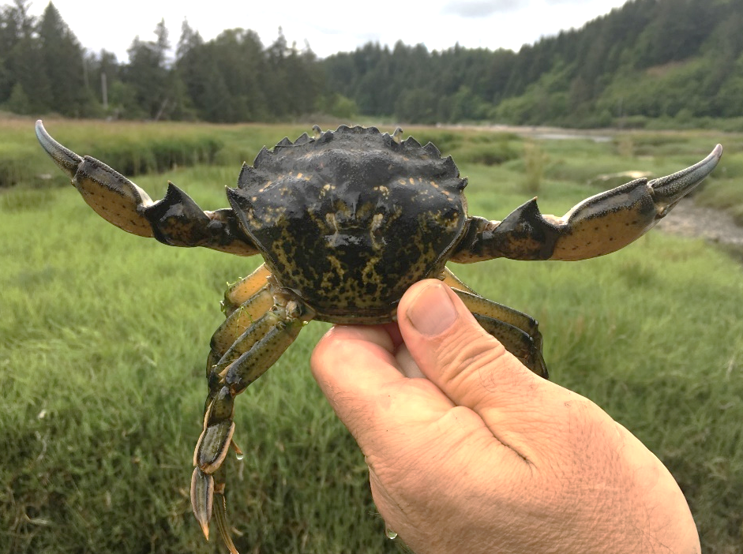
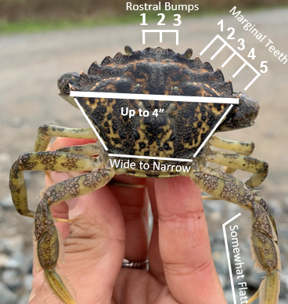
European Green Crab Management
European green crab is a globally damaging invasive species that poses a threat to native shellfish, eelgrass, and estuary habitat critical for salmon & other species.
In 2021, WDFW, tribal co-managers, and partners found a significant increase in European green crab populations within the Lummi Nation’s Sea Pond (Salish Sea) and outer coast areas Makah Bay, Grays Harbor, and Willapa Bay.

Slide 24
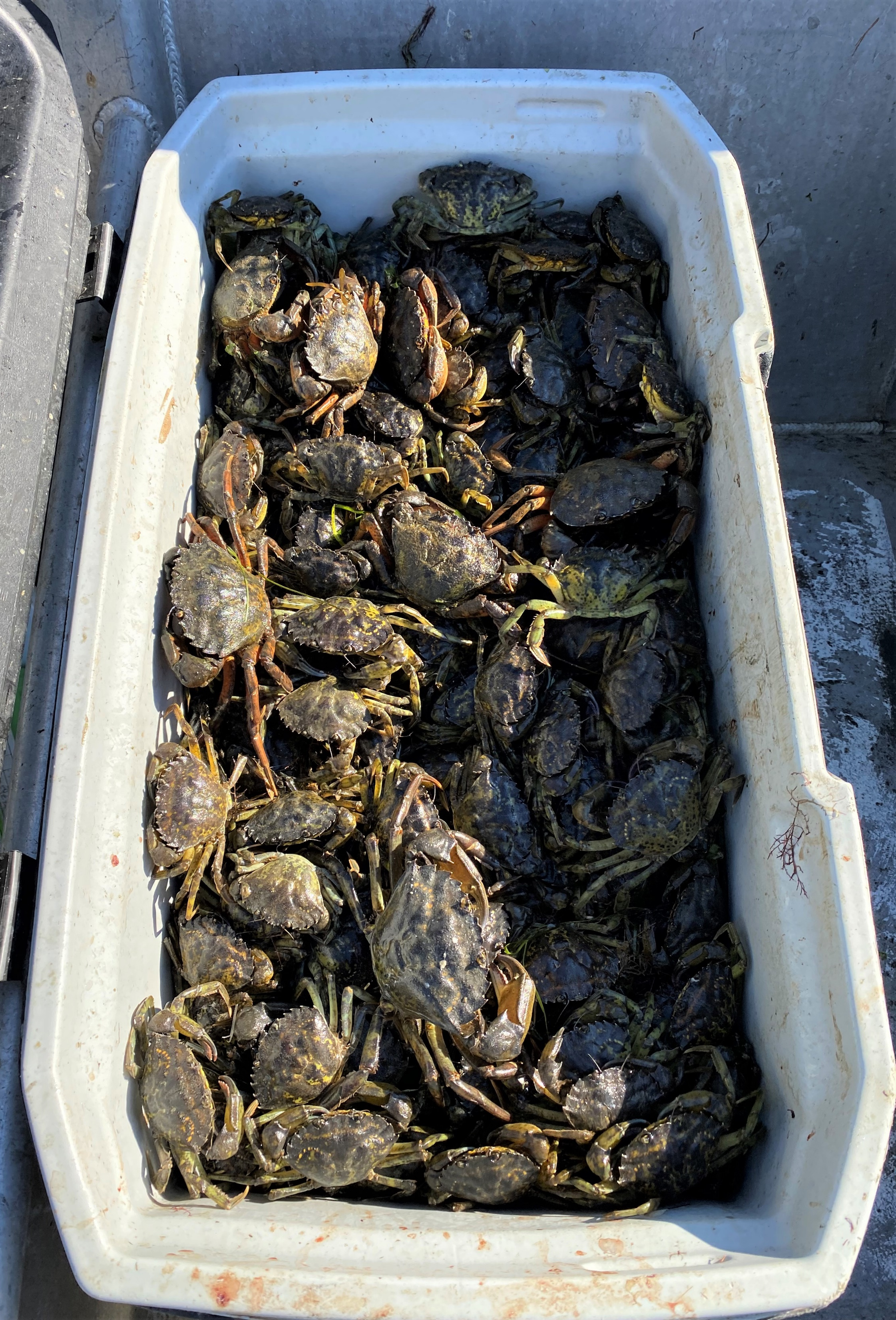
Green Crab Emergency Declaration
The Legislature had previously provided $783,000 in a one-time proviso in 2020 and $2.3 million in ongoing funding in 2021, but the amounts were not sufficient to control growing infestations.
In January, Emergency Proclamation ordering WDFW “to begin implementation of emergency measures as necessary to effect the eradication of or to prevent the permanent establishment and expansion of European green crab.”
On March 31, the Washington State Legislature provided WDFW $8.568 M in emergency measures funding for green crab control and coordination, local grants, and outreach.

Slide 25
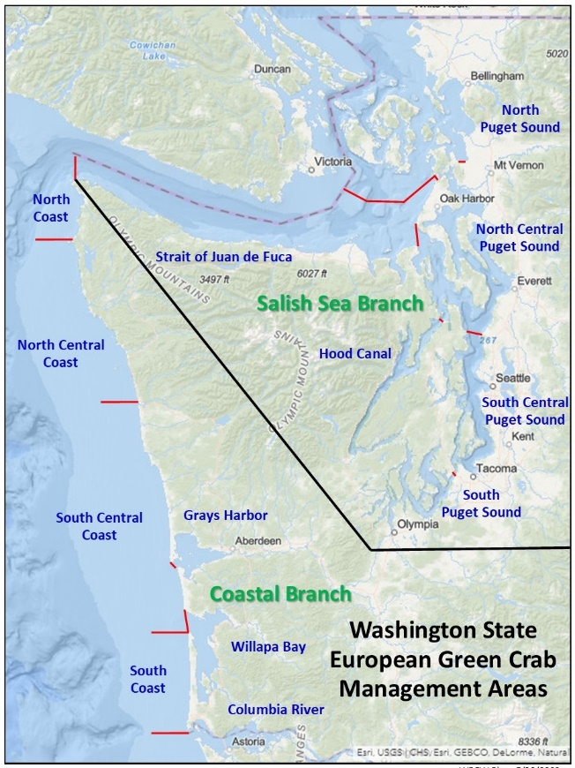
Emergency Response and Coordination
WDFW has implemented an Incident Command System (ICS) to facilitate a statewide EGC management strategy.
More than 138,000 European green crabs have been removed as of August 7.
Public reporting tools have been established, and outreach is underway to educate on green crab identification, reporting, and opportunities to support.

