Slide 1
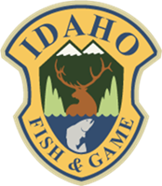
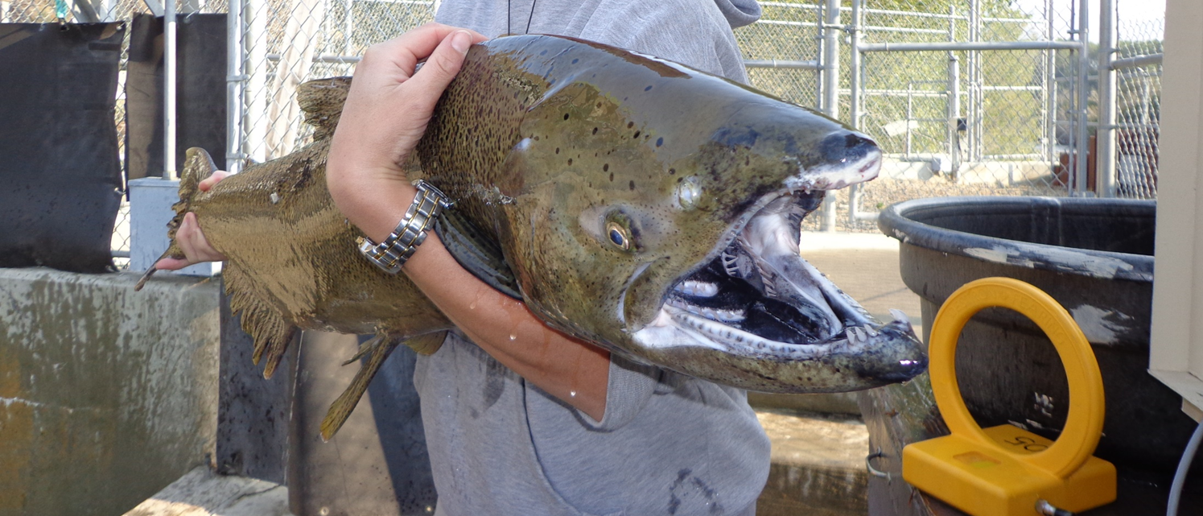
PSMFC Idaho Update, 2022
Ed Schriever; Director, IDFG
PSMFC Annual Meeting - Anchorage, AK - 2022

Slide 2
Mass Marking Anadromous Fish in Idaho
Notes:
Brief overview of the fish marking program

Slide 3
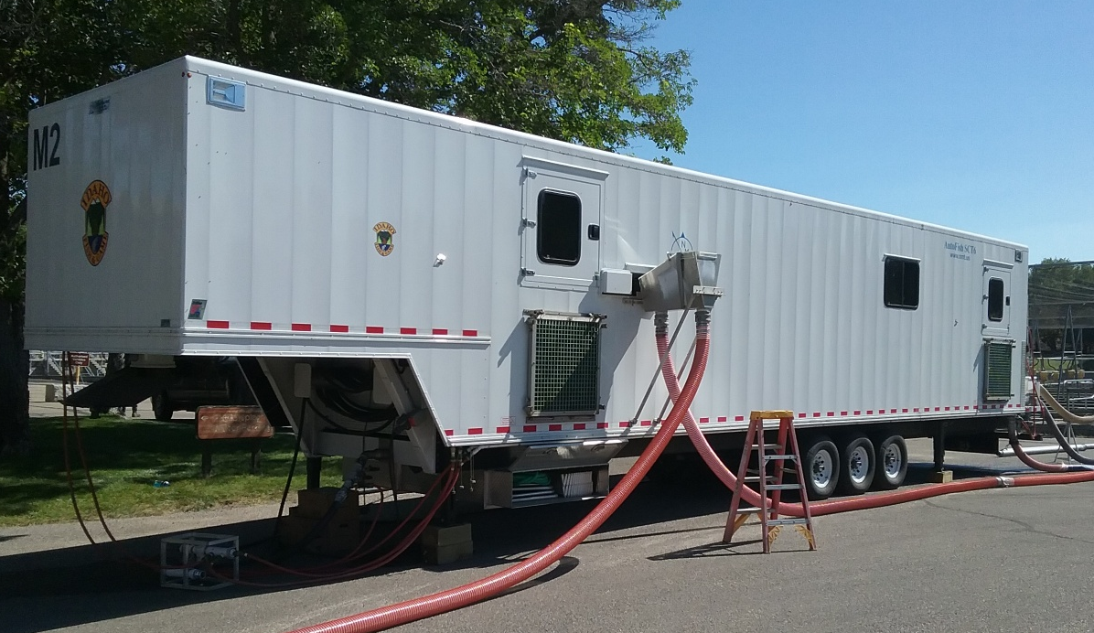
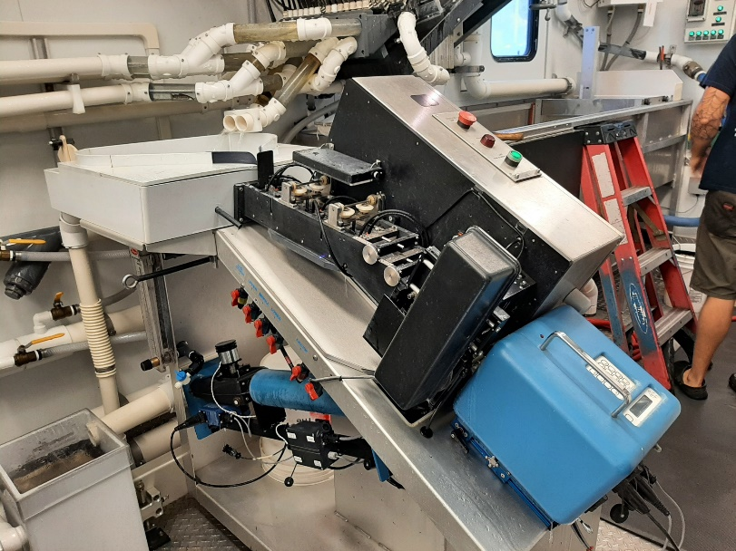
Project Successes
Long-standing PSMFC program
9 Idaho hatcheries
Annually, program fin-clips and/or CWT’s……
≈10 million Chinook Salmon
≈6 million steelhead
≈1 million Sockeye Salmon
Additional ≈400,000 fish are PIT tagged
Notes:
Note importance of marking/CWT tagging (mark-selective fisheries throughout basin, stock composition from CWT) and PIT tagging (in-season return estimates and harvest management) throughout the basin
Also of note, California tagging is also part of Braden’s program

Slide 4
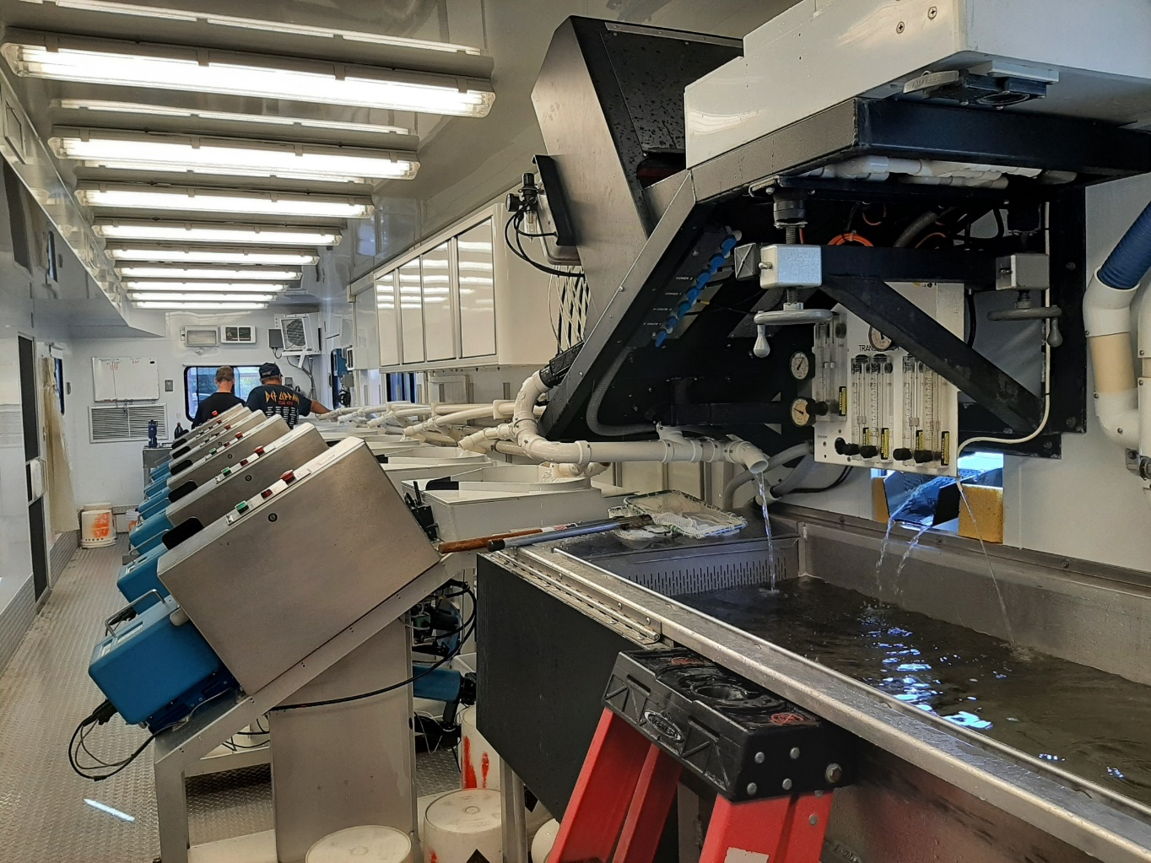
Ongoing Challenges
Hiring shortages despite increased starting pay
Training new staff to operate trailers takes a significant amount of time
Current staff having to operate multiple trailers
Tight schedule with little room to adjust
Notes:
A lot of travel, hard to find staff willing to commit. High degree of turnover when staff are hired. Training takes significant amount of time.
Tight schedule means changes in production numbers/ stocks/ release strategies, etc. all are difficult to absorb and adjust to. Also means program is less plastic when it comes to dealing with on-the-fly problems.

Slide 5
Columbia River Pinniped Removal Program Update
Notes:
Update on the Columbia River Pinniped Removal Program

Slide 6
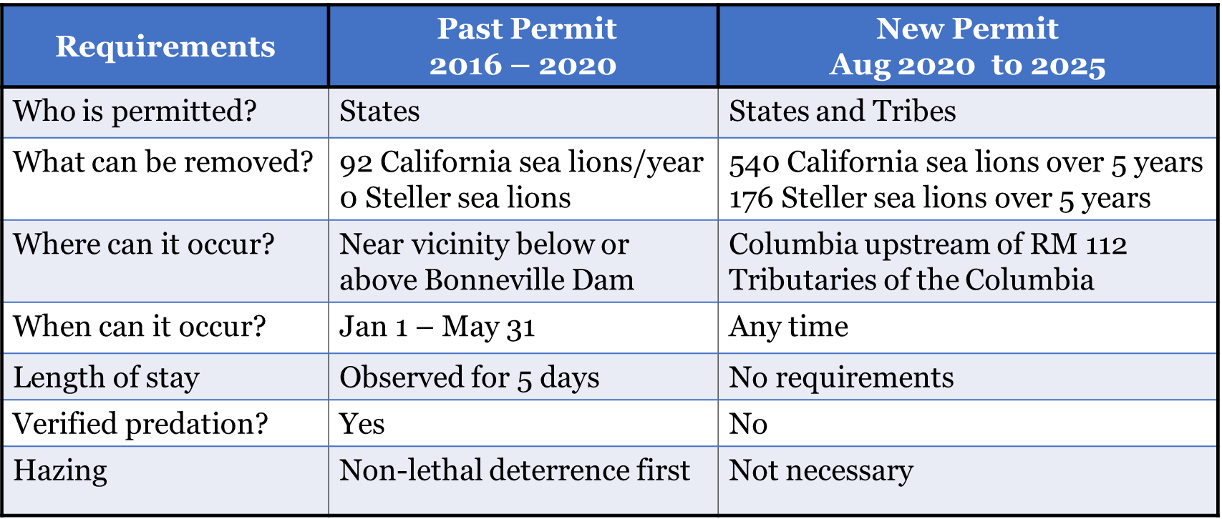
Project Status
Expanded management under MMPA Section §120(f)
Notes:
Between 2018 and 2020 the legislative and permitting changes allowed the project to expand management efforts in the Columbia River basin. The first of these changes was the passage of the Endangered Salmon Predation Prevention Act in 2018. This bipartisan bill was co-sponsored by Senators Risch from Idaho and Cantwell from Washington, and modified section 120 of the Marine Mammal Protection Act to allowing for tribal comanagement and improved efficiency of the management efforts in the Columbia River.

Slide 7
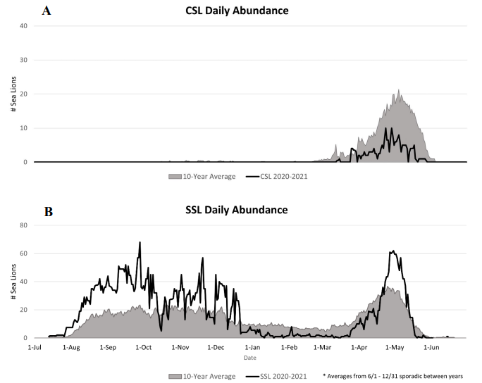
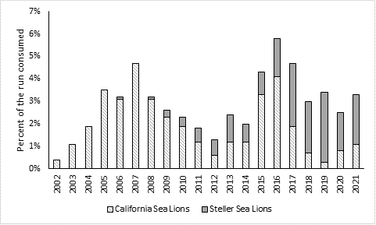
Project Status
Reduced California Sea Lion abundance and predation; increased Steller
Notes:
The project has been successful in reducing California Sea Lion abundance at Bonneville Dam. Plot on right shows the number of sea lions observed foraging at Bonneville Dam in 2020-2021. California sea lions are plotted in the top graph and Steller sea lions are plotted in the bottom graph. The annual counts are shown with black lines and the 10 year average is depicted with the gray shaded area. You can see that counts of California sea lions last year were well below the 10 year average. However, we have seen an increase in Steller abundance.
Second graph (left) shows trends in overall predation below Bonneville. Highly correlated with run size but overall CA proportional predation has decreased while steller has increased or styed consistent.

Slide 8
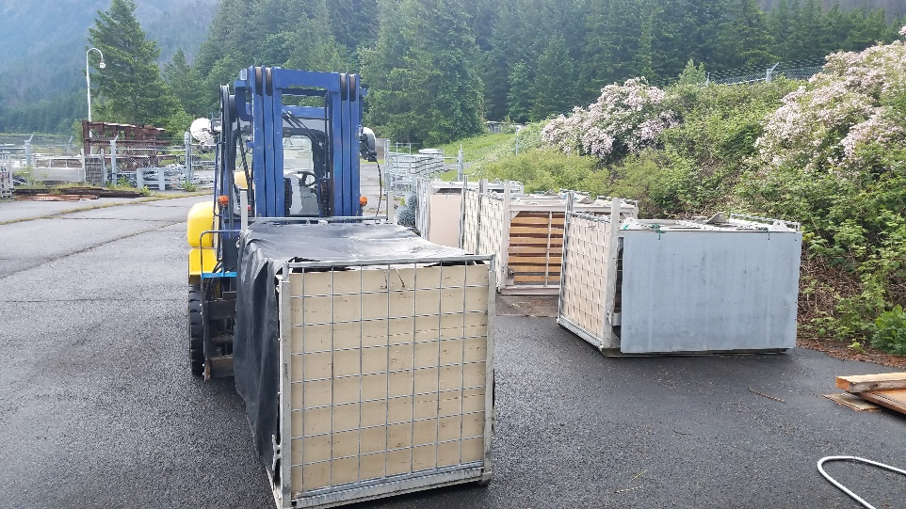
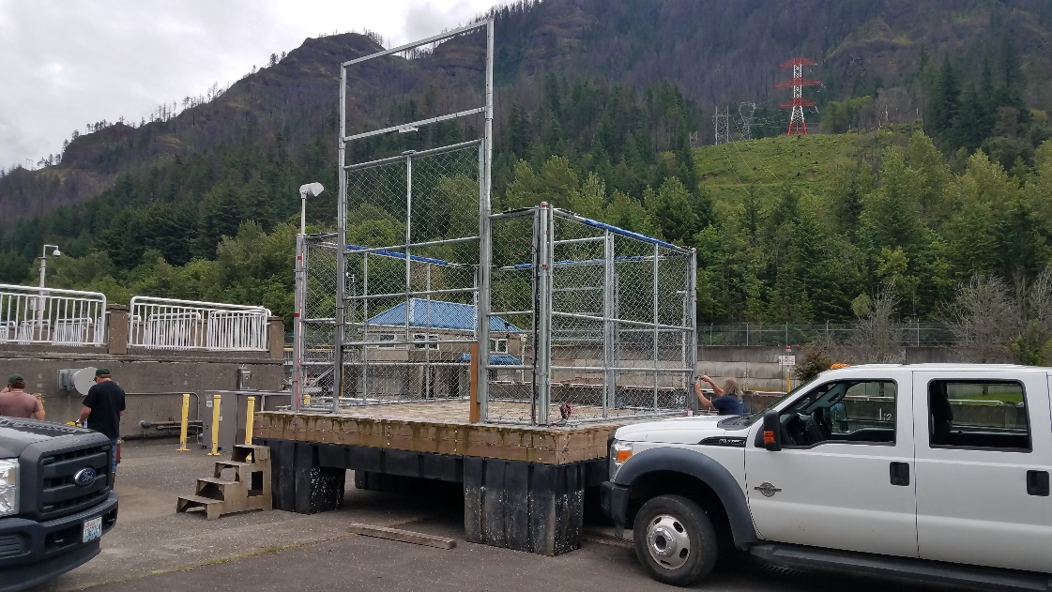
Project Status
Received increased funding
Notes:
Program received $892,000 of new funding through congressional appropriations.
Funding originally planned to help project purchase new equipment, allowing the project to expand efforts
A portion of this funding has now been dedicated to cover personnel costs of the project that were historically supported through NOAA Fisheries West Coast Region discretionary funds
Funds are still available to construct new traps, replace aging equipment such as boat motors, and purchasing a new boat that will allow the project to expand its efforts into Columbia River Tributaries

Slide 9
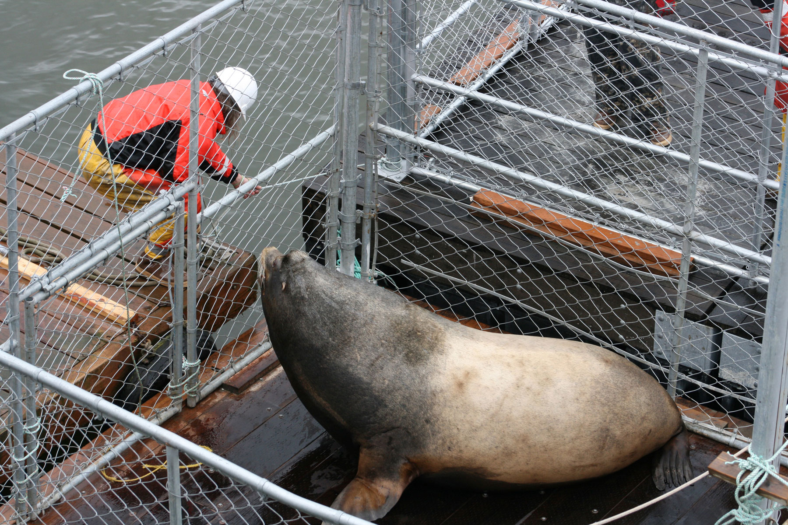
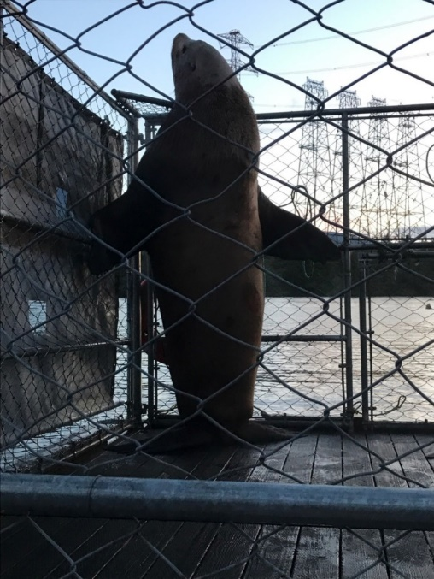
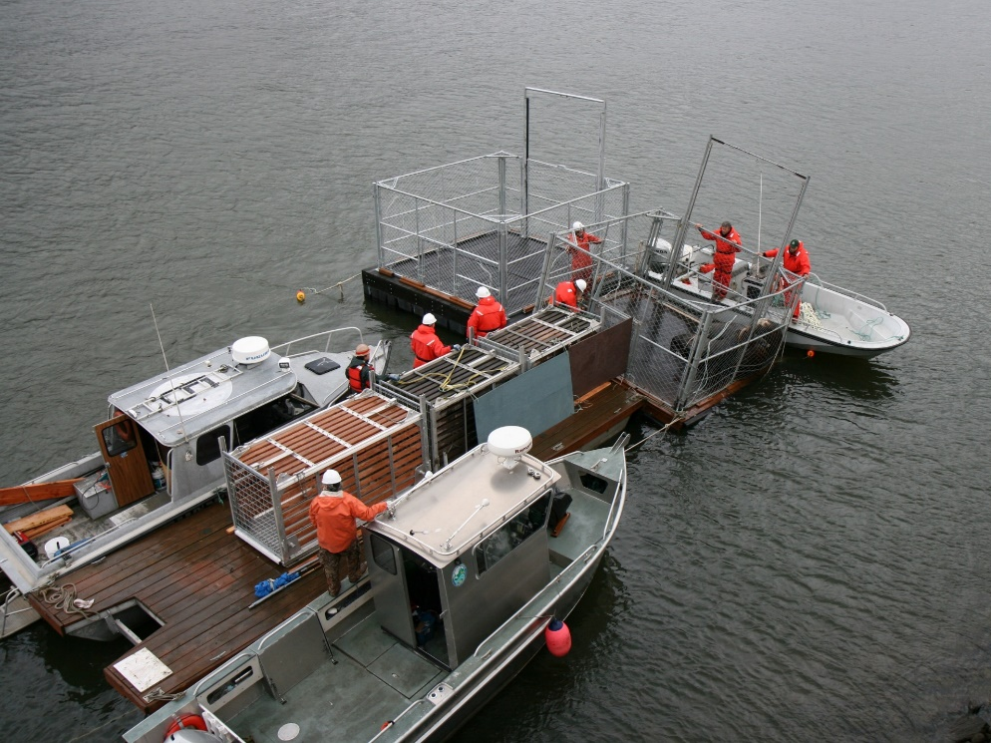
Ongoing Challenges
Increased Steller impacts
Difficult animals to work with due to their size
Secure source of mitigation funds
Notes:
Sea lions are large animals (especially Stellers) which makes them difficult to work with (pictures illustrate the difficulty). The largest sea lion handled by the crew at Bonneville Dam to date weighed more than 1,900 lbs……animals require large trapping and handling equipment that is expensive to purchase, construct, and operate. In addition, large crews (pic on lower right) are needed to staff the project. For these reasons it is costly to mitigate the effects of pinniped predation in the Columbia River.
Currently struggling to establish a secure source of funding for the project. This year the West Coast Region of NOAA Fisheries removed its historic discretionary funding support of $300,000 from the program. While the one time funding of $892,000 can be used to cover this gap, this is a short term solution. WDFW is leading efforts to secure congressional funding to support, and help expand, program activities. However, none of these funding sources are certain, which presents a challenge for partners to determine how to fund this important work.

Slide 10
Avian Predation Issues

Slide 11
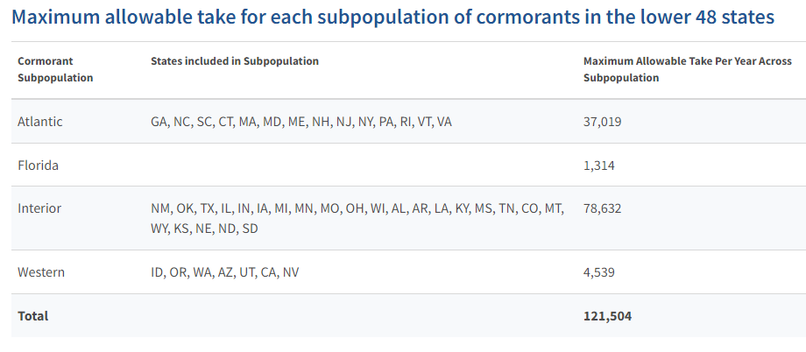
Cormorant Take
No applications for Western take (USFWS Permit 21.123) through August of 2022
Opportunity to prioritize cormorant control in Columbia and Snake rivers
Notes:
As of early August, no applications for use of 2022 western take. Why? Should be a priority management tool in the Columbia and Snake. Opportunity to use some in Idaho but probably more significant uses elsewhere.
As an FYI, 3,358 individual MY21 PIT tags were recovered from the Foundation Island DCCO colony (McNary Pool) in 2021 (2,119 Chinook, 81 coho, 1,009 steelhead, 149 Sockeye) and an additional 8,106 tags were detected from previous years.

Slide 12
NOAA Science Center Prioritization

Slide 13
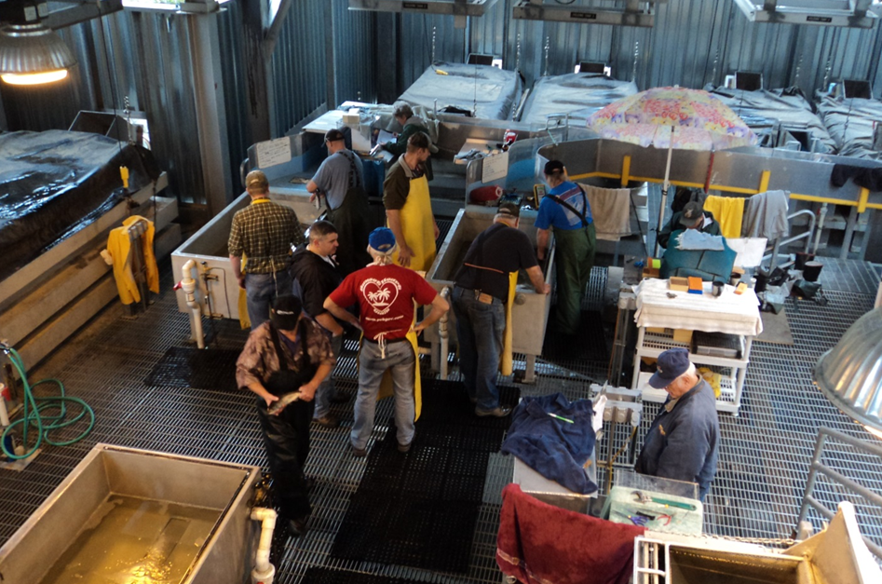
Ongoing Challenges
Internal prioritization process resulting in some significant proposed cuts
MMPA section 120-120(f) support for pinniped removal
Lower Granite Dam Trap operations
Opportunities for states to better understand and contribute?
Notes:
Opportunity to address these couple recent examples of NOAA simply pulling the rug (or trying to) on some programs they internally rank as low priority without any coordination or buy-in from action agencies or cooperators.

Slide 14
IDFG Genetics Lab Advancements

Slide 15
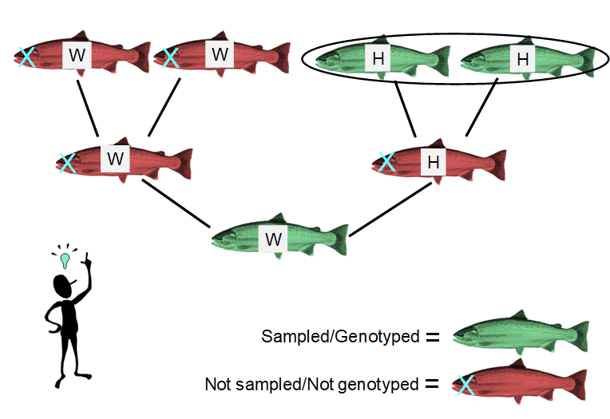
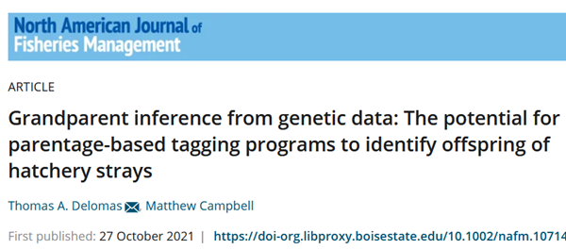
IDFG Genetics - Project Successes
Continued increases in PBT genetic markers allowing for…..
Single-parent assignments if one parent missing from baseline
Grandparentage assignments if hatchery offspring with two parents in baseline breed with a wild fish
Notes:
Up to 200-300 polymorphic markers now that enable these more sensitive assignments. Both are currently being tested in Chinook and steelhead in the Snake River.
Potential for use downriver to better assign stock-specific impacts?

Slide 16
Questions?

