Slide 1
State Agency Panel
CDFW Successes and Challenges
22 August 2022
Presented to:
Pacific States Marine Fisheries Commission – 75th Annual Meeting
Presented by:
Craig Shuman
Regional Manager
Marine Region

Slide 2
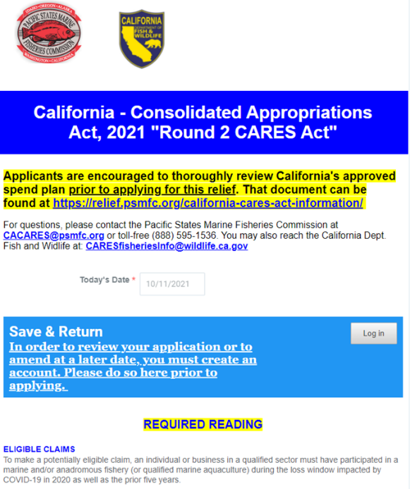
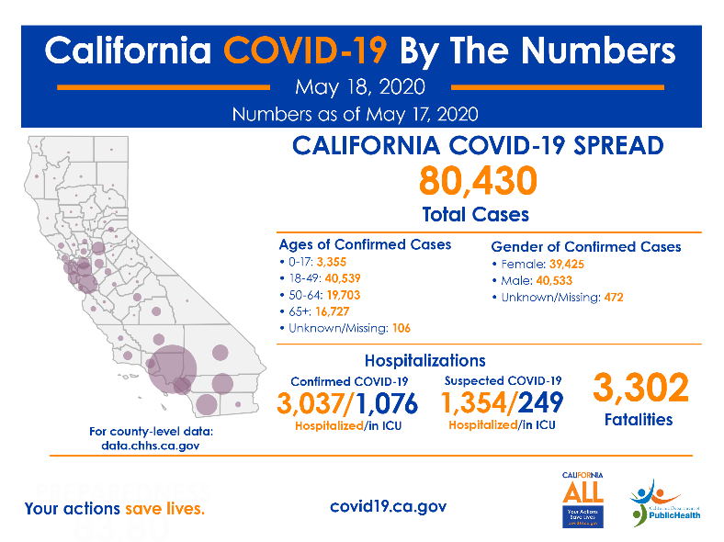
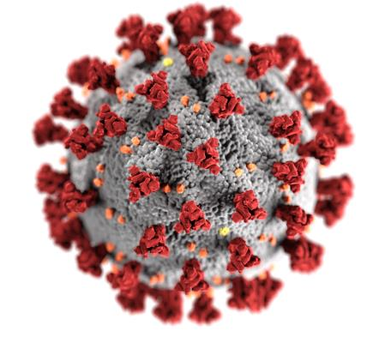
COVID-19
Successes
Challenges
Staff and Stakeholder Adaptation and Flexibility
CARES I
Staffing Shortages
Increased Costs
Transition to Hybrid Workforce
CARES II
Photo credit: CDFW

Slide 3
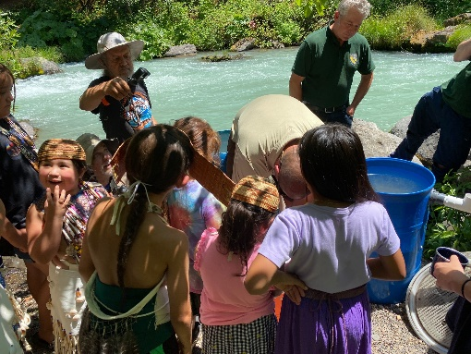
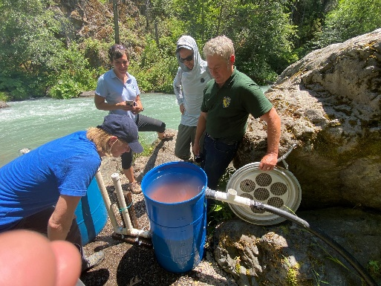
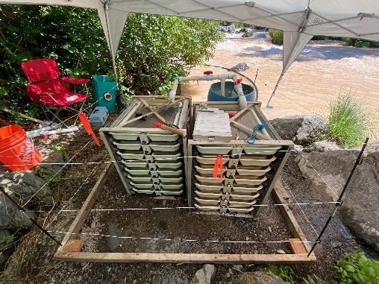
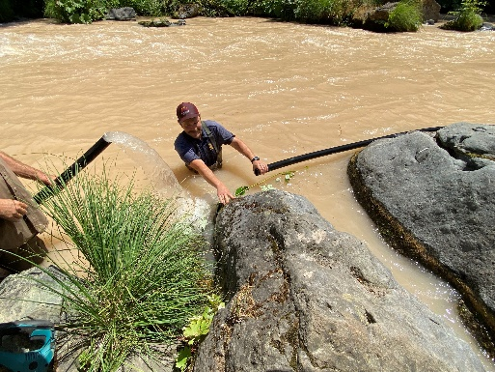
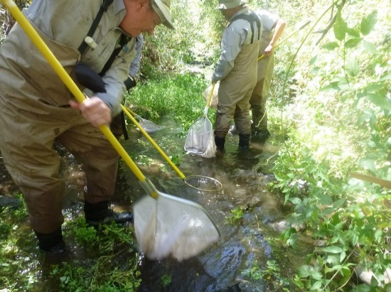
Drought
Successes
Challenges
Coordination
Fish Rescues and Translocations
Staffing, Equipment and Infrastructure
Low Flow Closure Authority
Historic Releases
Low Flows
Water Quality
Water Temp
Disease
Hatchery Evacuations
Emergency Fishery Closures
Photos: L. Navejas/Winnemen Wintu Tribe
Photo : CDFW

Slide 4
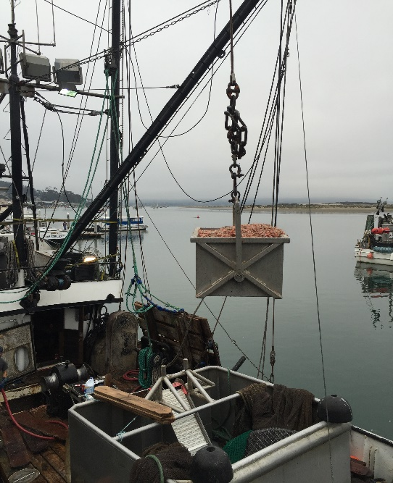
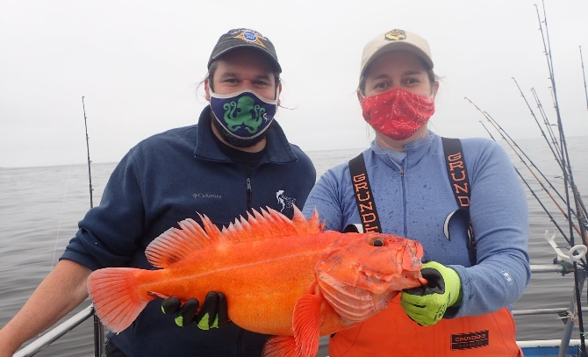
Coordination
Successes
Challenges
Data Sharing MOU with PSMFC
CWT Labs, Head Collections and CFM Reports
Pink Shrimp Management
Tri-State
RecFIN Invoicing
Groundfish Sampling
Fisheries Disasters
Photo:Tom Mattusch
Photo: CDFW
Notes:
New authority (Oct 2021) for mandatory sampling of commercial fisheries – but 1100 miles of coastline, 80 commercial ports of landing, over 380 unique recreational sampling sites across all modes creates challenges.

Slide 5
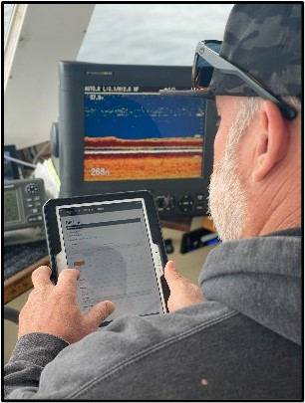
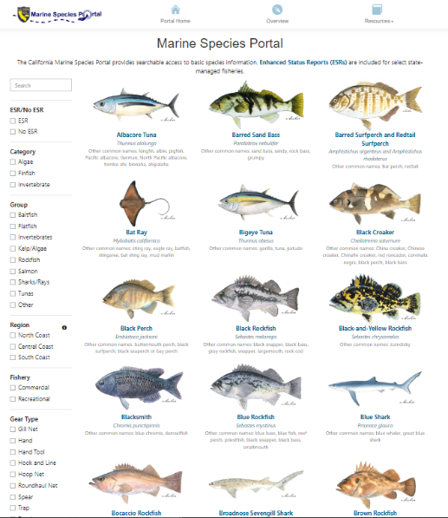
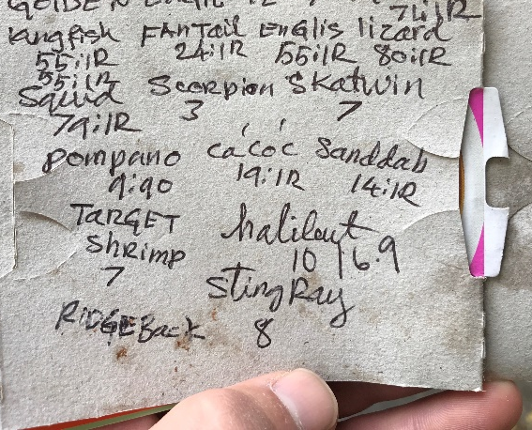
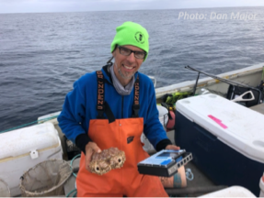
Technology
Successes
Challenges
Marine Species Portal
PSMFC Support for EM Development
Box Crab EFP
Recreational Fishing App
System Failures, Bug Fixes, Hardware Upgrades
Finding Commonalities and Alignment for EM
Photos: CDFW

Slide 6
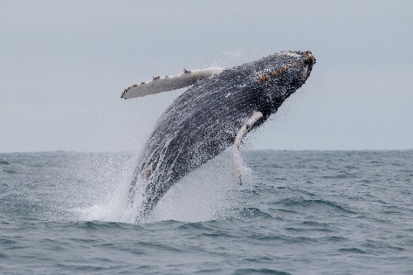
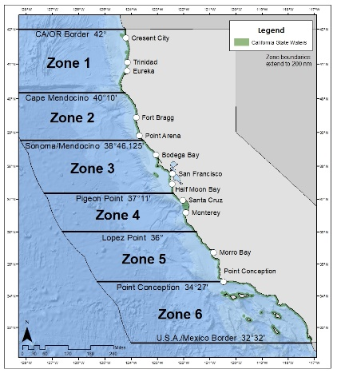
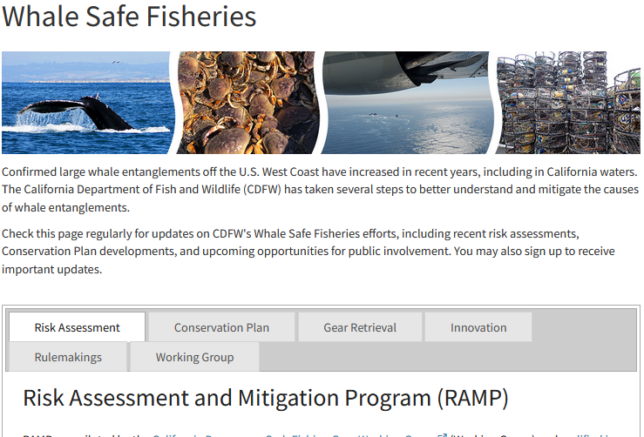
Whale and Sea Turtle Entanglement
Successes
Challenges
Rec and Comm Fisheries Under RAMP
Improved Data and Coordination
New Resources
Clear and Consistent Guidance for Conservation Plan
NEPA funding for CP
Fleet Interest in Alt. Gear
Poor Understanding of Fleet Dynamics and Economics

Slide 7
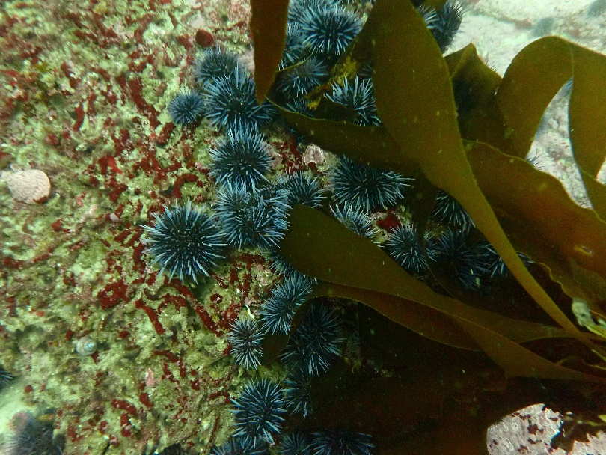
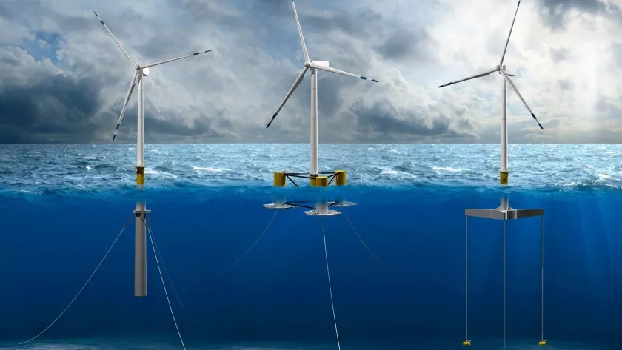
Emerging Opportunities and Challenges
Climate Ready Fisheries
Kelp Restoration and Management
Marine Aquaculture
Offshore Wind
Sustainable Fishing Communities
Improved Outreach and Communications
Marine Restoration and Mitigation
Artificial Reefs & Living Shorelines
Justice, Equity, Diversity, and Inclusion
Photo: CDFW/Elsmore
Photo: NREL

Slide 8
Thank You
Contact information:
Craig Shuman, D. Env. Marine Regional Manager
California Department of Fish and Wildlife
r7regionalmgr@wildlife.ca.gov
Coordinator:
Sonke Mastrup, California Department of Fish and Wildlife
Commissioners:
Charlton H. Bonham, California Department of Fish and Wildlife
Mike McGuire, California State Senator
Barabara Emley, Individual
Advisors:
Jim Caito, Caito Fisheries
Ken Franke, Sportfishing Assoc. of California
Mike McCorkle, Southern California Trawlers Association

