Slide 1
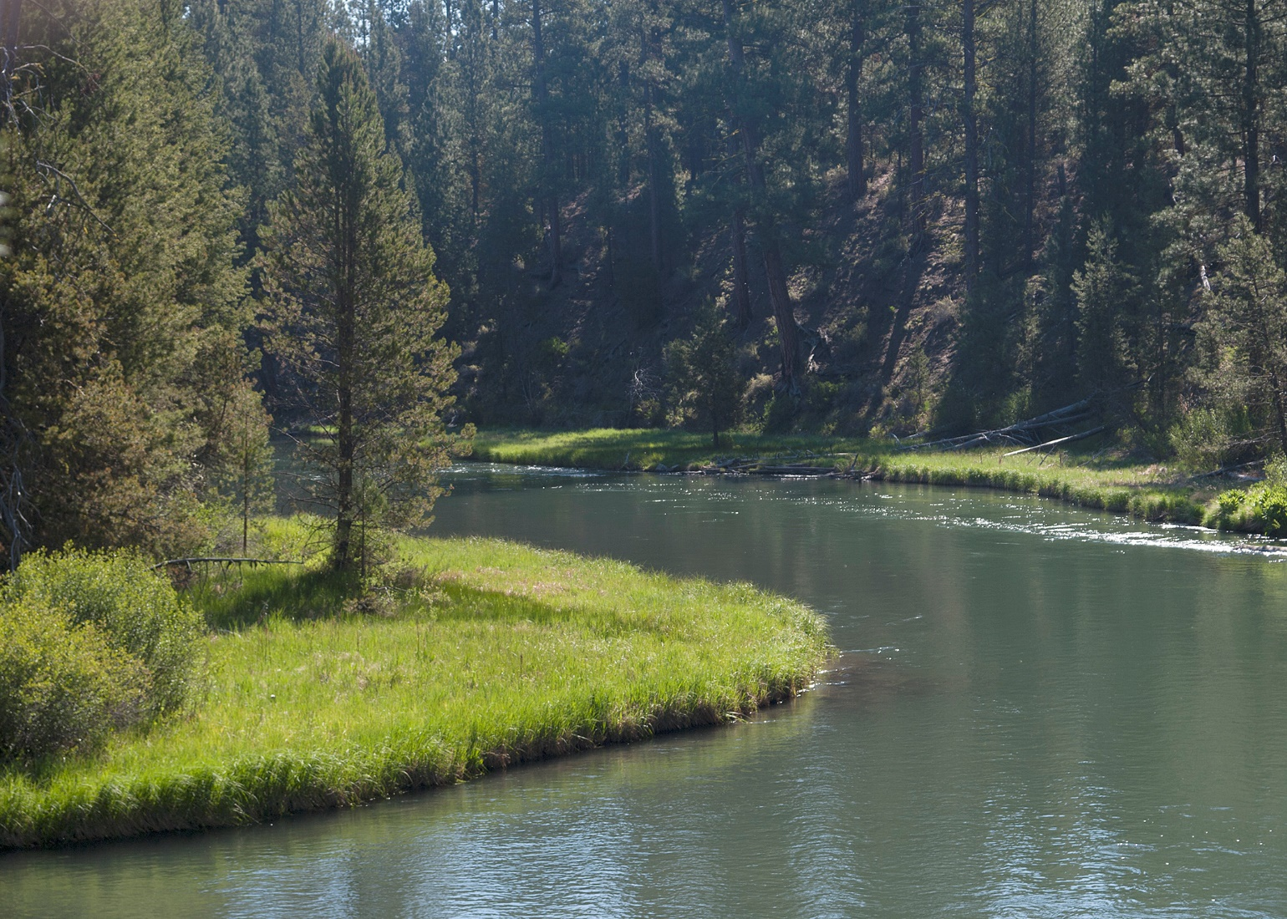
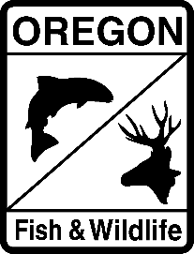
Climate Angling Framework
for Inland Fisheries in Oregon
March 14, 2023
2023 Pacific Coast Steelhead
Management Meeting
Kregg Smith
Senior Policy Analyst
Oregon Department of Fish and Wildlife
Notes:
This is a climate framework to codify the in-season temporary rule changes based mainly on temperature, flow, angling stressors, etc. This is not an effort to take away any of your fishery management centered around population effects, but to give you a tool for in-season emergency regulations based on environmental conditions. We acknowledge that we don’t have a geographic representation of environmental conditions across the state, but this meeting is to describe the science and get feedback from staff on where we have data gaps and where we need more information.

Slide 2
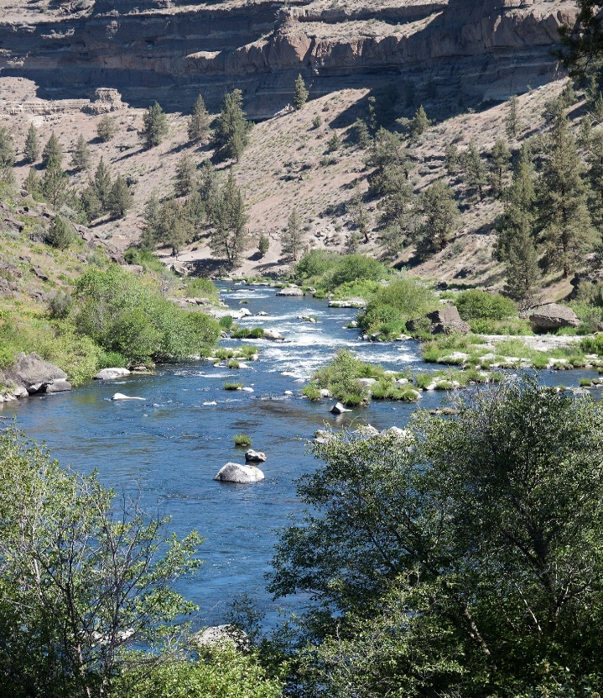
Purpose
Through science informed management the Department seeks to:
Develop a set of regulations that can be proactively implemented to reduce angling associated stressors and support climate change resiliency of inland native fish;
Implement regulations to ensure inland native fish conservation and optimize fishing opportunities that consider changing environmental conditions across Oregon.
Photo: ODFW Flicker account
Notes:
Framework that is transparent for making decisions and putting in place templates on how to implement.

Slide 3
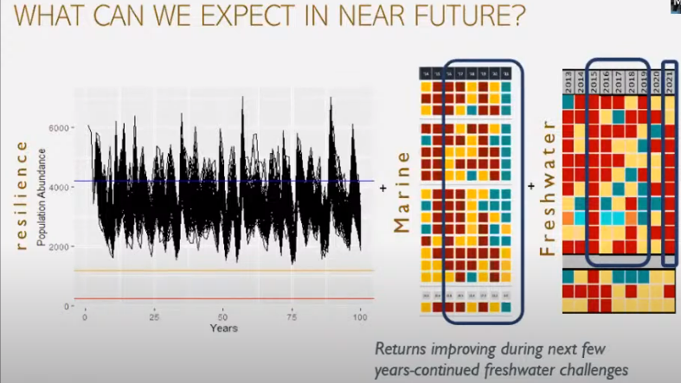
Notes:
Marine and Freshwater environmental changes creating stress on anadromous populations of Pacific Fisheries.
Recent studies have documented the angling duration can cause physiological stress to fish that can exacerbate mortality and survival within thermally confined habitat patches.

Slide 4
Creating a Management Framework
Regulation
Science
Climate Adaptive Angling Framework
Purpose: To ensure the Department takes a proactive approach to developing regulations that will reduce angling associated stressors on inland native fish populations.
Implementation
Communication
Notes:
climate angling framework is adaptive and not rigid like policy, acknowledging that there is a policy component, a regulations component, a science component and an outreach component that together constitutes the framework.

Slide 5
REGULATION
(1) Policy Framework
  Structure and guidance document for Implementing Temporary Rule
  Integrated with the Climate Change and Ocean Policy (2020)
  Intended to provide longer structure for adaptive management based on Best Available Science
(2) Climate Thresholds and Refuge Designations
Develop a defensible approach that links environmental stressors to angling pressure during warmest months of the year
    Geographical numeric environmental conditions that trigger regulatory action.
    Recognizable and enforceable areas that have expected benefits to fish within the region.
Notes:
The Department files hundreds of temporary rules per year (>200 in 2021) through the Secretary of State (ORS 183.355). These rules are filed for the purposes of:
Managing interjurisdictional fisheries in real time to protect weak stocks on the Columbia River
Managing other Oregon fisheries in near real time to provide opportunity on healthy stocks or constrain opportunity when runs are low.
Restricting or closing fisheries to protect fish during extreme temperature and low flow periods of the year

Slide 6
REGULATION
(1) Policy Framework
Environmental Indicators and Thermal Thresholds
Sets guiding principle for how the Department will assess indicators and to what purpose – NOT what the indicators or their thresholds are.
Angling Regulations
Defines a tiered approach to restrictions that include hoot hour closures (tier 1) and full closures (tier 2), as well as a course of action for public communication throughout the process.
ODFW currently addresses changes to fishery regulations through temporary rules. Temporary rule template developed for standardized processing
Process is cumbersome and time consuming with the standards by Secretary of State.

Slide 7
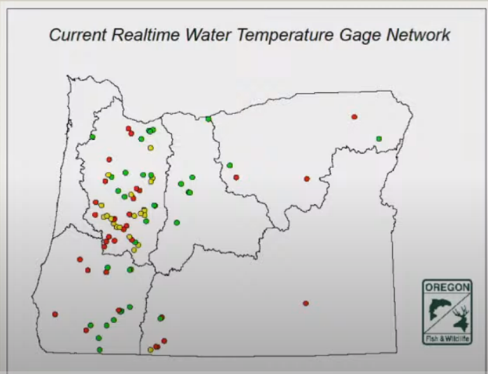
SCIENCE
(3) Thermal Thresholds and Water Temperature Data
Water Temperature Data
Thermal Tolerance Thresholds
Decision Making
Notes:
USGS gage real-time temperature data – generally available on large rivers, can reflect conditions through migration corridors; however will generally be warmer than tributary habitats where spawning occurs for many species. Limited statewide coverage.
ODFW Drought Package increased temperature monitoring across the state.
Kara’s study on Thermal tolerance thresholds

Slide 8
SCIENCE
(3) Cold Water Identification/Prioritization-Desktop Analysis
    NorWeST(USFS) – mean August water temp
      Δ 2°C (trib. junctions)
      Flow magnitude (VIC, NHD, USGS)
        - absolute contribution (e.g. ≥ 1 cfs)
        - relative to receiving stream (e.g. ≥ 10%)
      (3) Regional/statewide cold-water thresholds
Notes:
USGS gage real-time temperature data – generally available on large rivers, can reflect conditions through migration corridors; however will generally be warmer than tributary habitats where spawning occurs for many species. Limited statewide coverage.
Carter - Compiles additional data beyond the USEPA (2003) report.

Slide 9
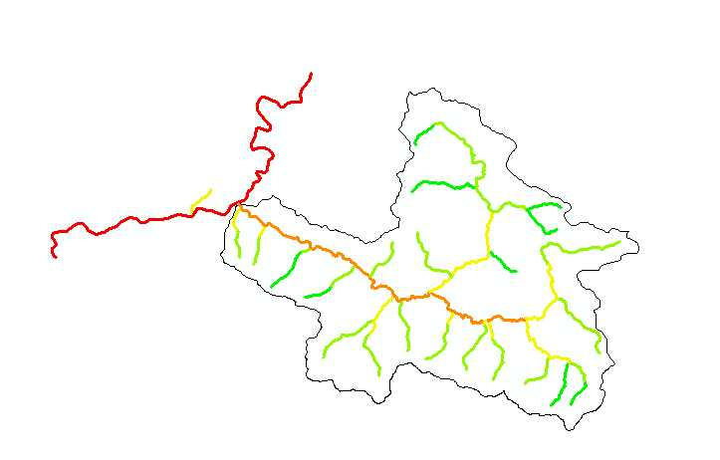
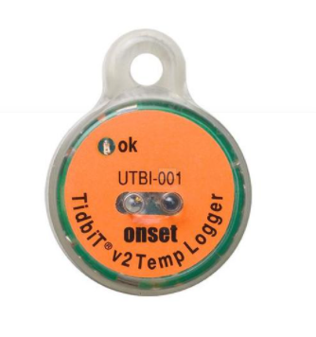
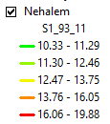
SCIENCE
(3) Cold Water Identification/Prioritization-Desktop Analysis
Nehalem
Snark Cr.
Salmonberry
Notes:
USGS gage real-time temperature data – generally available on large rivers, can reflect conditions through migration corridors; however will generally be warmer than tributary habitats where spawning occurs for many species. Limited statewide coverage.
Carter - Compiles additional data beyond the USEPA (2003) report.

Slide 10
IMPLEMENTATION
(5) Temporary Rules Application- In Season Changes
Basic considerations for implementation – both geographic scale and clarity
Hoot Owl Fishing Restriction prohibits fishing each day between a designated time period.
Fishing Closure prohibits any fishing on the stretch of water specified.
Daily hoot owl fishing restrictions are being implemented to reduce fish stress and mortality during high water temperatures.

Slide 11
IMPLEMENTATION
(6) Determination of Fishing Pressure
Current Fishing Regulations | ODFW | Maps showing regulations currently in effect by area/fishing zone. Updated annually.
Real-time Angling Effort | ODFW | Creel Surveys (Public interviews) by area during peak fishing times and during the hottest parts of the day (if two times differ) Updated weekly, or more frequently as needed.
Monthly Catch | ODFW | Electronic Licensing System [ELS] Data (Customer submitted fishing tags) - past and present data by area. Updated weekly.
In-season Population Status | ODFW and NOAA | Evaluation of population abundances and/or run size attributes. Updated seasonally, or more frequently as needed.

Slide 12
COMMUNICATIONS
(7) Public Meeting Process
The Department is dedicated providing opportunities for community awareness in ongoing angling framework development and implementation.

Slide 13
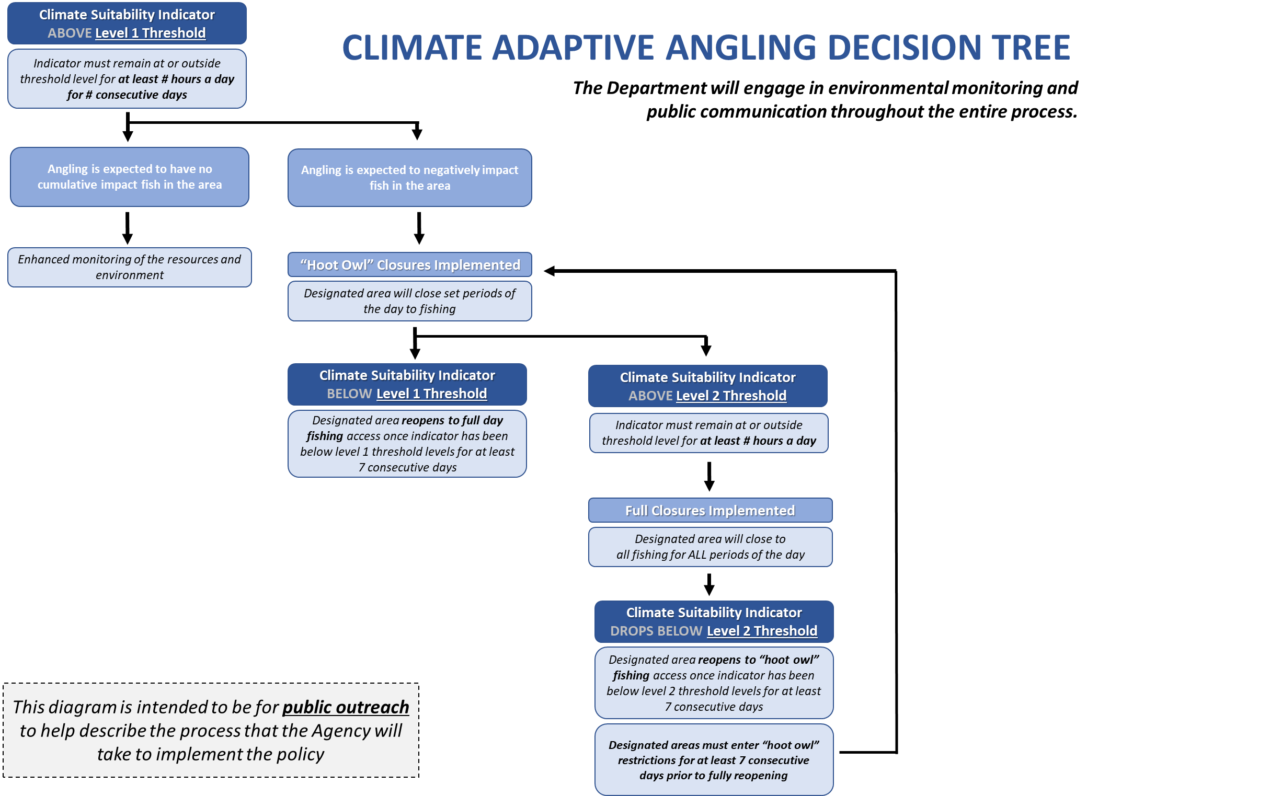
COMMUNICATIONS
(8) Implementation Outreach

Slide 14
COMMUNICATIONS
COMMUNITY EDUCATION
General Information Topics
State-wide General Awareness
Climate change impacts on Oregon fish and wildlife.
Interconnections of Agency Policies to protect and enhance fish and wildlife.
Climate and Local Impacts
Climate impacts by Oregon region – how regional variability in conditions impact aquatic habitats as well as fish health and behavior (i.e., fish stress).
Reducing Angling Stress on Fish
Importance of “Good Fishing Practices” – how to reduce stress on already stressed fish and aquatic habitats.
Climate Variability
Duration of Climate Impacts – how short/long an event is, and how it impacts aquatic habitats and fish stress.
Intensity of Climate Impacts – how extreme an event is, and how it impacts aquatic habitats and fish stress.
Removing Angling Stress on Fish
Importance of a “Proactive Approach” – how removing fishing pressure completely now will help promote more angling opportunities in the future.
Rebounding Fish and Aquatic Habitats
Importance of “Gradual Return to Fishing” – following climate impacts, aquatic habitats and fish need time to reduce stress levels. Reduced fishing pressure through limited angling stress allows time to recover.
Notes:
Information will be provided in a multitude of digital media formats (e.g., social media posts and videos, website), printed media (e.g., one pagers, press releases), and local news outlets. The Department will need to be proactive in the creation and the implementation of media in order to be timely with information to the public.

Slide 15
COMMUNICATIONS
COMMUNITY EDUCATION
State-wide General Awareness
CLIMATE ADAPTIVE ANGLING DECISION TREE
Climate and Local Impacts
Climate Suitability Indicator ABOVE Level 1 Threshold
Indicator must remain at or above threshold level for at least 12 hours a day for two consecutive days
Little to no fishing pressure at designated area
Fishing pressure is be expected to cause angling stress to fish
Reducing Angling Stress on Fish
“Hoot Owl” Closures Implemented
Designated area will close set periods of the day to fishing
Climate Variability
Climate Suitability Indicator BELOW Level 1 Threshold
Climate Suitability Indicator ABOVE Level 2 Threshold
Designated area reopens to full day fishing access once indicator has been below level 1 threshold levels for at least 7 consecutive days
Indicator must remain at or above threshold level for at least 8 hours a day
Removing Angling Stress on Fish
Full Closures Implemented
Designated area will close to
all fishing for ALL periods of the day
Rebounding Fish and Aquatic Habitats
Climate Suitability Indicator DROPS BELOW Level 2 Threshold
Designated area reopens to hoot owl fishing access once indicator has been below level 2 threshold levels for at least 7 consecutive days
Designated areas must enter hoot owl restrictions for at least 7 consecutive days prior to fully reopening

Slide 16
Climate Angling Framework
for Inland Fisheries in Oregon
Questions ?
Kregg Smith
Senior Policy Analyst
Oregon Department of Fish and Wildlife

