Slide 1
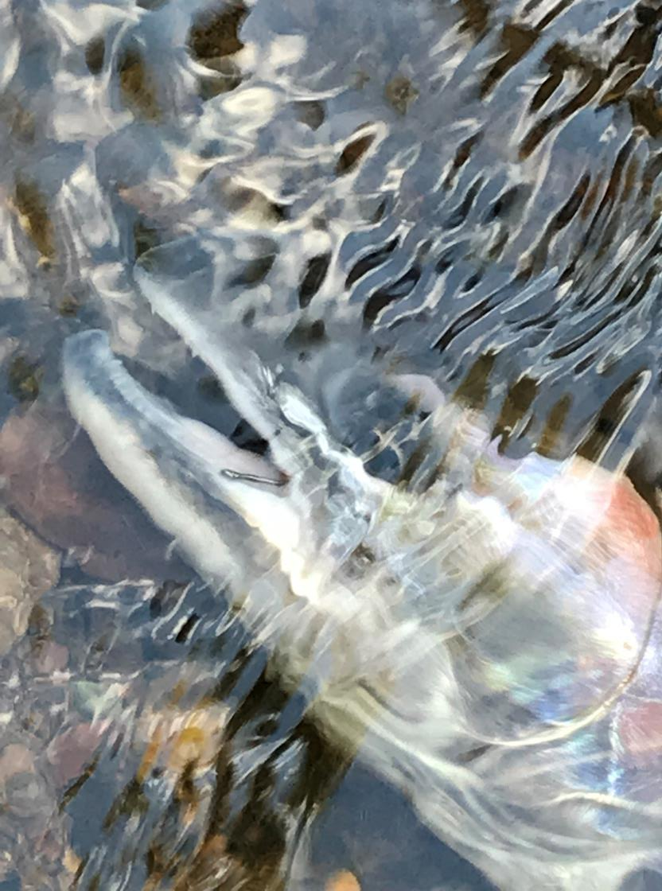
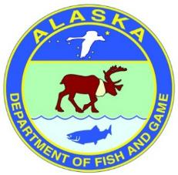
Alaska Steelhead Stock Status
Craig Schwanke
Alaska Department of Fish and Game
Sport Fish Division

Slide 2
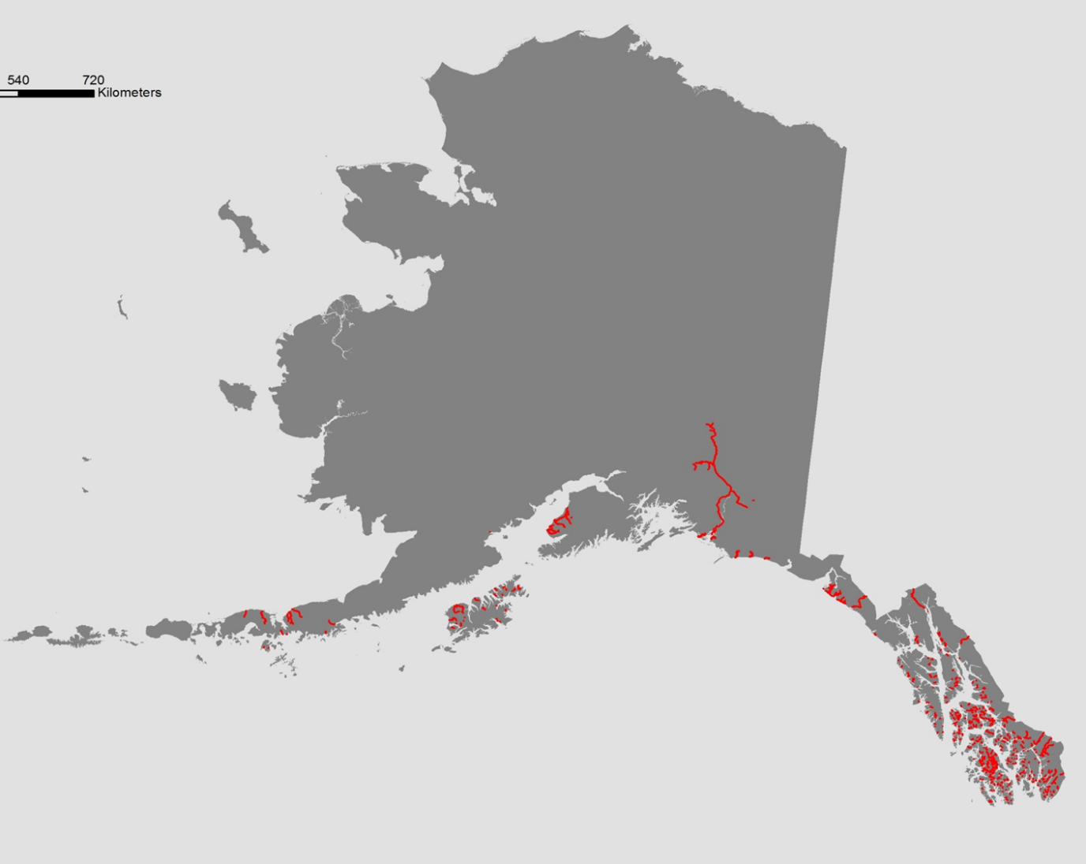
Steelhead in Alaska
Assessment Methods
Steelhead Streams
Weirs
  Situk River, Sashin Creek
  Litnik, Karluk, Ayakulik, Dog Salmon Rivers
Snorkel Surveys
  SEAK Index Streams
Fishery Information
n=10
Karluk River
Litnik River
Situk River
Ayakulik River
Dog Salmon River
Sashin Creek
Notes:
Steelhead in Alaska are found from Dixon Entrance in southern Southeast around the Gulf of Alaska to the Alaska Peninsula. Prominent populations are found in SE AK, Copper River, the Kenai Peninsula, Kodiak Island, and Alasks Penninsula. Assessments occur with snorkel surveys in SE AK and weirs in SE and Kodiak. Catch and harvest fishery information is also used to monitor steelhead trends in AK.

Slide 3
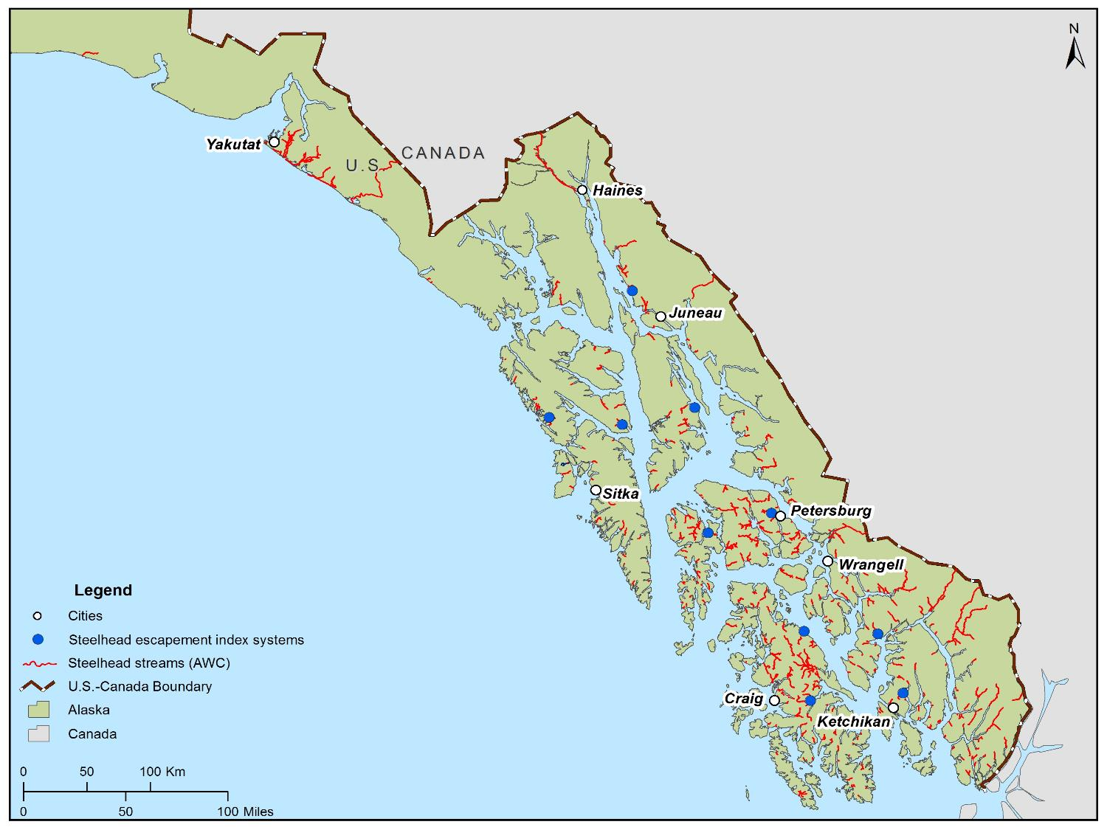
Southeast Alaska Steelhead Distribution
Notes:
Steelhead have extensive distribution in SE AK with over 300 streams that have documented steelhead populations. Many have populations of less than 200 fish.

Slide 4
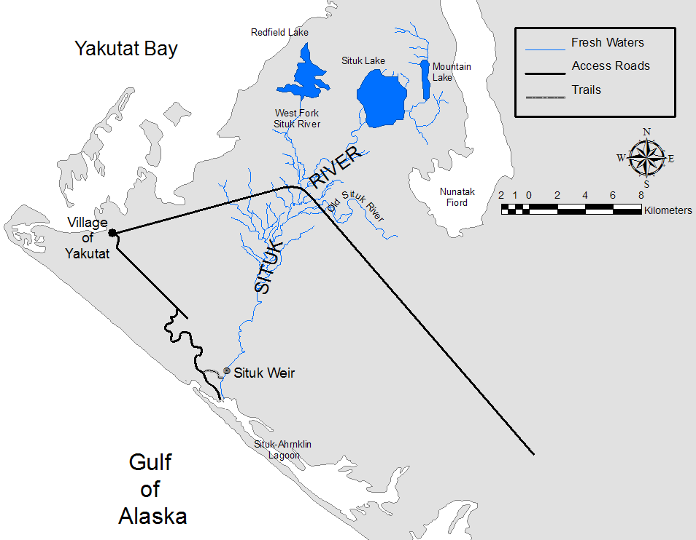
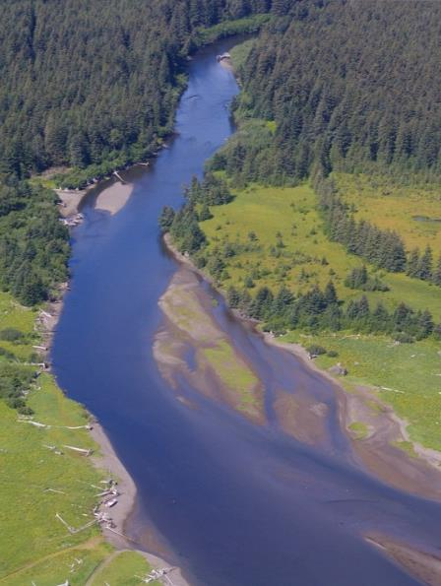
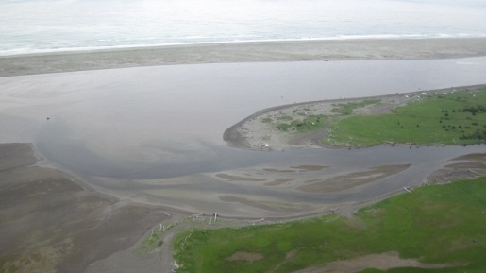
Situk River Weir
Map adapted from Marston et al. 2008.
Images courtesy of Nate Catterson, USFS
Notes:
The Situk River, located at the northern extent of Southeast Alaska near the town of Yakutat is home to the largest known population of steelhead in Alaska. Over the past 20 years returns of steelhead to the Situk averaged about 7,500 fish with a high count in 2006 of over 15,000. It is the most in depth and longterm steelhead assessment effort in the state with a weir project that collects kelt emigration counts, sex ratio and length composition.
The weir has operated at the same river location with consistent methodology since 1998

Slide 5
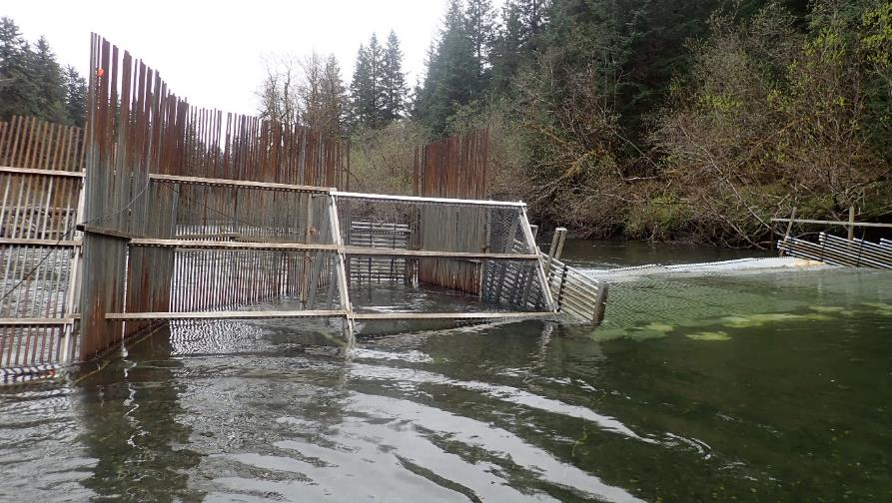
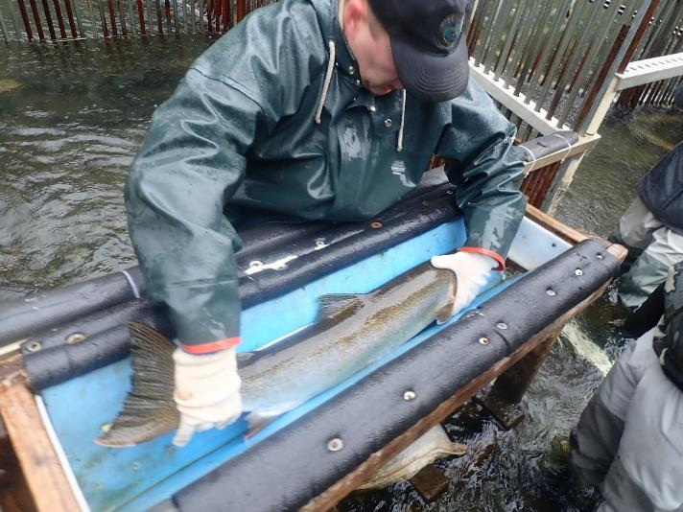
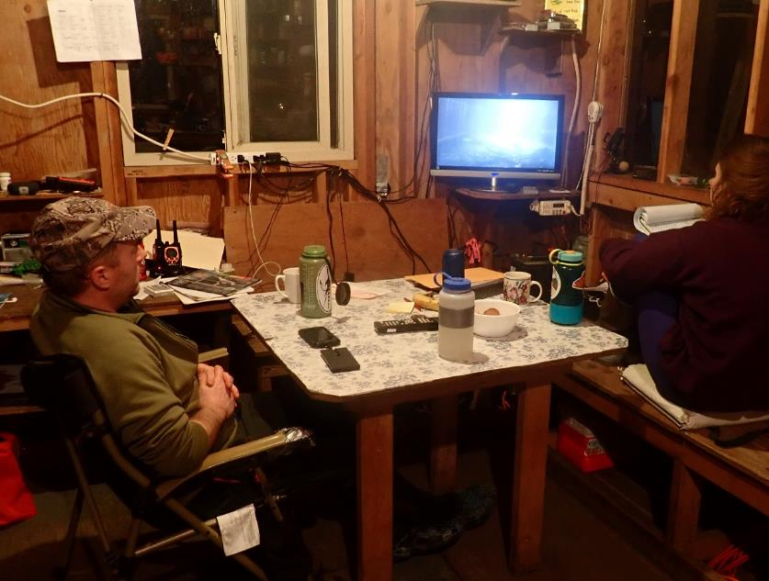
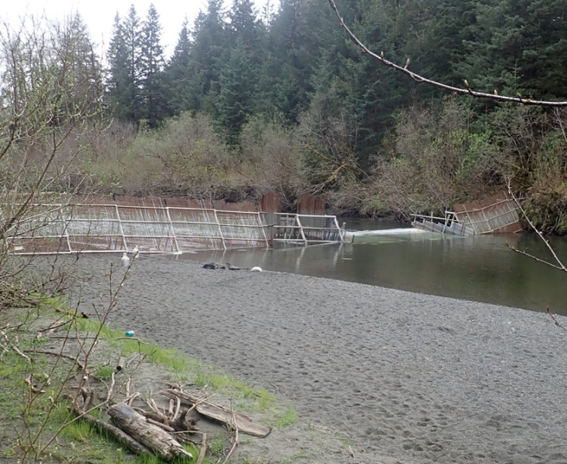
Notes:
The weir is a resistance board, bipod and picket weir with a fish trap. Steelhead are counted and sampled at the Situk River weir using an underwater camera and downstream trap configuration. The Situk River steelhead return is comprised of fall/winter fish and spring fish. Weir is installed in the spring so the fall/winter and early spring fish are not counted as they enter the river. The count of kelts takes these fish into account as they emmigrate downstream and the count is used as an index of steelhead spawning abundance. Counting is conducted via video feed from a nearby cabin and the majority of kelts pass downstream after dark.

Slide 6
High Productivity Period: 2004-2007
Notes:
Over the past 27 years steelhead kelt counts on the Situk have ranged from a low of 3,923 in 2021 to over 15,000 in 2006. A period of high productivity occurred in the mid-2000s. Long term median is approximately 7,000 and there have been historically low counts in recent years.

Slide 7
Notes:
The Situk weir also assesses fish size and we are seeing a recent trend of reduced fish size since 2015. As a result the most recent 10-year mean size is less than the previous 10 years.

Slide 8
Notes:
Sashin Creek is on Southern Baranof Island. NOAA has operated a weir since 1986 at Sashin creek as part of their Little Port Walter research facility. The weir is generally run April through September and counts are upstream steelhead migrants. Not operated in 2022 but there were low counts in 2020 and 2021.

Slide 9
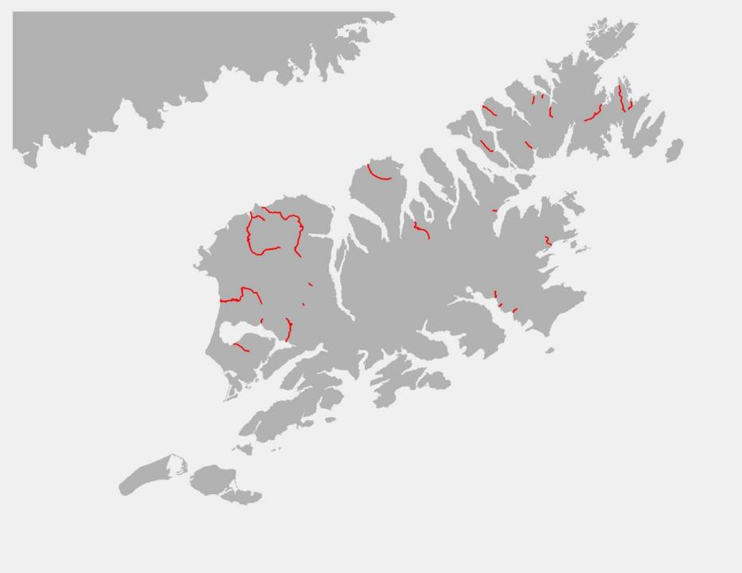
Karluk River
Litnik River
Ayakulik River
Dog Salmon River
Index Streams on
Kodiak Island Alaska
Notes:
Kodiak area weirs are setup to count salmon but incidentally count steelhead kelts as well which serves as an indicator for steelhead population monitoring. Only fall run fish that spawn in the spring so geographically between SE and SC there is a change in life history strategies.

Slide 10
Weir Counts – Southcentral Alaska
Number of steelhead
Notes:
There are 4 weirs on Kodiak that count emigrating kelt steelhead. Based on timing of weir installation in early summer, to count salmon, we understand that these are minimum counts and serve as indexs of steelhead abundance. The Division of Sport Fish considers the Karluk and Ayakulik weirs as the best indicators of steelhead population trends. Difficult to see any population trends among these weirs with the exception of 2022 which had a downward trend of counts less than the median. We know these are minimum counts of steelhead abundance due to weir timing and mortality of inriver spawning fish. A mark-recapture study conducted on the Karluk in 2019 estimated a spawning population of 7,952 steelhead compared to a weir count of 2,877 kelts with a 37% survival of spawning steelhead. This mark-recapture estimate is similar to a range of estimates estimated from 1992-97.

Slide 11
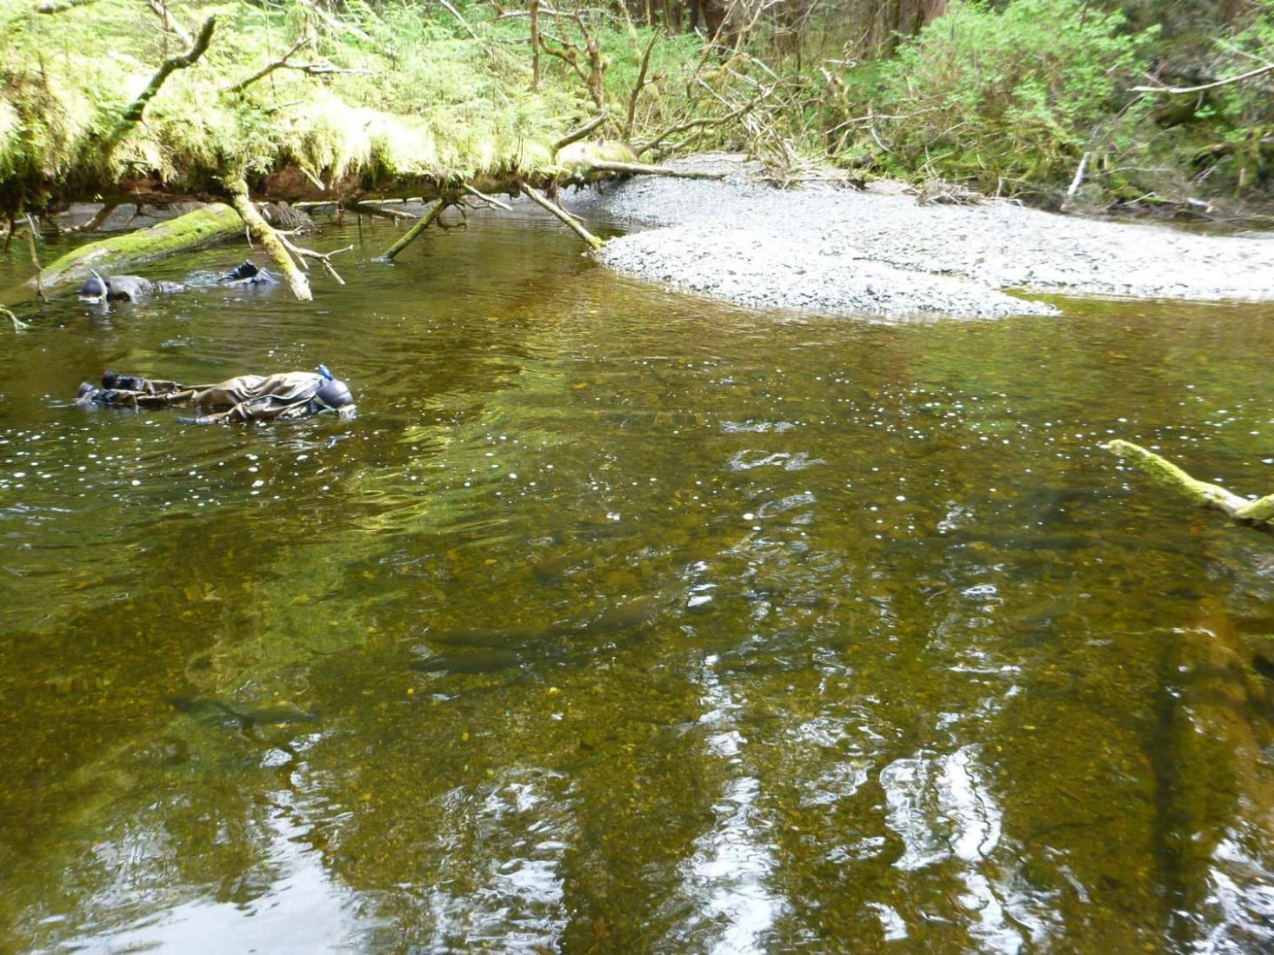
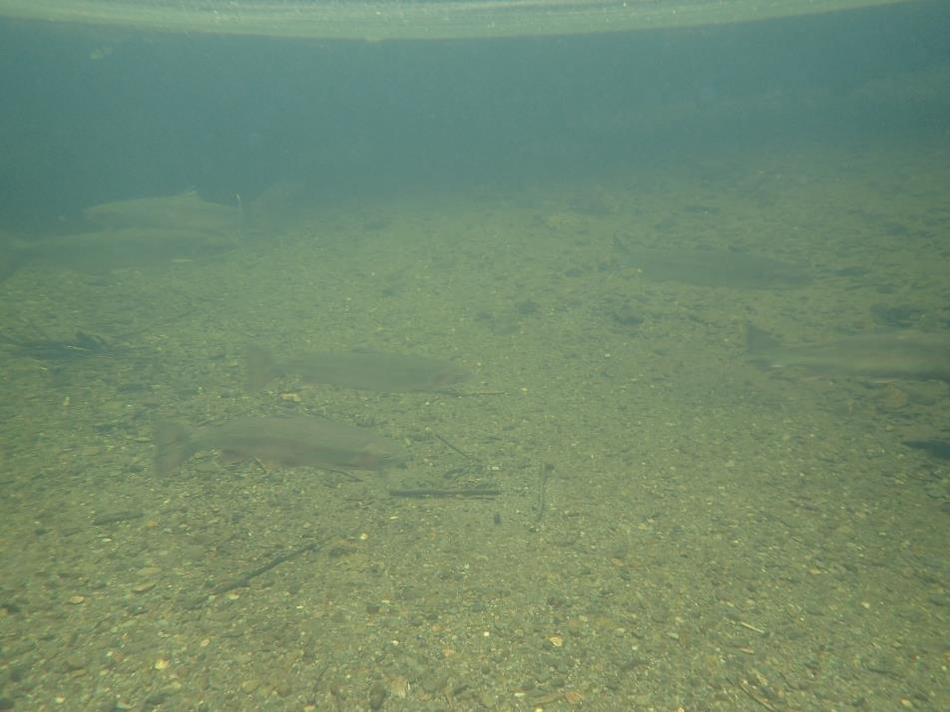

Snorkel Surveys
Notes:
Another steelhead population assessment used in Alaska are snorkel surveys which occur in SE AK.

Slide 12
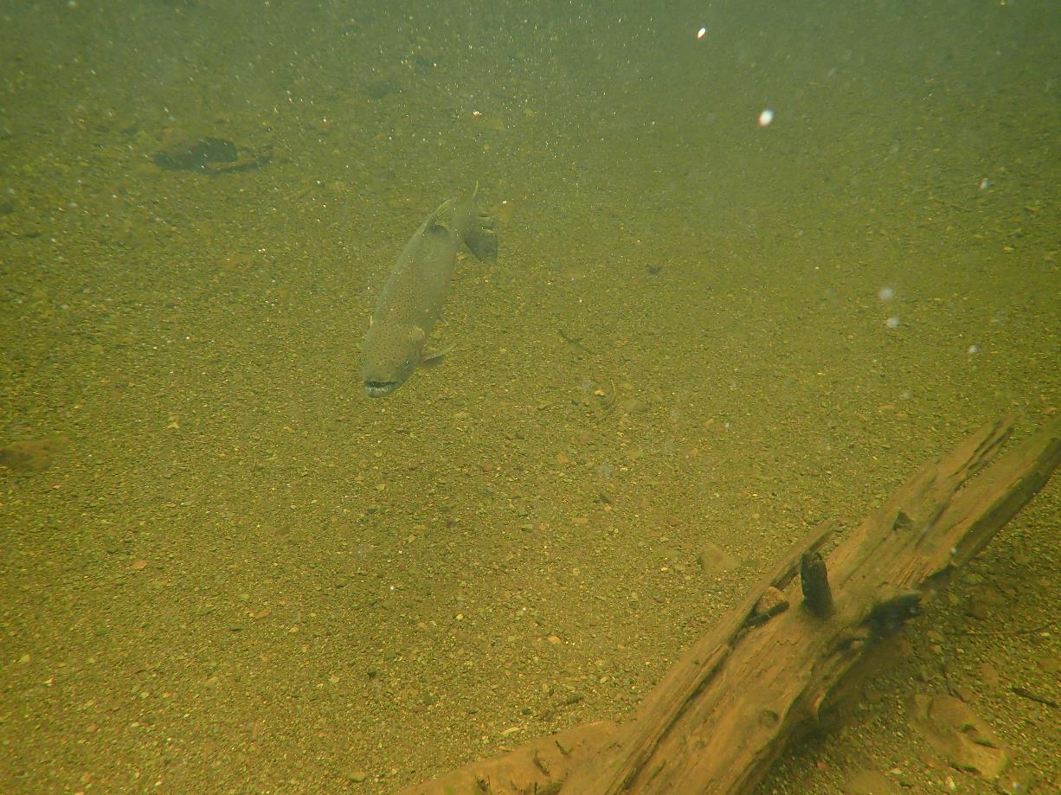
Index Streams in
Southeast Alaska
Notes:
Conduct snorkel surveys to enumerate adult steelhead during times of peak abundance within established areas of 10 previously selected index streams within Southeast Alaska. Attempt at least 3 surveys in April and May to determine peak count, where the highest count is bracketed between 2 lower counts. May have to do 4th count. Up to local bio to determine when to start surveying but need good survey conditions such as low water for effective counts. When peak counts not available there are still often unbracketed high counts, which can be useful as well. Water Temp for longterm monitoring.

Slide 13
Historic Counts
 | Stream Name | 1997 | 1998 | 1999 | 2000 | 2001 | 2002 | 2003 | 2004 | 2005 | 2006 | 2007 | 2008 | 2009 | 2010 | 2011 | 2012 | 2013 | 2014 | 2015 | 2016 | 2017 | 2018 | 2019 | 2020 | 2021 | 2022 | Average | Average peak count
Ketchikan | White River | 84 | 93 | 60 | 38 | 48 | 37 | 77 | 35 | 67 | 41 | 85 | 45 | 45 | 42 | 47 | 73 | 110 | 76 | 132 | 41 | 71 | 9 | 104 |  | 3 | 42 | 60 | 60
 | Ward Creek | 10 | 41 |  |  |  |  | 143 | 171 | 146 |  |  |  |  |  |  |  | 35 | 58 | 110 | 44 | 84 | 70 | 114 | 28 |  | 35 | 78 | 102
Prince of Wales | Harris River | 104 | 156 | 192 | 79 | 53 | 188 | 195 | 124 | 123 | 92 | 128 | 122 | 90 | 95 | 58 | 84 | 166 | 153 | 133 | 78 | 151 | 204 | 139 | 124 | 124 | 166 | 128 | 127
 | Eagle Creek | 90 | 56 | 118 | 82 |  | 36 | 95 | 67 | 102 | 154 | 134 |  | 137 | 69 | 54 | 116 | 154 | 133 | 146 | 84 | 99 | 67 | 66 |  | 53 | 27 | 93 | 99
Petersburg | Petersburg Creek | 123 | 152 | 115 | 42 | 64 | 41 | 188 | 330 | 369 | 241 | 289 | 251 | 198 | 221 | 131 | 112 | 215 | 151 | 149 | 124 | 184 | 175 | 333 |  |  |  | 183 | 218
 | Slippery Creek |  |  |  | 33 | 41 | 31 | 76 | 92 |  | 79 | 68 | 46 | 86 | 66 | 52 | 83 |  |  | 70 | 54 | 124 | 81 | 93 |  |  |  | 69 | 70
Sitka | Ford Arm Creek | 296 | 103 | 89 | 134 | 28 | 122 | 181 | 379 | 459 | 428 | 673 | 266 | 194 | 99 | 169 | 125 | 154 | 161 | 171 | 141 | 292 | 233 | 205 | 86 | 56 | 101 | 206 | 236
 | Sitkoh Creek | 329 | 154 | 120 | 112 | 115 | 65 | 296 | 354 | 259 | 213 | 70 | 167 | 201 | 71 | 68 | 69 | 99 | 243 | 120 | 89 | 78 | 77 | 76 |  |  |  | 150 | 172
Juneau | Pleasant Bay Creek | 155 | 81 | 132 | 48 | 48 | 36 | 50 | 51 | 47 | 59 | 94 | 53 | 64 | 51 | 94 | 76 | 77 | 61 | 58 | 37 | 72 | 78 | 40 |  |  |  | 68 | 60
 | Peterson Creek | 26 | 29 | 38 | 27 | 41 | 13 | 36 | 39 | 22 | 36 | 26 | 26 | 22 | 35 | 27 | 12 | 29 | 27 | 7 | 18 | 12 | 6 | 3 | 11 | 24 | 18 | 23 | 24
Notes:
We have a long-term dataset with good quality and consistent data collection through 2019. Peak counts are highlighted in light gray. Covid, budget cuts to travel, staffing issues and lack of air taxis has impacted counts since 2020 with some streams not surveyed and only 4 peak counts.

Slide 14
Standardized Southeast Alaska Peak Snorkel Steelhead Counts
Notes:
When all peak counts are examined collectively the resulting median trend line in red. There is a clear decline in count numbers from 2019-2022 and the few peak counts achieved in 2020-22 were below the median peak counts and historically low.
The median is the middle number and is sometimes used as opposed to the average or the mean when the data sets have outliers in the sequence that can lead to the skewness of the average of the values.

Slide 15
Incorporating High Counts into Trend Line
Notes:
Historically we’ve done a good job of documenting peak counts, but due to reasons explained earlier peak counts are not achieved all years, such as 2020-22. A high count may have been conducted at the appropriate time and under good conditions but was excluded from trend analysis because extenuating circumstances prevented 3 surveys from being conducted. When quality high counts are included into the regional trend line we see the same pattern as only using peak counts indicating that there is utility in using good quality high counts to monitor steelhead abundance trends.

Slide 16
Standardized Southeast Alaska Peak/High Snorkel & Situk Weir Steelhead Counts
Notes:
SE is a broad geographic area, 600 miles from Yakutat to POW, but Situk weir and regional snorkel count trends indicate a similar regional trend line with the period of high productivity in mid 2000s and downward population trend in recent years.

Slide 17
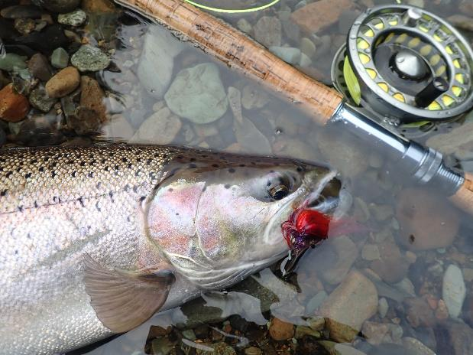
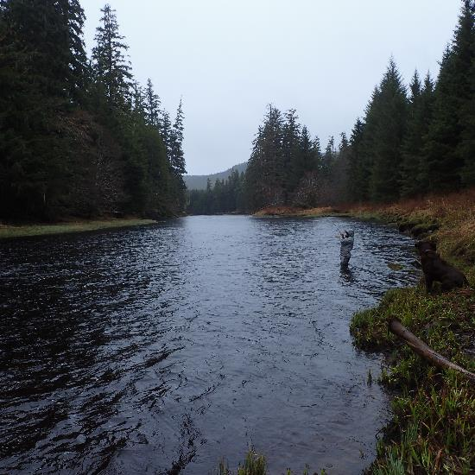
Steelhead/Trout Management
  5 AAC 75.220 Statewide Management Standards for Wild Trout
    Optimal Sustained Yield
    Conservative Regulations
  5 AAC 75.222 Policy for the Management of Sustainable Wild Trout Fisheries
    Recognizes importance of healthy trout/steelhead populations to Alaska
    Conservative management
    Habitat protection
    Importance of scientific research to guide management
Notes:
Alaska also monitors and manages based on fisheries catch/harvest information, which I’ll go over next.
Two Alaska Administrative Codes guide management of steelhead and trout in Alaska.
Optimal Sustained Yield where steelhead/trout populations managed for benefits other than maximum sustained yield such as quality of experience, diversity of opportunity, conservative harvest and economic benefits for the State of Alaska.

Slide 18
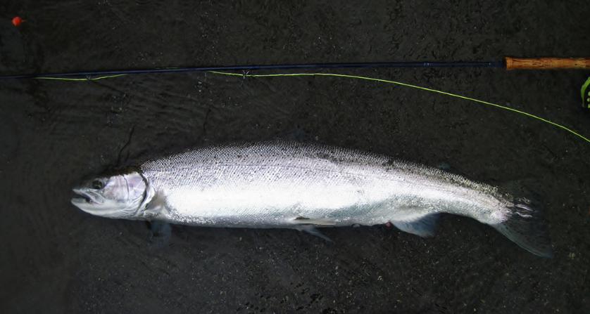
Conservative Sport Fishing Regulations
Southcentral Alaska
Harvest Limit: 1 per day, 2 annually (> 20 inches)
Spawning area closures (Kenai tribs, Kasilof)
Winter closures
Kodiak Road Zone: C&R
Trout: 2 per day ( <16) in combination with cutthroat
Upper Copper River
2 per day, 1 (> 20 inches)
  Catch and release
  Spawning closures
Southeast Alaska
Harvest Limit: 1 per day
2 annually (> 36 inches minimum)
Catch and release
Spawning area closures
Trout: 2 per day (11-22) in combination with cutthroat
Notes:
Sport fishing regulations are conservative statewide but vary by region.
In SC Alaska, anglers may only harvest 2 steelhead/cutthroat over 20 inches annually with no minimum size limit. Several popular steelhead streams on the Kenai Penninsula are closed to retention, ie. catch and release only. Kodiak Island and the Alaska Peninsula are similar but some streams are managed as catch and release fisheries.
In SE AK, A minimum size limit of 36 inches (916 mm) is estimated to protect 95 % of the population and anglers are limited to harvesting 2 steelhead per year and bait restrictions. A lot of drainages are managed as catch and release fisheries for steelhead.
The upper Copper River has a regional limit of 2 per day BUT is effectively catch and release only due to spawning area closures.

Slide 19
Notes:
SWHS data which is survey sent out to a proportion of fishing license holders to obtain effort, catch and harvest data by species and location. Over the last ten years, statewide, which is basically SE and SC combined, catches of steelhead by sport anglers has ranged from about 15,000 to 45,000 steelhead with a decline in catch in recent years.
SE catch is generally higher than SC, with the Situk River accounting for a large portion of the catch.
Approximately 69% SE region catch and 43% statewide catch.
Harvest dependent on restrictive harvest regulations and increased angler preference towards C&R over time.
SWHS is best fishery status indicator we have but not controlled for effort so not a real good abundance indicator. Highly influence by water flow conditions in spring on Situk.

Slide 20
Commercial Steelhead Harvest
Commercial Sale Prohibited in 1994
Mandatory Reporting in 2012
Notes:
Steelhead harvested incidentally in commercial fisheries within steelhead geographic range. Sale of steelhead was prohibited with 1994 regulation changes which decreased harvests substantially.
The incidental commercial take is not fully known and not sampled. Reporting became mandatory in all of Alaska as of in 2012.
Net fisheries may take a substantial amount. Many are also released after being caught with unknown mortality.
Little verification of reporting occurs due to minimal enforcement of mandatory reporting.

Slide 21
Federal Subsistence Harvest
Notes:
Federal rules allow local harvest of steelhead in SE AK for subsistence with a permitting system. Regulations are conservative with very low bag limits however the use of bait is allowed.
The United States Forest Service issue permits and compiles data from the permits returned.
Majority of harvest occurs on POW and is concentrated on 3 drainages.

Slide 22
Total Removals of Alaskan Steelhead
Notes:
To summarize steelhead harvest in Alaska, majority occurs in commercial net fisheries and likely has historically. All gear average harvest of 570 fish in State of Alaska since 2003 with an increase to 680 since mandatory reporting in commercial fishery in 2012.

Slide 23
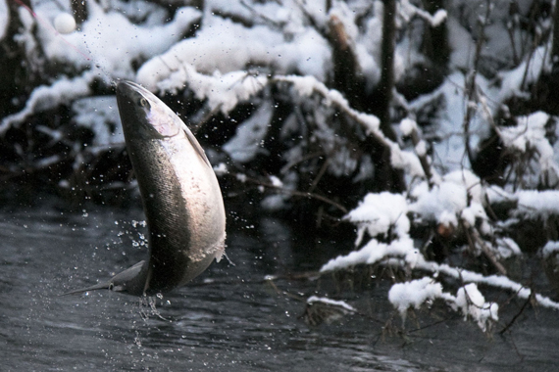
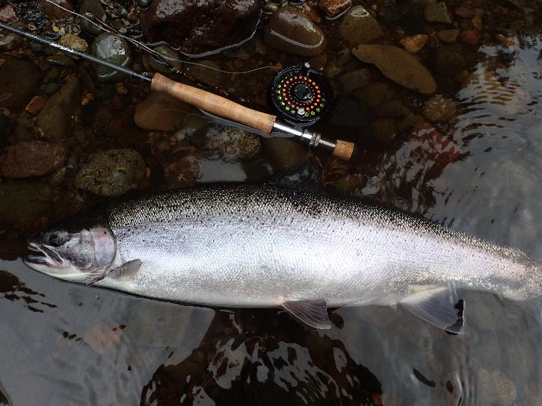
Conclusions
Sport fishery continues to trend towards catch and release with very low harvest rates.
Abundance trends in Southeast Alaska are historically low and stable in Southcentral Alaska.
Size composition has shifted to smaller fish on Situk River.
Continued opportunities for steelhead research in Alaska.
Continued stock monitoring and conservative management are priorities statewide.
Notes:
In Summary Alaska Department of Fish and Game uses a combination of weirs and snorkel surveys to conduct stock assessments and monitors steelhead fisheries with catch and harvest information.
Based on snorkel surveys scattered throughout SE, the Situk and Sashin weirs and sport fishery catch data SE steelhead returns from 2020-22 are at historic or near historic lows.
SC weir data had been near historic average counts in recent years except 2022 when all steelhead escapements were below average.

Slide 24
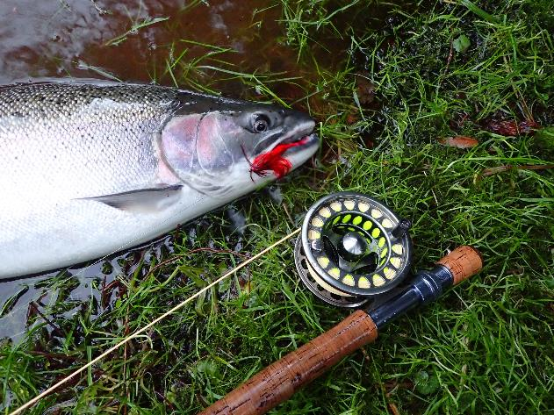
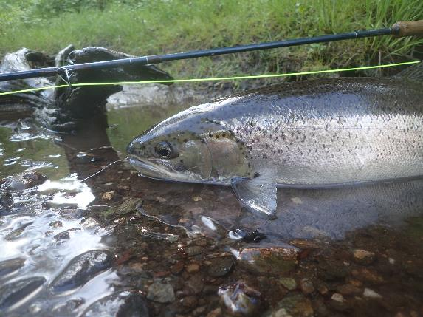
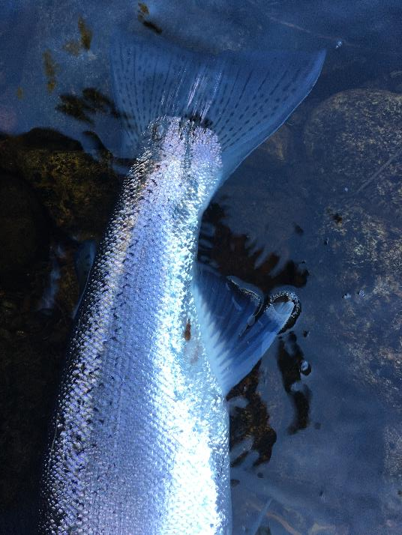
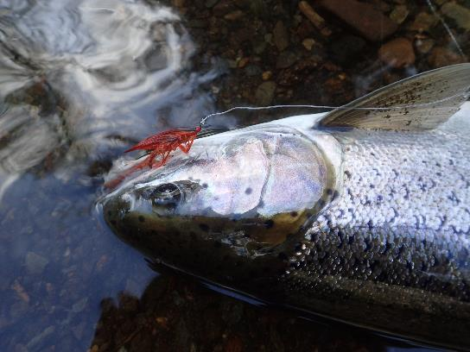
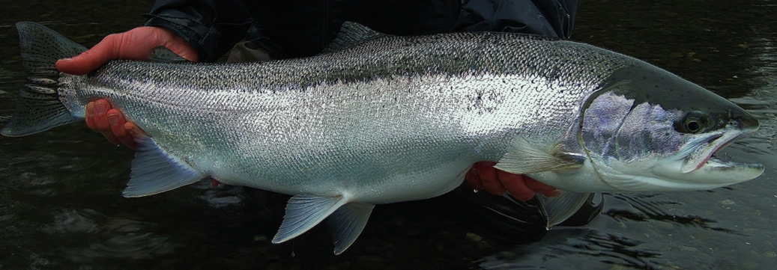
Questions?
Acknowledgements- ADFG Colleagues: Matt Catterson, Kelly Reppert, Troy Tydingco, Patrick Fowler, Dan Teske, Richard Chapell, David Love, Jason Pawluk, Tyler Polum, Brian Marston, Jeff Nichols, Ivy Schultz, Andy Piston; Charlie Waters (NOAA), Nate Catterson (USFS) and Jake Musslewhite (USFS)

