Slide 1
Status of steelhead in Washington
Neala Kendall
Thomas Buehrens
Dan Rawding
Steelhead Managers’ Meeting
March 14, 2023

Slide 2
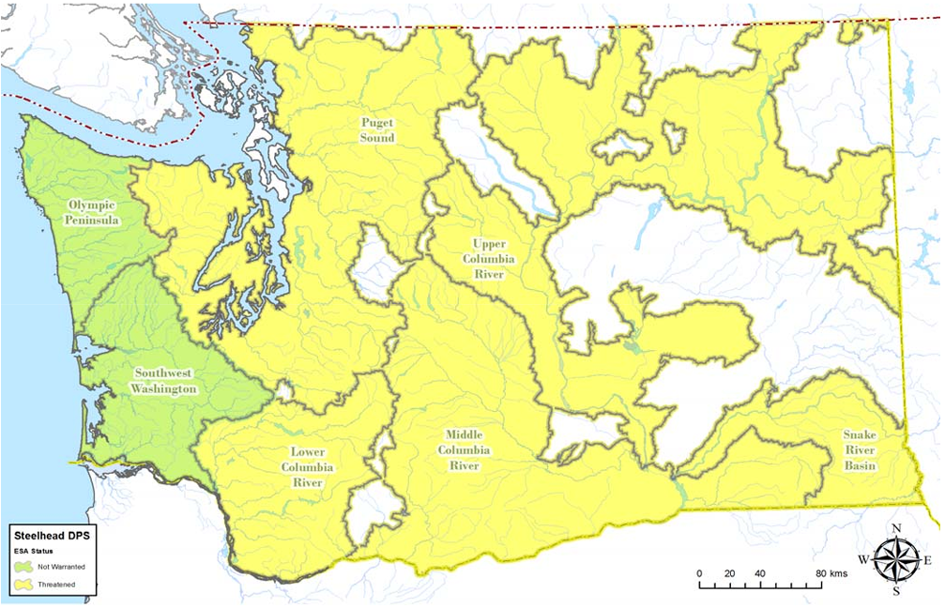
Steelhead DPSs
7 DPSs
5 Listed
2 Not
3 interior Columbia DPSs are summer run
4 DPSs western DPSs have both summer and winter steelhead
Olympic Peninsula DPS petitioned for listing August 2022; under consideration by NOAA
Blocked Habitat
Upper Columbia DPS

Slide 3
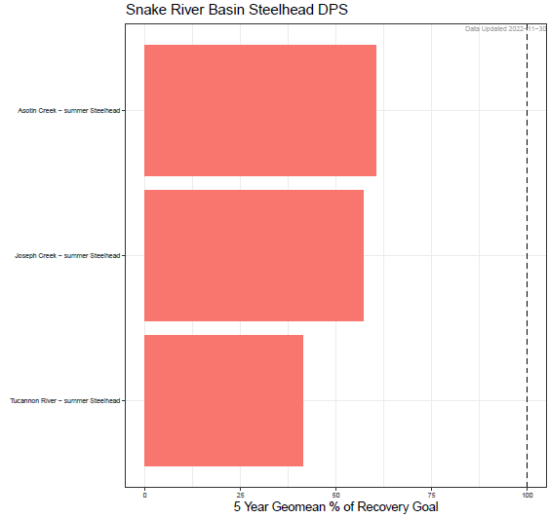
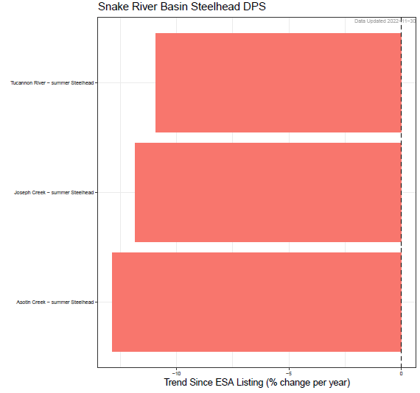
Snake River Basin
Listed as threatened under the ESA.
Most populations in Oregon or Idaho.
NOAA 2022 Biological Viability Assessment Update: Overall viability remains at “moderate” risk of extinction.
WDFW State of Salmon abundance status and trends:
Asotin Creek summer steelhead
Tucannon River
Joseph Creek summer steelhead
Joseph Creek
Tucannon River summer steelhead
Asotin Creek
5-year geomean % of recovery goal
Trend since ESA listing (% change per year)

Slide 4
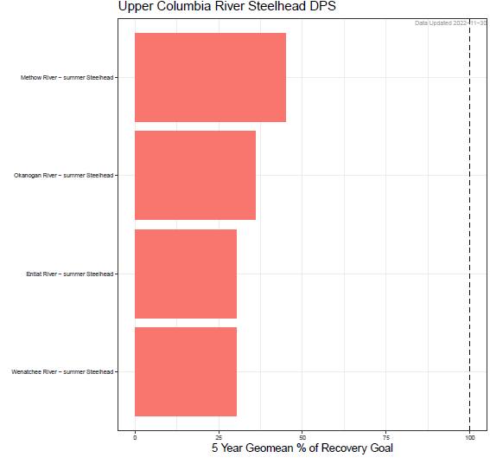
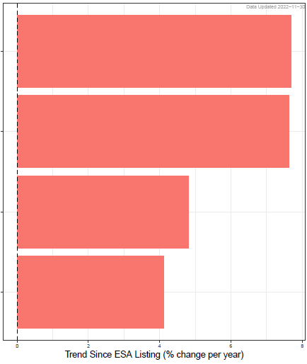
Upper Columbia
Listed as threatened under the ESA.
NOAA 2022 Biological Viability Assessment Update: Overall DPS is at “high” risk driven by low abundance and productivity relative to viability objectives and diversity concerns.
WDFW State of Salmon abundance status and trends:
Methow River summer steelhead
Entiat River
Okanogan River summer steelhead
Okanogan River
Entiat River summer steelhead
Methow River
Wenatchee River summer steelhead
Wenatchee River
5-year geomean % of recovery goal
Trend since ESA listing (% change per year)

Slide 5
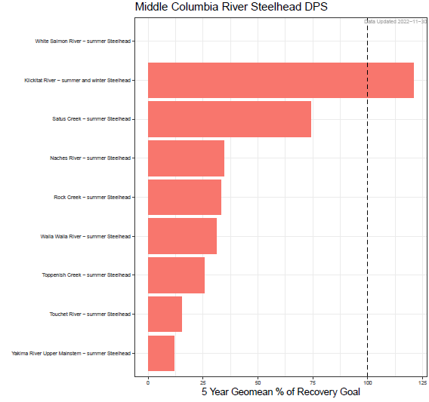
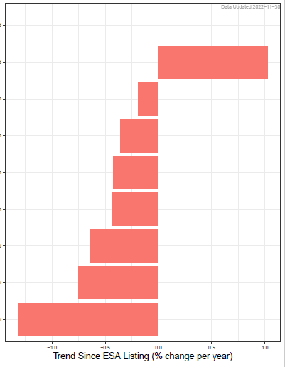
Middle Columbia
Listed as threatened under the ESA.
Some populations in Oregon.
NOAA 2022 Biological Viability Assessment Update: Overall viability remains at “moderate” risk of extinction.
WDFW State of Salmon abundance status and trends:
White Salmon River summer steelhead
Klickitat River summer & winter steelhead
Upper Yakima River
Satus Creek summer steelhead
Naches River
Naches River summer steelhead
Rock Creek
Rock Creek summer steelhead
Klickitat River
Walla Walla River summer steelhead
Satus Creek
Toppenish Creek summer steelhead
Touchet River
Touchet River summer steelhead
Walla Walla River
Upper Yakima River summer steelhead
Toppenish Creek
5-year geomean % of recovery goal
Trend since ESA listing (% change per year)

Slide 6
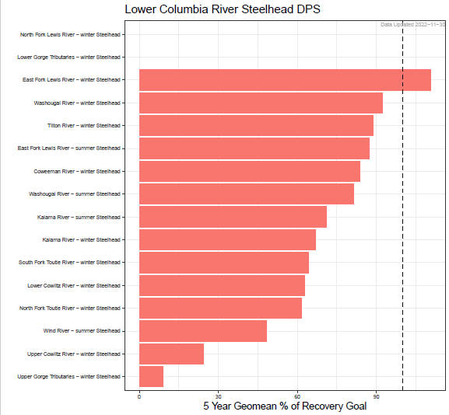
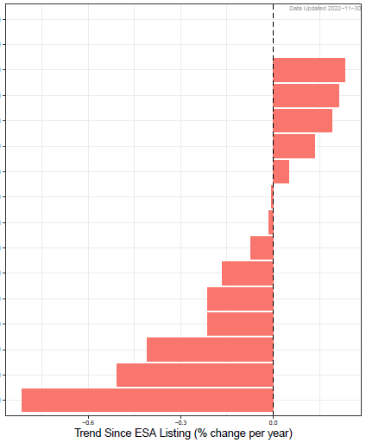
Lower Columbia
Listed as threatened under the ESA.
Some populations in Oregon.
NOAA 2022 Biological Viability Assessment Update: Overall viability remains at “moderate” risk of extinction.
WDFW State of Salmon abundance status and trends:
North Fork Lewis River winter steelhead
Lower Gorge Tributaries winter steelhead
East Fork Lewis River winter steelhead
Washougal River winter steelhead
Tilton River winter steelhead
East Fork Lewis River summer steelhead
Coweeman River winter steelhead
Washougal River summer steelhead
Kalama River summer steelhead
Kalama River winter steelhead
South Fork Toutle River winter steelhead
Lower Cowlitz River winter steelhead
North Fork Toutle River winter steelhead
Wind River summer steelhead
Upper Cowlitz River winter steelhead
Upper Gorge Tributaries winter steelhead
East Fork Lewis River winter
Upper Cowlitz River winter
East Fork Lewis River summer
Washougal River summer
Tilton River winter
Coweeman River winter
North Fork Toutle River winter
Kalama River summer
Wind River summer
South Fork Toutle River winter
Washougal River winter
Lower Cowlitz River winter
Kalama River winter
Upper Gorge Tributaries winter
5-year geomean % of recovery goal
Trend since ESA listing (% change per year)

Slide 7
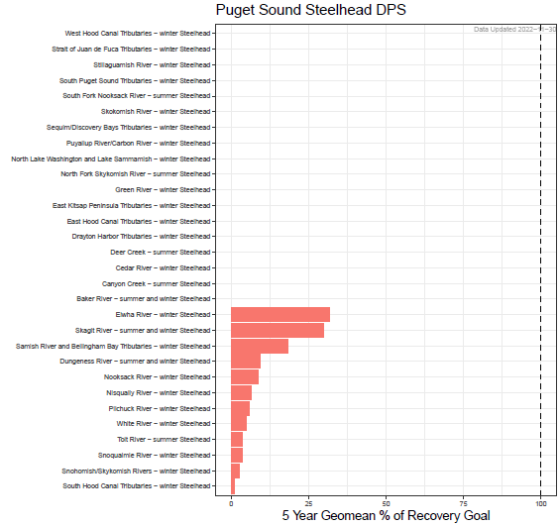
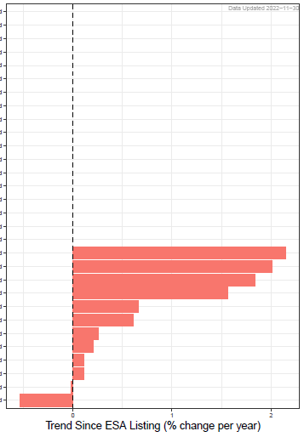
Puget Sound
Listed as threatened under the ESA.
NOAA 2022 Biological Viability Assessment Update: recovery efforts in conjunction with improved ocean and climatic conditions have resulted in an increasing viability trend, although the extinction risk remains “moderate.”
WDFW State of Salmon abundance status and trends:
West Hood Canal Tribs. winter steelhead
Strait of Juan de Fuca Tribs. winter steelhead
Stillaguamish River winter steelhead
South Puget Sound Tribs. winter steelhead
South Fork Nooksack summer steelhead
Skokomish River winter steelhead
Sequium/Discovery Bay Tribs. winter steelhead
Puyallup/Carbon River winter steelhead
N. Lake Washington & Lake Sammamish steelhead
North Fork Skykomish River summer steelhead
Green River winter steelhead
East Kitsap Peninsula Tribs. winter steelhead
East Hood Canal Tribs. steelhead
Drayton Harbor Tribs. winter steelhead
Deer Creek summer steelhead
Cedar River winter steelhead
Canyon Creek summer steelhead
Baker River summer and winter steelhead
Elwha River winter steelhead
Skagit River summer and winter steelhead
Samish River and Bellingham Bay Tribs winter steelhead
Dungeness River summer and winter steelhead
Nooksack River winter steelhead
Nisqually River winter steelhead
Pilchuck River winter steelhead
White River winter steelhead
Tolt River summer steelhead
Snoqualumie River winter steelhead
Snohomish/Skykomish rivers winter steelhead
South Hood Canal Tribs. winter steelhead
Elwha River winter
Nisqually River winter
Samish River and Bellingham Bay Tribs winter
White River winter
Skagit River summer and winter
Nooksack River winter
Pilchuck River winter
Dungeness River summer and winter
Tolt River summer
Snohomish/Skykomish rivers winter
Snoqualumie River winter
South Hood Canal Tribs. winter
5-year geomean % of recovery goal
Trend since ESA listing (% change per year)

Slide 8
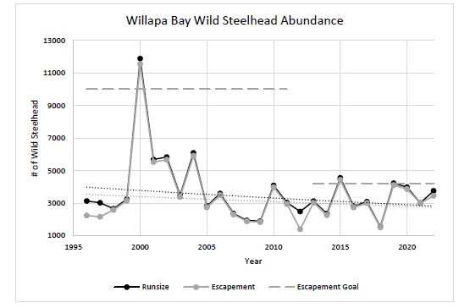
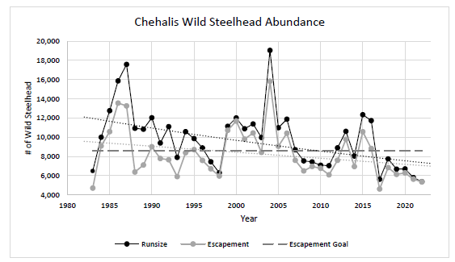
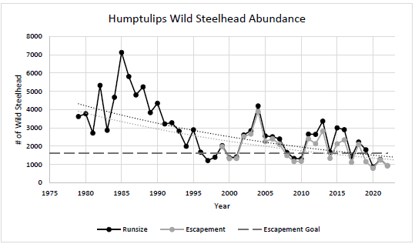
Southwest Washington
Not currently ESA listed.

Slide 9
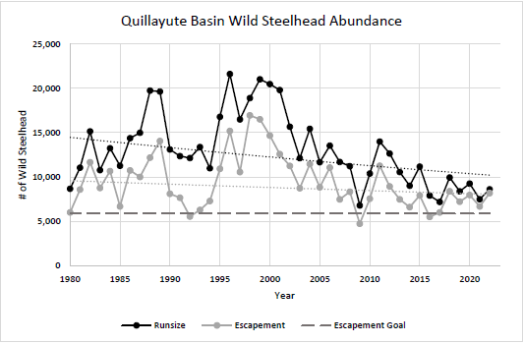
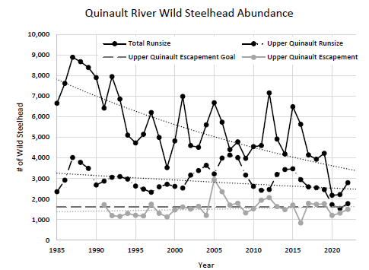
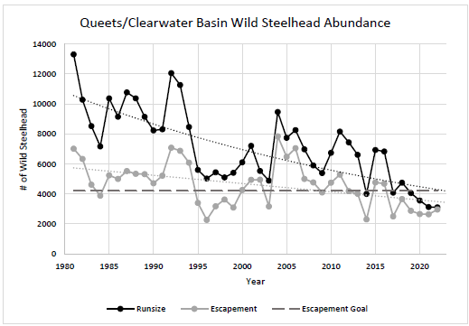
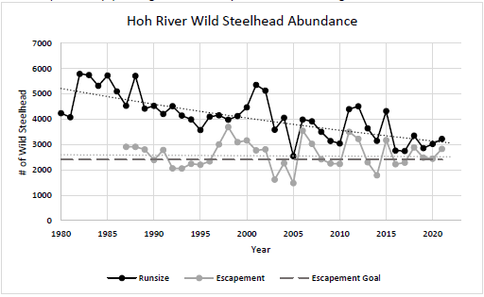
Olympic Peninsula
Not currently ESA listed.
Recently petitioned to be considered for ESA listing. NOAA has begun its consideration of the petition.

Slide 10
Washington steelhead DPS summary (WA State of Salmon report)
Puget Sound: “in crisis” (projected future status in 5 yrs < 25% of recovery goal)
Snake River Basin, Middle Columbia, and Upper Columbia: not keeping pace (future status > 25% of recovery goal & current status < 50% of recovery goal)
Snake River Basin shifted from “making progress” to “not keeping pace” from 2020 to 2022
NOAA: Upper Columbia at high extinction risk; other ESA-listed DPSs at moderate risk
Lower Columbia: making progress (future status< 50% of recovery goal & current status < 100% of recovery goal)
Olympic Peninsula: Not current ESA listed. Recently petitioned to be listed; NOAA is exploring.
Southwest Washington: Not ESA listed

Slide 11
Factors related to current status
Habitat
Freshwater habitat: degradation is ubiquitous. Particularly acute in heavily developed and agricultural areas where land use changes are most pronounced. Olympic Peninsula DPS has neither type of land use conversion and highest proportion of conserved habitat.
Ocean habitat: clear evidence of persistent multidecadal declines in marine survival as well as kelt survival
Hydropower
Pronounced for interior Columbia (Columbia hydropower system), Puget Sound and Lower Columbia (numerous high head dams that either block passage or have trap and haul that doesn’t meet federal standards)
Hatcheries
Identified as a threat during listings. Have undergone major reforms to reduce impacts in Puget Sound and Lower Columbia, with smaller changes in Upper Columbia and Snake. Less reform actions for unlisted DPSs so far.
Harvest
Sport retention: ended statewide in 201X. All listed populations require federal permits to operate sport fisheries, non-retention impacts are monitored and are held to very low exploitation rate (e.g., 1-10% depending on population and year).
Non-tribal commercial: closed for many decades
Tribal: greatly curtailed in Puget Sound and Columbia Basin tributaries. Mainstem Columbia ~5-15% for summer runs. Olympic peninsula and SW Washington ~0-30% depending on river.

Slide 12
Questions?
State of Salmon in Watershed, 2022
https://stateofsalmon.wa.gov/
Coastal Washington steelhead information
https://wdfw.wa.gov/sites/default/files/publications/02360/wdfw02360.pdf

