Slide 1
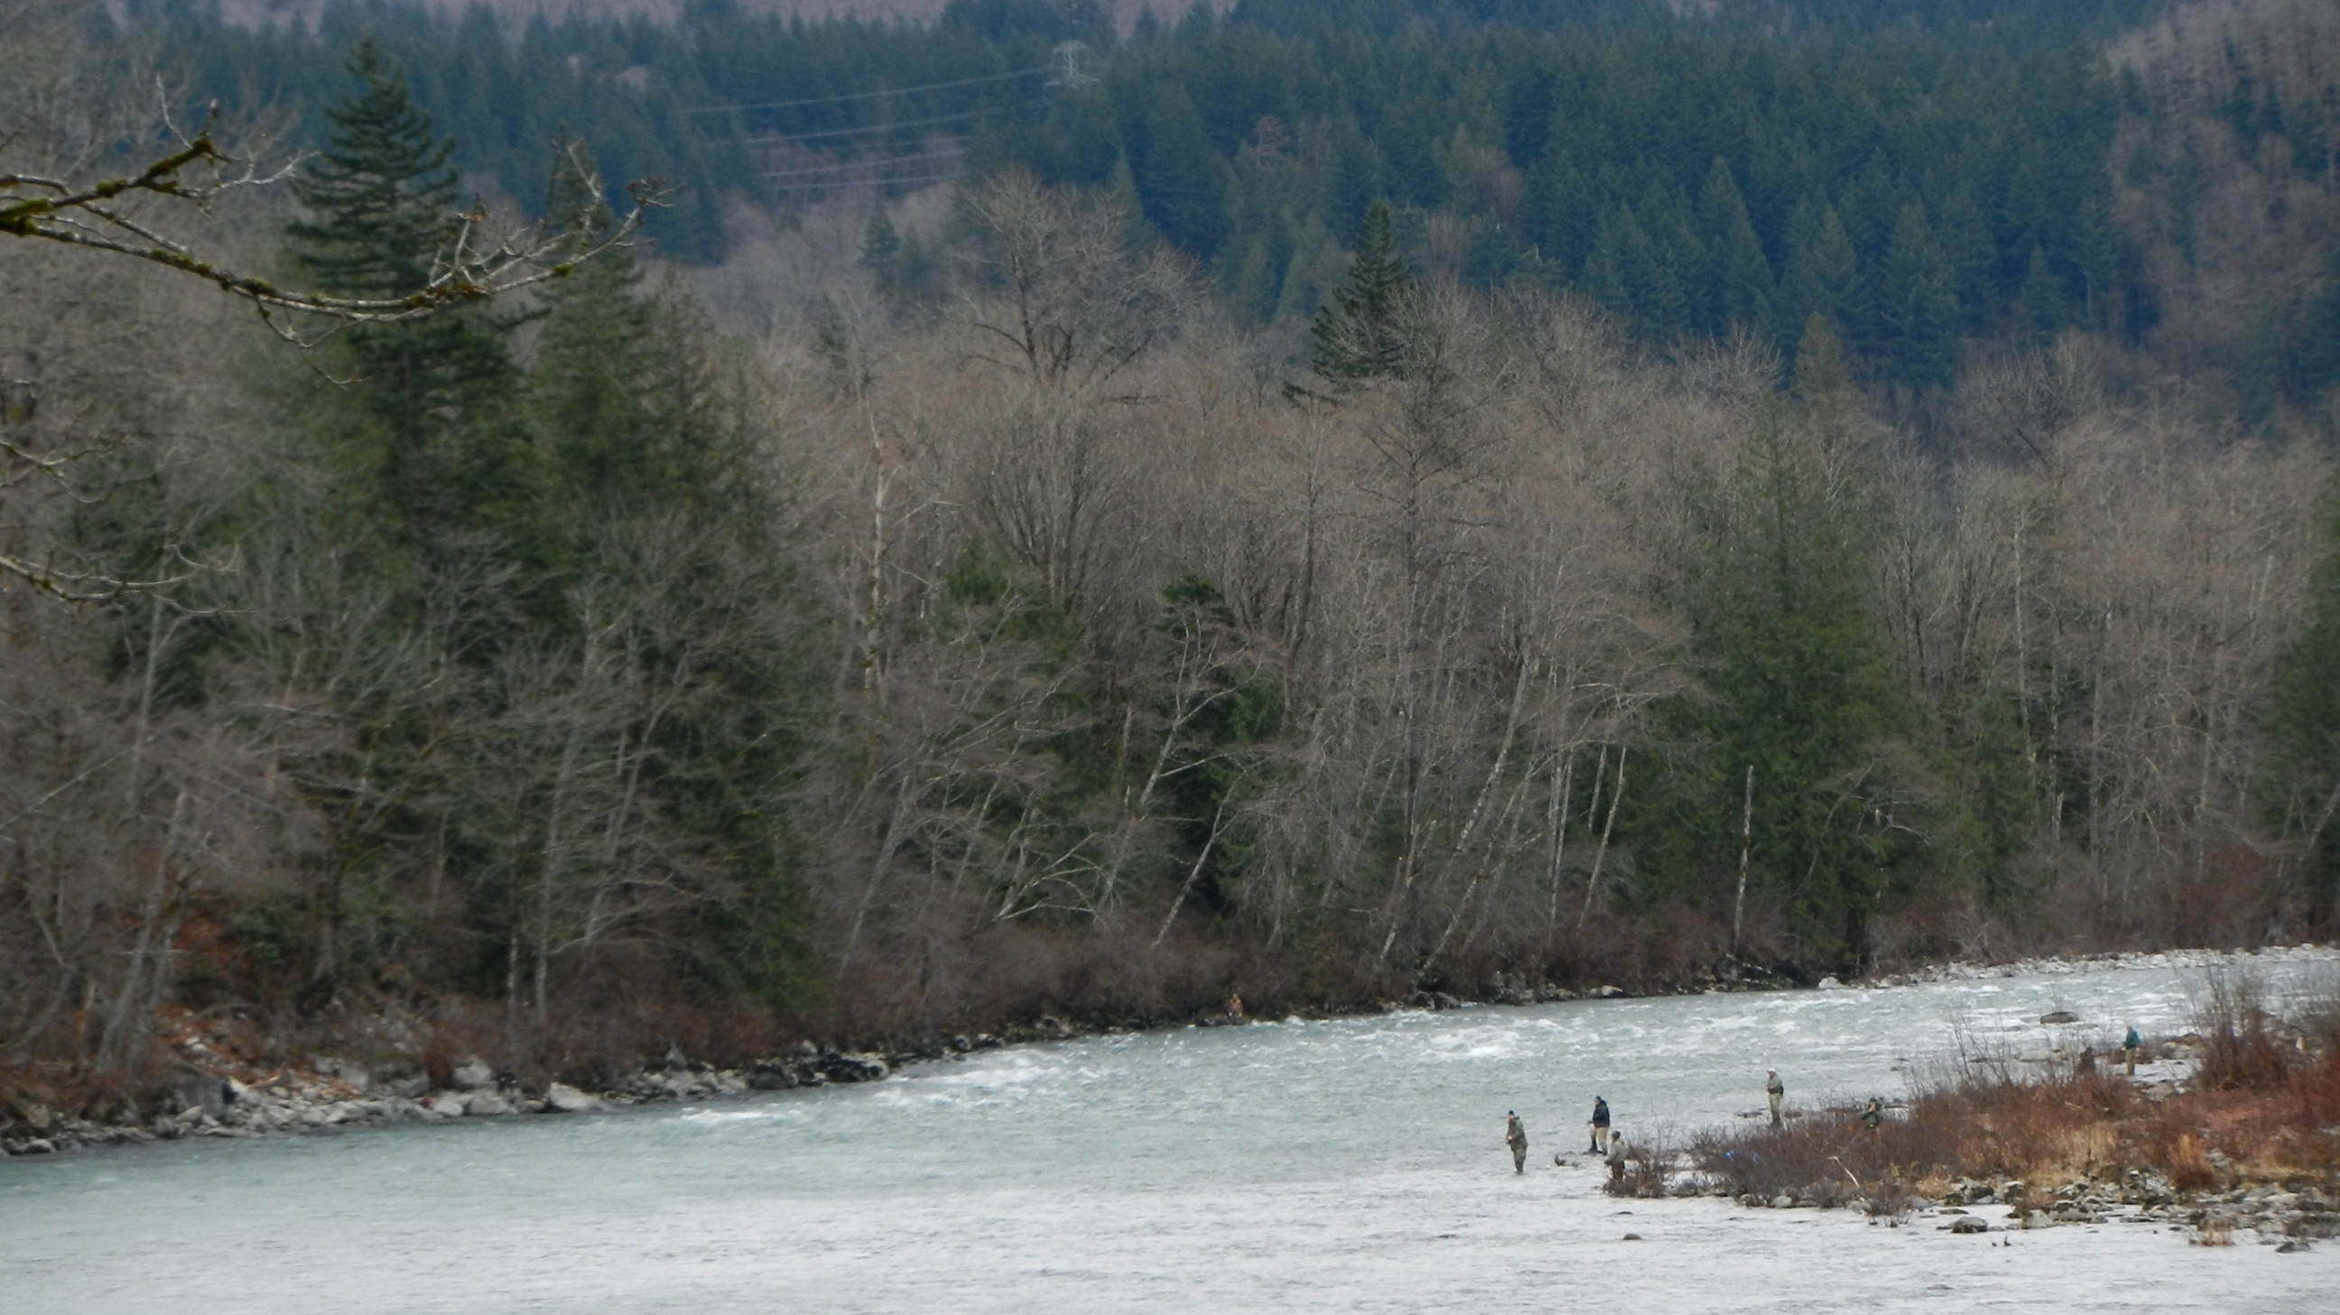

The Coastal Steelhead Proviso Implementation Plan:
Adaptive Management and Collaboration Catalyze Change
Toby Harbison
Research Scientist, WDFW Region 6
toby.harbison@dfw.wa.gov

Slide 2
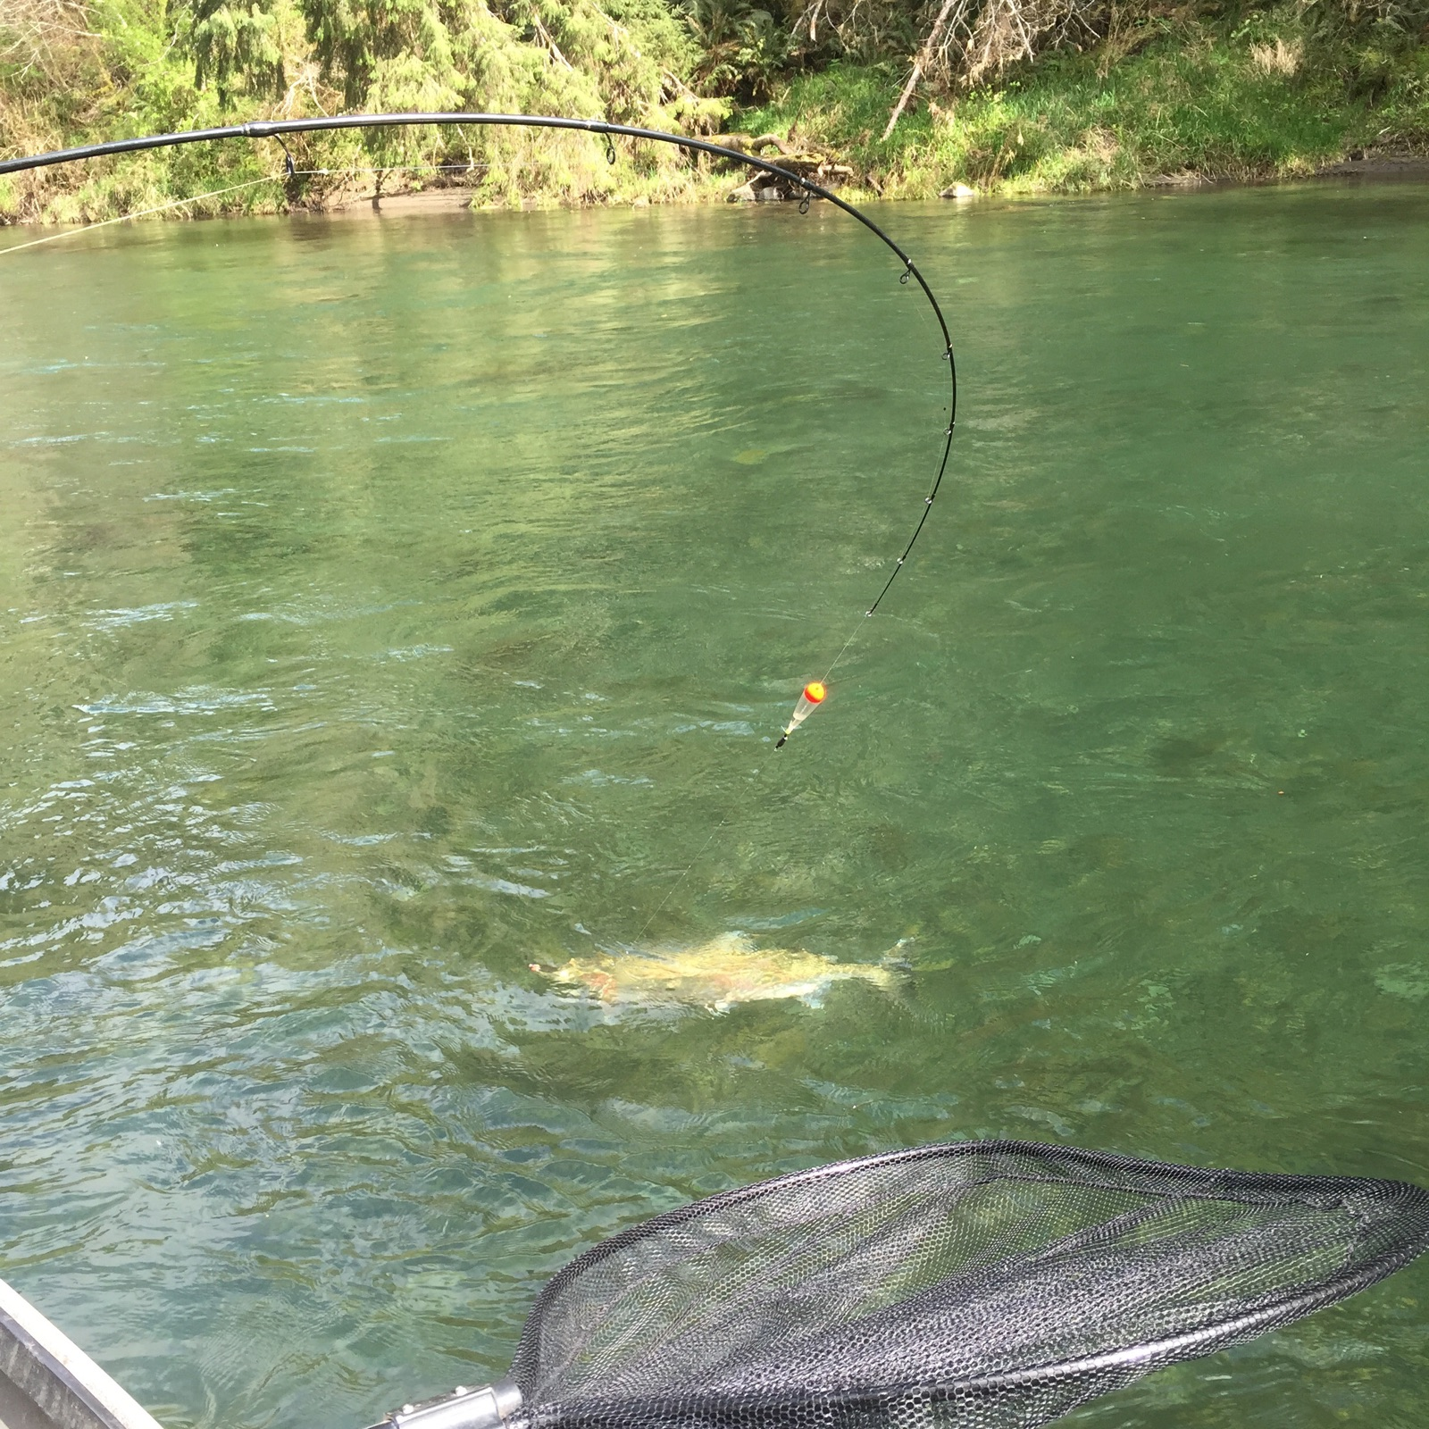
Talk Overview
Coastal steelhead population and management information
The Coastal Steelhead Proviso Implementation Plan (CSPIP)
3 ways collaboration and public engagement made the CSPIP development successful

Slide 3
Talk Overview
1
Coastal steelhead population and management information
The Coastal Steelhead Proviso Implementation Plan (CSPIP)
3 ways collaboration and public engagement made the CSPIP development successful

Slide 4
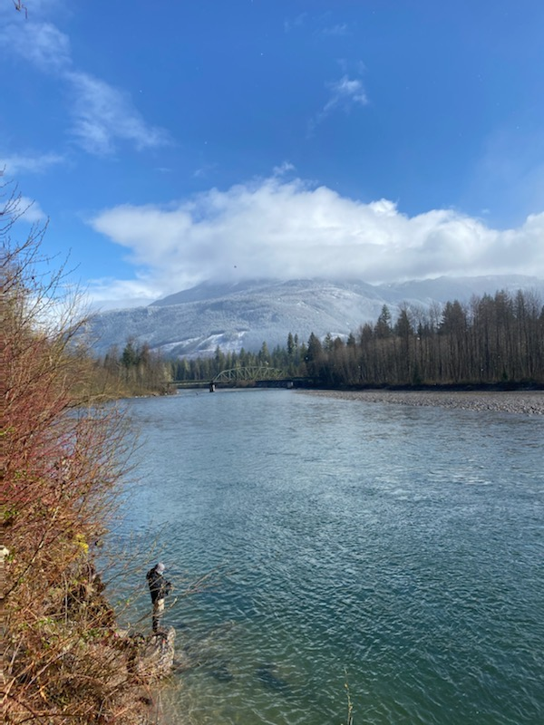
WDFW Mission Statement
1
The Washington Department of Fish and Wildlife's stated mission is to preserve, protect and perpetuate fish, wildlife and ecosystems while providing sustainable fish and wildlife recreational and commercial opportunities.
Photo courtesy of April Bosley

Slide 5
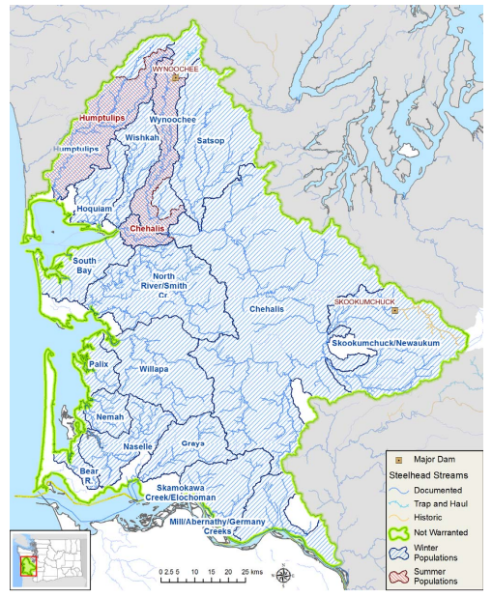
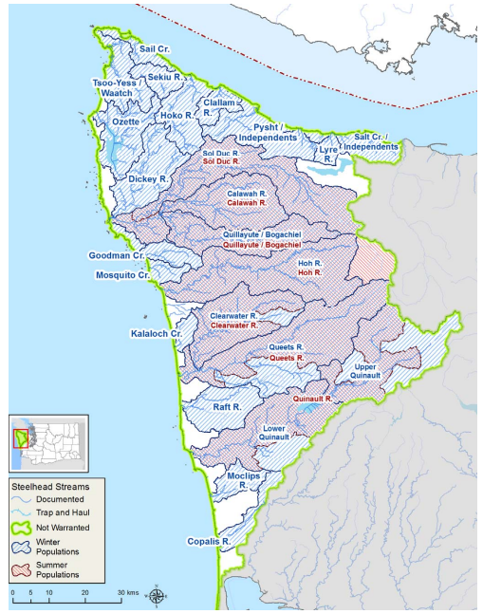
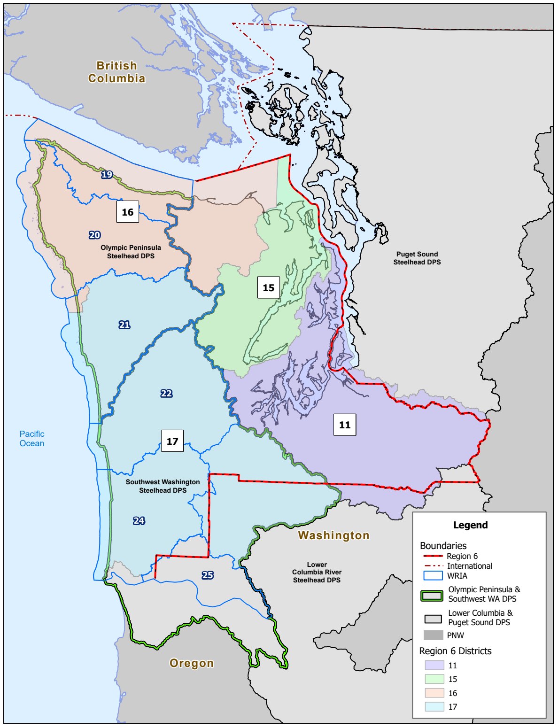
Geographic Scope
1
winter
in blue
summer in red
Southwest Washington DPS
Olympic Peninsula DPS
Intersecting Boundaries

Slide 6
Wild Steelhead Abundance in Major Coastal Systems
1

Slide 7
Wild Steelhead Abundance in Major Coastal Systems
1

Slide 8
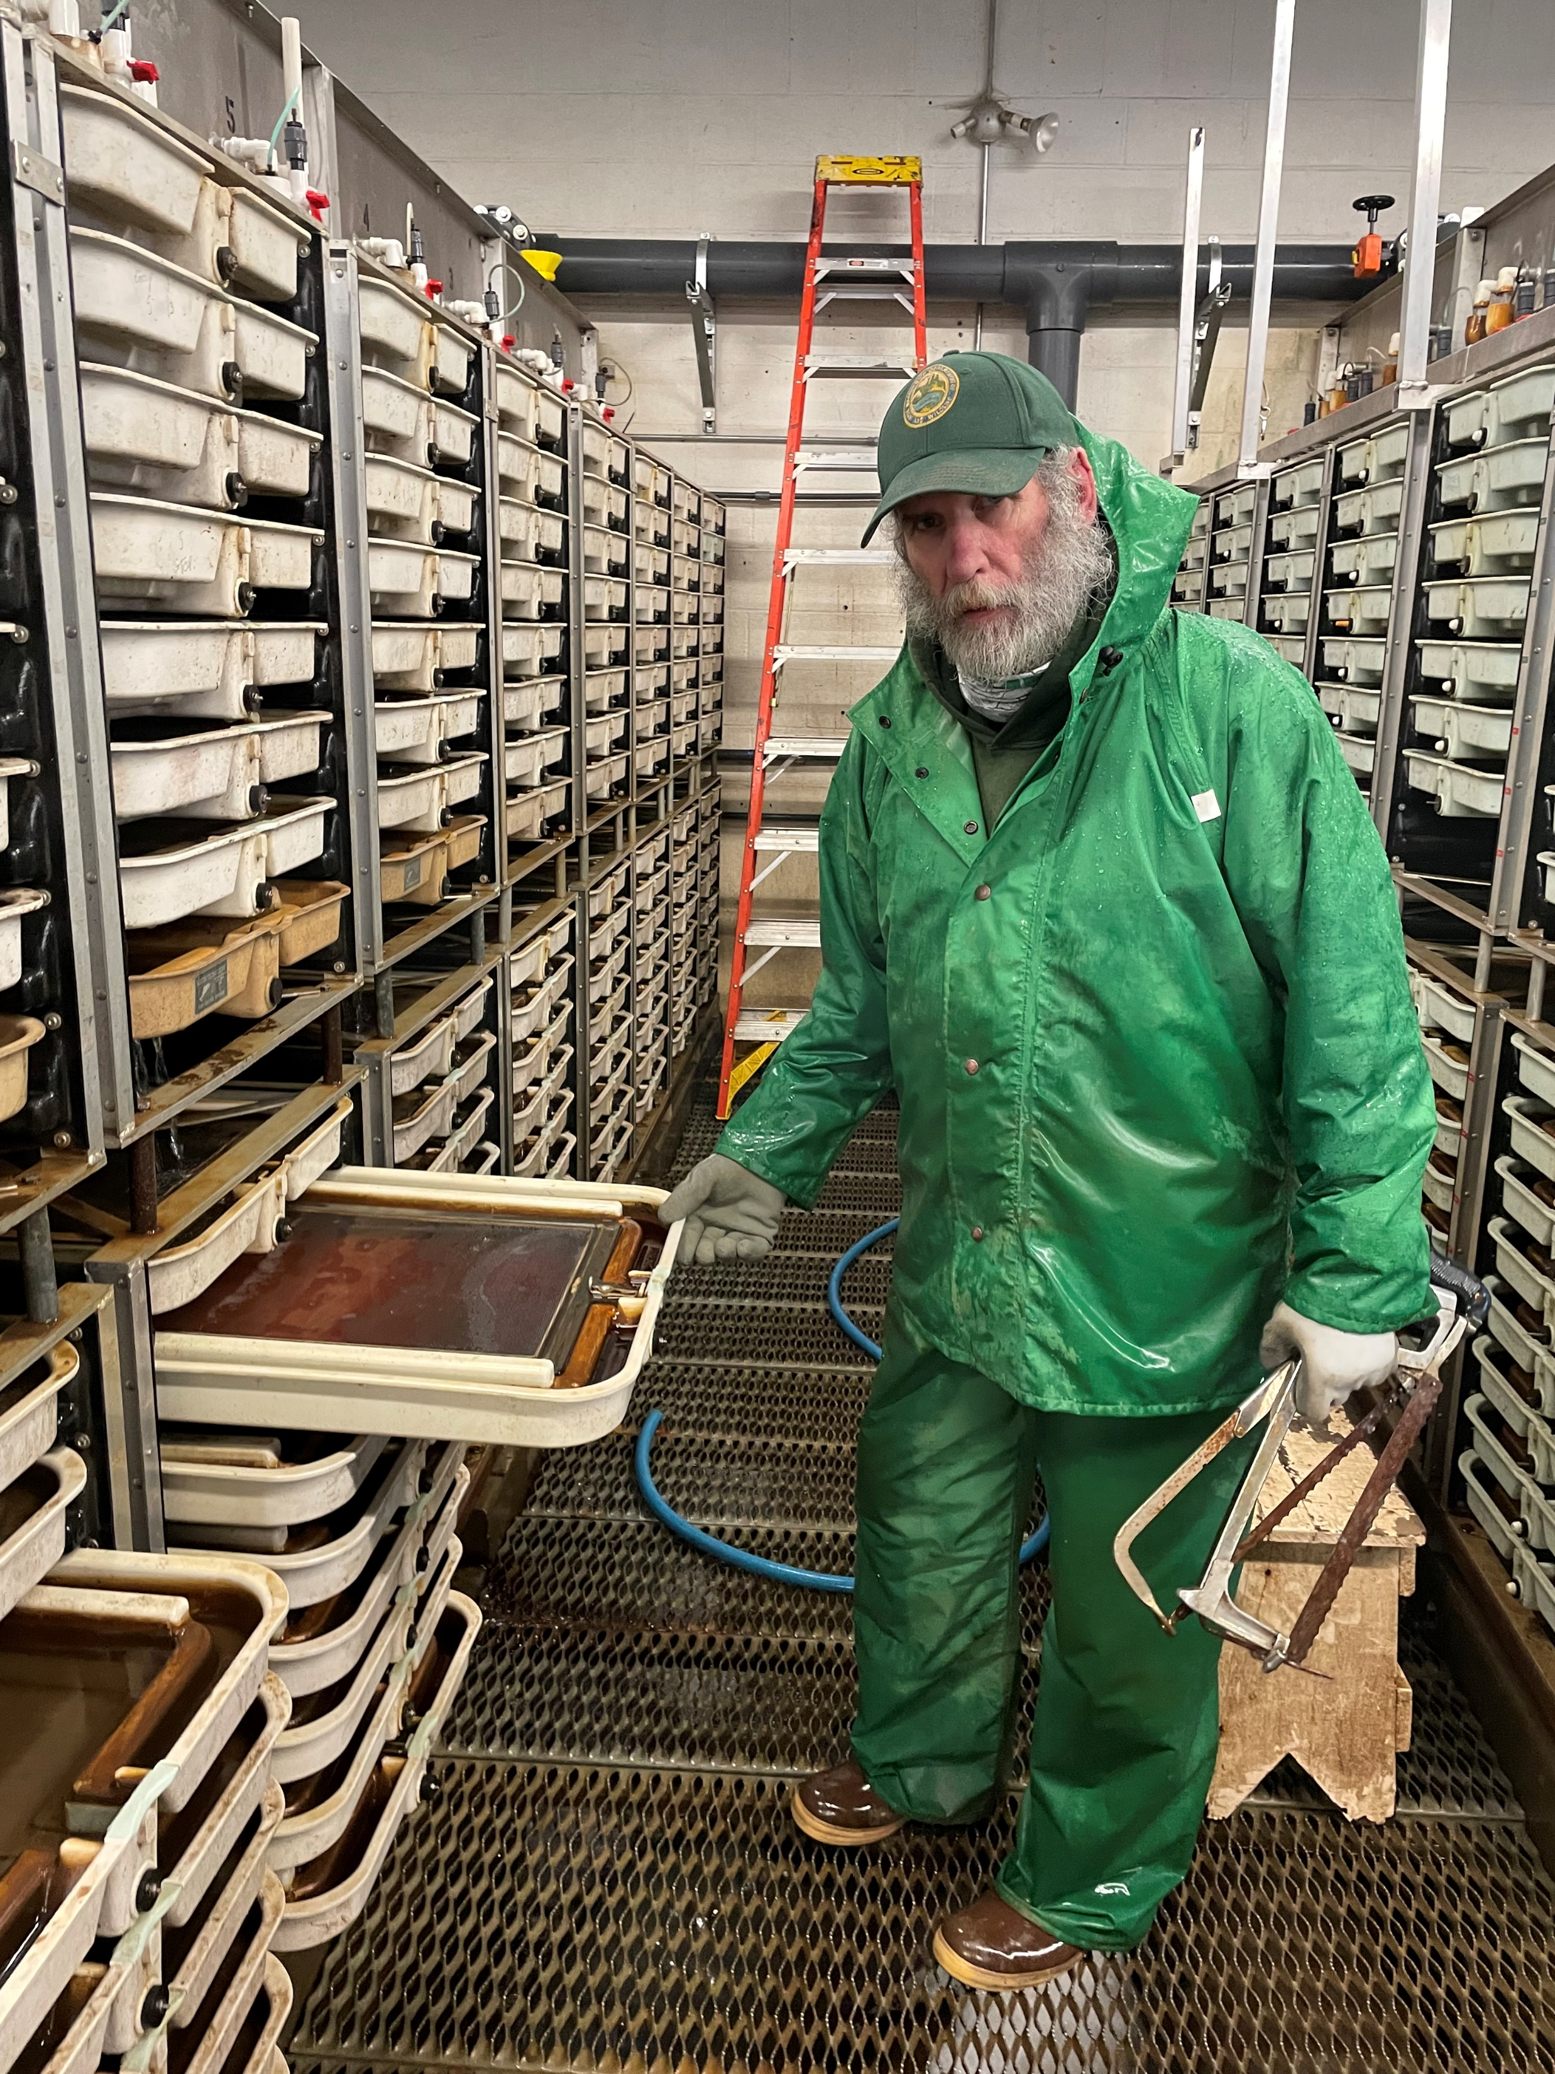
1
Coastal Steelhead Hatchery Program | Current Release Goal | Smolt survival range (RY 11/12-19/20)
Bogachiel EWS | 150,000 | 1.8%-9.8%
Bogachiel ESS | 30,000 | 0.8%-7.2%
Humptulips EWS | 125,000 | 0.6%-4.4%
Humptulips ESS | 30,000 | 0.6%-4.5%
Wishkah ESS | 15,000 | NA
Lake Aberdeen LWS | 170,000 | 0.9%-3.7%
Lake Aberdeen ESS | 60,000 | 0.6%-5.5%
Bingham Creek LWS | 55,000 | 0.8%-3.5%
Skookumchuck LWS | 75,000 | 1.0%-6.8%
Newaukum LWS | 30,000 | 0.0%-0.2%
Eight Creek LWS | 32,000 | 0.6%-1.0%
Forks Creek EWS | 45,000 | 0.6%-3.2%
Naselle EWS | 75,000 | 0.1%-1.8%
Total | 892,000

Slide 9
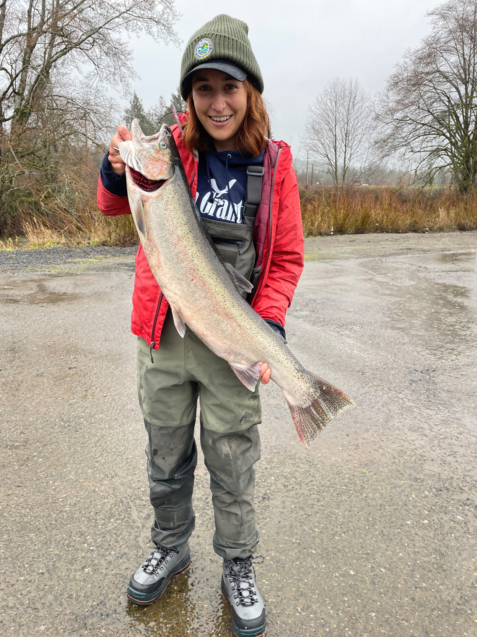
Fishery Overview
1
Tribal gillnet fisheries
Recreational catch and release fishery for wild steelhead
Public harvest-oriented fishery targeting hatchery steelhead
Various and variable gear restrictions
Commercial guide operations present, esp. on north coast
Recreational resident rainbow trout fishery allows retention w/limits

Slide 10
Management Guidance:
Statewide Steelhead Management Plan
1
Includes goals to maintain and restore Viable Salmonid Population (VSP) parameters: abundance, distribution, productivity, and diversity
Of VSP parameters, only sets specific goals for abundance relative to fishery escapement
  Runsize greater than escapement goal: Assure escapement goals are met
  Runsize less than escapement goal: Minimize mortality to wild stock(s); in no case exceed a 10% impact from all fisheries
Identified importance of but does not dictate specific long-term conservation objectives
Limits allowable hatchery genetic impacts; measures include pHOS, PNI, and geneflow

Slide 11
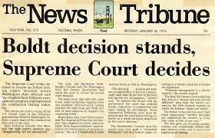
Harvest Control Rule: Escapement Goals
1
Escapement goals developed in early 1980s following the Boldt decision (1974)
Used Potential Parr Production method (Gibbons et al. 1985): available habitat w/modified Beverton-Holt
Steelhead MSY re-evaluated in north coast rivers (Ohlberger et al. 2017)

Slide 12
1
River Specific Regulation Options
Data used:
spawner-recruit relationships
age structure
Scenario:
Forecasted below escapement
Forecasted at or above Escapement
Forecasted “significantly” below escapement
Goal:
In no case exceed 10%
anticipated direct & indirect mortality
Meet or exceed Escapement
Unable to stay below 10%
spatial distribution & run timing
Options:
Diverse, including Status Quo
Reduced Season and/or Gear Restrictions
Fishery Closure
→ Maximizing opportunity within escapement goals
…problematic?
…especially given climate change.

Slide 13
Talk Overview
2
Coastal steelhead population and management information
The Coastal Steelhead Proviso Implementation Plan (CSPIP)
3 ways collaboration and public engagement made the CSPIP development successful

Slide 14
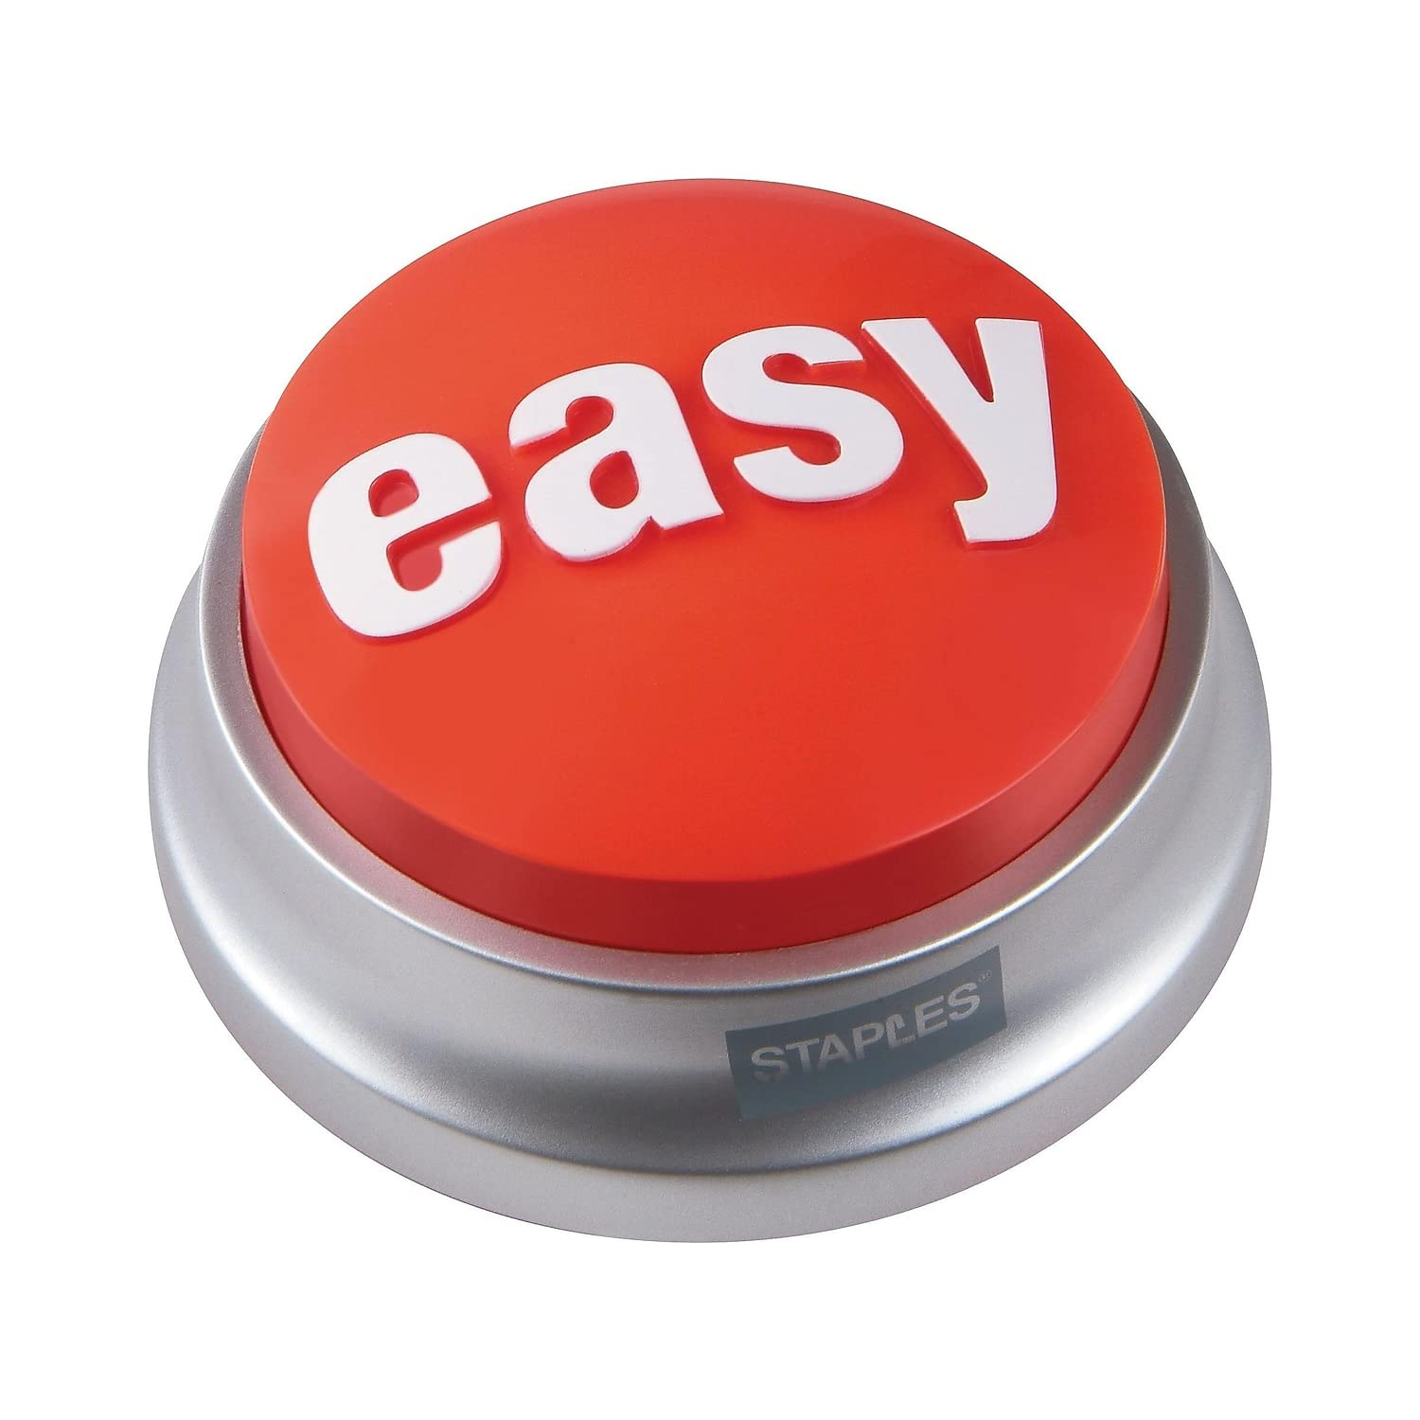
Coastal Steelhead Proviso Implementation Plan (CSPIP): Full Proviso Language
2
$200,000 of the general fund—state appropriation for fiscal year 2022 and $100,000 of the general fund—state appropriation for fiscal year 2023 are provided solely for the department to develop a plan to protect native and hatchery produced steelhead for each river system of Grays harbor, Willapa bay, and coastal Olympic peninsula. The plan must adequately protect those fisheries for healthy runs year-after-year as well as provide reasonable fishing opportunities. The plan must include active stakeholder input and include an outreach strategy sufficient to keep conservation and angler interests well informed of proposed changes in advance of annual fishing seasons. The plan must be reported to the appropriate committees of the legislature by December 1, 2022.

Slide 15
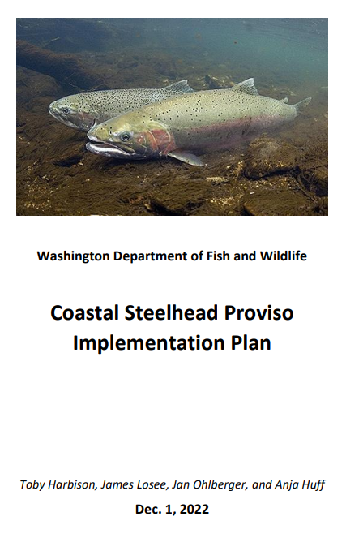
CSPIP: Overview
2
Supports the SSMP
Strategy addresses 5 subject areas: Monitoring and Evaluation, Fisheries Regulations, Hatcheries, Habitat, Human Dimensions
Applies strategy to major rivers + independent streams
Adaptive management framework
Creates pathway to carryout Management Strategy Evaluations
$5.9M budget, mostly M&E

Slide 16
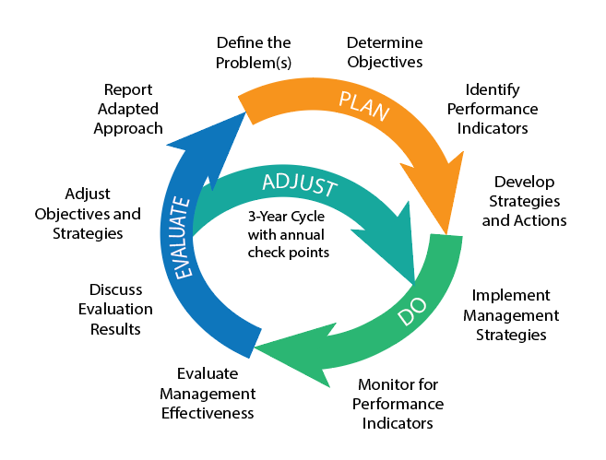
CSPIP Inspiration: From Linear to Adaptive
2

Slide 17
CSPIP: Plan
2
Complete the CSPIP
Problem: declining wild runs and angling opportunities
Objectives: long-term viable wild populations and sustainable hatchery runs, provide opportunity
Indicators: VSP parameters
Strategies and actions: management regimes shift based on wild runsize

Slide 18
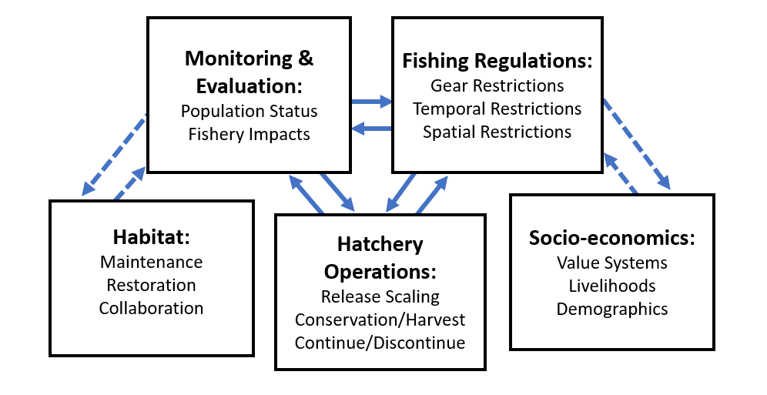
2

Slide 19
2
 | Maintenance | Transitional | Emergency
Wild Steelhead Thresholds | Population forecasted to meet or exceed escapement goal and/or other management thresholds | Population forecasted to be lower than escapement goal and/or does not meet other management thresholds but fisheries still feasible within management objectives | Population forecasted to be lower than escapement goal and/or does not meet other management thresholds; managers unable to design a fishery that will confidently meet management objectives
Monitoring and Evaluation | Ensure standard monitoring and evaluation guidelines are met | Increase the resolution and/or distribution of sport fishery monitoring and VSP data collection above the standard | Increase the resolution and/or distribution VSP data collection above the standard
Fisheries Regulations | Follow 3-Step Regulation Process Provide diverse angling opportunities within management objectives, designed considering all VSP parameters | Follow 3-Step Regulation Process Provide diverse angling opportunities within management objectives After 3 of 5 years in Transitional: Hatchery-Targeted Fisheries preceding fishery limitations or closures | Recreational fishery closure
Hatchery Operations | Design hatchery operations to provide angling opportunity, remain within genetic thresholds and minimize ecological impacts | Design hatchery operations to remain within genetic thresholds and minimize ecological impacts After 3 of 5 years in Transitional: Hatchery Equilibrium Protocol | Hatchery Equilibrium Protocol Prioritize conservation hatchery research Possible program discontinuation

Slide 20
2

Slide 21
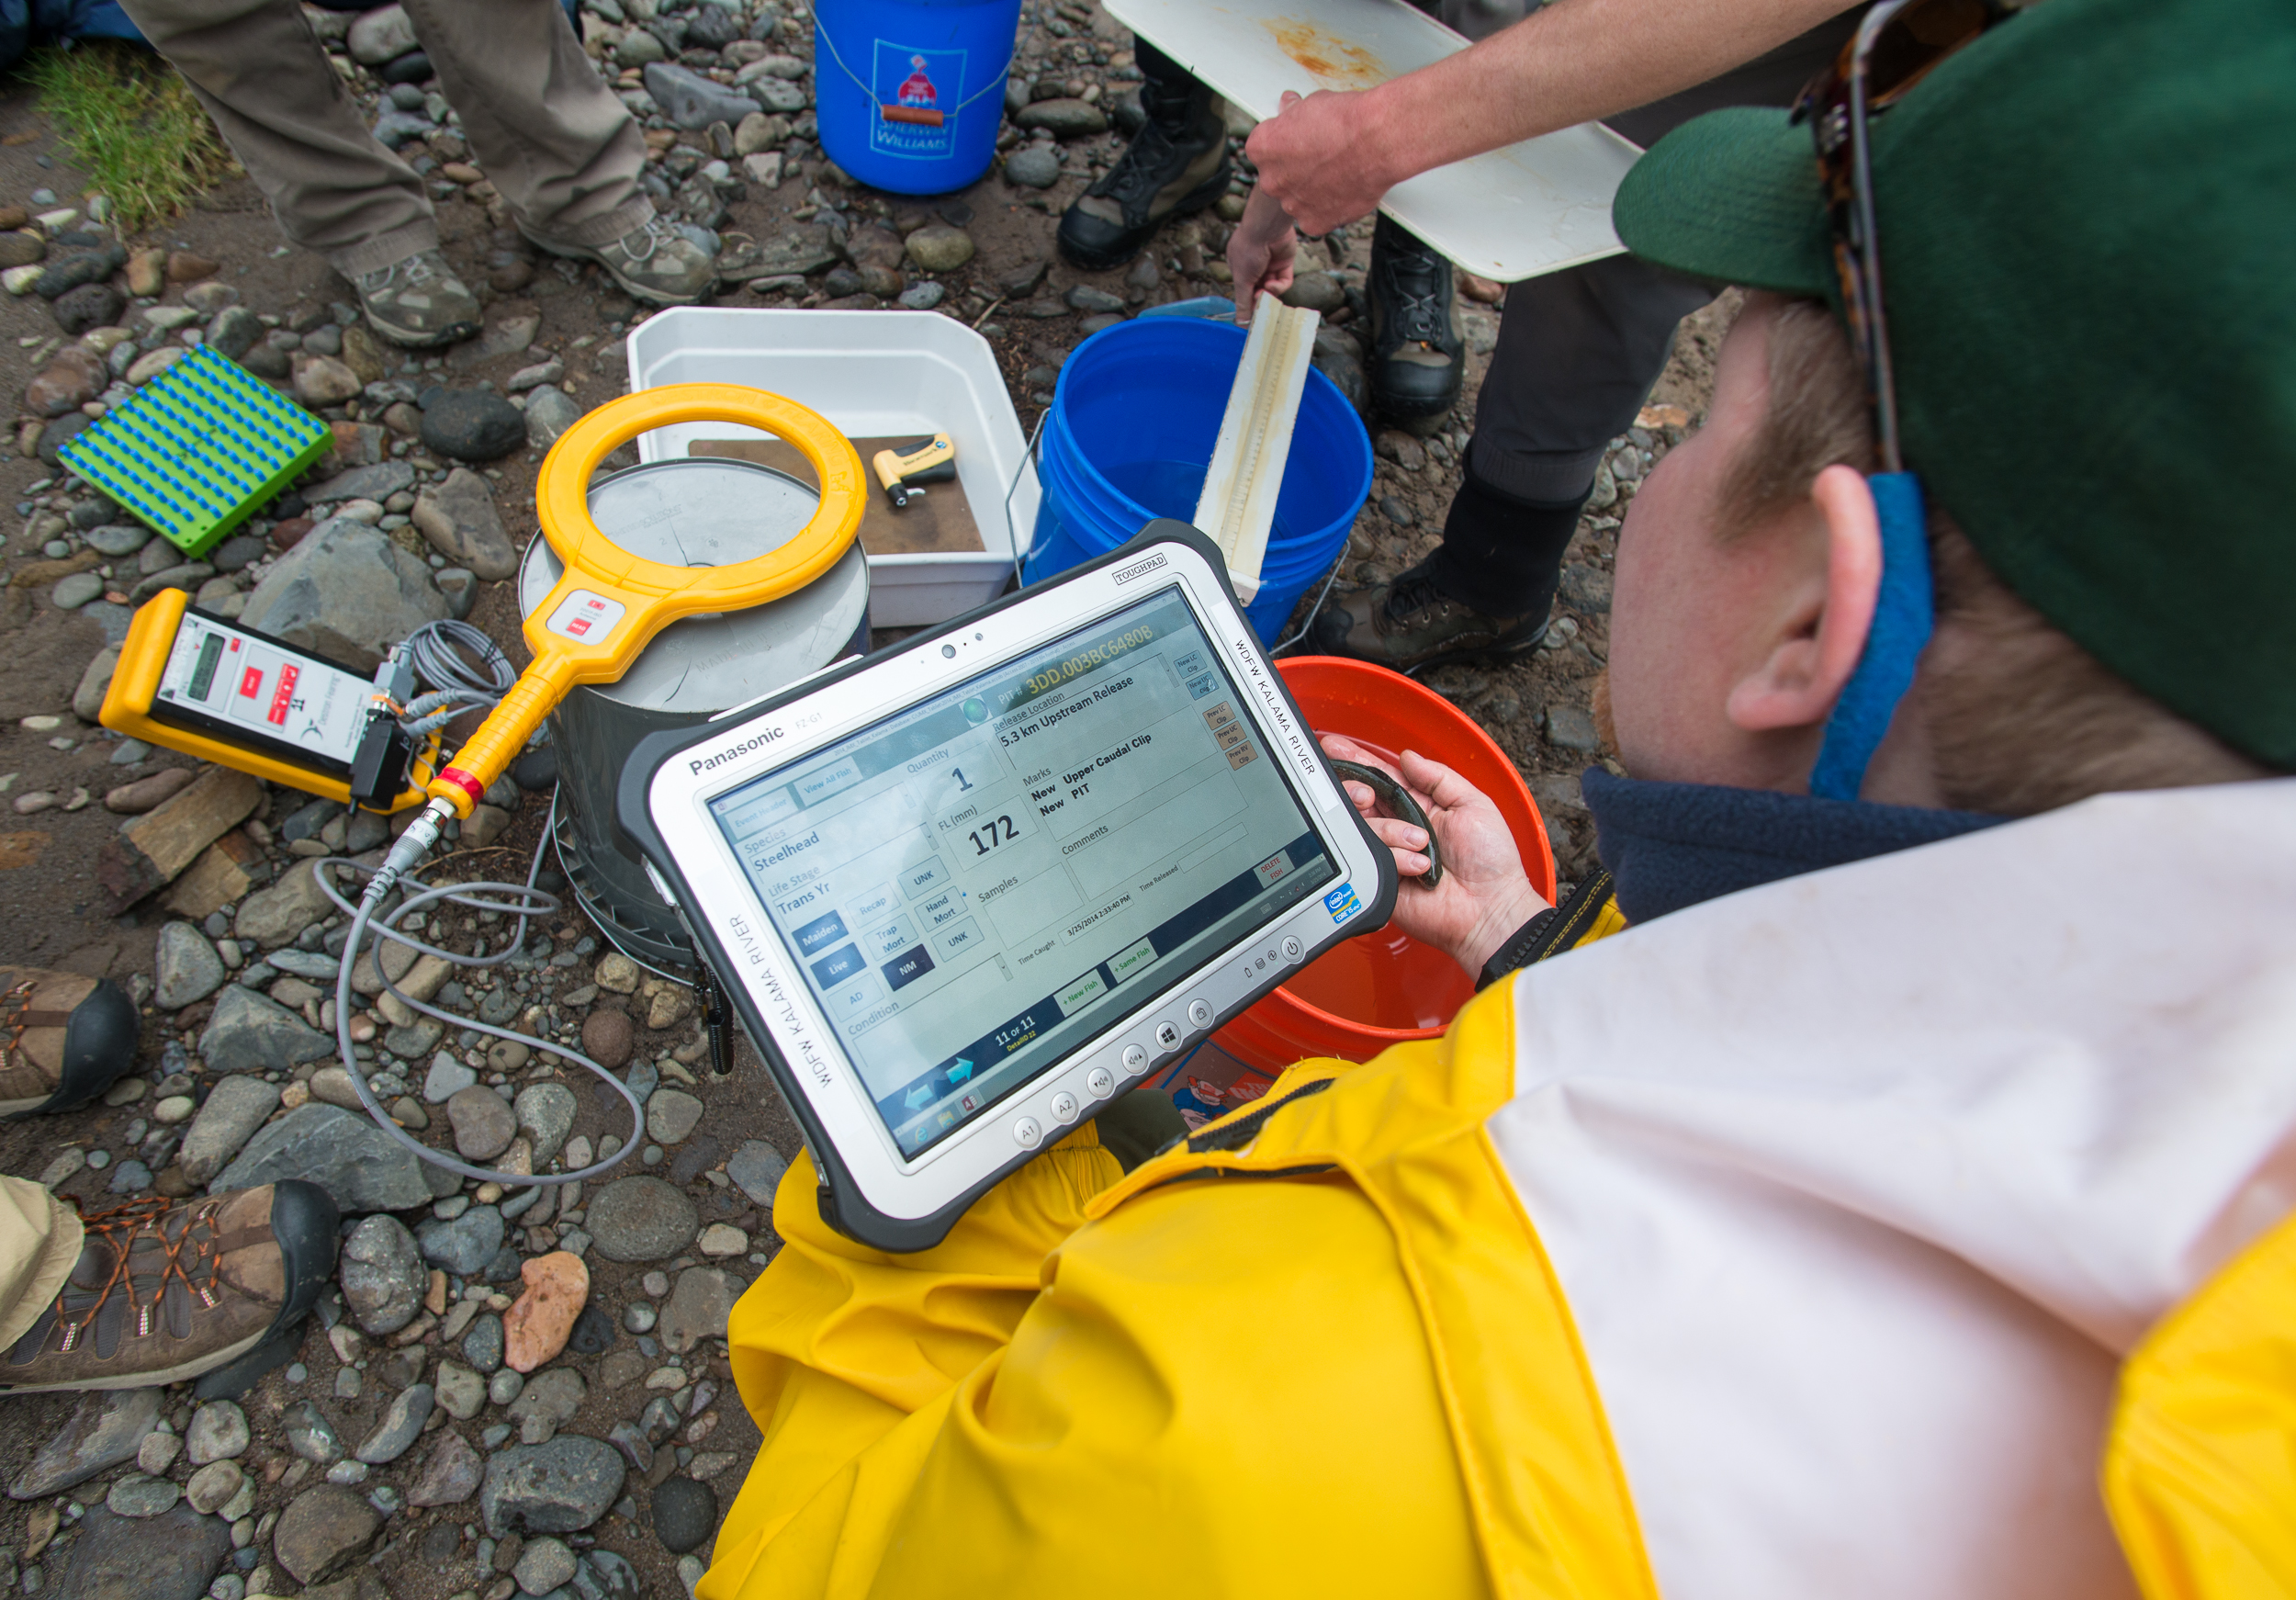
CSPIP: Do
2
Implement management strategies: begins in the 2023-2025 fiscal biennium period, starting in July
Classify rivers as Maintenance, Emergency, Transitional
Monitor for performance indicators: Coast-wide increase in M&E
  Expanded spawning ground surveys, creel, genetics, age-structure, research

Slide 22
2

Slide 23
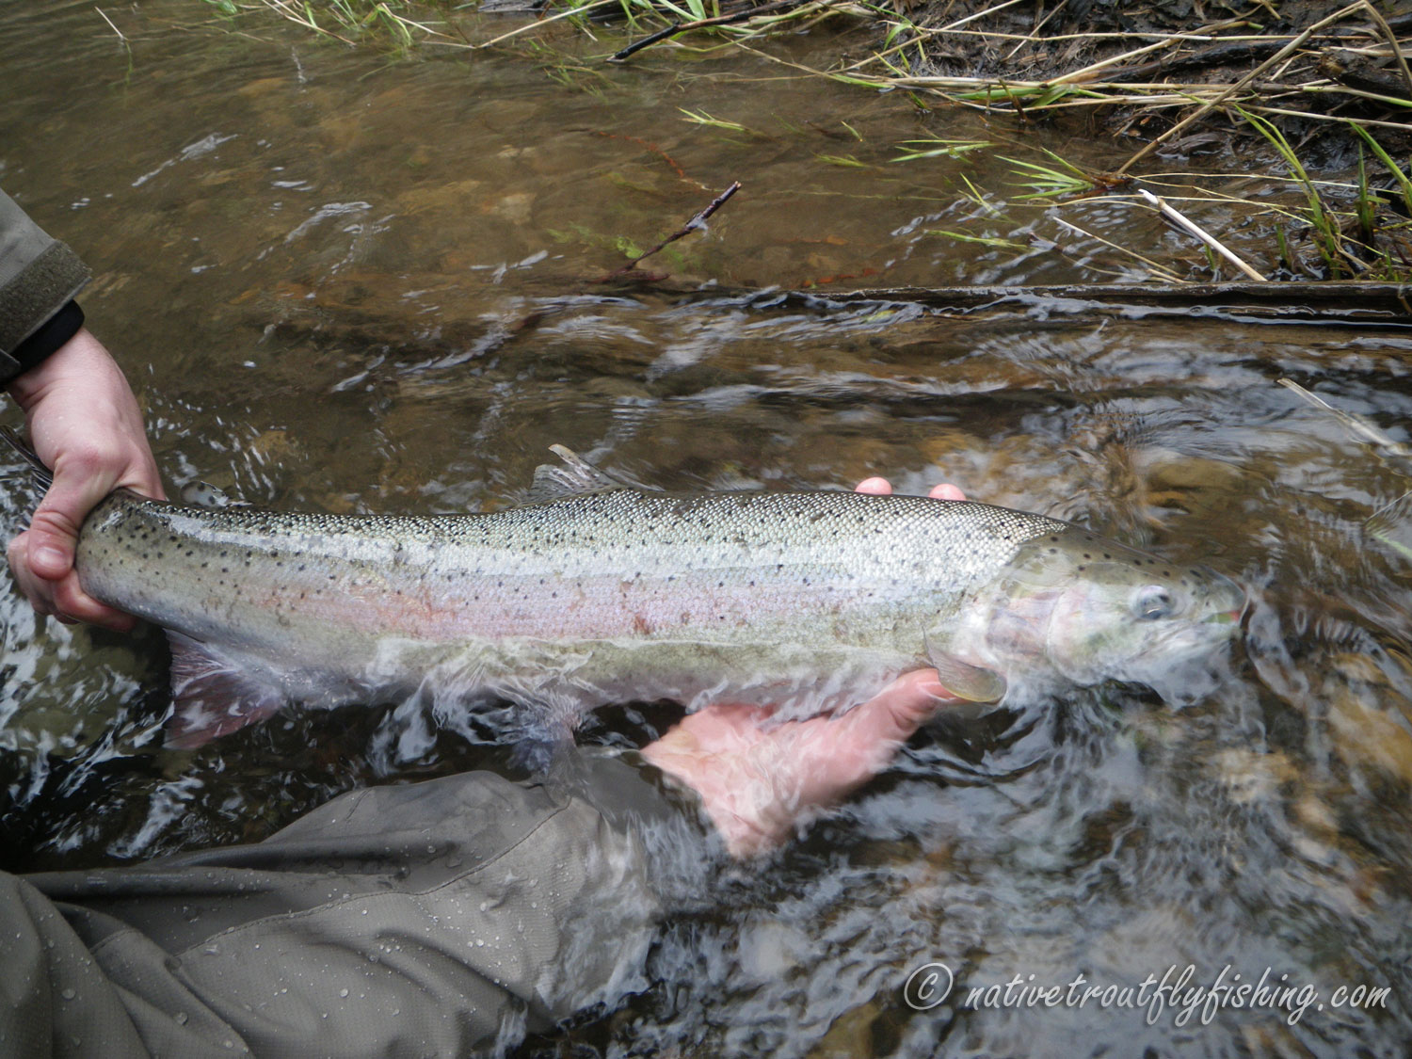
CSPIP: Evaluate
2
Evaluate management effectiveness
  Fishery/runsize performance relative to goals
  Conduct Management Strategy Evaluations to assess harvest control rules
Discuss evaluation results: internal and external partners
Adjust objectives and strategies
Report updated approach: Regional Management Plans
Photo courtesy of Gary Marston

Slide 24
2
 | Sustaining | Maintenance | Transitional | Emergency
Regime Thresholds (Multiple VSP Parameters)
Monitoring and Evaluation |  | This is a potential conceptual framework. Cells are intentionally left blank.
Fisheries Regulations
Hatchery Operations
Add fourth regime
“Sustaining” regime to contain long-term conservation objectives
Set specific goals and thresholds for multiple VSP parameters

Slide 25
2

Slide 26
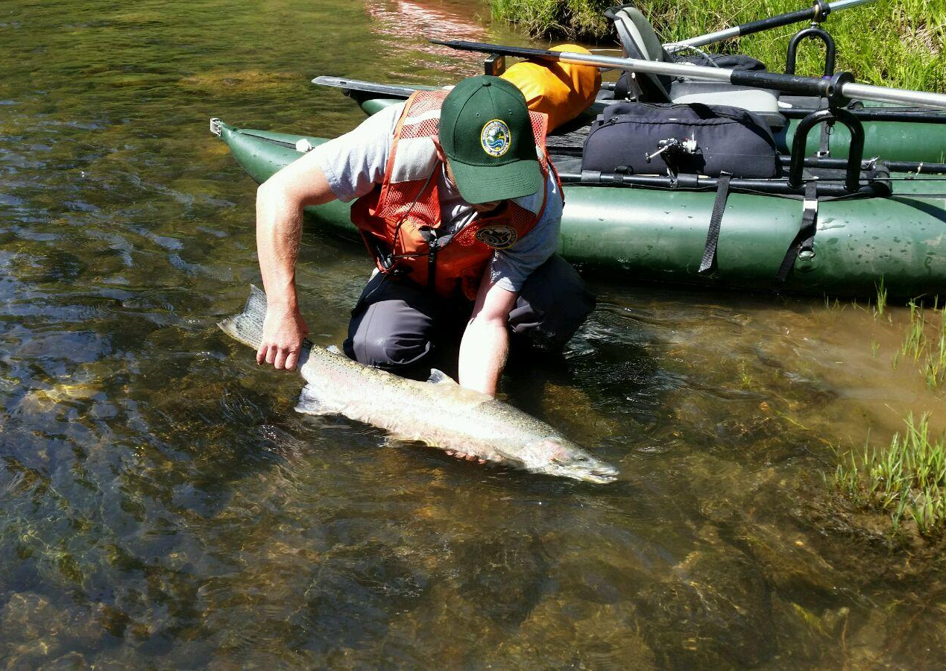
CSPIP: Adjust
2
3-year cycle with annual check-points:
  Every other biennium plan for the following biennium. Ex. In 2025/27 plan for 2027/29 (RMP development)
  Pre-fishery season check-points every fall
Collaboration w/co-managers and stakeholders
ESA listing?

Slide 27
Talk Overview
3
Coastal steelhead population and management information
The Coastal Steelhead Proviso Implementation Plan (CSPIP)
3 ways collaboration and public engagement made the CSPIP development successful

Slide 28
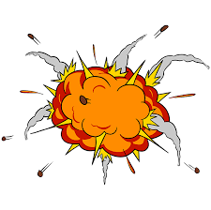
3
Multiple Perspectives
Conservation
Groups
Angling Public
Federal Agencies
Scientists
Conflict?
PROGRESS!
State Agencies
Tribal Co-Managers
Within-Agency Divisions

Slide 29
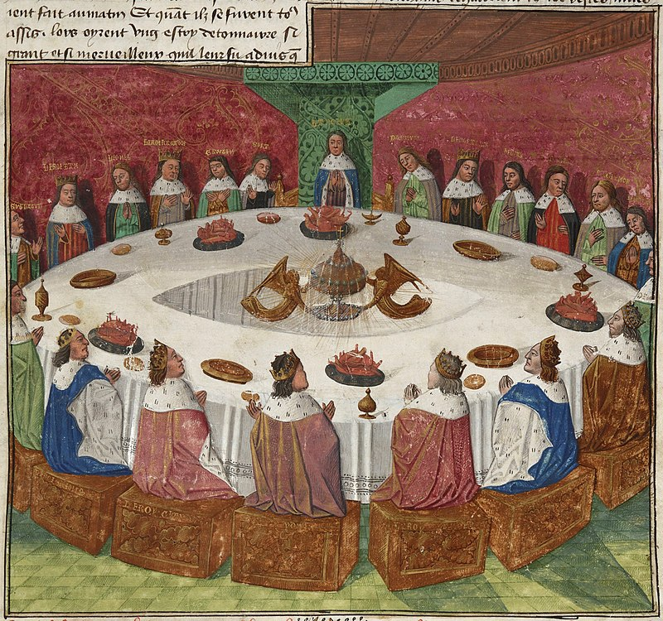
#1: Collaboration takes advantage of multiple areas of expertise!
3
Fisheries regulations and M&E: District bios, Amy Edwards, Jan Ohlberger, Thomas Buehrens
Hatcheries: Anja Huff and Gary Marston (HEAT Unit), Rob Allan, Joe Coutu
Habitat: Habitat Division, Mara Zimmerman (Coast Salmon Partnership)
Human Dimensions: Leif Anderson and Robby Fronner (NOAA), David Trimbach
And many more!

Slide 30
#1: Collaboration takes advantage of multiple areas of expertise!
3
AND YET!
Important to have strong leadership to coordinate between collaborators and engage in strategic planning (me and James Losee)
Oversight of leadership to ensure adherence w/agency and division mission (Craig Burley and Kelly Cunningham)

Slide 31

#2 Public comment highlights communication gaps and common perspectives
3
The public holds fisheries managers accountable
Notice themes in comments:
  “Broodstock” hatchery programs
  Catch and release mortality
Public affairs staff can tailor communications accordingly
Transparency builds trust and stewardship
https://www.bbklaw.com/news-events/insights/2018/authored-articles/12/public-comment-time-limit-ok-d-by-court

Slide 32
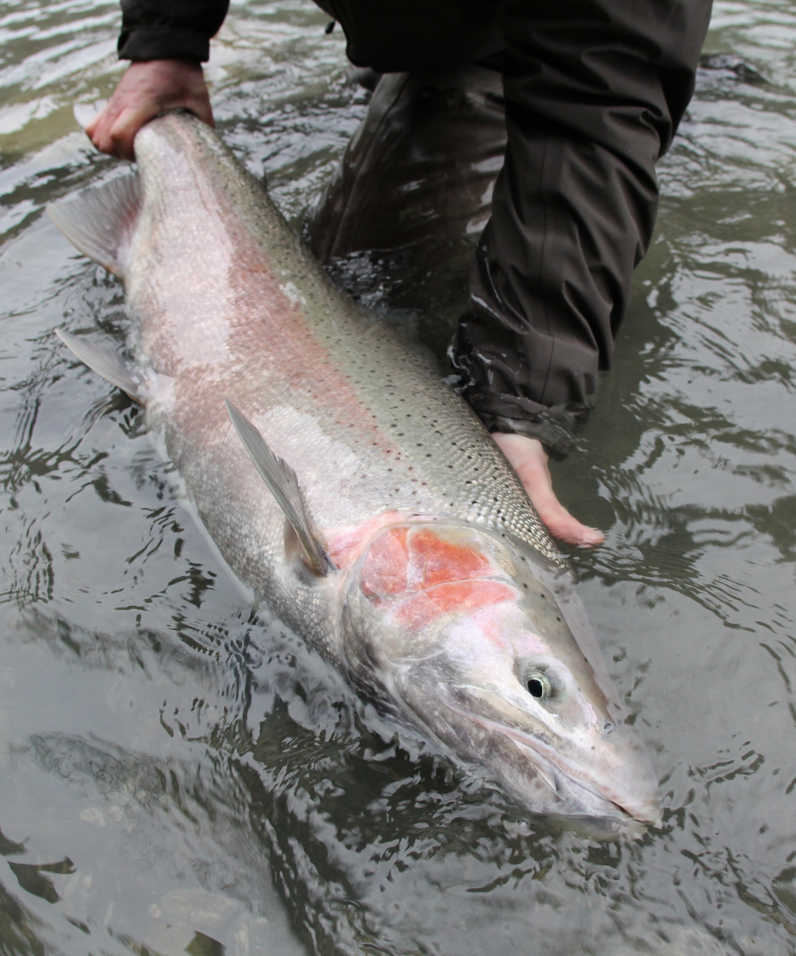
#3 Many reviewers improve the final product
3
Having an audience of reviewers helps:
  Motivation
  Breaking up large tasks into smaller ones
  Adherence to timeline
Ad-Hoc Coastal Steelhead Advisory Group advised/reviewed each section
Formal comment response matrix and “tracked changes” drafts → accountability & communication
Best chance at balance
Photo courtesy Andrew Fowler

Slide 33
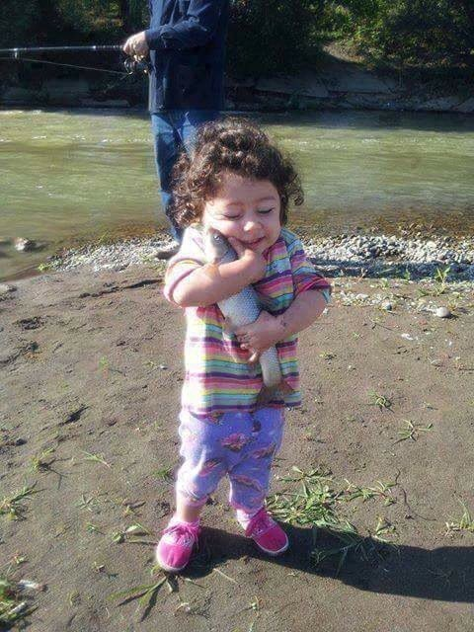
#3 Many reviewers improve the final product
3
BE LIKE HER
AND YET!
Too much feedback can be overwhelming, time consuming
Prioritize short-term and long-term feedback needs, communicate ASAP
Ask to get reviews back at least one month before you think you’ll need them
Remove ego from the process, be willing to change/adapt/rethink
…unless that’s a wild steelhead.
https://www.reddit.com/r/pics/comments/54ak0y/be_as_happy_as_this_kid_hugging_a_fish/

Slide 34
Thank you!
Toby Harbison
Research Scientist, WDFW Region 6
toby.harbison@dfw.wa.gov

