Slide 1
Washington’s Approach to Managing Columbia Basin Summer Steelhead Fisheries During Times of Depressed Adult Returns
Chris Donley
WDFW Region 1 Fish Program Manager

Slide 2
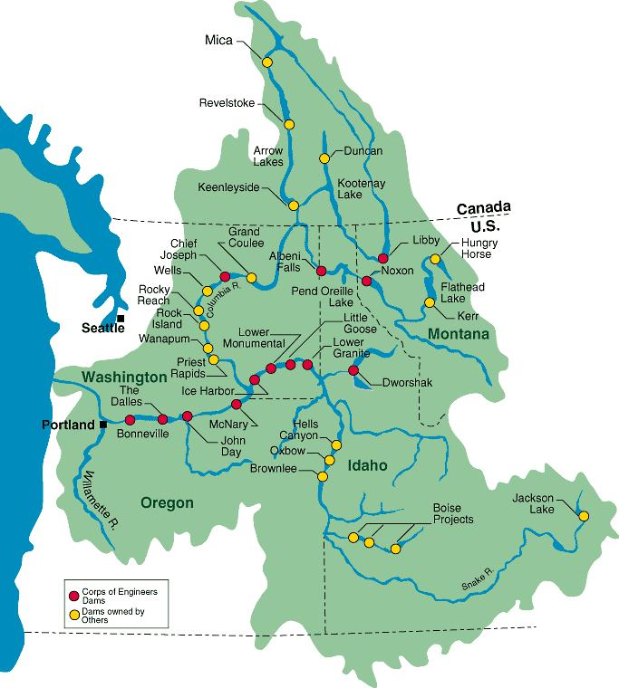
Overview
Review Columbia Basin summer steelhead fisheries management approaches and challenges
  Pre 2017
  Post 2017
  Conclusions
  Future Direction
  Spatial Orientation
  Lower Columbia
    Mouth to Bonneville Dam
    Bonneville Dam to McNary Dam
    Thermal refugia
  Mid- Columbia
    McNary to Priest Rapids Dam
    Priest Rapids to Chief Joseph
  Snake River
    Mouth to Idaho/Oregon Border

Slide 3
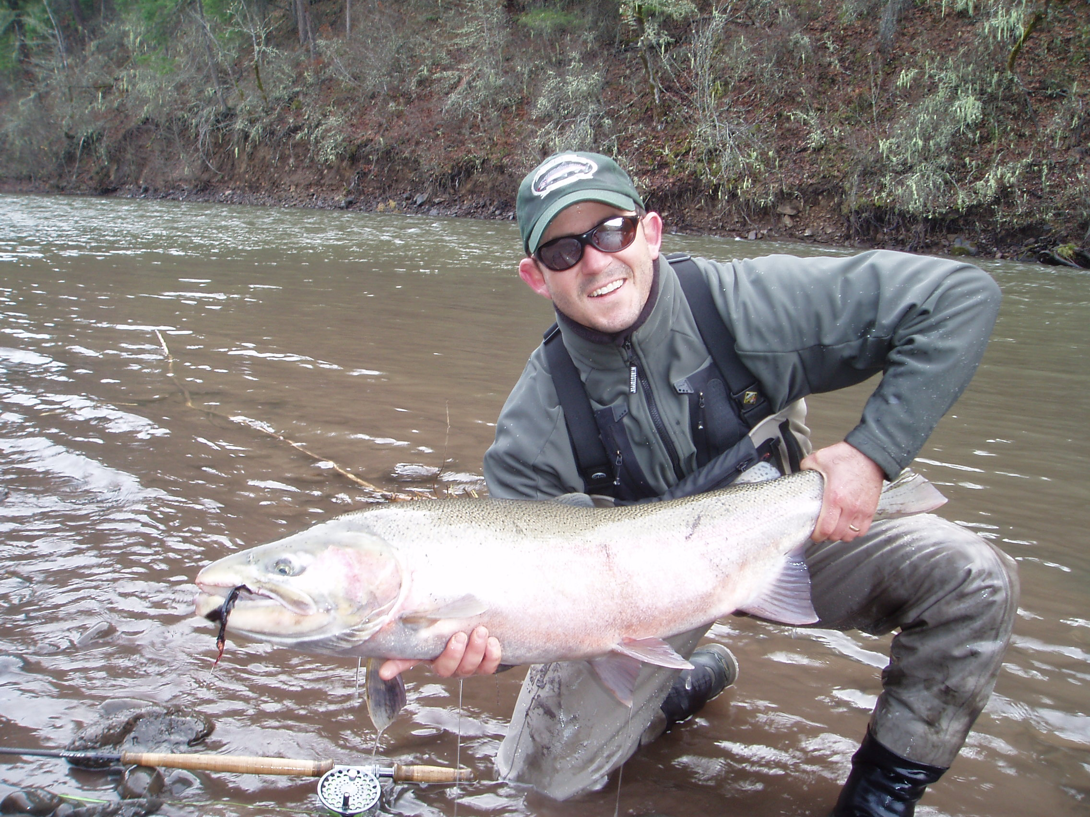
WDFW Mission
To preserve, protect and perpetuate fish, wildlife and ecosystems while providing sustainable fish and wildlife recreational and commercial opportunities
Within the Columbia basin, shared stewardship responsibilities (US v OR) with Oregon, Idaho and multiple Treaty Tribes

Slide 4
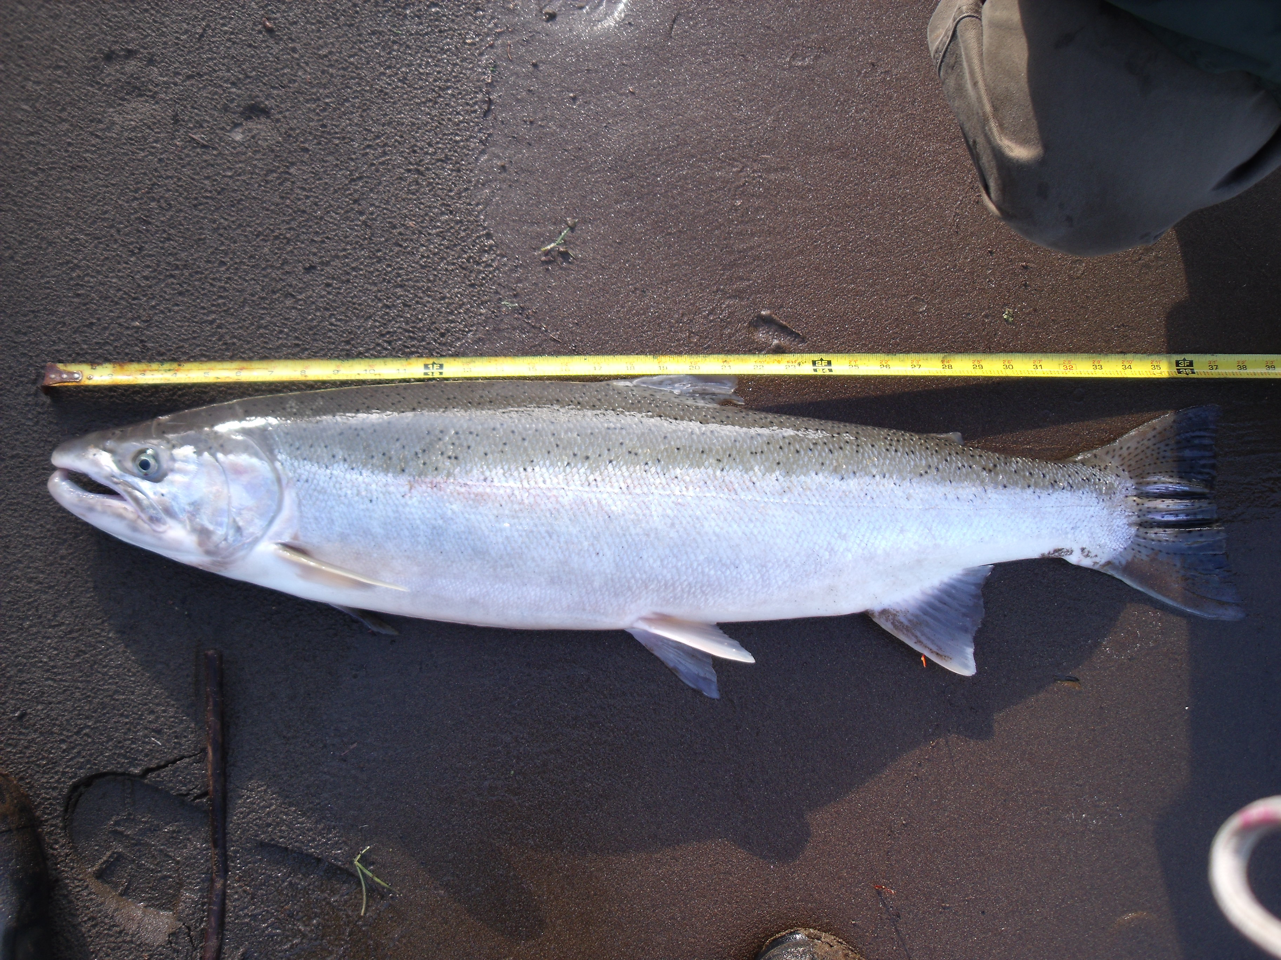
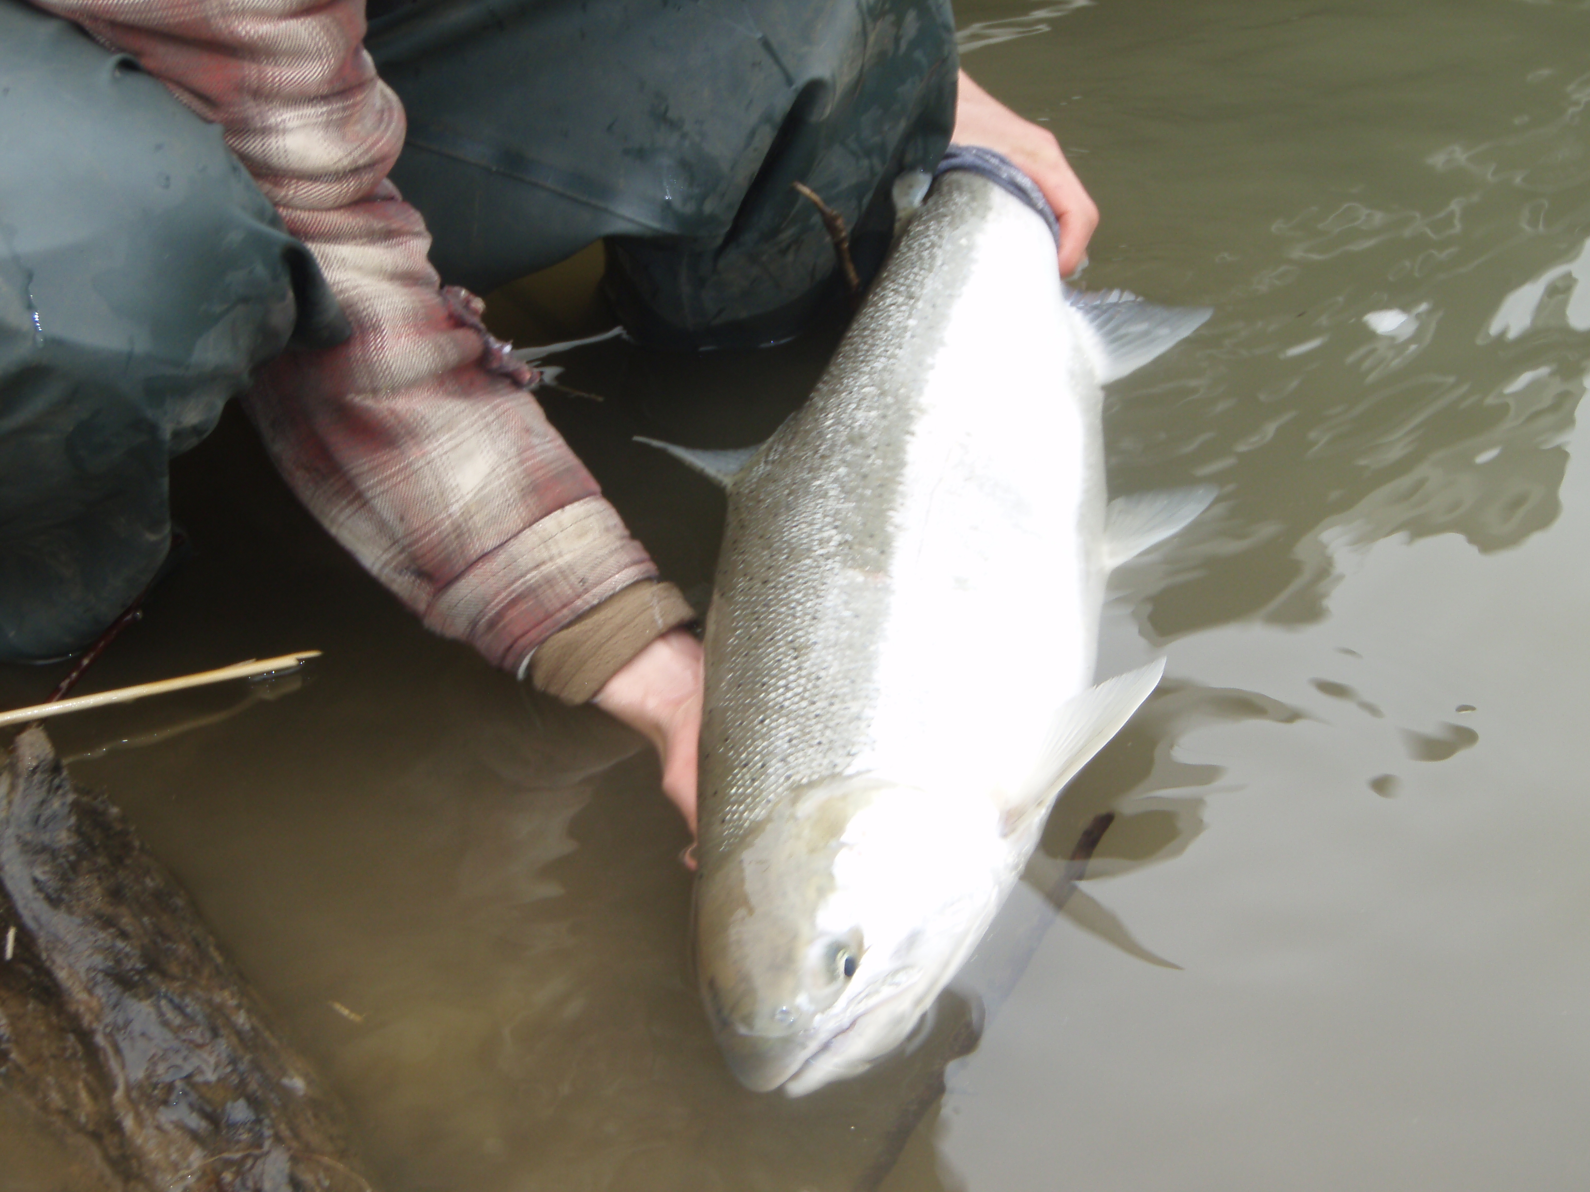
Season setting process
Seasons set based on preseason forecast
  Forecast is agreed upon by States and Tribes through US v OR
  Mainstem Columbia up to McNary coordinated with Oregon
  Mainstem Snake coordinated with Idaho
Forecasts and anticipated fisheries are vetted through an annual public process.
  Embedded in the salmon season process known as North of Falcon
    Public testimony collected multi-modally

Slide 5
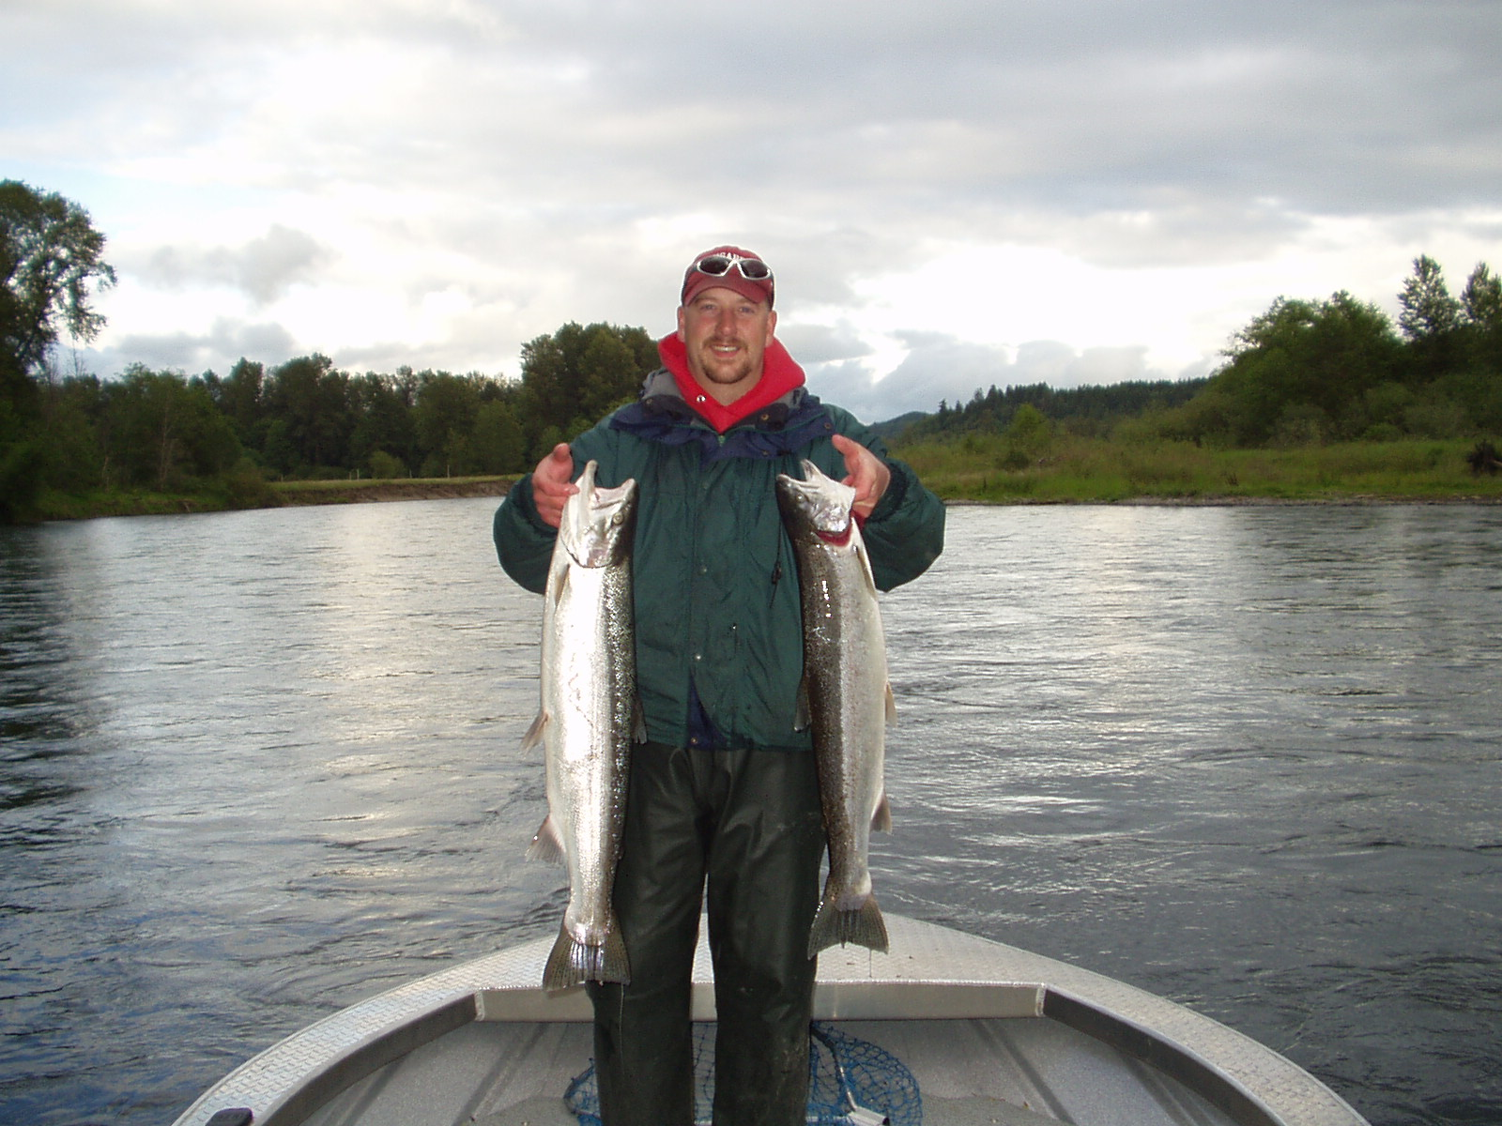
Over Arching Framework
No saltwater exploitation, control impacts by how fisheries are designed in freshwater
Summer steelhead are ESA listed as threatened, requires federal fishery permits
Allowable impact rates:
Below Bonneville Dam – 2%
  Split between recreational and commercial
Bonneville to McNary - 2%
Snake River - 2%

Slide 6
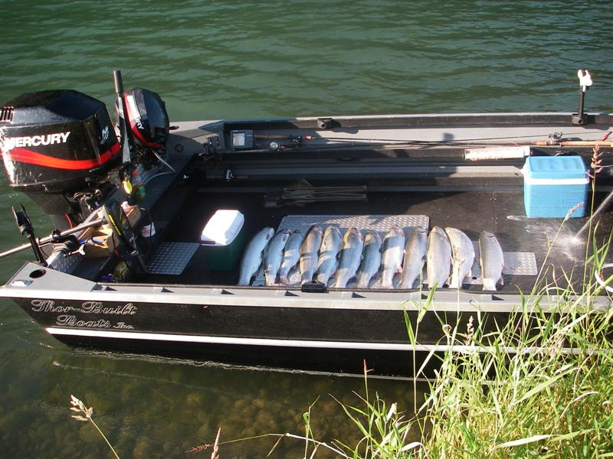
“ Normal” Fishery Paradigm
Adult returns of A-index and B-index steelhead >125,000 fish. Component of B-index wild and hatchery >10,000 combined.
Below Bonneville –
May 16 - March 31 – 2 hatchery fish daily limit
Full commercial salmon fishery
Major Tributaries open year-round – same harvest rules as mainstem
Minor Tributaries – rules are shaped to be protective of wild winter/summer steelhead and out migrating smolts. If hatchery fish present, harvest rule similar to major tributaries
Bonneville to McNary (including thermal refugia areas)
June 16 – March 31- 2 hatchery fish daily limit
Tributaries – aren’t many (it’s a desert you know), rules are similar to mainstem or are catch and release only for wild Skamania strain summer steelhead
Above McNary
Emergency rules/no published season. Bubble exception at Ringold Springs
Mainstem and tributaries above Priest Rapids are opened conditionally (discuss later), some closed for decades
Snake River
Mainstem - September 1-March 31-3 hatchery fish daily limit
Tributaries – September1 until April 15, 3 hatchery fish daily. Extended season facilitates increased harvest of hatchery steelhead at terminal areas
Entire basin (mostly) - Closed for ~ 2.5 months to be protective of out-migrating smolts and kelts

Slide 7
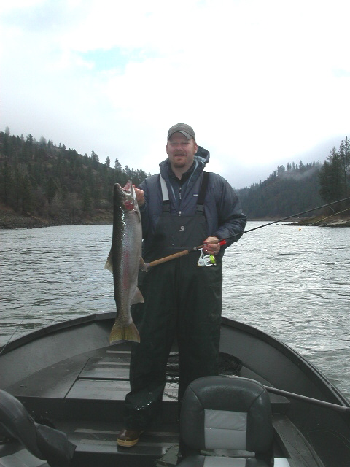
Fishery modifications 2017-2023
Adult returns of A-index and B-index steelhead <125,000 fish. Component of B-index wild and hatchery <10,000 combined.
  In the absence of sufficient adult abundance to support “normal” fisheries, invoke the Precautionary Principle
Objectives:
Ensure maximum survival of sensitive wild stocks or weak hatchery brood returns destined for the middle and upper basin
Increase or maintain passage conversion rates from Bonneville to Lower Granite or Priest Rapids
Reduce conservation risk in areas where steelhead are highly concentrated and subject to possible over exploitation
Harvest surplus hatchery steelhead in terminal areas to provide mitigation benefit and reduce risk of hatchery fish on the spawning grounds

Slide 8
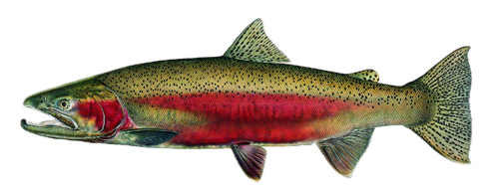
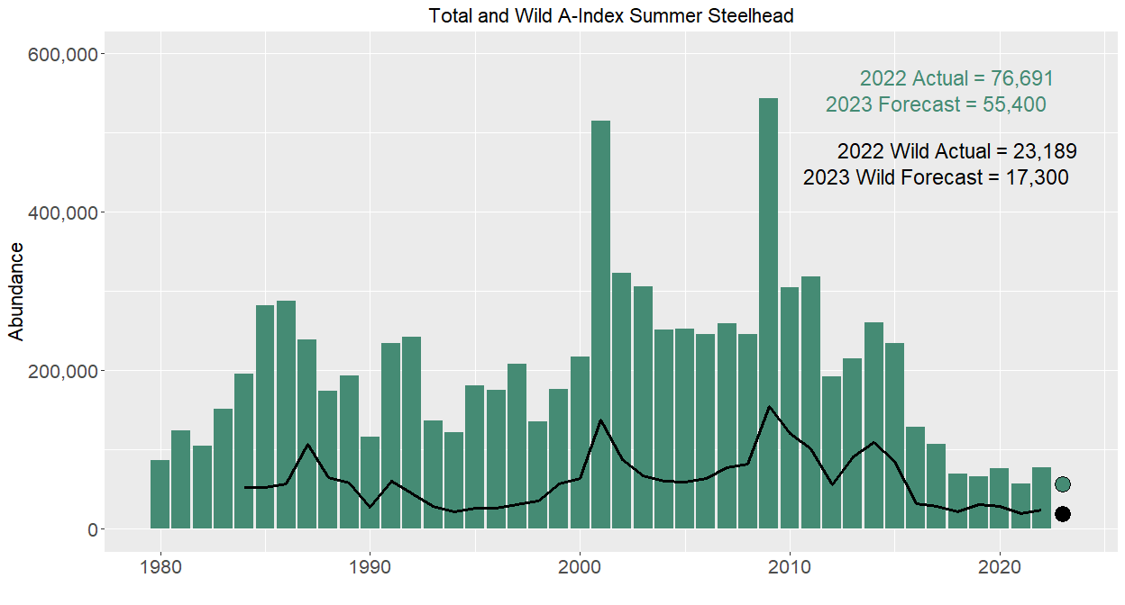
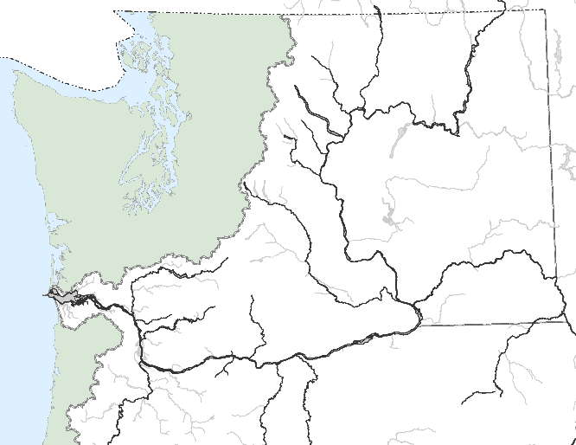

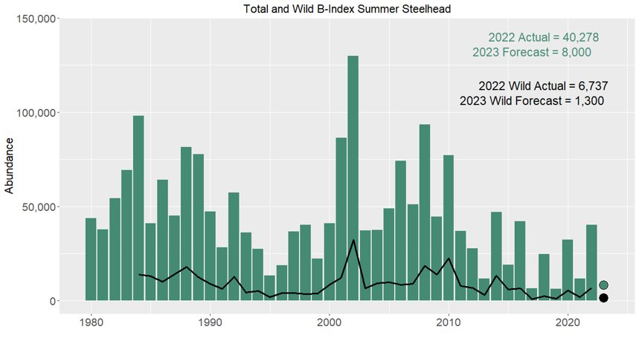
Steelhead Returns 2017-2023
Tomelleri
A-index
Wild A-index
A-index
B-index
A-index
Wild B-index
Includes hatchery and wild combined
Notes:
-

Slide 9
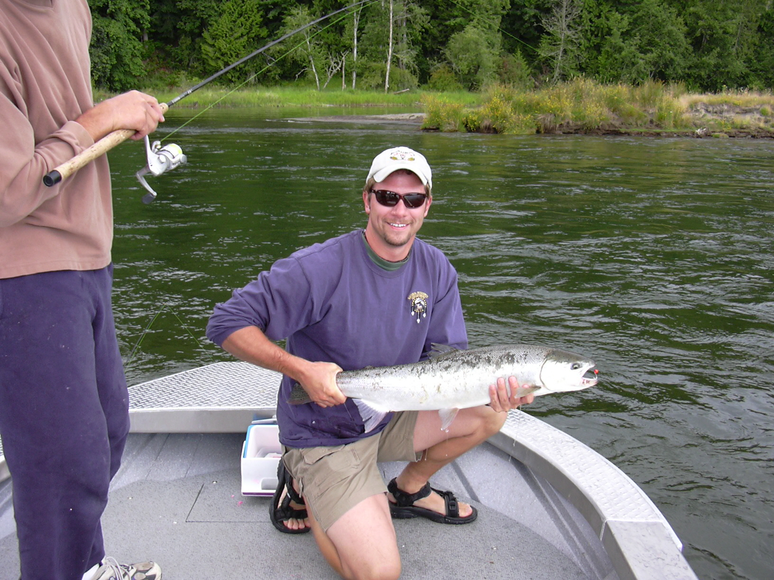
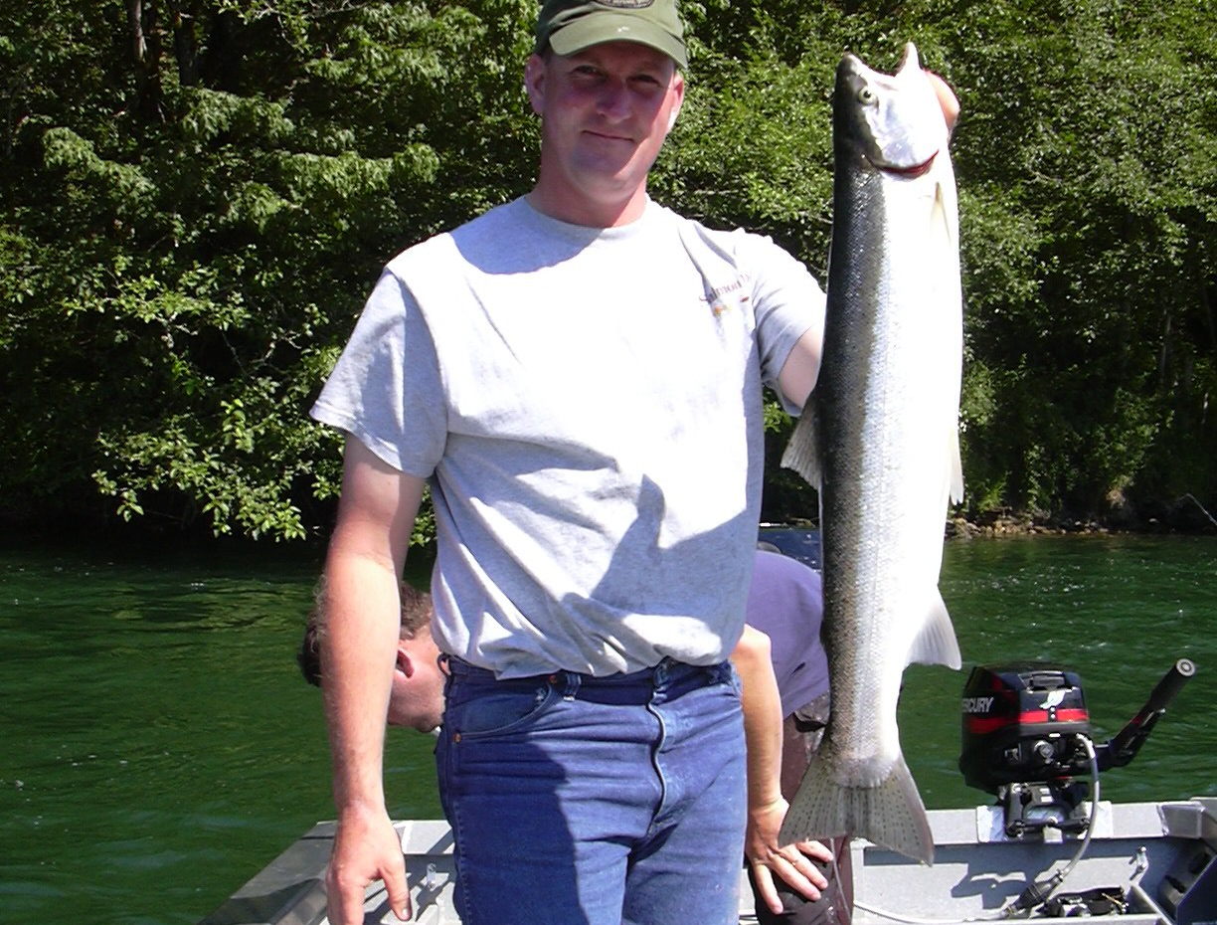
Below Bonneville
2017-2023
Stay within the allowable 2% impact on wild A-index and wild B-index steelhead
Shortened season – May 16- July 31 complete closure August 1- October 31
Limit reduced to 1 hatchery fish daily
Major Tributary rules not adjusted –not warranted from a conservation standpoint (thermal refugia exception)
Commercial fisheries curtailed – fewer fisheries offered
Complex mixed stock fishery, allows for lowering conservation risk to independent stocks
Lower river fisheries are confounded by presence of Coastal/Skamania stocks in fisheries (May- July). Predominately hatchery origin
No way to get an in-season update of abundance until fish pass Bonneville- too late for additional conservation measures
Highest conservation risk from fishery exploitation. massive fishing power “Big Machine”

Slide 10
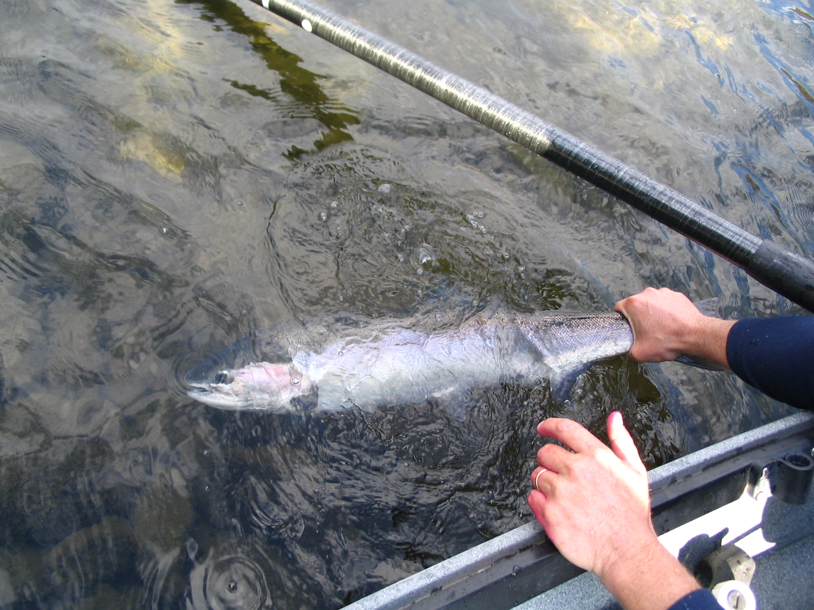
Bonneville to Priest Rapids
2017-2023
Stay within the allowable 2% impact on wild A-index and wild B-index steelhead
Rolling closures to all steelhead fishing, timed with passage of adult summer steelhead through the lower and mid-Columbia.
  Bonneville to the Dalles - August 1 - October 31.
  The Dalles to above McNary Dam (HWY 395) – September 1- March 31
  HWY 395 to Priest Rapids-Closed by permanent rule (Ringold Springs exception)

Slide 11
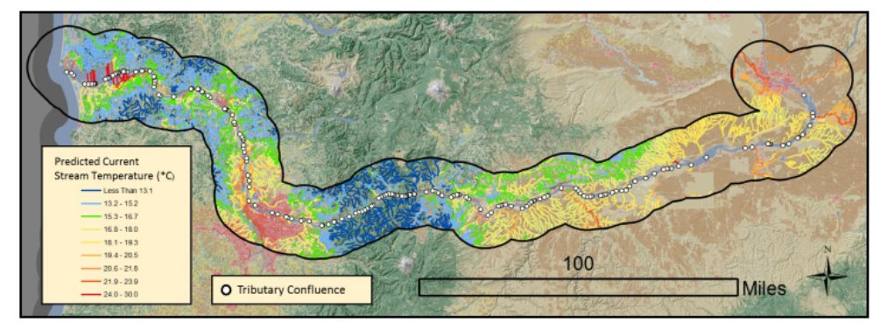
Thermal Refugia
2017-2023
Complete closure of thermal refugia to steelhead angling
  Includes Wind River, lower reaches of the White Salmon and Klickitat rivers. Most critical Drano Lake (Little White Salmon River). Corresponding rules for tributaries on the Oregon side of the Columbia
    Salmon fisheries are allowed beginning August 1-December 31
August critical month – on average 85% of steelhead present between Bonneville and The Dalles occupied thermal refugia (EPA 2021)
  Average of 68,000 of an estimated 80,000 adult steelhead for years 2007-2016
Notes:
For second bullet about mont of august68000 fish of 85000 estimated ot be in the reach
Environmental Protection Agency (EPA). 2021. Columbia River Cold Water Refuges Plan. Prepared by the U.S. Environmental Protection Agency Region 10. EPA-910-R-001. January 2021.

Slide 12
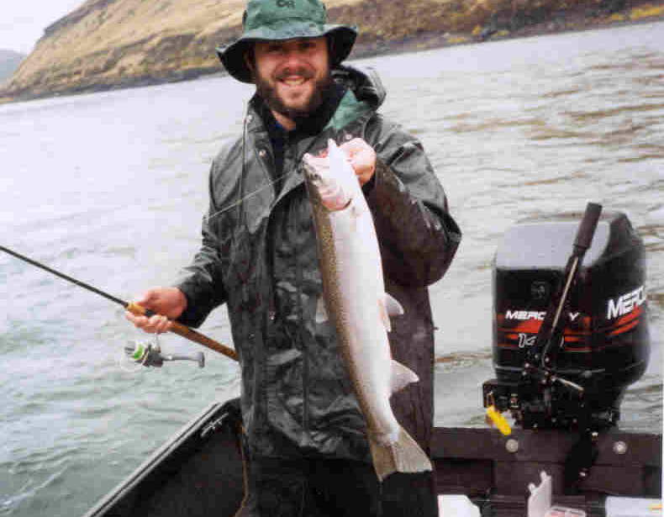
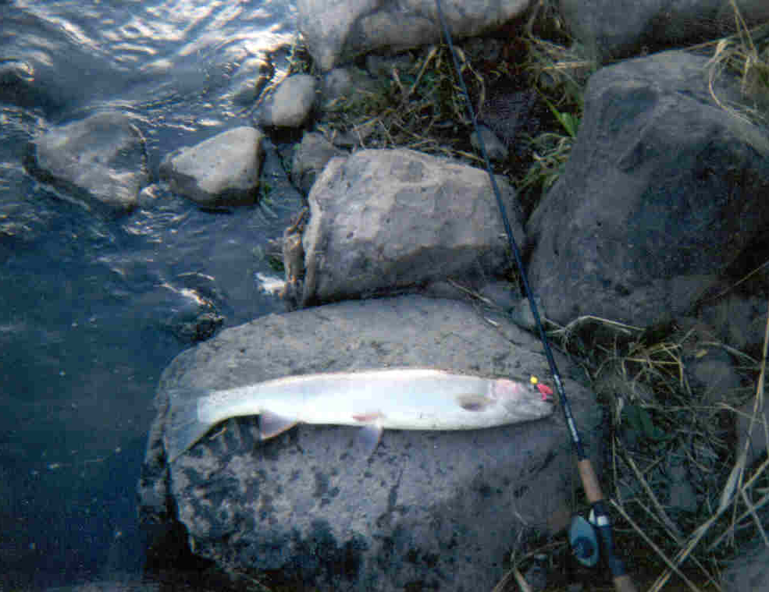
Priest Rapids to Chief Joseph
No fishery has occurred in this portion of the basin since 2014-15
Mainstem Columbia fisheries allowed when total steelhead abundance and natural-origin component over Priest Rapids is ≥9,550 and ≥1,300, respectively
Tributary conservation fisheries authorized if predicted to meet or exceed spawner escapement goals
Natural-origin take limits higher with increased predicted run sizes - PIT tag expansions – see Snake River example
  Both natural- and hatchery-origin steelhead are listed as threatened under ESA
  UCR hatchery steelhead programs:
    Deemed essential for recovery
    Conservation (WxW) and Safety-Net (WxW, WxH, and/or HxH) components
    Conservation component generally not externally mass marked, safety-net component externally mass marked, both are CWT tagged (and PIT tagged)
    In years with low returns, all sources of steelhead are allowed to spawn naturally
    In years with moderate to high returns, spawning of natural-origin and conservation program steelhead is prioritized over spawning of safety-net program steelhead
    Conservation fisheries authorized under ESA permits
    Section 10 for mainstem Columbia, Okanogan/Similkameen, and Methow Rivers
    FMEP for Wenatchee River
    Conservation fisheries intensively monitored to ensure take limits are not exceeded

Slide 13
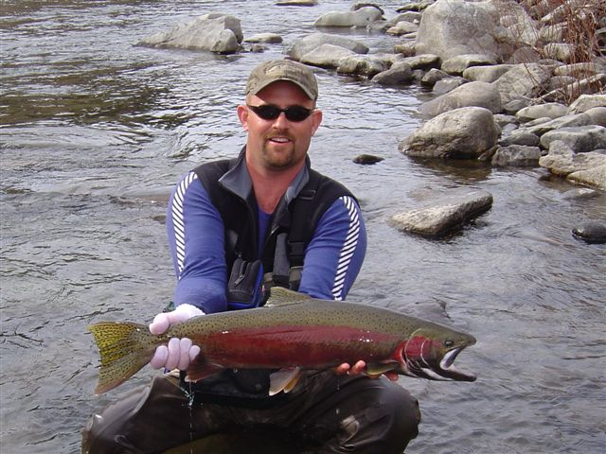
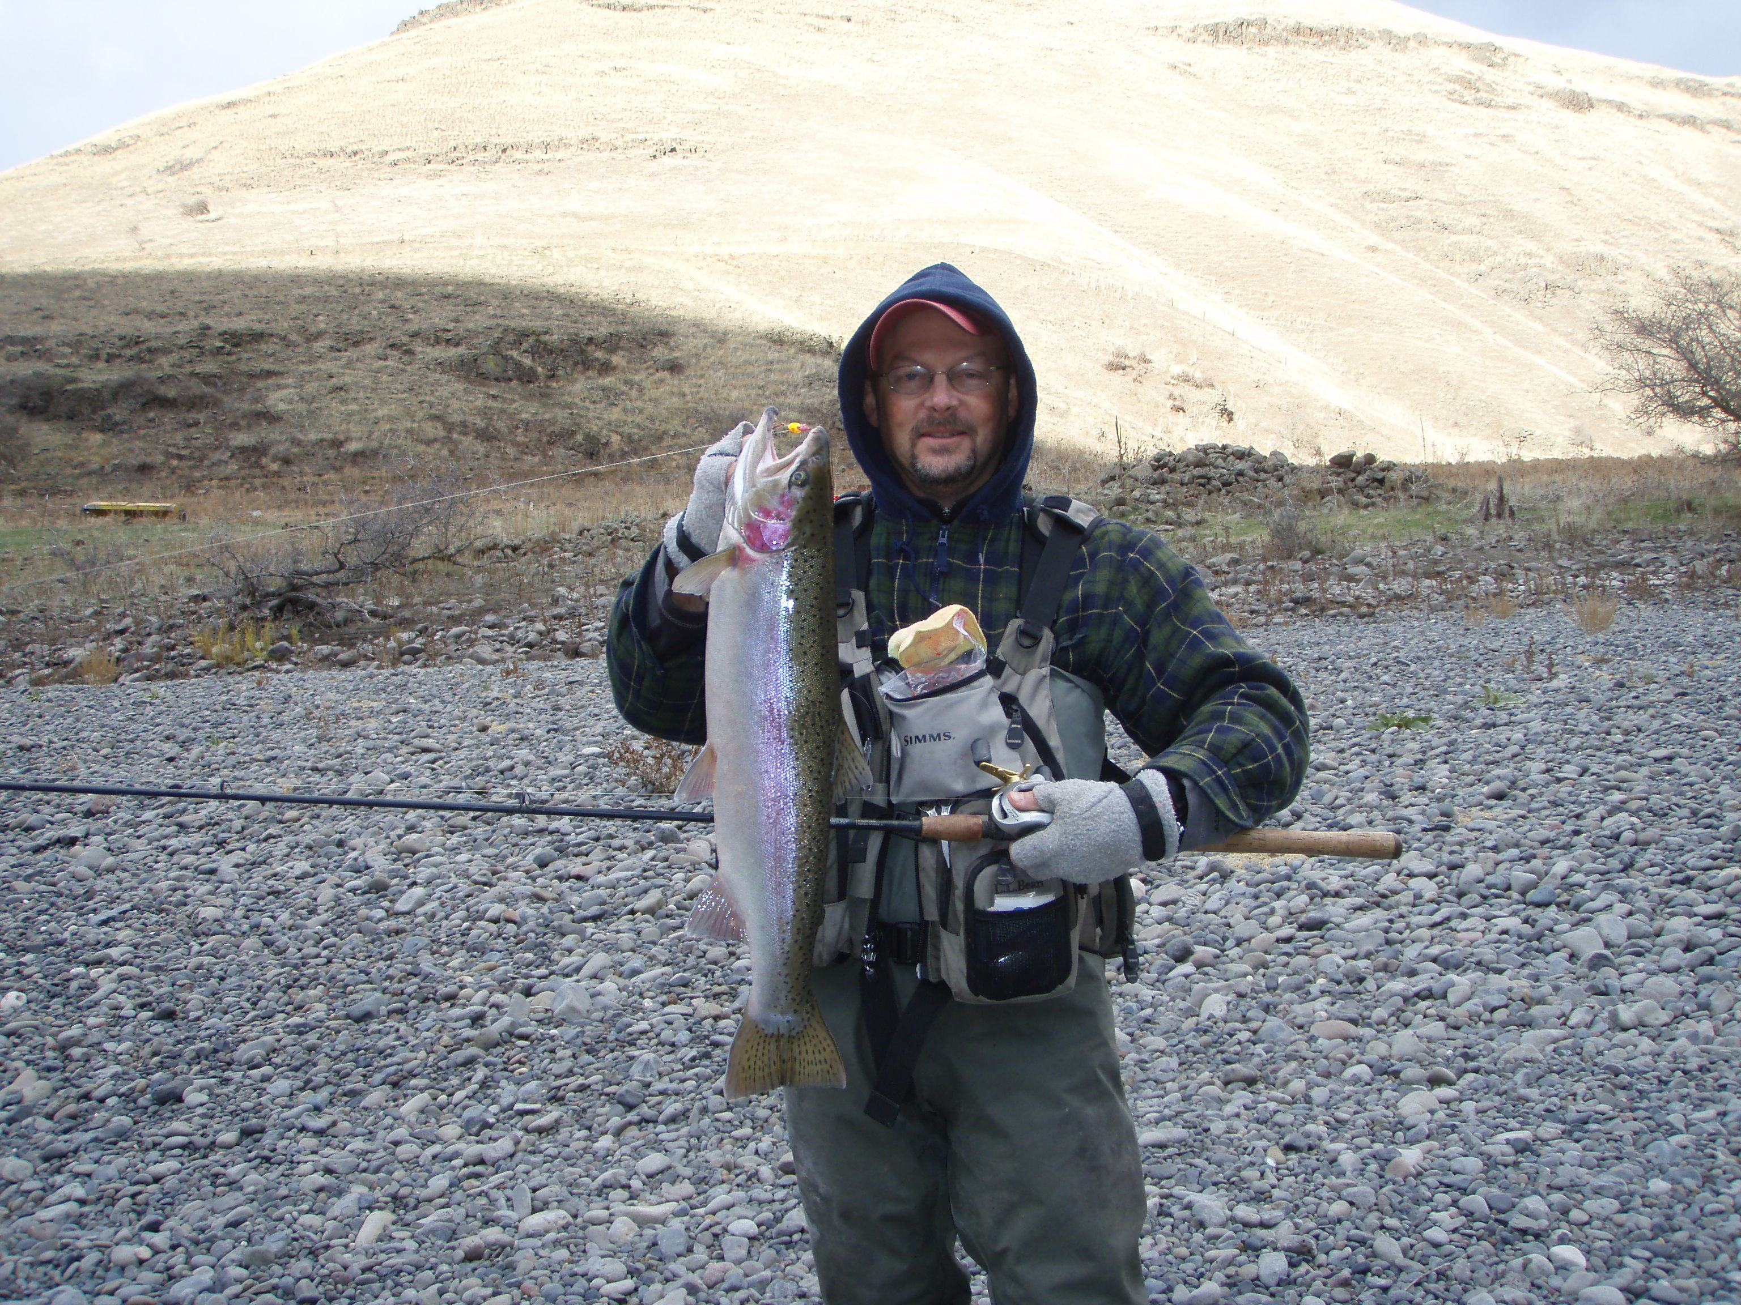
Snake River
2017-2023
Use of PIT tags for estimates of adult returns to specific tributaries -hatchery and wild
  Consult with ID, OR on populations of concern
In individual tributaries, relate abundance to conservation thresholds MAT and CAT. If estimates exceed CAT fisheries are possible within the bounds of the allowable impact rate.
  The Minimum Abundance Threshold (MAT) represents the abundance at which the population has a high probability of long-term persistence.
  The Critical Abundance Threshold (CAT) the level of abundance at which a population is at high risk of extinction over a short period of time.

Slide 14
Notes:
For second bullet about mont of august68000 fish of 85000 estimated ot be in the reach
Environmental Protection Agency (EPA). 2021. Columbia River Cold Water Refuges Plan. Prepared by the U.S. Environmental Protection Agency Region 10. EPA-910-R-001. January 2021.

Slide 15
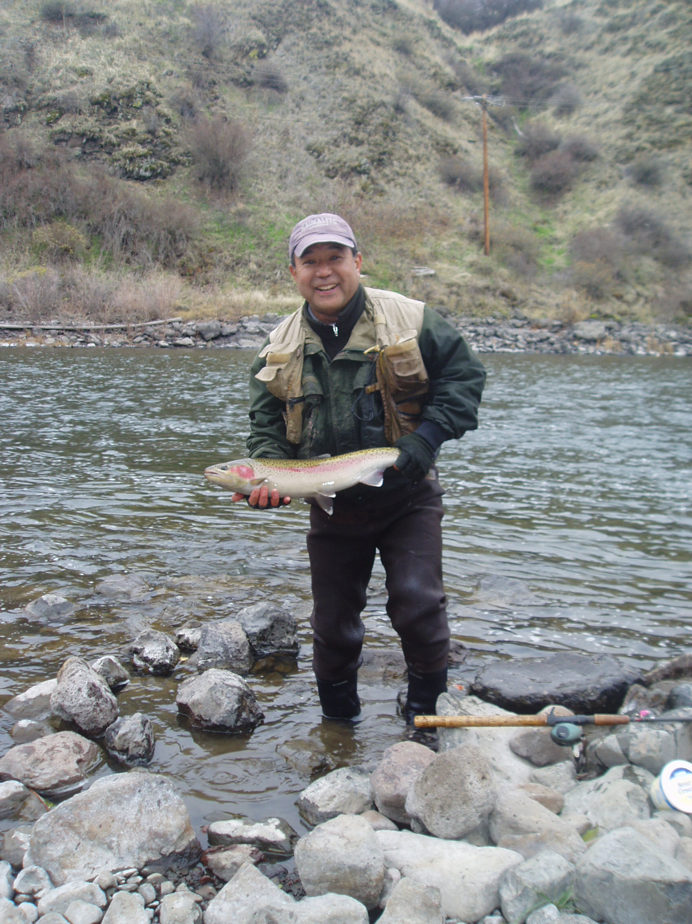
Snake River
2017-2023
Stay within the allowable 2% impact on wild A-index and wild B-index steelhead
Set seasons based on adult steelhead passage at Bonneville Dam (July 1- October 31). Ground truth with Lower Granite passage
Harvest seasons begin for the mainstem and tributaries September 1- March 31 or April 15, harvest limits have gone from 1 to 3 during the last 7 years
  Harvest limits maintained or reduced in mainstem and specific tributaries to be protective of composites of stocks or individual stocks respectively- more liberal as fishery nears terminal area
Mainstem is managed as a mixed stock fishery. However, based on abundance of A-index and B-index portions of the mainstem closed
Individual tributaries completely closed to be protective of wild and hatchery brood escapement
Balance wild abundance with hatchery abundance - need to remove surplus hatchery fish (mitigation and conservation)

Slide 16
Conclusions from 2017-2023
Rule modifications were successful in keeping fisheries from bottom to the top of the basin within conservation bounds
Never exceeded 1.5 % in allowable mortality in below Bonneville, Bonneville to McNary and Snake River fisheries.
Lower Columbia - Exploitation rates of the recreational fishery were so low it didn’t impact upper river adult survival
Mid- Columbia, including above Priest Rapids – no directed recreational fishing, conservation risk was exceptionally low
Snake Basin – All conservation metrics were achieved (Impact rate, MAT, CAT, hatchery brood)
Conversion rates slightly increased at Lower Granite recruiting additional wild and hatchery fish
Recreational fishing isn’t limiting the recovery of wild steelhead in the Columbia Basin.
  Focus on the other “H”s – specifically Hydro and Habitat. Lots of effort in the Columbia Basin over the last 20 years on Hatcheries.
Fishery permits across the basin are inconsistent in their approach to conserving wild steelhead (above Priest different from Snake River biologically?)
  ESA listing dates occurred at different times
  Regulatory Agency staff had differing conservation, ecological and social values
  WDFW did not use a consistent approach for permitting
Current forecast models, management strategies, and exploitation models are not robust enough to maximize opportunity within the bounds of conservation across the basin.
  Precautionary principle – “If a product, action or policy has a suspected risk of causing harm to the public or the environment, protective action should be supported before there is complete scientific proof of risk”
  Fishing opportunity left on the table? Idaho Management Strategy Evaluation (McCormick et al. 2021)

Slide 17
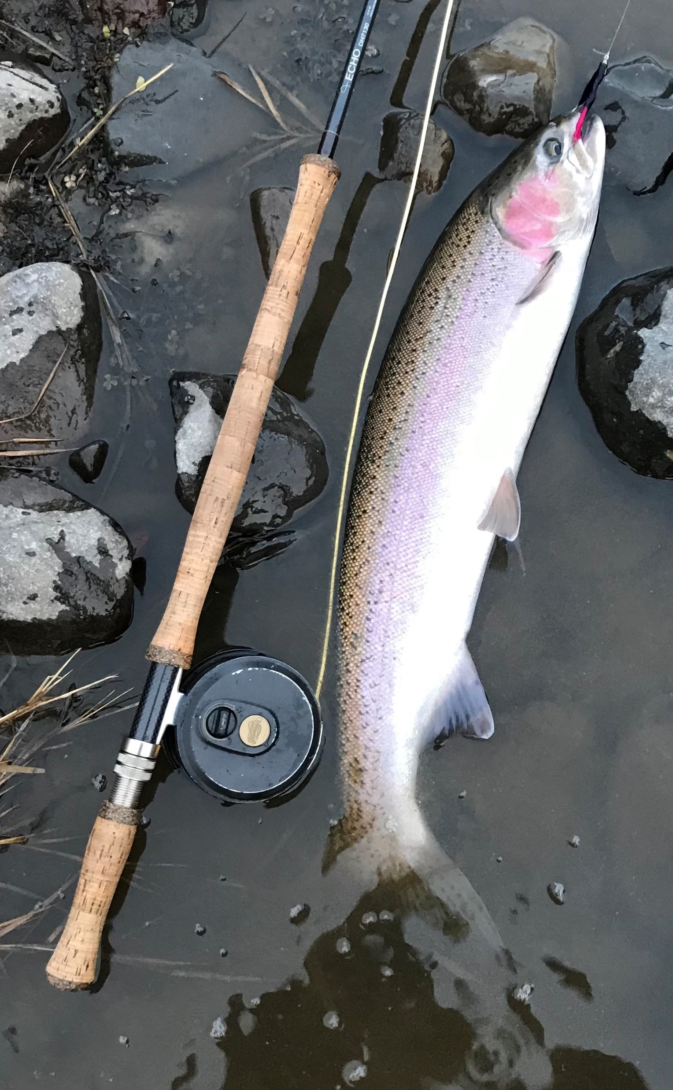
Future Direction
Improve forecast modeling.
Standardize creel surveys across the basin.
Increase number of PIT tags in wild steelhead - tighten abundance estimates.
Use our Scientists/Modelers to develop an MSE with a gradient of conservation risk
  Managers choose strategies based on conservation need by reach of the mainstem or tributary
Use MSE approach to go back and redesign fishery permits across the basin.
  Consistent conservation approach across regions of the basin.
  Predictable conservation outcome of fishery structure.
  Greater transparency to the public about fishery structure.

Slide 18
Questions?

