Slide 1
Dispersal, survival and mortality mechanisms of steelhead kelts in the Northeast Pacific
Trevor Davies, Fisheries Stock Assessment Scientist; Ministry of Forests. BC Government
Mike McCulloch,
Jamieson Atkinson,
Jeramy Damborg,
Collin Middleton

Slide 2
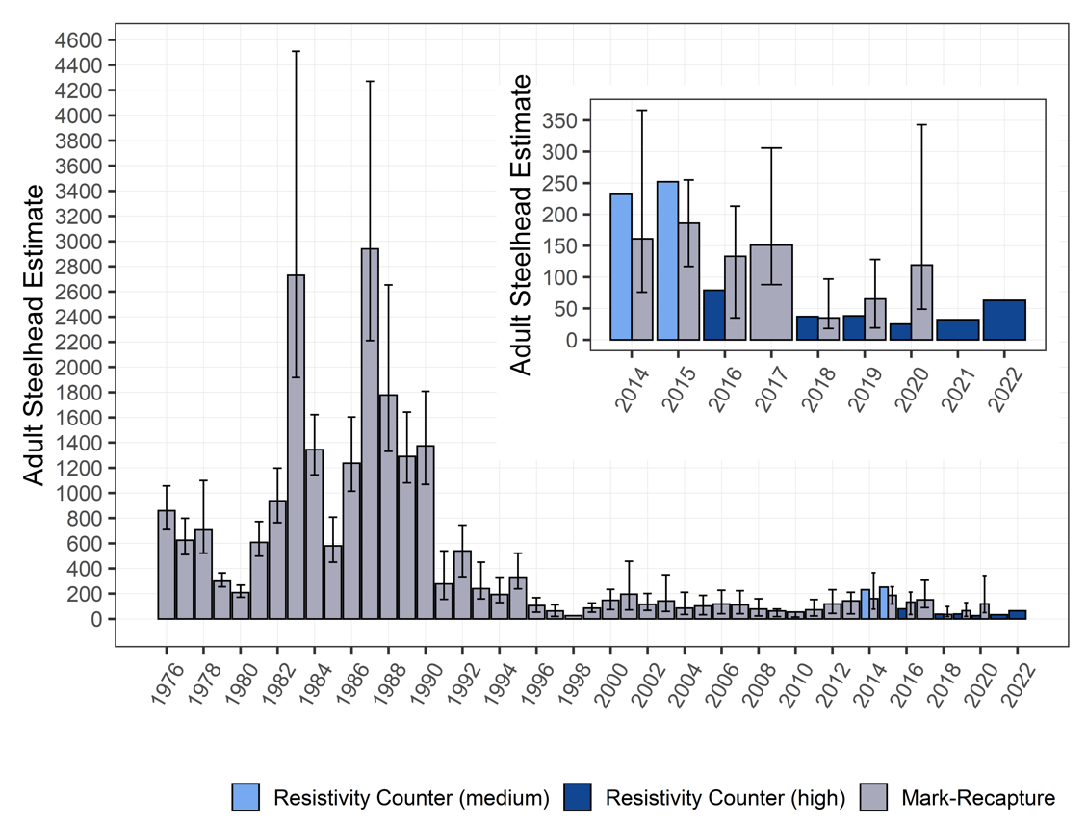
Steelhead status in BC
Steelhead Adult Abundance: Keogh River
Observed large declines in steelhead abundance in last 30 years
Declines most pronounced in southern latitudes particularly Vancouver Island
One primary driver is poor marine survival.
<4 % last 5 years
Compare to >10 – 25% in the 1980’s.
Ratzburg, A. 2022. Adult steelhead trout (Oncorhynchus mykiss) and salmonid smolt migrations at the Keogh River, BC, Winter 2021 and Spring 2022.

Slide 3
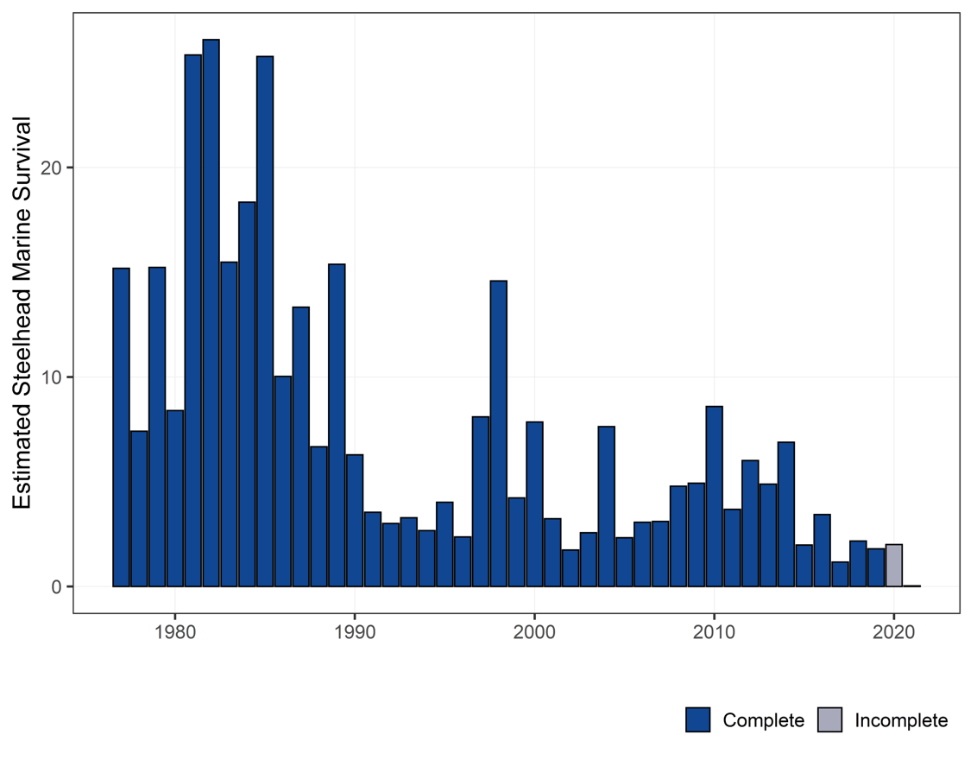
Steelhead status in BC
Steelhead Adult Abundance: Keogh River
Observed large declines in steelhead abundance in last 30 years
Declines most pronounced in southern latitudes particularly Vancouver Island
One primary driver is poor marine survival.
< 3 % last 5 years
Compare to >10 – 25% in the 1980’s.
10%
5%
Ratzburg, A. 2022. Adult steelhead trout (Oncorhynchus mykiss) and salmonid smolt migrations at the Keogh River, BC, Winter 2021 and Spring 2022.

Slide 4
Mechanisms of Marine survival are complex
Changing ocean conditions (climate change)
Disease
Prey availability (competition)
Fishery interception
Predation
Difficult to disentangle – frequently referred to as a ”BLACK BOX”

Slide 5
Looking into the black box
Northern & Southern Island experimental Design
Cowichan & Keogh River are well studied systems
Steelhead are iteroparous
Captured & tagged post spawned kelts
Reconditioned 2021
Release ASAP 2022

Slide 6
MINIPAT: pop-up archival transmitting tag
Data Products
Depth (Pressure)
Temperature
Light Archive
Light-Level Geolocation (GPE3)
Argos Locations (when at surface)
Depth Sensor Range (0 – 1700m)
Acceleration 3-Axis Archive
Size
61 g in air
118 mm (length) x 38 mm (diameter)

Slide 7
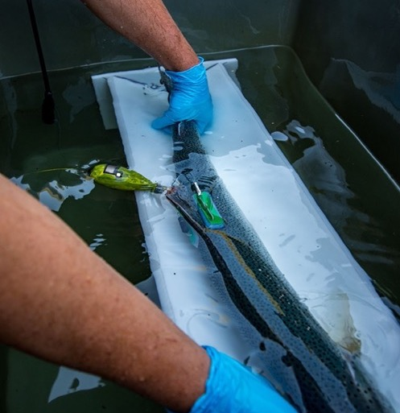
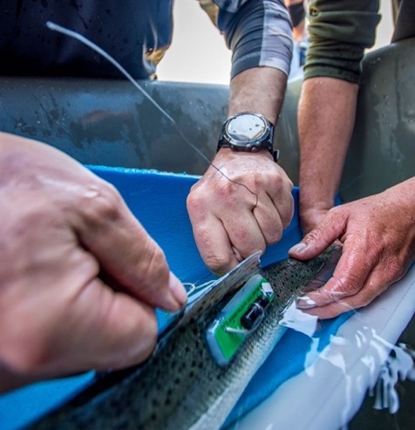
Tagging process

Slide 8
Release

Slide 9
Release sizes and locations
 | 2021 | 2022
North Island
Keogh River | 3 | 2
Nahwitti River | 2 | 0
Mid-Island
Englishman | 1 | 0
Cowichan | 9 (1 data deficient) | 7 (3 non-report)
Total | 15 | 9

Slide 10
Rapid mortality
Track Length: 67 km
Track time: 1.6 days

Slide 11
Long Migrations
Track Length: 1462 km
Track time: 69 days

Slide 12
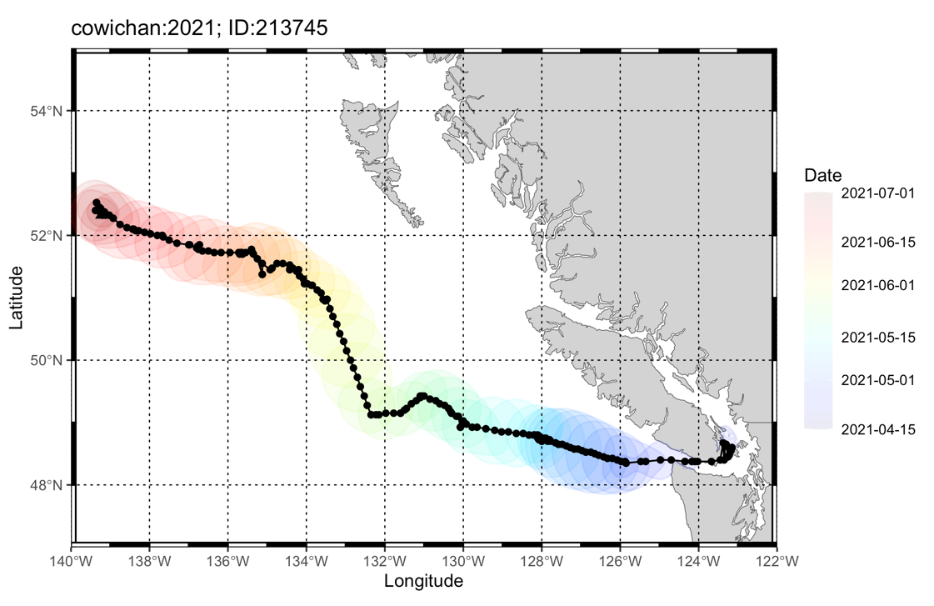
Long Migrations
Track Length: 1462 km
Track time: 69 days

Slide 13
Can we identify Predation mechanisms?
Light sensor can indicate ingestion
Marine mammals have clear temperature signal if consumed;
Some fish are endothermic (eg. Salmon sharks body temp ~25C)
Fish behavior (active vs bottom)

Slide 14
Identifying predation

Slide 15
Predator movement
Steelhead:
143 km; 9 days
Predator displacement
344 km; 13 days

Slide 16
Predator movement
Predator characteristics
Tag was ingested
Fast moving ectotherm
Fairly large (mouth gap / insulation)

Slide 17
Predation unknown

Slide 18
Pelagic traveler

Slide 19
Predation Bottom

Slide 20
Predation: Drag deep

Slide 21
Predation: Drag deep

Slide 22
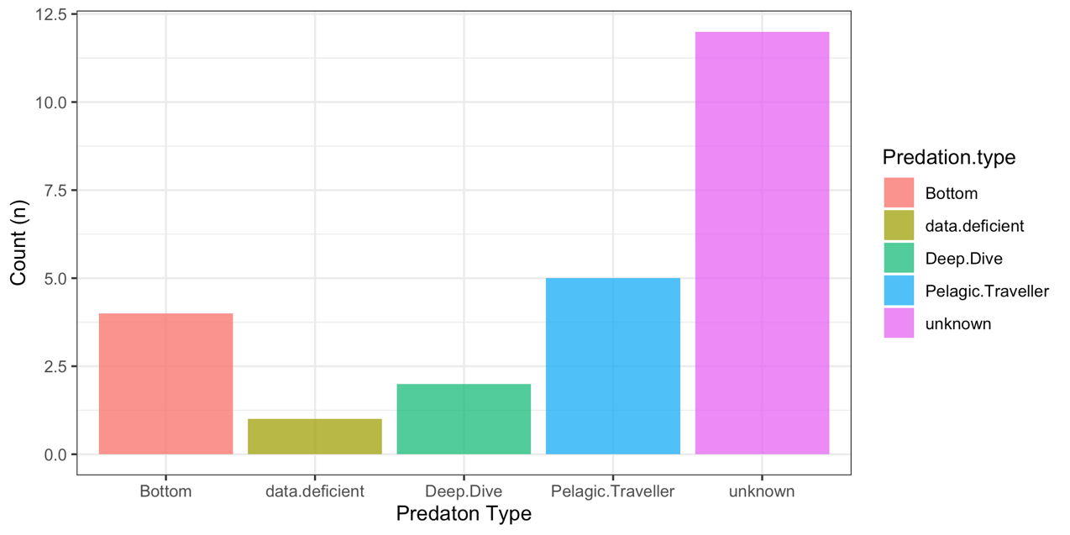
Results

Slide 23
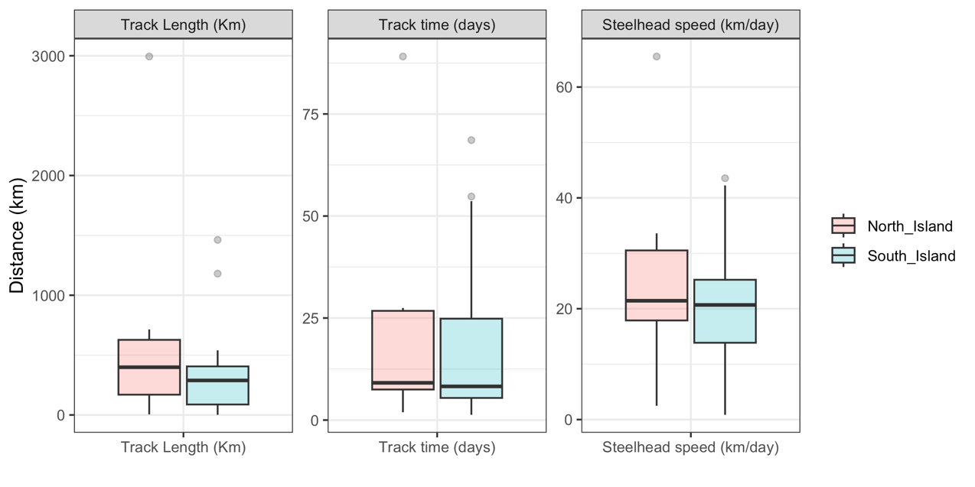
Results: Steelhead

Slide 24
Predation mechanisms
Travel | Average | Minimum | Maximum
Steelhead Track length | 461 km | 0km* | 2993 km
Predator travel distance | 76 km | 0km* | 576 km

Slide 25
Predation mechanisms
Mortality Pattern | Count | Proportion
Not Consumed (unknown) | 12 | 52 %
Pelagic traveler | 5 | 22 %
Deep | 2 | 9 %
Bottom | 4 | 17 %
Data deficient | 2 | NA
Total | 23 (25)

Slide 26
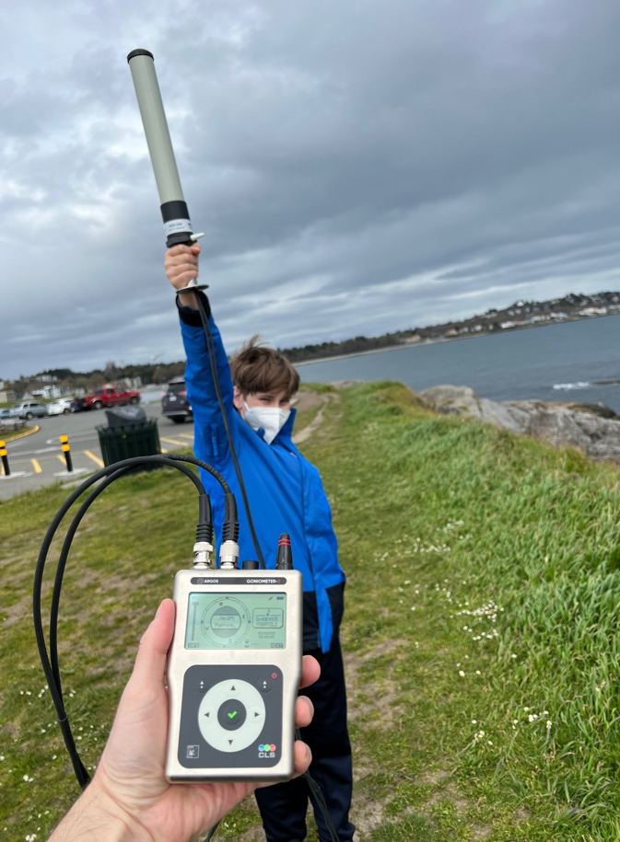
Next steps
Clean up tracks
Can mortality mechanisms be more reliably identified?
Use accelerometer data to identify predation events
Plan for 2023
Increase sample sizes: 18 tags
Release maiden adults in NE Pacific

Slide 27
Acknowledgements

Slide 28
Thank you Questions?

Slide 29
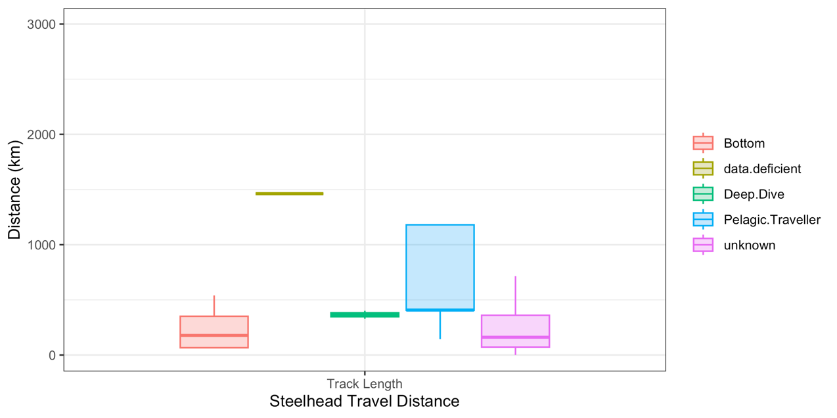
Results: Steelhead

Slide 30
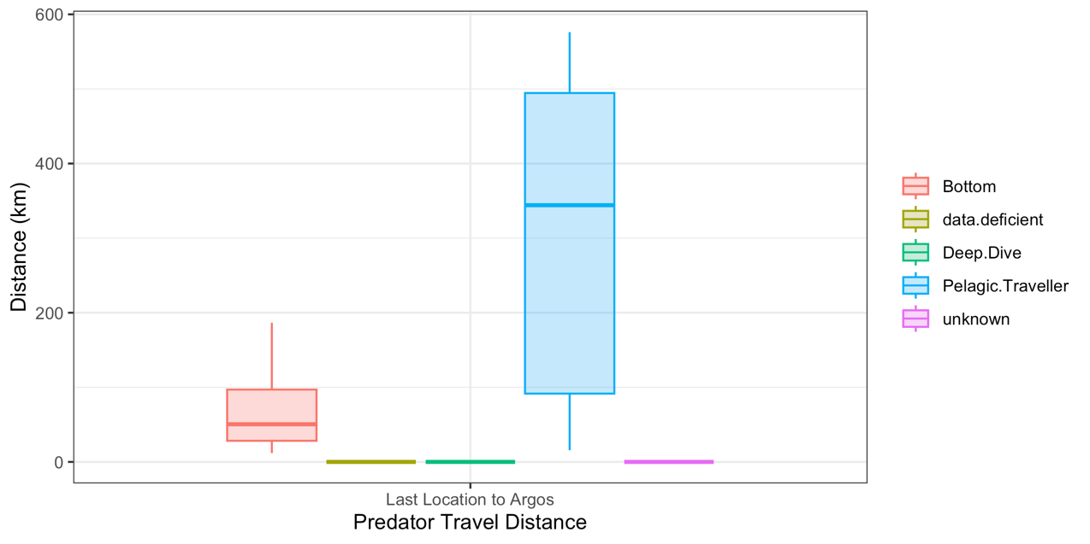
Results: Predators

