Slide 1
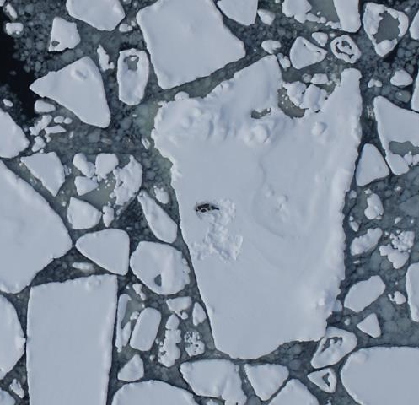
The U.S. Arctic and NOAA’s Role
Overview
U.S. is an Arctic nation
The Arctic: Big Picture
Loss of Sea Ice
Increasing activities
Arctic Resources
Arctic Council
U.S. Arctic Defined
U.S. Arctic Initiatives
Integrated Arctic Management Plan
Federal / State of Alaska collaboration
NOAA’s Arctic Vision and Strategy
NOAA Fisheries Involvement in the Arctic
NOAA Fisheries primary Arctic roles
Arctic Research
Marine Mammal Surveys
Arctic Fishery Management Plan
Arctic challenges
Notes:
Main Goals
Start with the Big Picture of the Arctic
Why we should care about the Arctic
Summarize key US Arctic initiatives with a focus on NOAA’s role
Talk a little about SOA/Federal collaboration
Describe some of our management responsibilities and research programs
And end up with a summary of challenges that we face going forward
Cover a lot of stuff fairly quickly - Something that you are particularly interested in let me know ..

Slide 2
Alaska makes U.S. an Arctic Nation
Alaska’s Physical Environment:
• 70% of U.S. Continental Shelf
• 47,300 Miles of Tidal Shoreline
• 28% of U.S. EEZ
• 698,000 Residents
Notes:
Not the usual map of Alaska that you see
ALASKA is the only U.S. state located in the Arctic, and therefore provides our country with a big foothold in the Arctic region.
Alaska is 2.3 times the size of Texas;
Contains about 800,000 sq miles of Outer Continental Shelf, 70% of U.S. total.
Has more than 47,000 miles of tidal shoreline—more than all of the other states combined.
Alaska has 28% of the U.S. Exclusive Economic Zone…produces $4.6 Billion worth of wild, sustainable seafood annually (about 60-percent of all seafood caught in U.S. waters)
Yet there are fewer residents in entire state than some cities in the lower 48: Indianapolis, Fort Worth, Austin
I guess more importantly for the purposes of this discussion, Alaska has 2x the warming rate as the rest of the U.S.

Slide 3
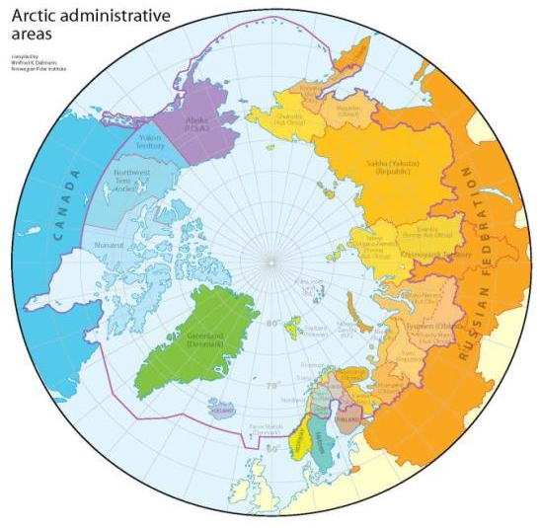
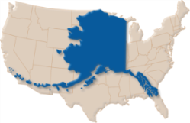
The Arctic: Big Picture
Arctic Region
5.5 million square miles
Eight countries
U.S.
Russia
Norway
Denmark (Greenland)
Canada
Sweden
Finland
Iceland
Internat’l jurisdictions challenge coordinated action
Notes:
Again you see how large Alaska is compared to the contiguous U.S. but Alaska doesn’t seem so big when viewed from the total Arctic region perspective.
The Artic Region (purple line) is a huge area.
Estimated to be about 5.5 million square miles, 8% of the total world’s surface; 15% of the land surface
Eight countries border the Arctic
Obviously these international jurisdictions can be quite challenging when coordinating action

Slide 4
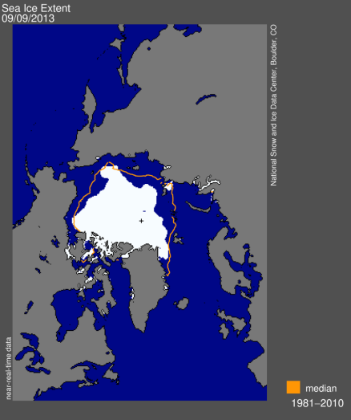
Loss of Sea Ice
Image: Managing for the Future in a Rapidly Changing Arctic: A Report to the President
September 2012:
Record low sea ice
“Ice free” in the coming decades
Notes:
So…why should we be concerned about the Arctic and why now – well basically loss of sea ice due to climate change.
On the left is an image of the Arctic sea ice in September 2012, the day that the National Snow and Ice Data Center identified to be the minimum reached in 2012 – this was the smallest extent of sea ice recorded in over three decades of satellite measurements.
On the right the yellow outline shows the average sea ice minimum from 1979 through 2010.
Polar ice cap today is 40% smaller than it was in 1979.
The summers could be “ice free” within decades.

Slide 5
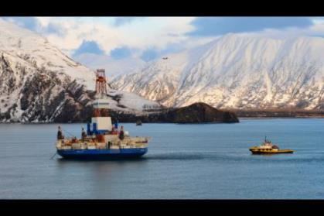
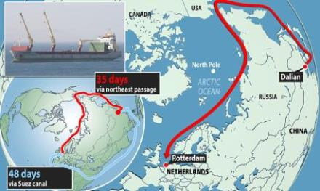
Loss of Sea Ice = Increased Access
Oil and gas development
90 billion barrels of oil
13% of world’s undiscovered reserves
30% of world’s undiscovered natural gas
Primary driver for increase in shipping
Shipping
Time / $ saving routes
118% increase in maritime transit through the Bering Strait from 2008-2012
1 million tons of cargo in 2012
Image: US Coast Guard
Notes:
With the loss of sea ice, there is increased access to the Arctic. The two areas where we are really seeing a big increase in human activities are oil and gas development and shipping.
Estimated 90 billion barrels of oil in Arctic Region (13% of world’s undiscovered reserves);
Estimated 30% of world’s undiscovered natural gas
There is recent strong interest in accessing oil and gas resources particularly in the Chukchi and Beaufort Seas. Shell—2012 drilling. We’ve also been very busy working with DOI -BOEM and industry on seismic surveys.
Loss of sea ice has also encouraged the growth of commercial shipping via international trans-Arctic routes.
The Yong Sheng shown here just became the first commercial Chinese container vessel to make the journey through the waters of the Arctic, rather than south via the Indian Ocean and the Suez Canal.
Via the Northern Sea Route (NSR), ships can make the 8,100-nautical-mile journey in about 35 days, That compares to 48 days through the southern route.
Oil and gas exploration is the primary driver for increase in shipping in U.S. Arctic.
Maritime transit through the Bering Strait more than doubled from 2008-2012
There were 1 million tons of cargo shipped through the U.S. Arctic in 2012.

Slide 6
Undiscovered, Untapped resources in the Arctic
Also:
Fisheries
Tourism
Others?
Global competition for influence, economic opportunities extends far beyond the nations that border the Arctic.
Notes:
Again showing the entire Arctic region
The loss of sea ice in the Arctic is also opening doors to other important natural resources and possible economic activities for example
$1 trillion worth of minerals such as zinc and nickel
90 billion barrels of petroleum
And the loss of sea ice is increasing global competition for influence and economic opportunities, not just for the countries that border the Arctic.
The opening up of the Arctic will have impacts not only for our country, but for the entire planet.

Slide 7
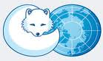
Arctic Council
May 2013
Chairmanship: Canada 2013-2015 • United States 2015-2017
Notes:
The 1996 Ottawa Declaration established the Arctic Council as forum for promoting cooperation, coordination, and interaction among the Arctic States and indigenous peoples in areas of sustainable development and environmental protection.
As you might expect - Some of those countries that are seeking Arctic influence and economic opportunities don’t actually border the arctic – see those listed on the right. They are permanent observers on the Arctic Council
And the 8 Arctic Council member countries are on the left, which of course include the U.S.
The Chairmanship of the Arctic Council rotates among the member nations. The United States will chair from 2015-2017.

Slide 8
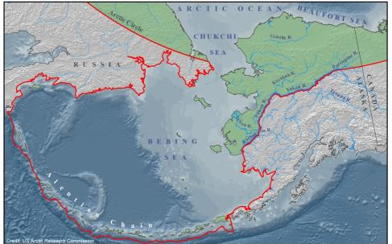
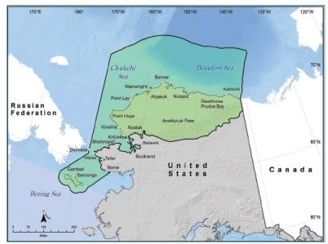
U.S. Arctic Defined
U.S. Arctic
U.S. High Arctic
Defined by Arctic Research and Policy Act (ARPA)
Encompasses Bering Sea & Aleutian Islands
Term generally refers to areas north of the Bering Sea and Aleutian Islands, and includes the Chukchi and Beaufort Seas
Notes:
U.S. Arctic Boundary is defined in statute by the Arctic Research and Policy Act (adopted 1984) . It includes the Beaufort, Bering and Chukchi Seas, and the Aleutian chain.
Most of this presentation focuses on the US High Arctic—northern Bering Sea, Chukchi and Beaufort Seas.

Slide 9
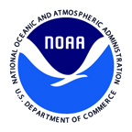
U.S. Arctic Initiatives
Arctic Research Commission and Interagency Arctic Research Policy Committee (1984)
National Ocean Policy (2010) *
NOAA’s Arctic Vision and Strategy (2011) *
Interagency Working Group on Domestic Energy Development and Permitting in Alaska (2011)*
Interagency Arctic Research Policy Committee 5 Year Research Plan (2013) *
Integrated Arctic Management report (2013) *
USCG Arctic Strategy (2013)
CMTS Arctic Marine Transportation System report (in development) *
* NOAA involvement
Notes:
There are about 20 federal agencies involved in a growing list of U.S. Arctic Initiatives—see some listed here at the bottom.
NOAA is actively involved in many of these initiatives…as you can see from the asterisk next to some of these on the list.
Drivers for most of these initiatives are climate change and oil/gas exploration
Arctic Research Commission (ARC) and Interagency Arctic Research Policy Committee (IARPC) (1984)—
Established by the Arctic Research and Policy Act of 1984 with the ARC mandated to inform IARPC
The IARPC consists of fifteen-plus agencies, departments, and offices across the Federal government. IARPC is chaired by the National Science Foundation.
National Ocean Policy (2010) * Arctic is one of 9 priority areas; of 26 Arctic milestones, 23 list NOAA as a responsible agency, with 4 emerging areas of focus:
Enhance Communication Systems
Improve Environmental Incident Prevention and Response
Improve Sea Ice Forecasting
Improve Mapping and Charting
Cover NOAA’s Arctic Vision and Strategy (2011) * (more later)
Interagency Working Group on Domestic Energy Development and Permitting in Alaska (2012)*
Aims to improve collaboration among federal agencies on energy permitting in Alaska (not just the Arctic, although the Arctic is a primary focus)
Also -includes SOA, local communities, tribes, and industry
Interagency Arctic Research Policy Committee 5 Year Research Plan (2012) *
2013-2017
National Science Foundation
Identifies 7 research areas dealing with Arctic atmosphere and ecosystems
Integrated Arctic Management report (2013) * (discussed in more detail later)
USCG Arctic Strategy (2013)
10-year strategy
3 strategic objectives
Improving awareness
Modernizing governance
Broadening partnerships
CMTS Arctic Marine Transportation System report (in development) *
Committee on the Marine Transportation System is a Federal Cabinet-level, inter-departmental committee chaired by the Secretary of Transportation. Report on US Arctic MTS has detailed reporting on what will be needed for marine transportation in the Arctic.

Slide 10
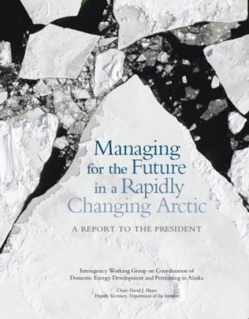
Integrated Arctic Management report
Whole government approach
Calls for strengthening key partnerships—specifically with the State of Alaska and Alaska Native Organizations
Science-based stewardship, decision-making
Balance environmental, economic, and cultural needs and objectives
NOAA played a large role in developing the IAM report
http://www.afsc.noaa.gov/Publications/misc_pdf/IAMreport.pdf
Notes:
The Integrated Arctic Management report (IAM) was released in 2013.
Key recommendations of the report:
Makes the case for looking at the Arctic from an integrated management approach, a “whole government approach”;
A key component of the whole government approach is more engagement with the State of Alaska and Alaska Natives
Advocates Science-based decision making
Seek to balance environmental, economic, and cultural needs and objectives—there is a lot wrapped into this including
Environmental protection—stewardship should take an ecosystem-wide and long-term perspective
Economic development—objective is sustainable communities and economies with adequate infrastructure (including capability for emergency preparedness and response)
Cultural needs include the continuation of the subsistence way of life and food security for these Arctic communities
Developed by Interagency Working Group on Coordination of Domestic Energy Development and Permitting in Alaska
Lead federal agency was the Department of the Interior…NOAA played a big role in the development of this roadmap for the Arctic.

Slide 11
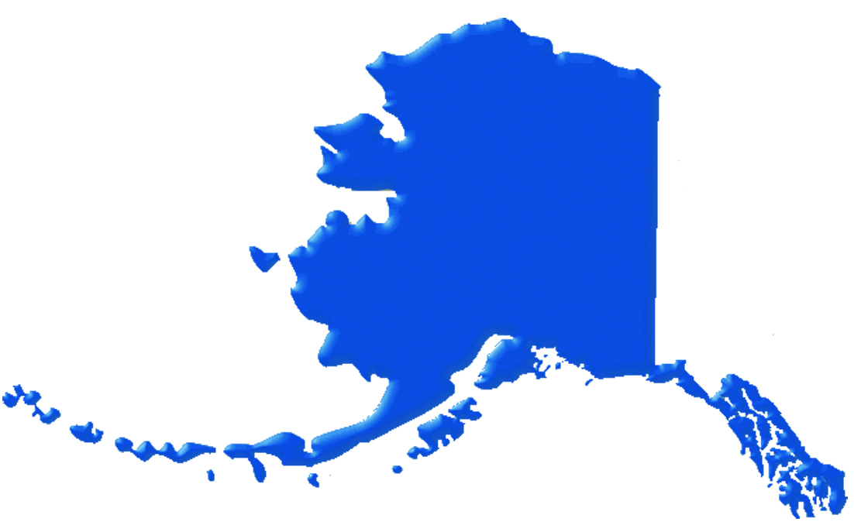
Alaska Arctic Council Ad Hoc Working Group
Chaired by Alaska Governor’s DC Office
U.S. Department of State
Native Organizations
Universities
Private sector
NGOs
Federal agencies in Alaska
Alaska Climate Change Executive Roundtable
AK Dept. of Fish & Game
AK Dept. of Natural Resources
AK Dept. of Commerce, Community, and Economic Development
Alaska-based federal resource management agencies (NOAA, BOEM, BLM, etc.)
Alaska Arctic Policy Commission
10 Alaska Legislators
16 subject matter experts from throughout Alaska
North Slope Borough, AK
Northwest Arctic Borough, AK
State of Alaska /
Federal collaboration
Whole government approach
Direct and meaningful partnerships
Science-based decision-making
Notes:
State of Alaska /Federal Collaboration
Because Alaska makes the United States an Arctic nation, the state is directly involved in much Arctic research, security, and policy. 90% of the state-funded portion of the budget comes from oil tax revenue—but the fisheries industry is also very significant.
The Alaska Arctic Council Ad Hoc Working Group is chaired by the Alaska Governor’s DC office and includes representatives of the US Department of State, the State of Alaska, Native organizations, universities, the private sector, non-governmental organizations and federal agencies in Alaska.
Alaska Climate Change Executive Roundtable: The Alaska Region, with USGS and Alaska Department of Environmental Conservation, hosts the Alaska Climate Change Executive Roundtable, a coalition of senior level executives of both federal and state resource management agencies from throughout Alaska that has been meeting regularly since the Climate Change Forum for Alaska in February 2007 to share information and facilitate cooperation among agencies.
The SOA’s Alaska Arctic Policy Commission (AAPC) is made up of 26 commissioners, including 10 Legislators and 16 experts from throughout the state. The Commission is co-chaired by a State Senator State House Representative.
One of the most important aspects of the AAPC’s work will be positively influencing federal Arctic policy. The Commission will compile a list of all the current federal programs that directly affect Arctic Alaska and Arctic policy, and track and thoroughly investigate each program. These findings will inform the Commission’s Final Report.

Slide 12
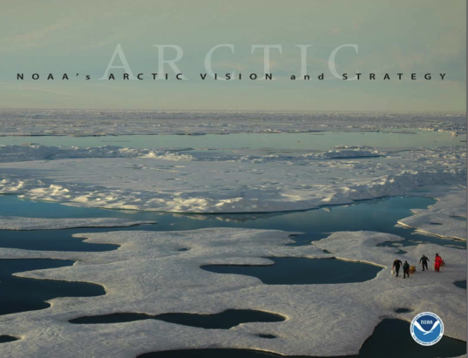
NOAA’s Arctic Vision & Strategy Goals
Forecast Sea Ice
Strengthen Foundational Science to Understand and Detect Arctic Climate and Ecosystem Changes
Improve Weather and Water Forecasts and Warnings
Enhance International and National Partnerships
Improve Stewardship and Management of Ocean and Coastal Resources in the Arctic
Advance Resilient and Health Arctic Communities and Economies
Notes:
2011—NOAA released its Vision and Strategy for the Arctic.
6 goals—closely linked to the various NOAA line offices
To briefly give you a sense of the main objective for each goal –
Goal 1 is focused on forecasting sea ice for safe maritime operations as well as ecosystem stewardship. The forecasts include daily, weekly, and some longer term forecasts. These activities are conducted in partnership with the USCG and Navy under the auspices of National Ice Center.
Goal 2 is focused on basic science and research, which also involves understanding climatic changes, but through data collection on baseline information. A very important component of this goal at an interagency and international level is developing Arctic Observing Networks.
Goal 3 is weather forecasting. Main focus is to improve our ability to forecast weather and storms in the Arctic. Another component is protecting AK coastal communities from storm surge and other erosion hazards.
Goal 4: The partnerships goal has a pretty obvious mission – to maintain and foster relationships with national and international partners. Partnerships are an important part to all of NOAA’s work in Alaska/the Arctic.
Goal 5: The main mission of Goal 5 is to conserve and manage ocean and coastal resources in the Arctic. This goal has a heavy NOAA Fisheries role but we are engaged in the international and foundational science goals as well.
Goal 6 is really focused on Marine Transportation and Emergency Response, as a means to improve Arctic communities and economies. The main priorities are advancing charting and mapping in Alaska/the Arctic, and doing oil spill research.
My understanding - NOAA is currently developing a document building on the 2011 Vision and Strategy document which will more fully explain NOAA’s role in the Arctic.

Slide 13
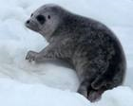
NOAA Fisheries Primary Arctic Roles
Marine Mammal Protection Act & Endangered Species Act
Manage impacts of oil and gas activity on marine mammals & ESA-listed species
Co-management of marine mammals
Magnuson-Stevens Fishery Conservation and Management Act
Arctic Fishery Management Plan
Arctic Scientific Research
Many BOEM-funded studies
Environmental intelligence
In close collaboration with partners
Notes:
NOAA Fisheries’ primary roles in the Arctic
Manage impacts of oil and gas activity on marine mammals & ESA-listed species
Incidental Harassment Authorizations
Section 7 Consultations
Coordination, MOU with BOEM / BSEE
Arctic Environmental Impact Statement
Co-management of marine mammals
Cooperative agreements with 8 Alaska Native Organizations
International Whaling Commission
In case you are asked: Ice seal listings
Ribbon seals—not listed under ESA
Bearded seals—listed as threatened in U.S. waters (Alaska)
Ringed seals—listed as threatened in U.S. waters (Alaska)
Spotted seals—not listed in U.S. waters
Under the Magnuson-Stevens Act, we worked with the North Pacific Fishery Management Council in implementing the Arctic Fishery Management Plan
We are involved in a lot of scientific research in the Arctic to inform decision-making…much of it funded by the Bureau of Ocean Energy Management (BOEM). It is important to have the environmental intel if we are going to be able to make the best possible decisions regarding Arctic ecosystems and economic activities.
Most of our research is done in close collaboration with our partners.

Slide 14
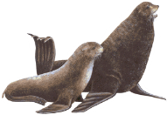
Current Arctic Ecosystem Research
Chukchi Acoustic, Oceanographic, and Zooplankton Study (CHAOZ) *
Arctic Whale Ecology Study (ARCWEST) *
Ecology of Ice-Associated Seals
Synthesis of Arctic Research (SOAR) * *
Pacific Marine Arctic Regional Synthesis (PacMARS)
Pacific-Arctic Gateway Ecosystem Study (PAGES) *
Arctic Ecosystem Integrated Survey (Arctic Eis) * *
Aerial Survey of Marine Mammals (ASAMM) *
ShoreZone Coastal Mapping Program *
Arctic Coastal Ecosystem Survey (ACES) *
Loss of Sea Ice-Ice Seal Surveys (LOSI) *
Chukchi Sea Environmental Studies Program (CSESP)
Hanna Shoal Ecosystem Survey *
Marine Arctic Ecosystem Surveys (MARES)
Bering Aleutian Salmon International Survey (BASIS)
Russian-American Long Term Census of the Arctic (RUSALCA)
Distributed Biological Observatory (DBO)
U.S. Canada Transboundary Fish Survey
* BOEM funding
* State of Alaska collaboration
Notes:
Here’s a list of some of the current Arctic ecosystem research under way
As you can see from the asterisks, some of these are funded by the Bureau of Ocean Energy Management (red), and there are several we are doing in collaboration with the State of Alaska.
Highlight just a few that I’m more familiar with
Shorezone Coastal Mapping Program-
First inventory of the biology and geology of Alaska’s coast.
Baseline data for response and planning for the dynamic coastal changes taking place in Alaska
More than 20 partners
Bering Aleutian Salmon International Survey (BASIS)
NPAFC's coordinated program of cooperative research on Pacific salmon in the Bering Sea designed to clarify the mechanisms of biological response by salmon to the conditions caused by climate changes.
2009-2013
U.S. (NOAA, USFWS, academia), Japan, Korea, Russia, Canada

Slide 15
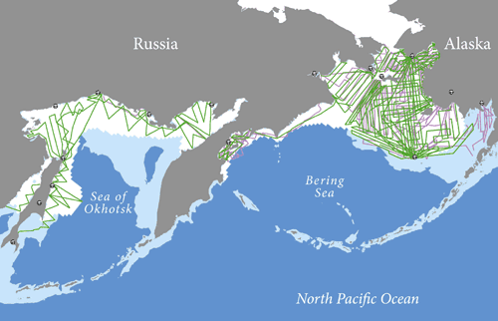
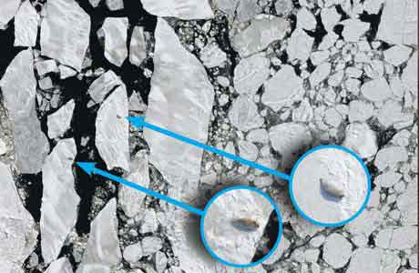
Marine Mammal Surveys
US/Russian Ice Seal Surveys—2012/13
Advanced thermal-imaging technology was used on both the U.S. and Russian survey aircraft to detect the warm bodies of seals against the background of the cold sea ice. Pictured above are two adult bearded seals detected with thermal imagery
Notes:
Range Wide Ice Seal Abundance Estimate: 2012-2013
This project is a collaboration between AFSC and Russia to conduct aerial surveys and develop abundance estimates of bearded, ribbon, and spotted seals across their primary breeding areas, including the Bering Sea and Sea Okhotsk. Supported in part by BOEM.
Bearded, spotted, ribbon, and ringed seals are key components of Arctic marine ecosystems and they are important subsistence resources for northern coastal Alaska Native communities. Obtaining reliable abundance estimates for ice-associated seals is vital for developing sound plans for management, conservation, and responses to potential environmental impacts of oil and gas activities and climate change.

Slide 16
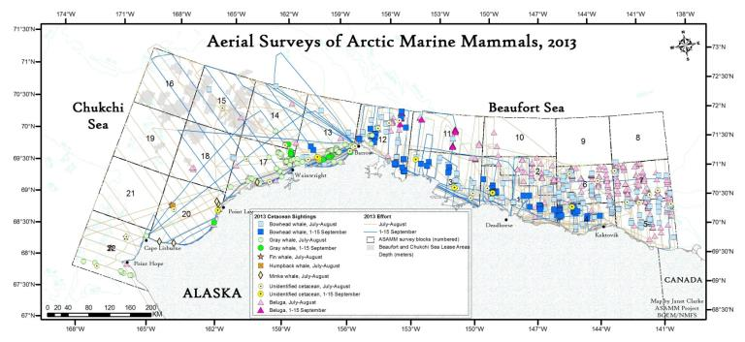
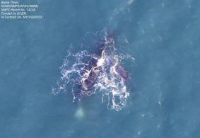
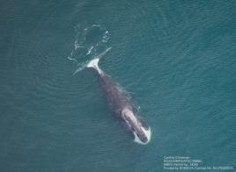
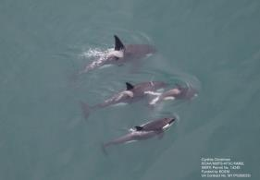
Marine Mammal Surveys
Notes:
Aerial Surveys of Arctic Marine Mammals:
This project is a continuation of long-term aerial surveys and provides real-time data and a 30-year time series of marine mammal distribution, relative abundance, habitat, and behaviors in the Western Beaufort Sea and Northeastern Chukchi Sea. Also Supported by BOEM.
Started in 1979, ASAMM is the longest-running and most extensive ongoing effort by federal agencies to monitor marine mammals in the Arctic.
The goal of the surveys is to document the distribution and relative abundance of bowhead, gray, right, fin, and beluga whales, as well as other marine mammals.

Slide 17
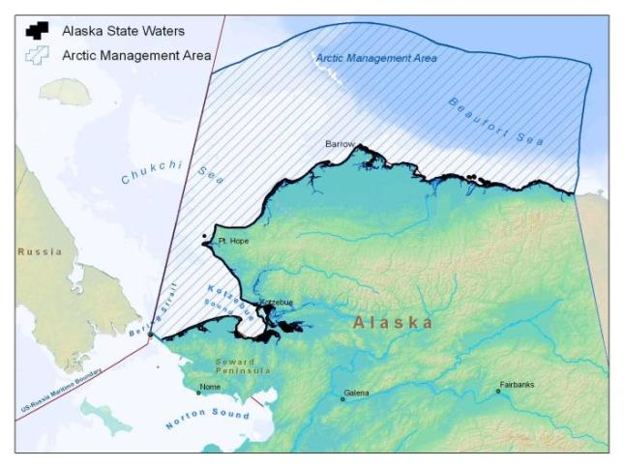
Arctic Fishery Management Plan
Approved 2009
Closure of 150,000 sq nautical miles
More information needed on fish stocks
Notes:
As some of you know, the Fishery Management Plan for the Fish Resources of the Arctic Management Area was implemented in 2009.
The NPFMC’s action (precedent setting) effectively closed the area on this map (Arctic waters of the United States in the Chukchi and Beaufort seas) to commercial fishing until an assessment of the practicality of sustained commercial fishing is completed.
Includes a framework for sustainably managing Arctic marine resources.
It is theorized that warming ocean temperatures, migrating fish stocks and shifting sea ice conditions from a changing climate may potentially favor the development of commercial fisheries.

Slide 18
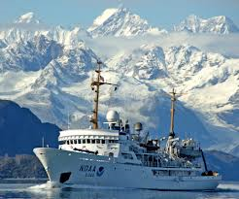
Arctic Challenges
Arctic knowledge gaps
Ice diminished, not ice–free
Limited Arctic base resources
Limited U.S. survey capacity
Collaboration / partnerships
NOAA has capability, lacks resources
Notes:
Arctic knowledge gaps.
“We don’t know what we don’t know”
For example, only 2% of the Arctic is mapped—which could have dangerous consequences as marine traffic through the area increases.
Ice-diminished, not ice-free
Although the ice is diminishing, it is not ice-free.
Short survey seasons (late May to Sept)
Harsh environment to sample in (weather, light, ice)
Limited Arctic base resources
Lack of supporting infrastructure
(communications are limited, tidal data is lacking, there are a lot of logistical issues)
Limited U.S. survey capacity
Age of existing fish and hydroacoustic-capable fleet
Need for new concepts of operations, new technologies
Collaboration / Partnerships
Partnerships will continue to be an important component of our research, management, and regulatory programs
You can see that NOAA has a lot of capability to do good work in the Arctic. We are facing numerous challenges looking to the future –

Slide 19
Questions?
More info:
http://alaskafisheries.noaa.gov/ or http://www.afsc.noaa.gov/

