Slide 1
NOAA Fisheries Update
Pacific States Marine Fisheries Commission – Coeur d’Alene, ID
Paul Doremus DAA for Operations September 23, 2013

Slide 2
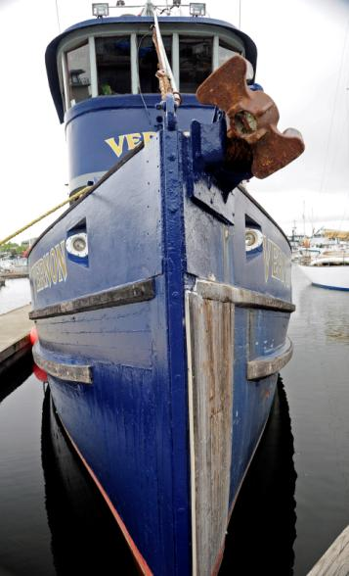
Topics
Fiscal update
Current budget status
Trends and outlook
Current issues
Leadership changes
MSA reauthorization
Electronic monitoring & reporting
Promoting U.S. fisheries
Saltonstall-Kennedy grant

Slide 3
NOAA Fisheries: Top Line Budget Trends
($ Millions)

Slide 4
Winding Down FY 13
The FY 2013 Final Spend plan level included sequestration reductions and rescissions; it did not include furloughs
Combined, budget reductions over the last three fiscal years have impacted NMFS core mission functions

Slide 5
Mission critical activities scaled back in 2013
Reductions in fisheries data collection, impacting catch limits, leading to lost fishing revenue
Statutorily required deadlines delayed, leading to increased litigation risk
Reduced inspections at restoration sites, inability to meet fiduciary responsibilities
Staff reductions have reduced capacity across the board

Slide 6
Fewer staff = fewer services, less output
Notes:
SF example – Inability to fill high priority hires
Result: Delays in completing regulatory actions that would decrease economic burdens on stakeholders and strengthen management of fish stocks currently being considered for listing under the Endangered Species Act (i.e. dusky sharks)
OHC example -- Staff vacancies have not been backfilled
Result: Lack of staff impacting our ability to fill critical staffing needs for Deepwater Horizon and RESTORE Act work; shifting work to existing staff led to burdensome workloads, staff burnout, reduced morale
Result: An 18% reduction in Habitat staff at PIRO resulted in a 17% reduction in EFH consultation coverage

Slide 7
FY 14 Budget Line Detail: Substantial reductions in FY 13; uncertain outlook for FY 14
Line Item / Account ($ in millions) | FY 2010 | FY 2011 Spend Plan | FY 2012 Spend Plan | FY 2013 Spend Plan | FY 2014 Request | FY 2014 House Mark | FY 2014 Senate Mark
Protected Resources Research and Management | $204.0 | $188.1 | $174.2 | $165.5 | $186.0 | $167.0 | $183.8
Fisheries Research and Management | $432.9 | $438.5 | $426.1 | $414.0 | $430.1 | $405.9 | $435.5
Enforcement and Observers/Training | $106.7 | $105.7 | $105.4 | $102.7 | $111.3 | $107.0 | $111.3
Habitat Conservation and Restoration | $58.2 | $41.8 | $41.7 | $38.8 | $47.0 | $29.0 | $47.0
Other Activities Supporting Fisheries | $102.7 | $71.1 | $57.5 | $56.1 | $64.5 | $55.0 | $62.7
Subtotal ORF | $904.5 | $845.2 | $804.7 | $777.3 | $846.5 | $763.9 | $840.3
Pacific Coastal Salmon Recovery Fund (PCSRF) | $80.0 | $79.8 | $65.0 | $60.4 | $50.0 | $35.0 | $65.0
Other Accounts | $23.6 | $42.4 | $25.3 | $44.9 | $32.8 | $39.8 | $189.8
TOTAL | $1,008.2 | $967.5 | $895.0 | $882.5 | $929.3 | $838.7 | $1,095.1

Slide 8
Summary of FY14 House and Senate Marks
House Mark
Provided $763.9 million for ORF
$82.6 million (9.8%) below the FY 2014 request
$13.4 million (1.7%) below the FY 2013 Spend Plan
Senate Mark
Provided $840.3 million for ORF
$6.2 million (0.7%) below the FY 2014 request
$63.1 million (8.1%) above the FY 2013 Spend Plan
U.S. Department of Commerce | National Oceanic and Atmospheric Administration | NOAA Fisheries | Page 8

Slide 9
Proposed FY 2014 NMFS Budget Increases
Species Recovery Grants: + $15.0 M ($17.8 M Requested)
House provided $9.0 ($8.8M below request)
Senate provided $7.5 M ($10.3 M below request)
Expand Annual Stock Assessments: + $4.9 M ($69.3 M Requested)
House provided $66.0 ($3.3M below request)
Senate provided $69.3 M (same as request)
Survey and Monitoring Projects: + $2.6M ($24.8 M Requested)
House provided $24.0 M ($0.8 M below request)
Senate provided $24.8 M (same as request)
American Fisheries Act: + $1.7M ($5.7 M Requested)
House provided $3.8 M ($1.9 M below request)
Senate provided $3.7 M ($2.0 M below request)
U.S. Department of Commerce | National Oceanic and Atmospheric Administration | NOAA Fisheries | Page 9

Slide 10
Proposed FY 2014 NMFS Budget Increases - Continued
Interjurisdictional Grants: + $2.5 M ($2.5 M Requested)
House provided $2.0 M ($0.5 M below request)
Senate provided $2.5 M (same as request)
Observers and Training: + $3.1 M ($43.6 M Requested)
House provided $43.0 M ($0.6 M below request)
Senate provided $43.6 M (same as request)
Habitat Management and Restoration: + $4.1 M ($47.0 M Requested)
House provided $29.0 M ($18 M below request)
Senate provided $47.0 M (same as request)
Aquaculture: + $1.1 M ($6.7 M Requested)
House provided $5.7 M ($1.0 M below request)
Senate provided $6.7 M (same as request)
Cooperative Research: + $1.0 M ($12.0 M Requested)
House provided $10.0 M ($2.0 M below request)
Senate provided $12.0 M (same as request)
U.S. Department of Commerce | National Oceanic and Atmospheric Administration | NOAA Fisheries | Page 10
Notes:
House Mark Funding:
Habitat Management and Restoration reduced by $18M from the FY14 request, and $9.8M from the FY13 spend plan.
The House Mark level will eliminate grant funding for competitive restoration projects, and cuts into base funding that supports NOAA’s contributions to Natural Resources Damage Assessments (NRDA) and other interagency restoration programs and activities.
House Mark Language Provisions:
Cooperative Research : NMFS interpretation– House expects that all funding should go directly to the research recipients. Neither realistic nor feasible. NMFS incurs costs associated with staffing for regional coordination, oversight, grant and permitting processing, administration of the Regional Set-Aside programs, equipment and supplies.
Senate Mark Language Provisions:
Directs NOAA to close NERO immediately – NMFS working to get report to congress cleared
Direction to dedicate Alaska observer fees to electronic monitoring systems would reduce observer deployment funding in Alaska by about $1M annually.
The reduction in funds would significantly impact NMFS’ ability to provide observer coverage in the Alaska trawl and fixed gear fisheries necessary for total catch accounting.
NMFS and the North Pacific Fishery Management Council may consider increasing the fee rom 1.25% up to the 2% maximum allowed under MSA section 313(b)(2)(E) to maintain coverage.

Slide 11
Proposed FY 2014 NMFS Budget Decreases
Prescott Grants: - $1.1 M ($0.0M requested)
House provided for full reduction
Senate provided $4.0 M, same as FY 2014 base level
Salmon Management: -$6.6 M ($27.0 M requested)
House provided $25.0 M ($2.0 M below request)
Senate provided $30.3 M ($3.3 M above request)
Pacific Coastal Salmon Recovery Fund: -$15.4 M ($50.0 M requested)
House provided $35.0 M ($15 M below request)
Senate provided $65.0 M ($15 M above request)
U.S. Department of Commerce | National Oceanic and Atmospheric Administration | NOAA Fisheries | Page 11

Slide 12
Outlook for FY 14: President’s Budget, House and Senate Marks, and beyond
Budget stalemate continues
Potential for government shutdown
End of fiscal year
Debt ceiling
Potential continuation of sequestration
Fiscal uncertainty will continue
Notes:
We are planning for a 1 year CR for the start of FY14 at roughly the same level as FY13, but Sequestration could reduce FY14 by another 5%.
Continuing to operate at FY 2013 funding levels means:
Protected Species: $20.5M below the FY14 President’s Budget.
Will increase Section 7 consultations backlog; slow permitting and incidental take authorizations; and delay recovery efforts.
Fisheries Research and Management: $23.7M below the FY14 President’s Budget.
Will increase delays in drafting and implementing regulatory changes to benefit stakeholders
Will increase uncertainty setting and monitoring ACLs.
The low level of funding for Regional Councils will affect the Council’s ability to develop and implement Fishery Management Plans.
The lower funding level for Commissions will lead to gaps in data collection, enforcement, compliance and monitoring efforts.
Enforcement: $5.2 M below the FY14 President’s Budget.
Will slow the expansion of the compliance assistance program (part of IG recommendations)
Observers & Training: $3.4 M below the FY14 President’s Budget.
Will require NMFS to shift funding of observers/at-sea monitors in catch share programs in the NE and NW to Industry earlier than planned.
Habitat Conservation & Restoration: $8.2M or 17% below the FY14 President’s Budget.
Represents a 40% reduction in restoration grant funding that would have supported 122 jobs
Other Activities Supporting Fisheries: $8.3M below the FY14 President’s Budget.
Will reduce research and monitoring in the Arctic; reduce cooperative research projects, and Aquaculture projects

Slide 13
Fiscal Outlook: Uncertainty Ahead

Slide 14
Current Issues
New Leadership
Magnuson-Stevens Act Reauthorization
Promoting U.S. Fisheries
Electronic Monitoring and Reporting
Saltonstall-Kennedy Grant Program

Slide 15
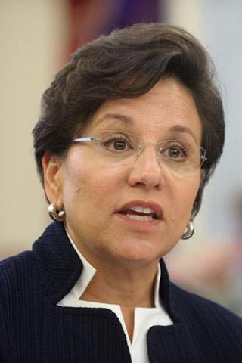
New Leadership
Secretary Penny Pritzker Confirmed June 2013
Kathryn D. Sullivan Under Secretary for Oceans and Atmosphere Nominated August 2013
Mark Schaefer Assistant Secretary for Conservation and Management Confirmed August 2013

Slide 16
MSA Reauthorization – Building on Success
Build on Managing Our Nations Fisheries III
Regional discussions/stakeholder input
Key Reauthorization Themes:
Regulatory changes, legislative refinements
Strengthen science an data collection capacity
Ecosystem-based approaches
Electronic monitoring technologies
Certification of U.S. fisheries

Slide 17
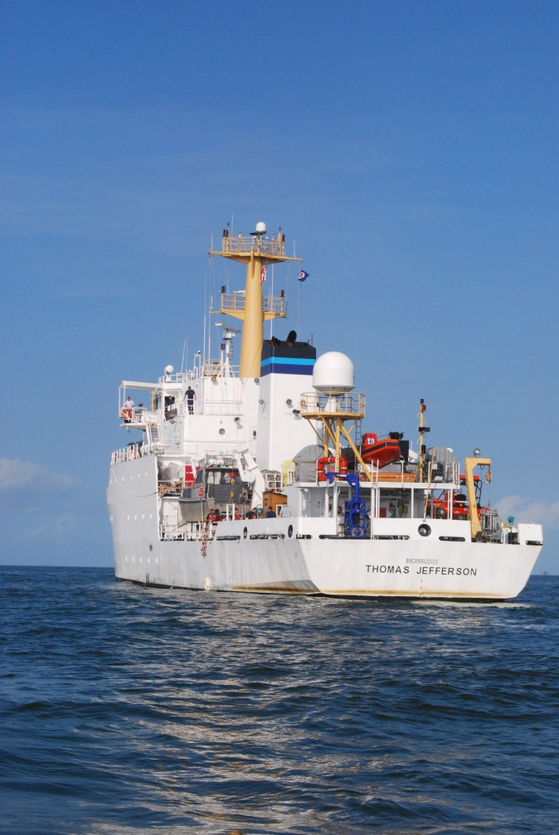
Electronic Monitoring and Reporting
Goal: provide quality, trusted fisheries information
George LaPointe hired to coordinate regional planning:
Identify needs
Evaluate technologies
Implement where appropriate
Develop in partnership with Councils, States, Fishing Communities, and other partners.

Slide 18
Promoting U.S. Fisheries
Recognition of U.S. fisheries as “responsibly managed” – a global leader in sustainable seafood
Expanding stakeholder-base to include broader spectrum of seafood supply chain
Further develop FishWatch
Continue strengthening strategic communications

Slide 19
Saltonstall-Kennedy Grant Program – FY13
Anticipate awarding $5-10 million; competitive selection
Optimize economic benefits in the context of rebuilding and maintaining sustainable fisheries
Demonstrate benefits to U.S. fishing industries; encourage fishing community participation
Six priority areas
Aquaculture
Optimum utilization of harvested resources under Federal or State management
Fisheries socioeconomics
Conservation engineering to reduce bycatch
Ecosystem studies
Territorial science

Slide 20
The Bottom Line
Looking ahead, we cannot rely on larger federal budgets to continue delivering value to the nation
Stronger partnerships, new business models, and strategic choices are required

Slide 21
Reference

Slide 22
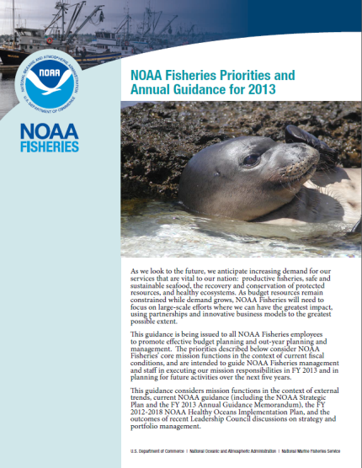
NOAA Fisheries Priorities: FY13 – FY18
Primary NOAA Fisheries mandates for science-based living marine resource stewardship:
—To continue the quest to end overfishing and rebuild stocks
—To recover and conserve protected resources
All other NOAA Fisheries programs, projects, and activities support these core mission mandates

Slide 23
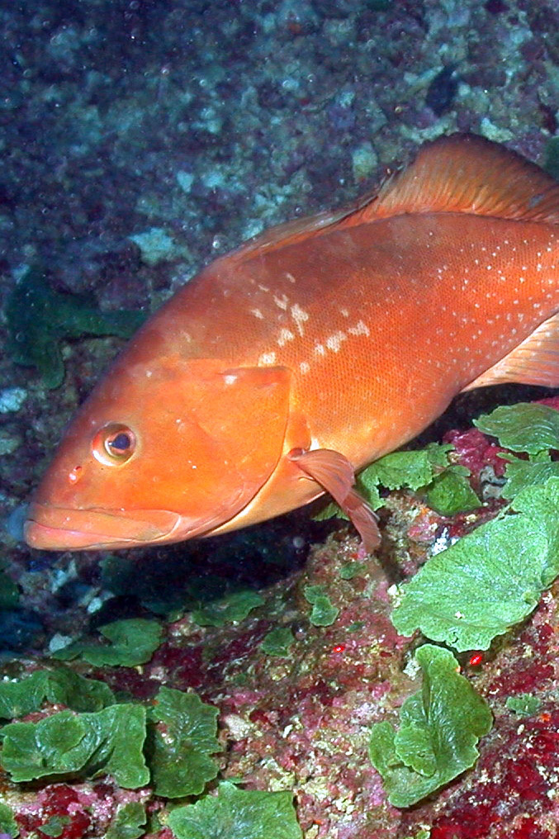
End Overfishing and Rebuild Stocks
Ensure food and economic security
Help maximize the productivity and sustainability of fisheries
Minimize risk of overfishing
Rebuild stocks
Reduce uncertainty and management complexity
Foster the development of marine aquaculture
Provide enhanced enforcement and compliance assistance
Continue international efforts to end overfishing and combat illegal, unregulated, unreported fishing

Slide 24
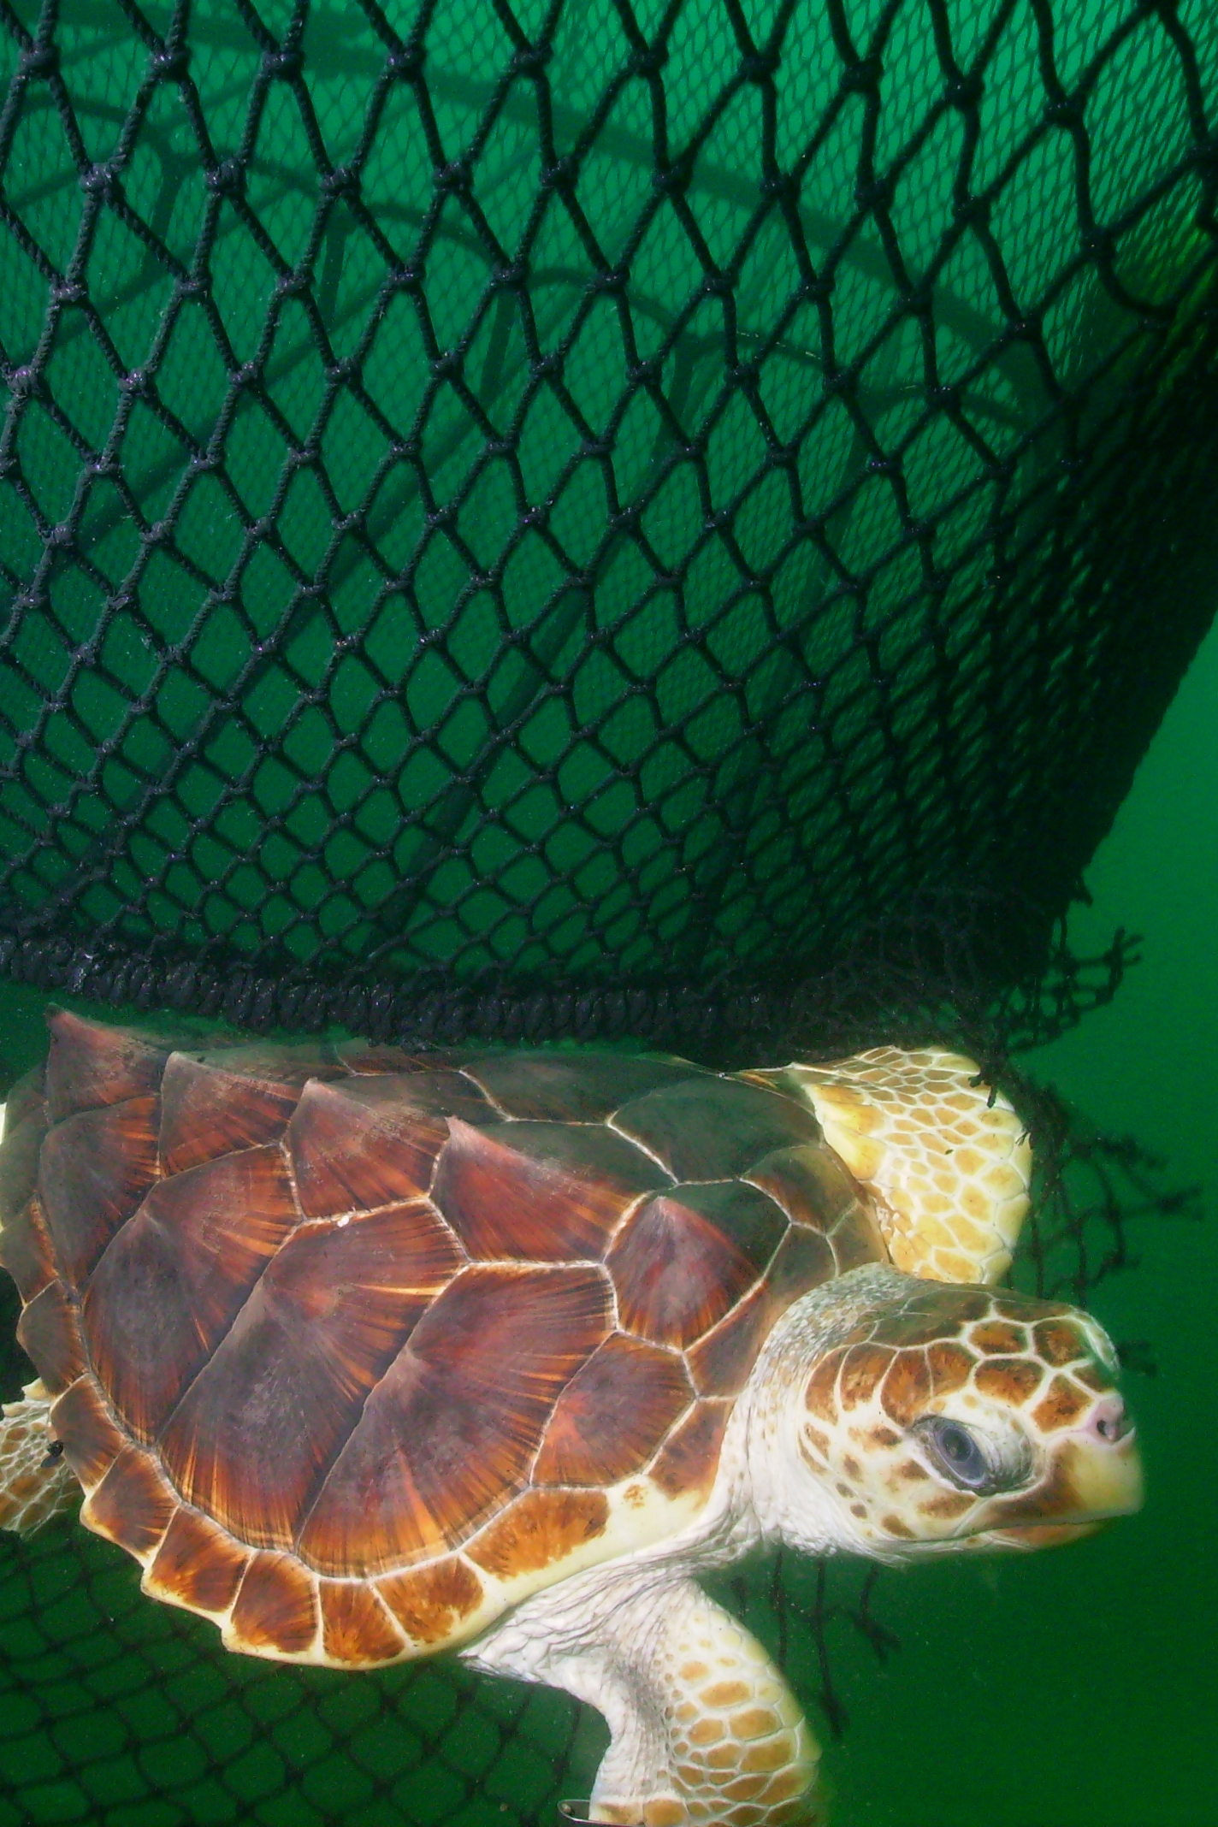
Recover, Conserve Protected Resources
Protect, recover, and conserve species listed through:
Proactive conservation
Formal listing of species needing protection
Recovery and conservation of protected species
Enhanced enforcement

Slide 25
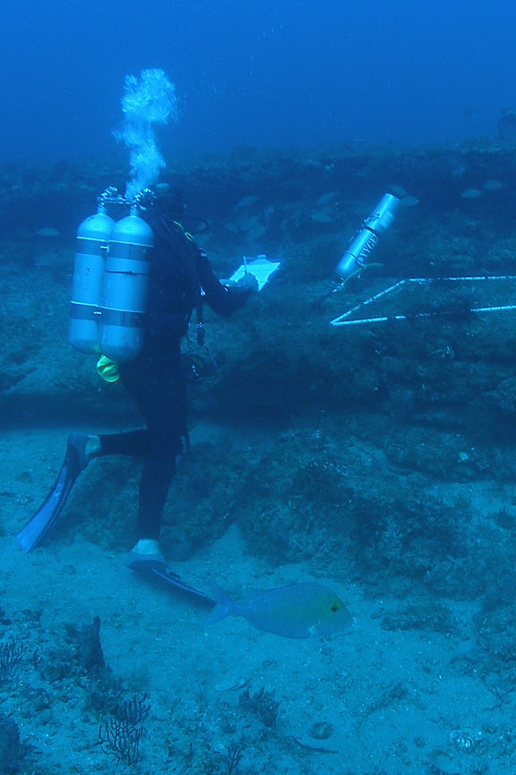
Advance Science and New Methodologies
Implement improvements and efficiencies in fisheries science that informs management through:
Advanced sampling techniques
Next Generation Stock Assessments
Develop new and improved methods for assessing the abundance and distribution of protected species

Slide 26
Focus Habitat Efforts in Priority Areas
Implement the Habitat Blueprint with focus on habitat conservation priorities that will:
Focus on ecosystem-level outcomes
Improve stock status
Protect biodiversity and ecosystems that support sustainable fisheries and protected resources
Implement RESTORE Act provisions to mitigate damage and restore habitat in the Gulf of Mexico

Slide 27
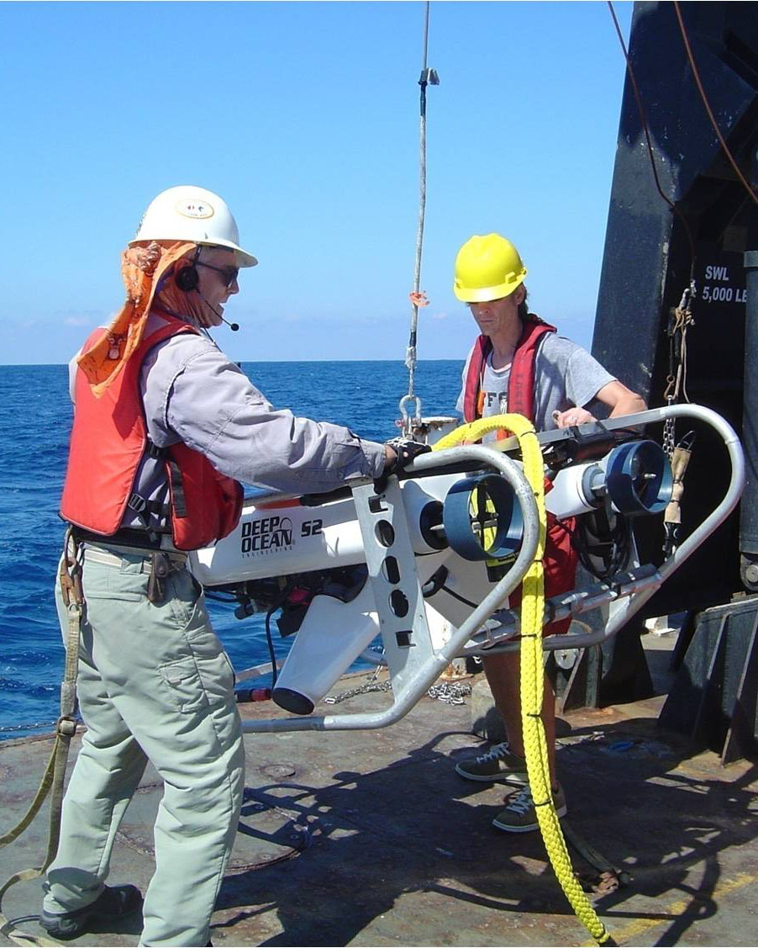
Improve the Cost-Effectiveness of Information Technology, Facilities, and Observing Systems
Improve capacity utilization and cost-effectiveness of mission-critical observation platforms
Improve the capacity and cost-effectiveness of systems for providing fishery-dependent observers at sea
Improve efficiency and cost effectiveness of our IT resources

