Slide 1
Factors Influencing Redd Observer Efficiency in the Wenatchee Basin
Chad Herring WDFW
Andrew Murdoch WDFW

Slide 2
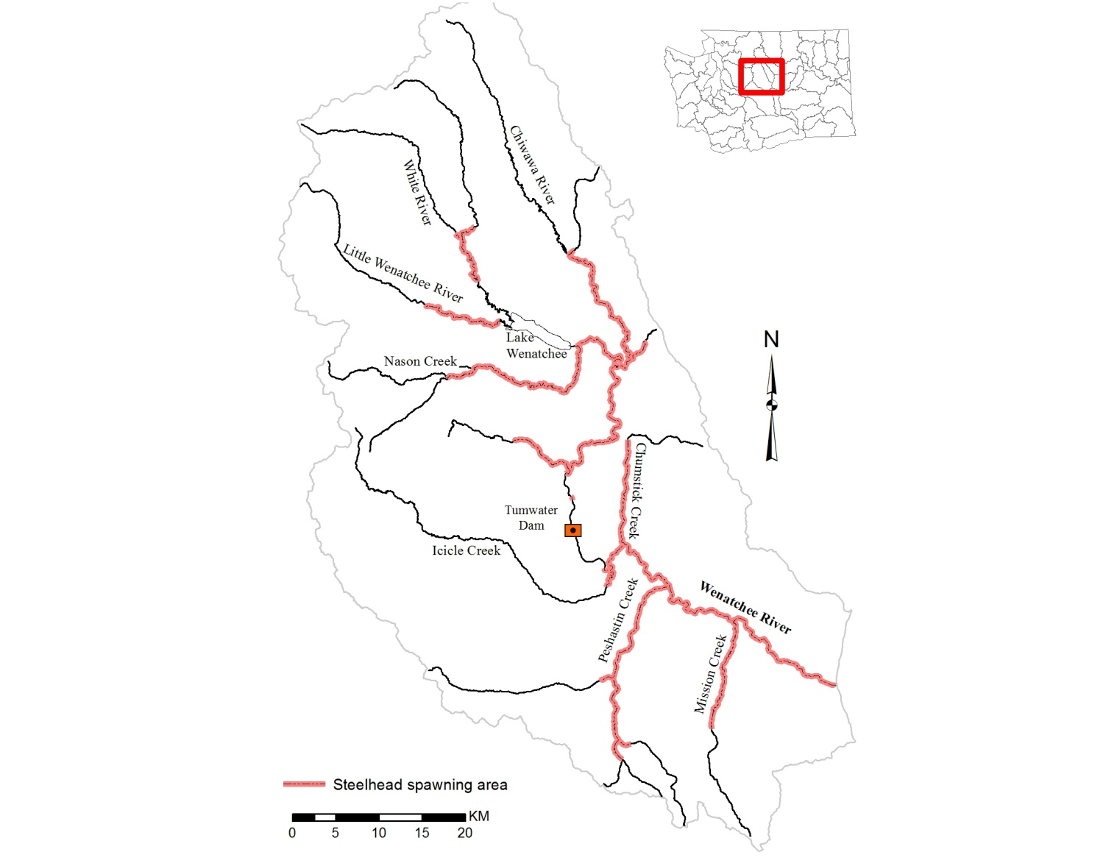
Wenatchee Basin Steelhead Spawning Distribution

Slide 3
History of Steelhead Spawning Ground Surveys in the Wenatchee Basin
First year of run escapement estimates generated from Tumwater Dam was 1999
Limited surveys conducted 2001 thru 2003
In 2004, current survey index areas were finalized
  Index spawning ground counts
  Surveys conducted weekly
  Redds are numbered sequentially and geo-referenced
  Expand non-index areas by ratio of visible to total redds in index areas
Mean run escapement to spawning escapement conversion rate of 56% for 2004 to 2009

Slide 4
Observer Efficiency Study
Evaluate the influence of habitat, environmental and observer specific variables
Three year study
Mark-resight approach adapted from Thurow and McGrath (2010)

Slide 5
Study Reaches
Minimum of 50 redds within reach
Reaches selected to maximize contrast
  Elevation
  Gradient
  Stream width
  Habitat type
  Spawner density
  Spawner distribution
  Channel complexity
4 reaches met criteria (2 in lower basin and 2 upper basin)

Slide 6
Census Surveys
Most experienced surveyors
Surveys conducted every three days
All features were numbered sequentially, mapped on aerial photos and geo-referenced (steelhead redds, false redds and salmon redds)
Environmental variables
Habitat variables
Redd counts were assumed to be the “truth”

Slide 7
Naive Surveys
Novice to expert surveyors
Surveys conducted during peak spawning
Environmental variables
Redds were numbered sequentially, mapped and geo-referenced
Goal of 10 surveys per census reach

Slide 8
Variables
Observer | Environmental | Habitat | Biological
Spawning ground experience | Precipitation | Substrate size | Density of redd like features
Steelhead spawning ground experience | Index of visibility | LWD
Reach specific steelhead spawning ground experience | Mean wind speed | Reach length (m)
Effort | Sunlight | Proportion of substrate with overhead cover type
 |  | Channel complexity
 |  | Thalweg variation
 |  | Mean width
 |  | Mean depth
 |  | Mean discharge

Slide 9
Observer Efficiency and Error Rates
Used aerial photos and GIS in combination
Proportion of redds correctly identified
Errors of omission (missed redds)
Errors of commission (false redds)
Total error (O + C/Total)
Net error (C-O/Total)

Slide 10
Results
Observer
  Effort
Environmental
  Visibility index
Habitat
  Stream width
  Discharge
  Channel complexity
Biological
  Density of redd like features

Slide 11
Effort
R_{s} = 0.47

Slide 12
Visibility index

Slide 13
Stream Width
R_{s} = -0.35

Slide 14
Discharge
R_{s}= -0.45

Slide 15
Channel Complexity

Slide 16
Redd Density
R_{s}= 0.83

Slide 17
Relationship between Experience and False ID rates

Slide 18
Relationship between Total Error and Net Error for All Redds

Slide 19
Discussion
The usual suspects
Error rates
The plan moving forward
Environmental x habitat interaction
Model development

Slide 20
Acknowledgements
Funding Entities: Bonneville Power Administration and Chelan County PUD
Technical assistance: Chris Jordan, NOAA and Kevin See, QCI Consultants
WDFW spawning ground surveyors and naive surveyors

