Slide 1
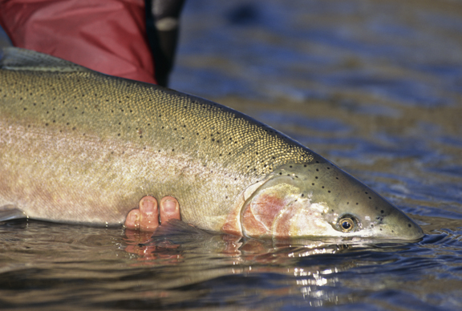
Steelhead Status Update for British Columbia
S. Pollard and M. Beere
BC Ministry of Forests, Lands and Natural Resource Operations

Slide 2
Overview
Stocks and Ecotypes in BC
Regional Trends in Abundance
Sport Fishery and Stocking Trends
BC Policy, Management and Challenges

Slide 3
Stocks and Ecotypes in BC

Slide 4
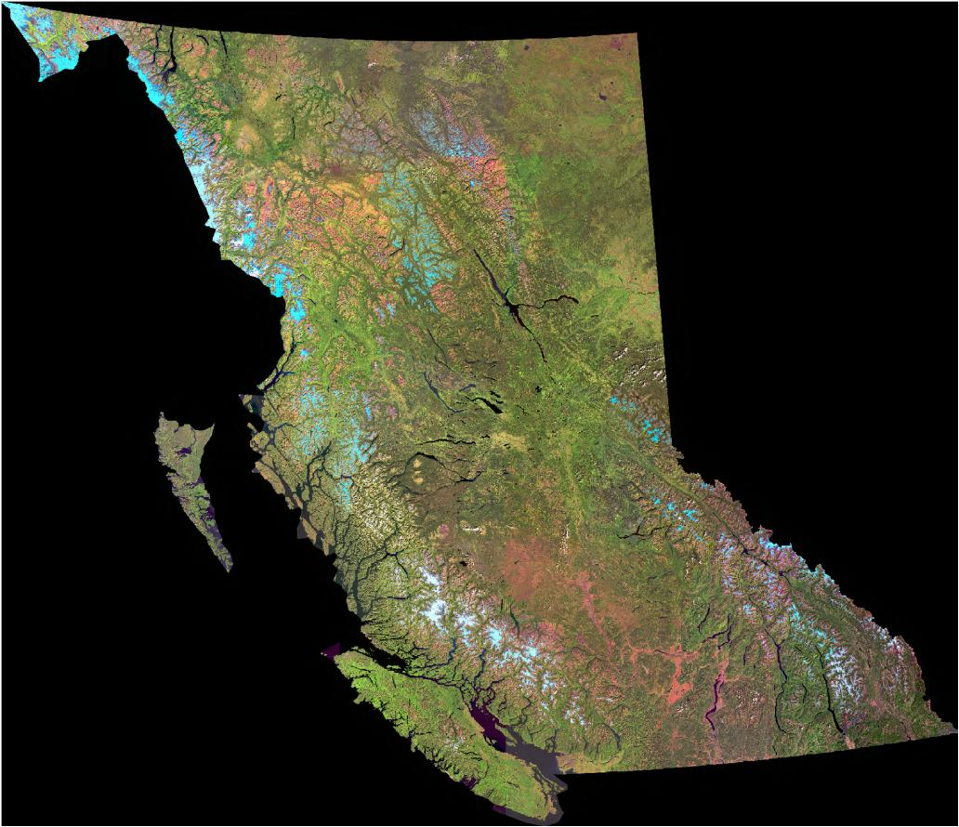
Taku
Stikine
Nass
Chilko/Chilcotin
Skeena
Mid Coast
(Bella Coola, Dean)
Thompson
L. Fraser
(Chilliwack, Coquihalla)
Vancouver Island
(Cowichan, Keogh,Stamp)
Vancouver

Slide 5
Stocks and Ecotypes
~430 steelhead stocks
Ecotype | Major systems | Number of stocks
Coastal winter (Dec-May) | L. Fraser, S. Coast, VI, Boundary Bay, L. Skeena, L. Nass, N. Coast | ~280-300+
Coastal summer (late Spring) | L. Fraser, VI, Bella Coola, Dean | ~30-40
Interior Summer (Summer-fall) | Mid-Fraser, U. Nass, U. Skeena, Stikine, Taku | ~70-80
Three main ecotypes:
Coastal winter
Coastal summer
Interior summer

Slide 6
Abundance and productivity
Most BC stocks occur in small coastal watersheds <300 km²,
typically support <10,000 smolts
Coastal BC streams generally not naturally productive due to
geology, high precipitation and gradient, in some cases declining
salmon stocks
Interior BC streams highly variable natural productivity, influenced
by growth season and geology; south more productive, north limit
of range considered very low (i.e. 4-5 years to grow a smolt)
Aggregate abundance for BC ~340,000 wild steelhead

Slide 7
Geography x ecotype determine:
Angler accessibility
Exposure to various commercial/FN salmon fisheries
Migration paths exiting/approaching rivers
Vulnerability to freshwater limiting factors such as low flows
Sport interest
Conservation status

Slide 8
Routine management zone
Conservation concern
Extreme conservation concern
Conservation
Status
(Ahrens 2004)

Slide 9
Regional Trends
in Abundance

Slide 10
Stock assessment tools:
Total adult counts (n=5) – weirs, resistivity counters
Abundance indices
  Adults
    Gillnet test fisheries (n=2)
    Fishwheels (n=1)
    Snorkel surveys (n=10-20) - winter, coastal summers
    Aerial counts (n=1) – interior summer
    Steelhead Harvest Analysis (catch, effort) – provincial
  Juveniles
    Fry and parr sampling (often hydro-related)

Slide 11
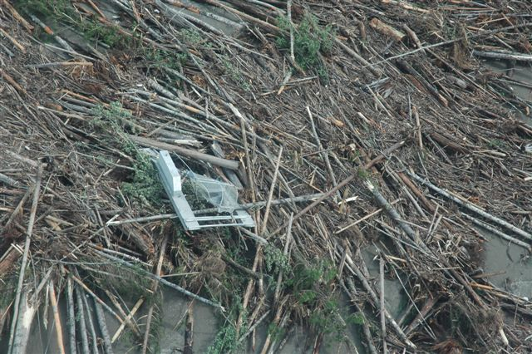
Find the fishwheel....

Slide 12
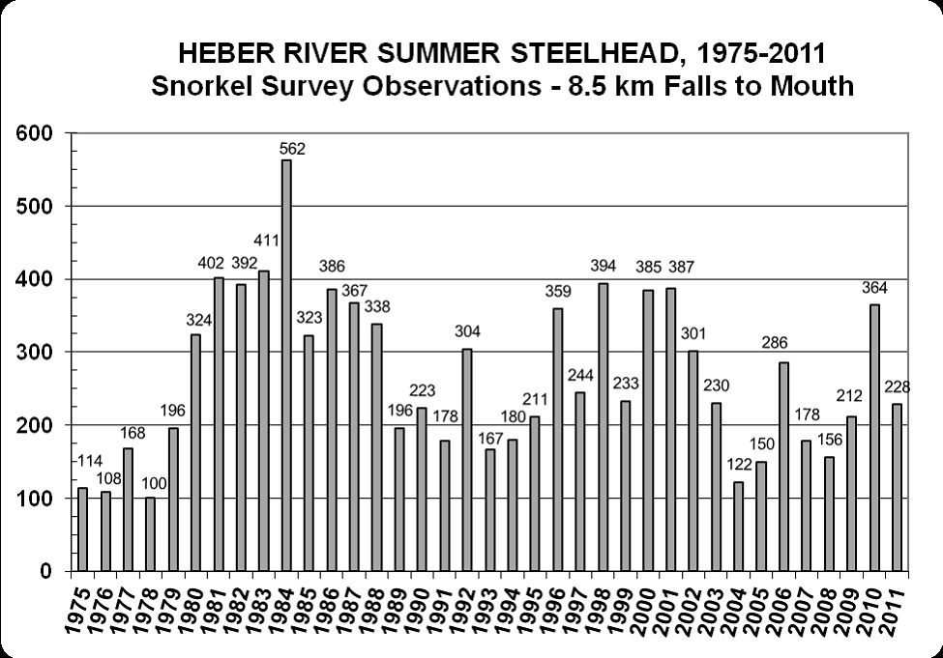
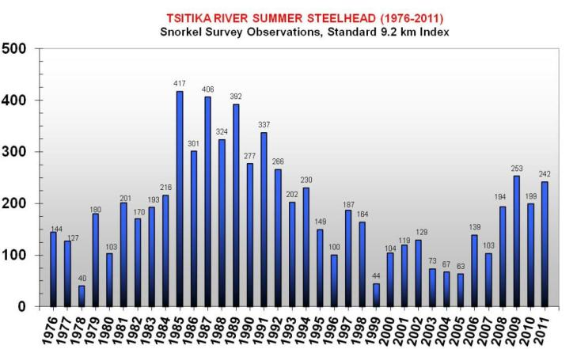
Heber River (WC) – 1975-2011 snorkel surveys
Vancouver Island
Coastal summer
stocks
Tsitika River (EC) – 1976-2011 snorkel surveys

Slide 13
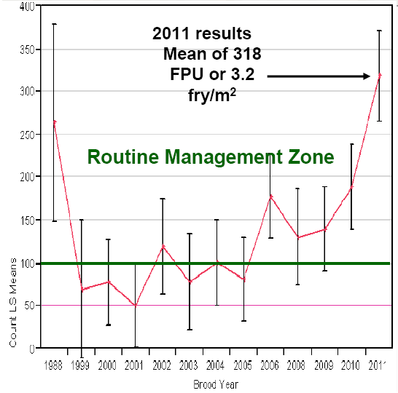
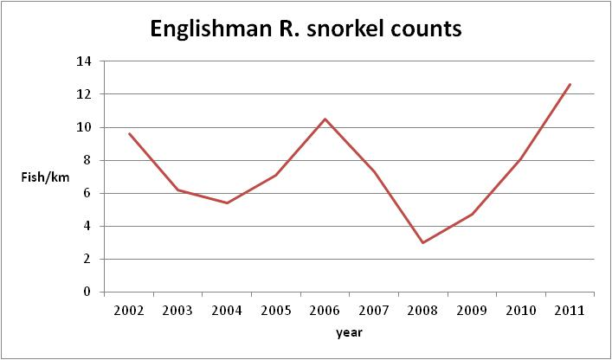
Cowichan River 1998-2011 - fry densities
Vancouver Island
Coastal winter
stocks
?
Englishman River 2002-2011 – snorkel surveys for adults
Notes:
Moving to coastal winters, here are two eastcoast Vancouver Island stocks –
Englishman is most comprehensive in terms of available stock assessment data for trend analyses -similar recent upswing
Though no adult data beyond catch information is available, fry data suggests the well-known Cowichan may also be experiencing a recent increase
general consensus that this upswing represents improving ocean conditions for these stocks.

Slide 14
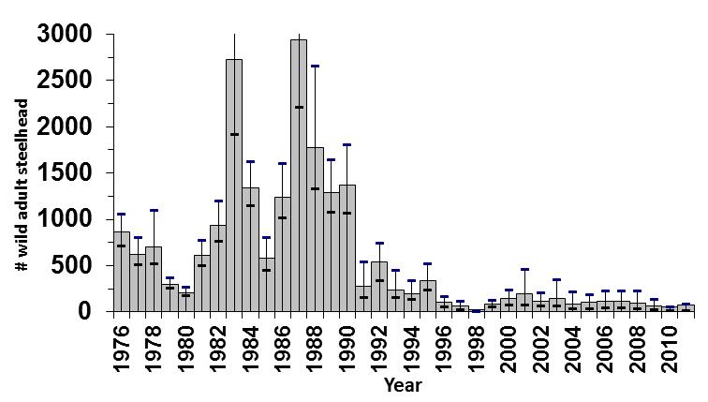
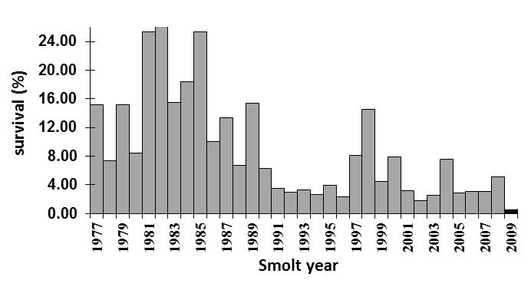
Keogh River (coastal winter stock)
Notes:
Perhaps BC’s most well-known research system for steelhead as our longest standing index system (in place since 1976-our equivalent to Snow Creek)
Keogh River is also outstanding in that unlike many VI systems, no recent increase observed – why? Not necessarily representative of other systems; low spring flows in this fairly small stream have hampered smolt output significantly, and parr habitat very limited to begin with – clearly something else going on; significant research, a fence, hatchery program….plus habitat restoration efforts
The Keogh is also the only system for which we have a direct measure of ocean survival – here we see the decline since 80’s with slight upswing in 90s.
The estimated number of wild adult steelhead at the Keogh River from 1976 to 2011, +/- 95% CL. Population estimates of the winter-run steelhead returns of the Keogh River are derived utilizing the Chapman modification of the Peterson mark recapture abundance estimator by marking upstream migrants and recapturing downstream migrant kelts at the fish fence during December through June.
Marine survival estimates for steelhead smolts by ocean entry year, Keogh River 1977- 2009, (data for 2009 requires additional returns in 2012 for the complete estimate).
The Keogh River on Northern VI has been a steelhead index stream since 1976.
The abundance of Keogh stock adult and smolt has undergone shifts.
Simplified reference points for Keogh are:
smolts/km adults/km
K 230 27
CCT 68 8
LRP 23 3
Recent abundance 61 3.8

Slide 15
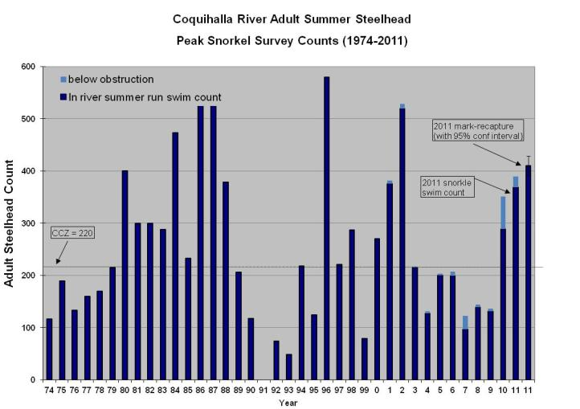
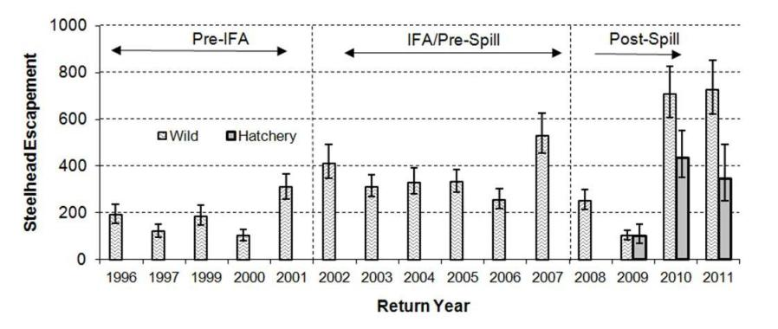
Lower Mainland
Coastal summer stocks
Chekamus River
Notes:
Over to mainland portion of Georgia Basin, and lower Fraser watershed
similar recent trends for some coastal summer stocks including Coquihalla and up the coast slightly, the Chekamus
Uptick in 2010-11 most evident in Cheakamus escapement estimate; you may recall the caustic soda rail spill in 2007; low returns expected in spill impact years; however in 2010-11 record returns of 700 were recorded
Some compensatory response expected, with some recovery as well, but not to this extent
Trend seen in several monitored lower mainland stocks AGAIN thought to reflect improved ocean survival, all else being equal
IFA – instream flow agreement

Slide 16
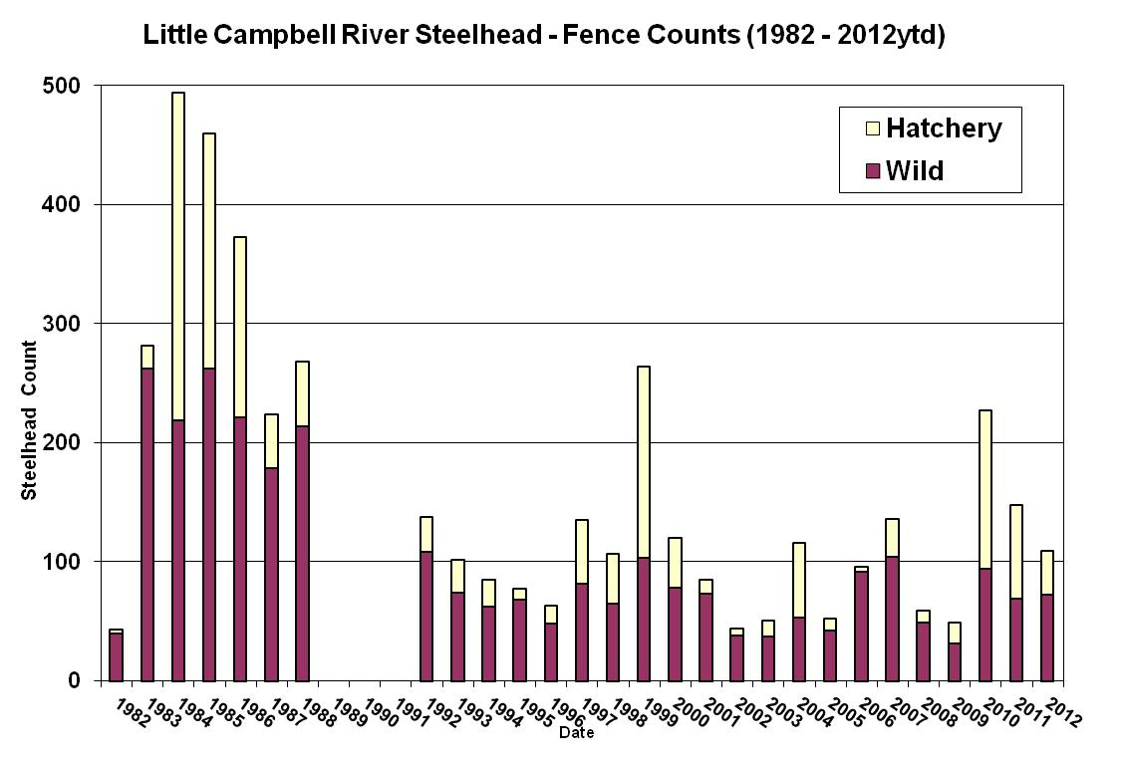
?
Winter run stock

Slide 17
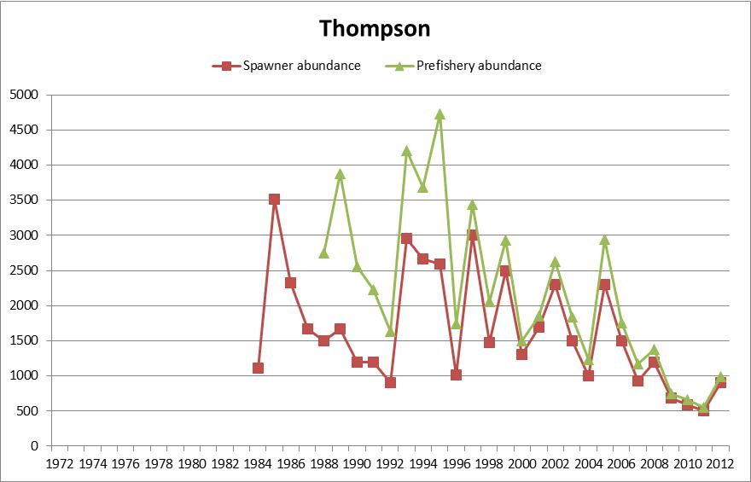
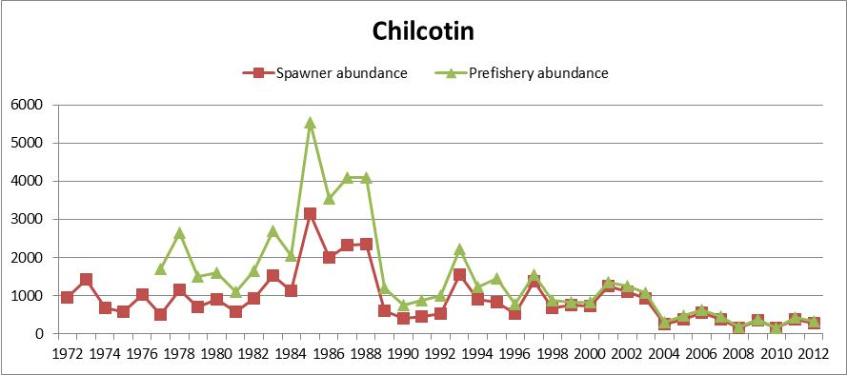
Thompson/
Interior Fraser
Interior summer
runs

Slide 18
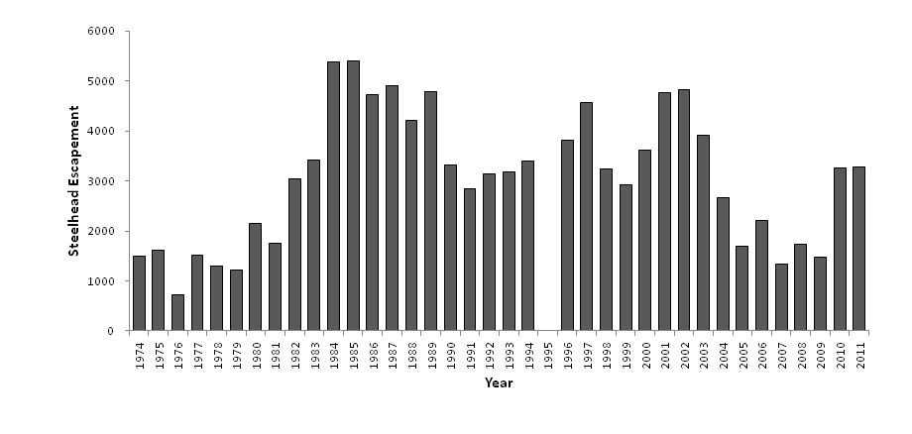
Mid Coast
Dean (coastal summer run)
catch

Slide 19
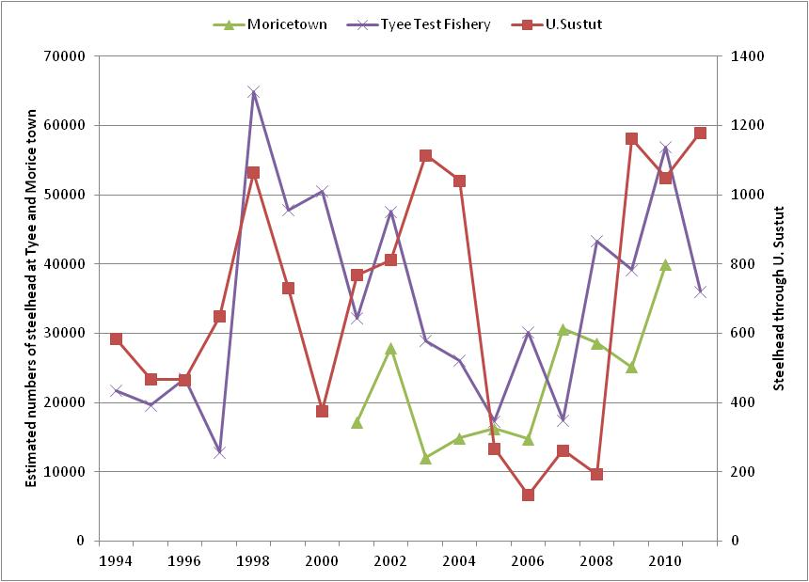
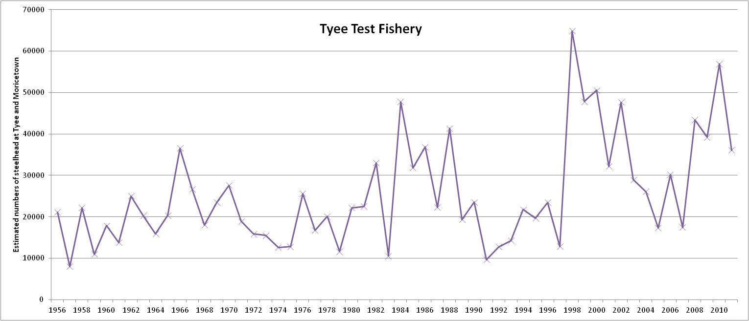
North Coast
Skeena (interior summer run stocks)

Slide 20
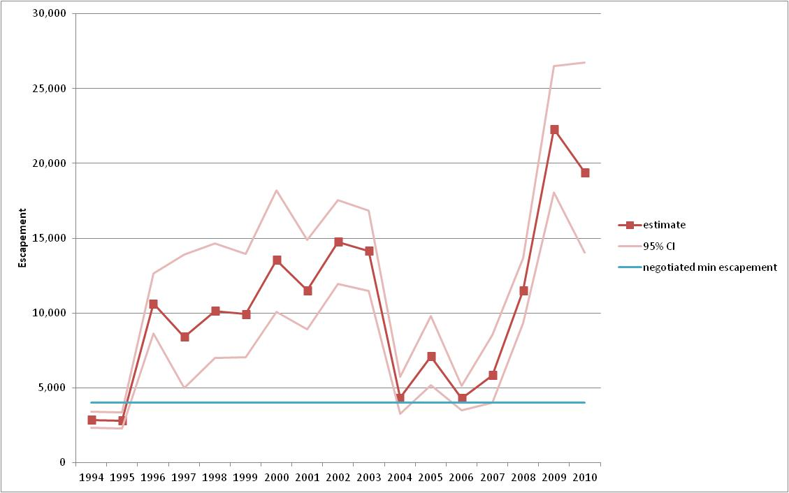
Nass (interior summer run)
Notes:
Slightly north of Skeena Nass is the other large watershed in the north that support interior summer run steelhead, though only a portion of that for the Skeena, as well as coastal winters
This is other watershed in the region were an index program for the aggregate run has been in place for a number of years.
The Nisga’a run fishwheels (n= up to 6, M-R through consecutive wheels) provides annual index which is augmented every 3 years with tributary marked/unmarked catch ratios.
Recent estimates of escapement suggest an increase significantly higher than the minimum escapement goal outlined in the Nisga’a treaty agreement.
North of Nass, have summers in Taku and Stikine but know very little of these populations

Slide 21
Sport Fishery and
Stocking Trends

Slide 22
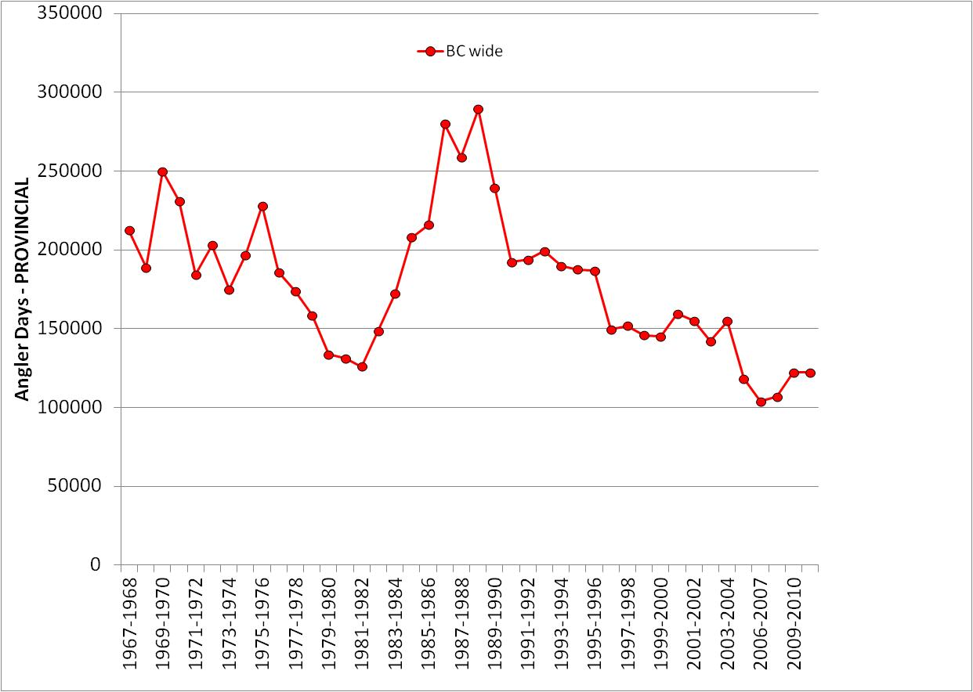
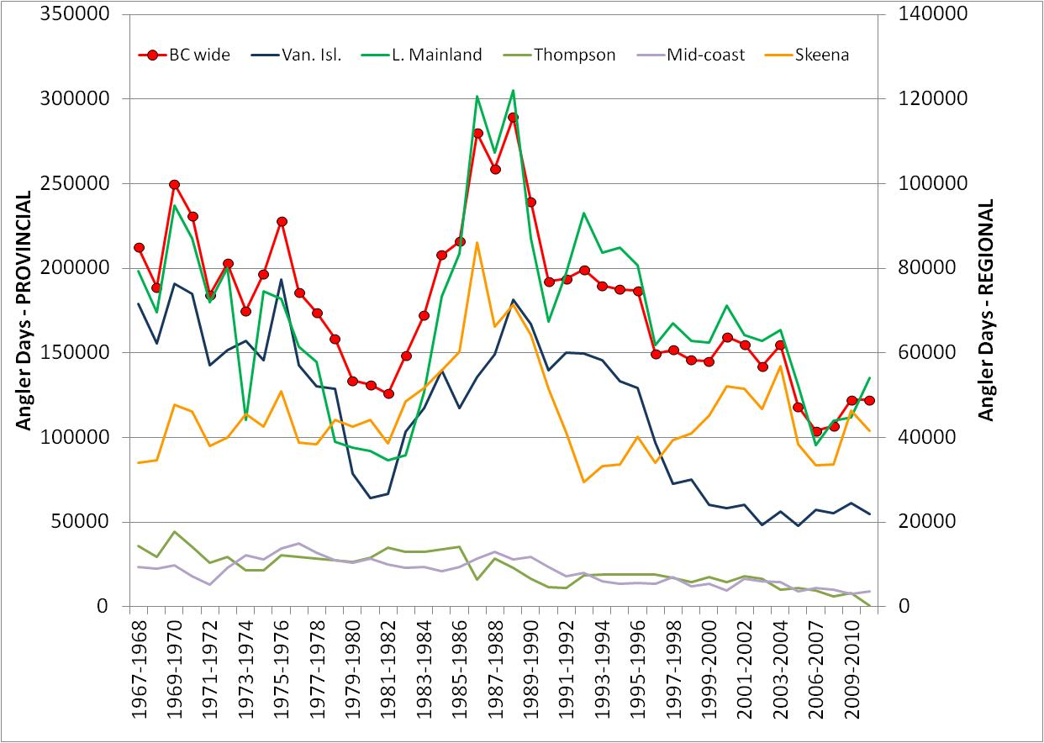
Results of Steelhead Harvest Analysis (SHA)
– Effort by Region and Provincially

Slide 23
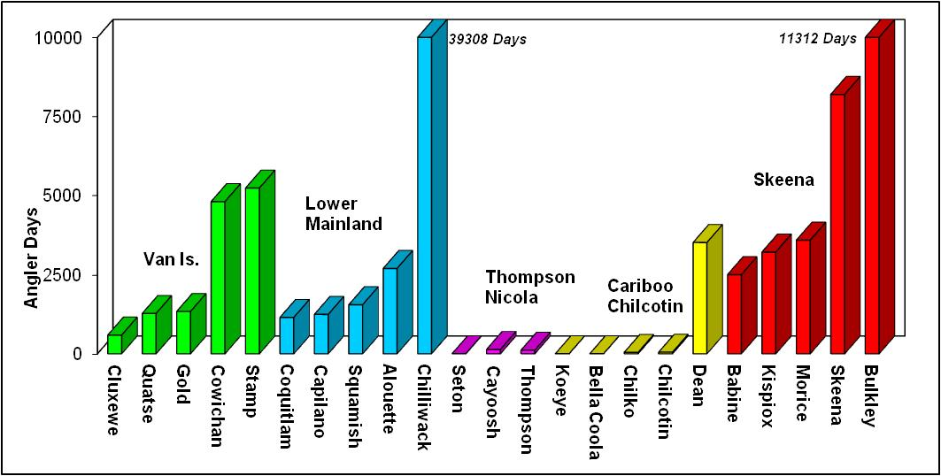
Effort Distribution over Top 5 Streams by Region

Slide 24
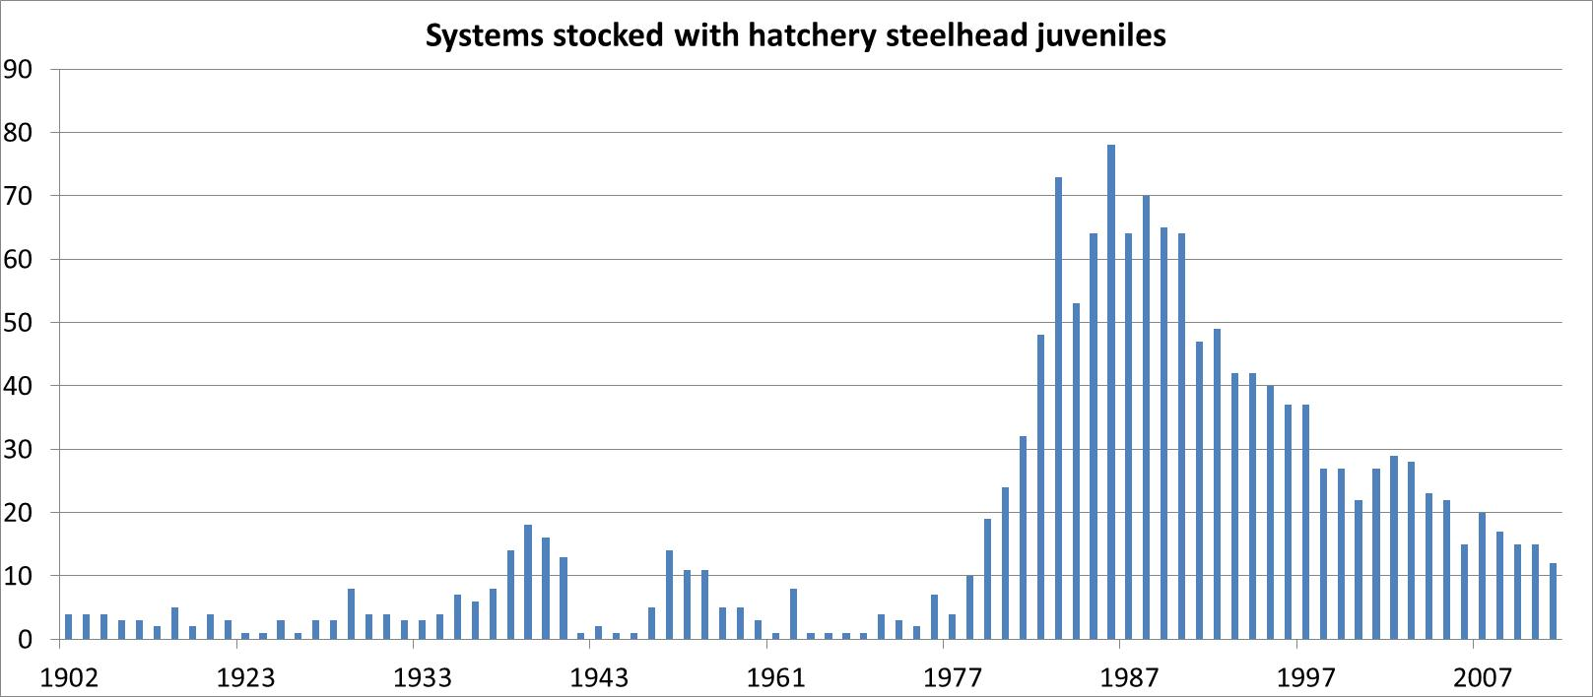
The Hatchery Factor
Period Av # Fry/yr Av # Smolts/yr
1975-79 .07M .07M
1980-84 1.03M .60M
1985-89 1.59M .91M
1990-94 .73M .82M
1995-99 .26M .63M
2000-05 .09M .60M
2006-11 0 .38M
SEP

Slide 25
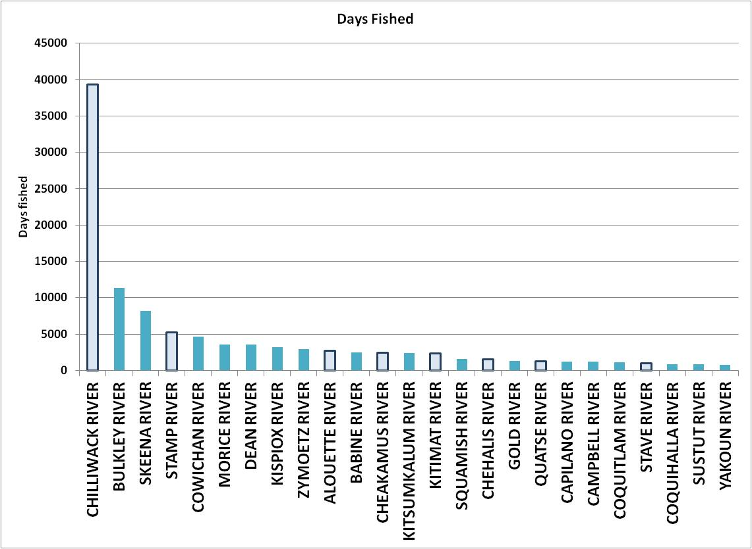
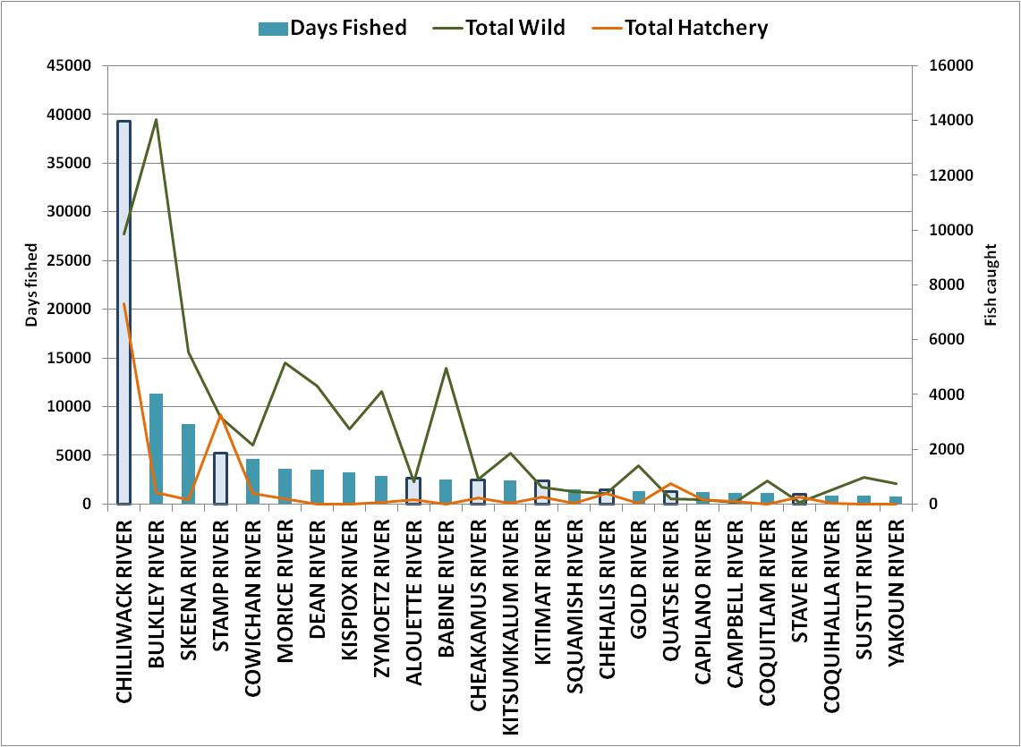

Slide 26
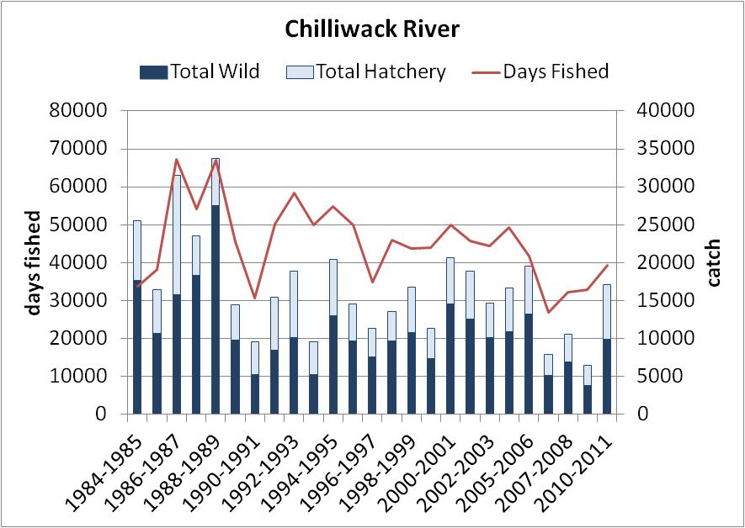
Lower Mainland

Slide 27
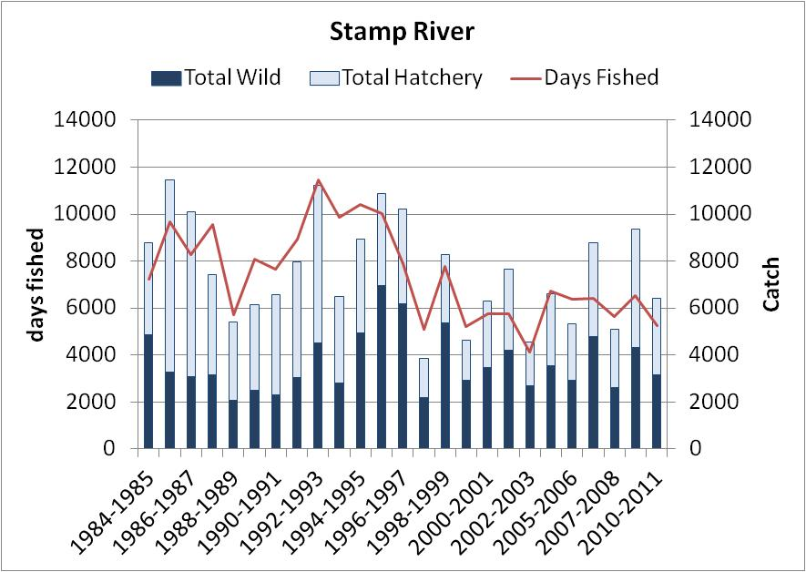
Vancouver Island

Slide 28
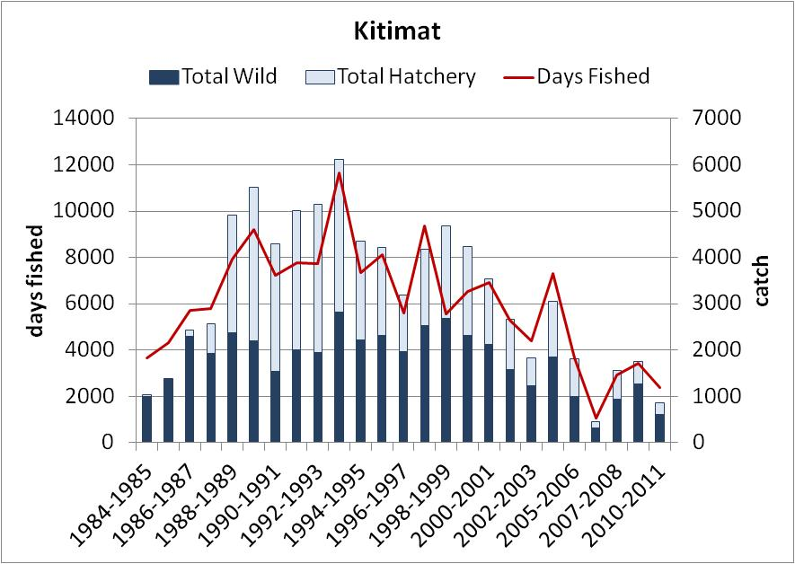
North Coast

Slide 29
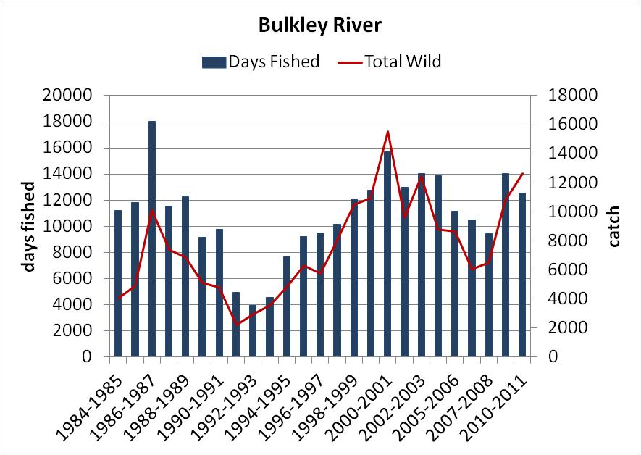
North Coast

Slide 30
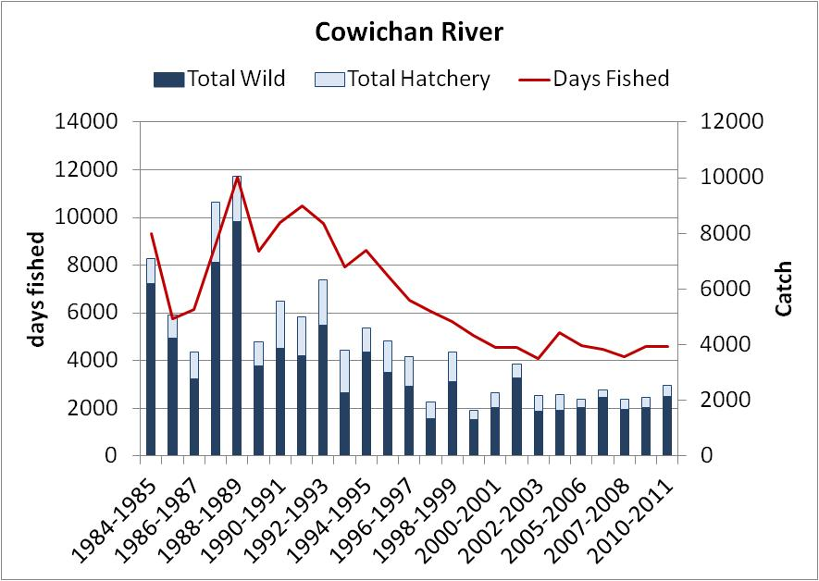
Vancouver Island

Slide 31
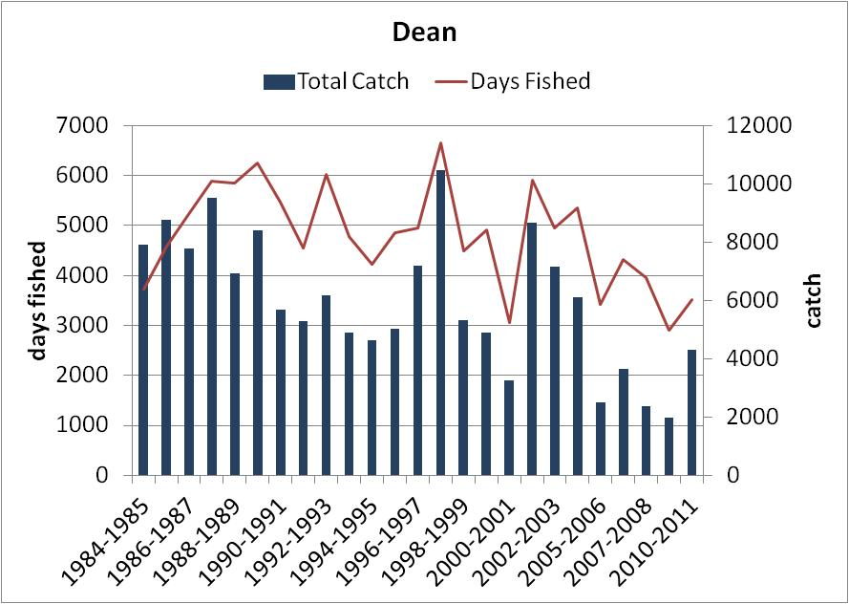
Mid Coast

Slide 32
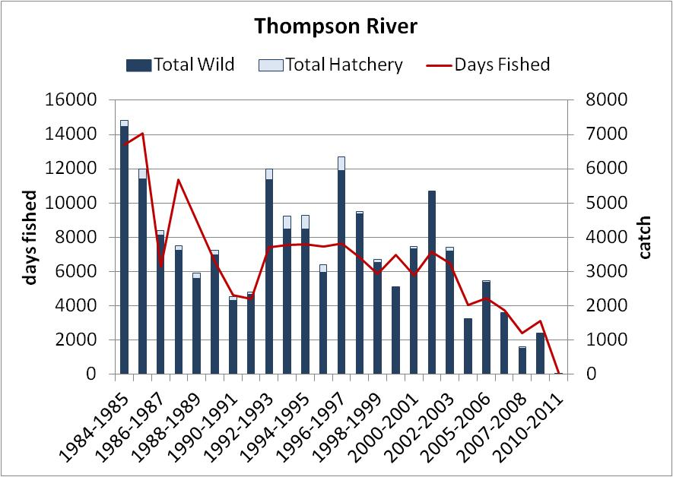
Interior Fraser

Slide 33
Take-home messages on trends:
Mixed; recent increase or much declined but stable
Fewer systems supporting effort provincially
Shifted focus to north
moving into an era of highly variable, unpredictable
ocean conditions

Slide 34
BC Policy, Management
and Challenges

Slide 35
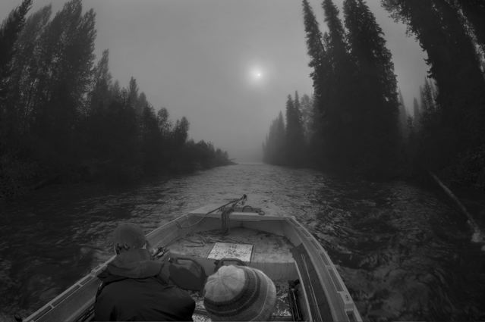
Where are we going?
Steelhead Stream Classification Policy up for 5 year review
Classification as wild (default) or hatchery-augmented
All wild fish catch and release, harvest on hatchery fish
Hatcheries only for sport fish augmentation, not rebuilding
Provincial objective: Maximize escapement upstream
Conservation e.g. Thompson
Socio-economic e.g. Skeena
Where interception occurs: Minimize encounter rates in non-selective fisheries
Consistency in management approach
The great bait debate --- bait ban for all summer run fish ?
Seasonal closures where extended freshwater residency occurs

Slide 36
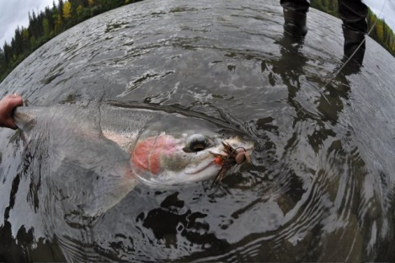
Thank You.
Acknowledgements
Mike McCulloch
Greg Wilson
Rob Bison
Ron Ptolemy
George Scholten
Bob Hooton

