Slide 1
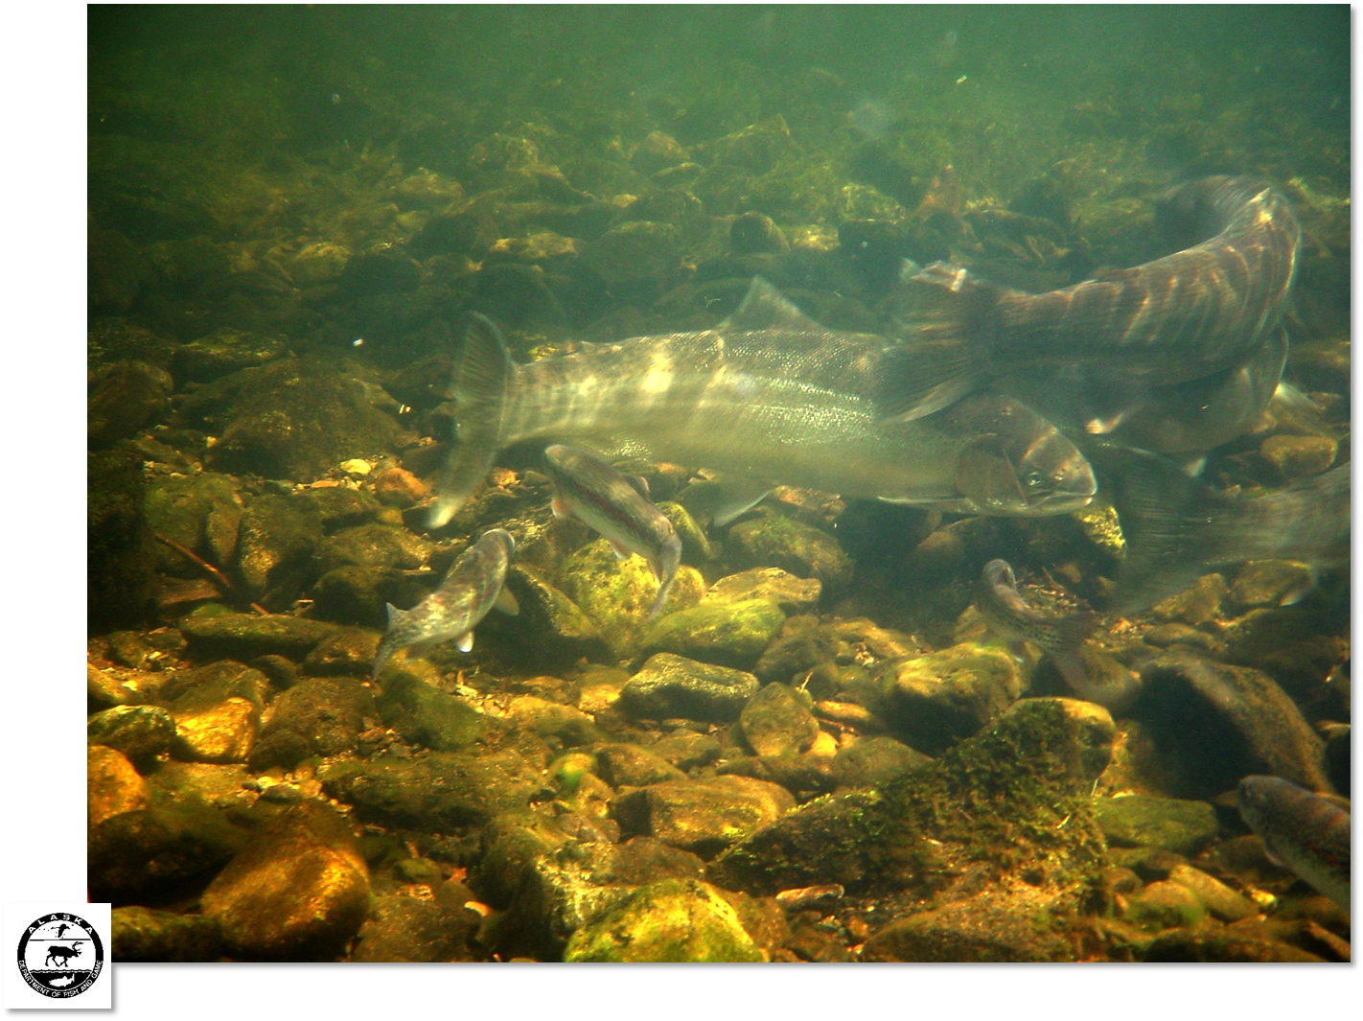
Important factors in sustaining production in a small Southeast Alaska stream: repeat spawning, smolt survival and straying
David Love
and
Roger Harding
March 2012
Pacific Coast Steelhead Management Meeting, Port Townsend, WA
Alaska Department of Fish and Game-Division of Sport Fish
Matching funds from US Fish and Wildlife Service Federal Aid in Sport Fish Restoration Act
(16 USC 777-777K) under projects F-10-18 toF-10-23, Job R-1-9)

Slide 2
Location | Overall sample size | repeat spawning (%) | # spawning events
stream maturing
SE Alaska - ? systems | trans-boundary rivers + ?# others
SC Alaska - 2 systems | 591 | 11-38 | 1-3
British Columbia - 4 systems | 279 | 3-7 | 1-2
Washington - 0 systems | stream-maturing other than the Columbia?
Columbia R. Basin – 2 systems | 1,057 | 3-7 | 1-2
Idaho - Clearwater River | ? | 0.85- 2(?) | 1-2(?)
Oregon – Rogue R. | 4,058 | 17-21 | 1-2
California - 0 systems | stream-maturing in any systems?
Notes:
Stream-maturing….. July(or earlier…) –as late as December…Stream maturing…Summer-run

Slide 3
Location | Overall sample size | repeat spawning (%) | # spawning events
ocean maturing
SE Alaska - 5 systems | 2,010 | 11-70 | 1-5
SC Alaska - 2 systems | 385 | 44-74 | 1-4
British Columbia - 4 systems | 2,627 | 5-31 | 1-4
Washington - 7 systems | not cited (Snow Ck: n=921) | 7-12 | 1-3
Columbia R. Basin - 3 systems | 1,456 | 4-10 (~12% pre-dam) | 1-4
Oregon - 2 systems | 1,348 | 11-14 | 1-5
California - 4 systems) | 4, 032 +/- | 17-23 | 1-4
Notes:
Ocean maturing in Alaska: Sept-July….Ocean maturing = winter run…

Slide 4
Repeat spawning in Steelhead:
most spawn once, high repeat spawning rate, variable elsewhere
more common in ocean-maturing
more commonly females
size of repeat spawners varies
5) lowest for inland populations, higher for coastal
6) higher in short streams and at higher latitudes
7) In Alaska: selection by dynamic, geologically young systems
8) In Alaska: may also be a result of slower growing, older, better surviving smolts
(various authors)
(Busby et al. 1996)
(Burgner et al. 1996)
(Hendry and Stearns 2004; Seamons and Quinn 2010)
(Narum et al. 2008; Busby et al. 1996)
(Riva-Rossi 2007; Savvaitova et al. 1999, Lohr and Bryant 1999)
(Montgomery 2000)
(Berrigan and Charnov 1994)
Notes:
Rainbow trout coastal refugia:
California(center of endemism), Columbia River (clade A mt DNA source of haplotype),
Queen Charlottes , Berengia/ NW Alaska (clade B mt DNA-coastal haplotype)
(McCusker et al. 2000)

Slide 5
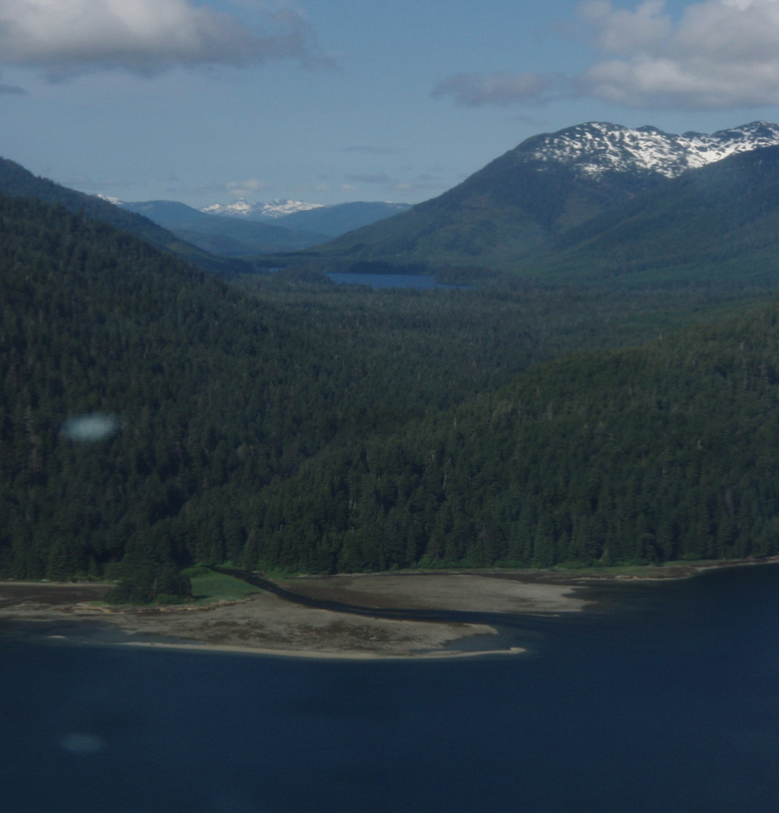
Sitkoh Creek steelhead production study, 2003-2009
lake-fed, non-glacial, short (9km) source at Sitkoh Lake
Latitude: ~ 58 º N
Also supports:
  sockeye, pinks, chums and coho
  Dolly Varden char, cutthroat and resident rainbows
Previously weired: 1936/37, 1980, 1993, 1997
Important sport fishing system
Supports moderately large population
Notes:
In 2003, through matching funds from U.S. Fish and Wildlife Service’s Federal Aid in Sport Fish Restoration Act
Alaska Dept of Fish and Game Sportfish Division initiated a multi-year study of steelhead production at Sitkoh Ck, SE Alaska,
Sitkoh Creek is a coastal stream at high latitude (about 58 º N), that is 56 km NE of Sitka, sourced at Sitkoh Lake it flows 8 km, to saltwater estuary
SE facing, lake fed, non-glacial system that also supports salmon (sockeye, pinks, chums, & cohos), Dolly Varden char, cutthroat, rainbow trout and steelhead
Chosen because: 1. important sport fishery – top 10
2. weir site 5 times previously-1936/37
3. clearwater system - moderately large escapement 400-1200 adult steelhead

Slide 6
CHICHAGOF IS.
WEIR
SITE
SITKOH CREEK
SITKOH LAKE
SITKOH
BAY
PERIL STRAITS
Notes:
SE facing, lake fed, non-glacial system that also supports salmon (sockeye, pinks, chums, & cohos), Dolly Varden char, cutthroat, rainbow trout and steelhead
Chosen because: 1. important sport fishery – top 10
2. weir site 5 times previously-1936/37
3. clearwater system - moderately large escapement 400-1200 adult steelhead
Note location of FORD ARM

Slide 7
Sitkoh Creek Steelhead Production Project
Objectives
adult steelhead & steelhead smolt production:
enumeration, PIT tagging, age/sex/lengths
Ultimate Goals: estimate production, develop brood-tables & smolt-per-spawner estimates, support habitat use project
  Also got:
  marine survivals, adult repeat spawning and straying, life-history variations
  Support 2 concurrent projects:
  Smolt per usable habitat – habitat capability project
  Expansion estimates – annual index stream snorkel surveys
Notes:
Sitkoh Project goals, objectives and additional demographic knowledge gained
ADDITIONAL: Habitat Capability study: characterization and fish use (Crupi & Nichols)
SE Alaska snorkel surveys on regional INDEX streams(Coyle & Harding)

Slide 8
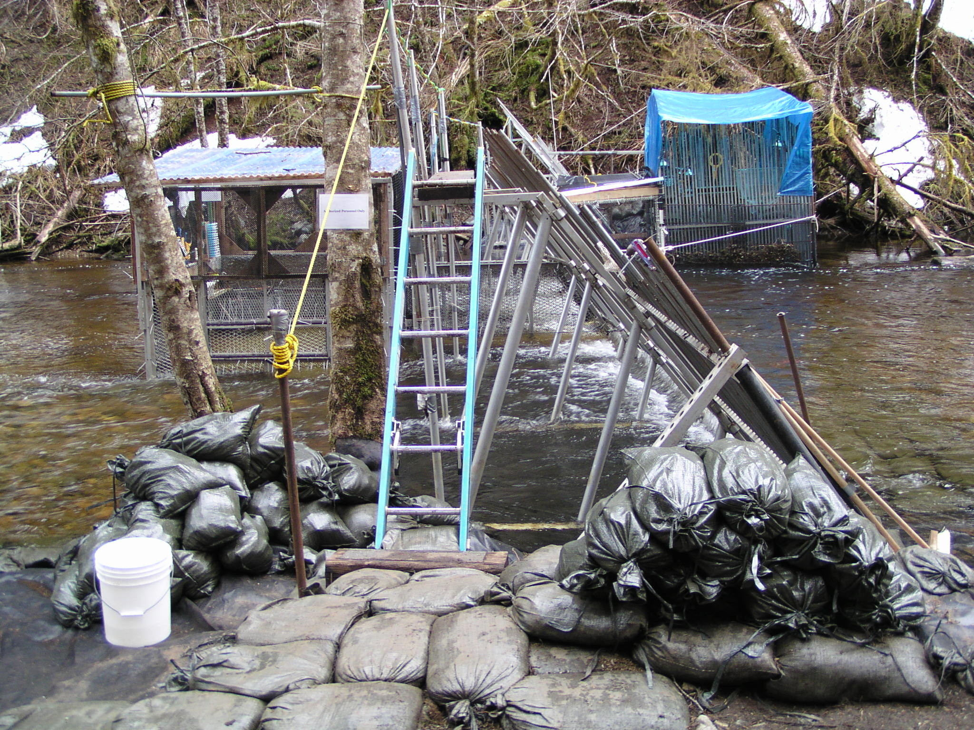
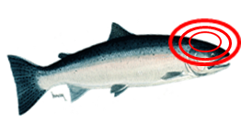
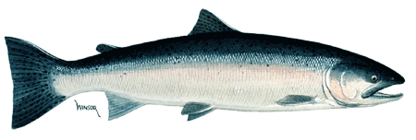
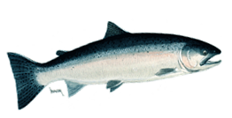



Sitkoh Creek Weir- configuration and operations
Notes:
SITKOH CREEK WEIR CONFIGURATION AND OPERATIONS
Aluminum Bipod & Picket weir-300 m upstream from confluence w/ saltwater, upstream & downstream traps
same location that was used in 1936-1937, 1982, 1990, 1996
April-end of June each year 2003-2009
Click 1: Upstream Adults: PIT tagged, fin clipped, Scale samples/Gender/Lengths (less than 1 minutes/45 secs), previously tagged
Click 2 Downstream smolts:
Front of weir…Vinyl Coated Wire…. ….catches everything 150 mm and larger…
anesthetized, tagged, clipped, scale samples, lengths, held and released at night
Click 3 Downstream Kelts,
checked for tags/tagged if absent, lengths & release
Most movement from 11 pm to 2 am
Also counted & systematically sampled for lengths: cutthroat trout, Dolly Varden char, “Sea-run”Rainbow trout

Slide 9
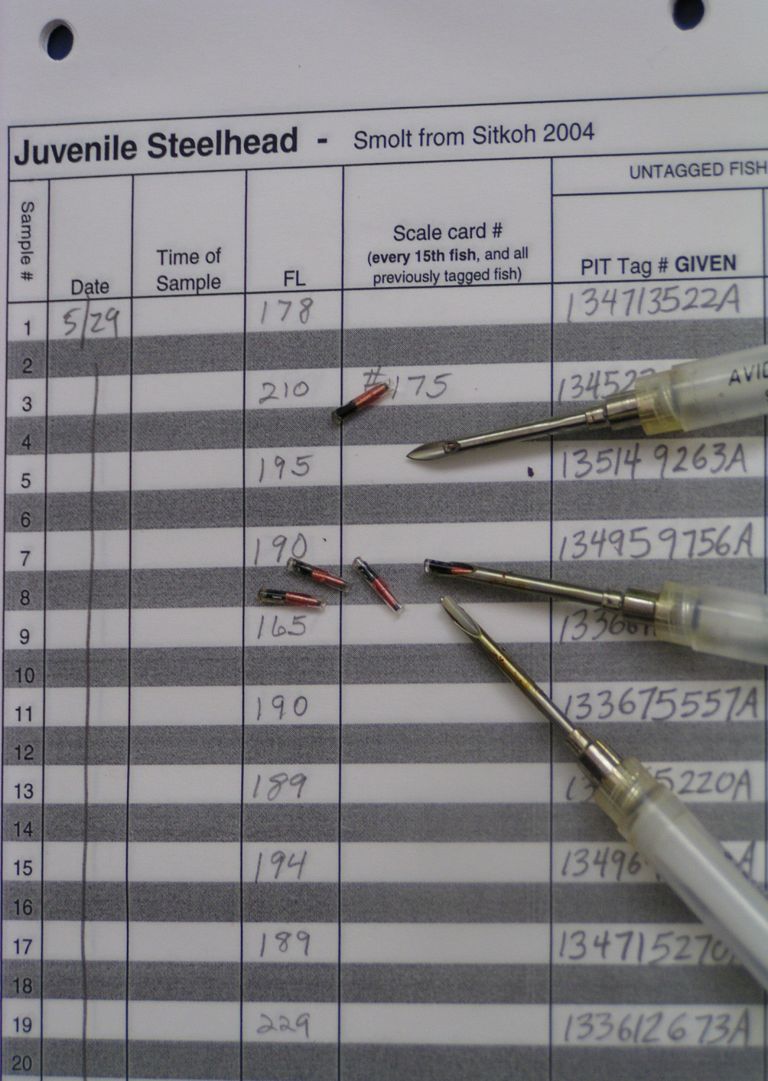
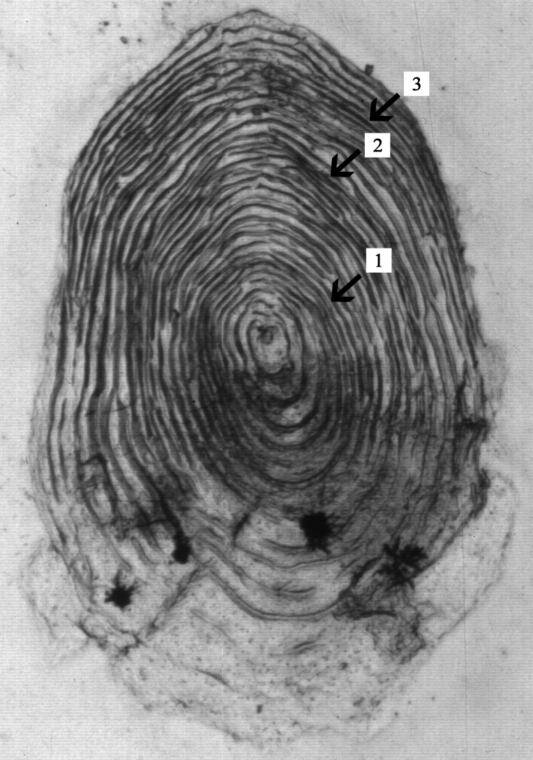
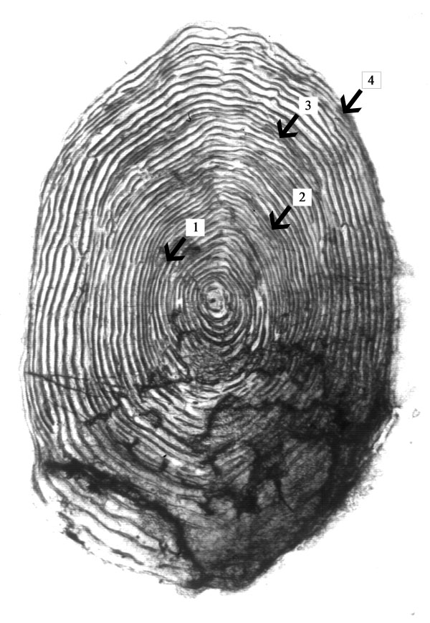
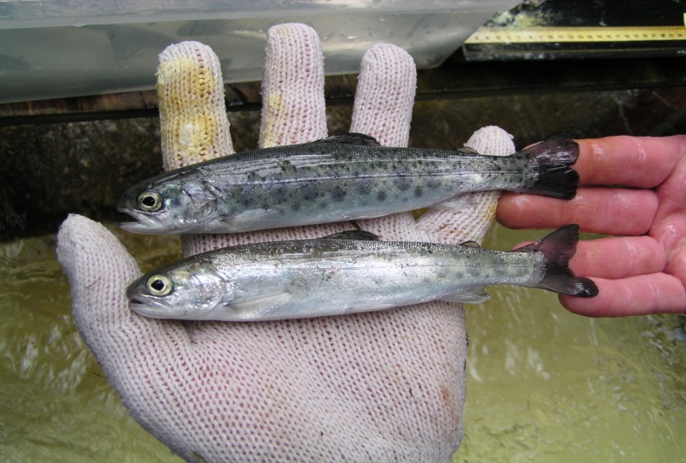
during 2003-2009:
3,626 (99%) adults tagged
16,666 (98%) smolt tagged
Tag survivals: 85-98% overnight Tag retention: 94%, up to 7 yrs
during 2003-2009:
1,551 (44%) adults scaled
1,628 (9%) smolt scaled
Scale aging:
Triplicate reads
Same scale ager throughout entire study
Verified adults with PIT-tag recaptures (88-100% agreement)
Notes:
PIT-tagging: subdermal insertion, PIT numbers recorded electronically and on paper,
Tag survivals good
very good tag retention (94% compared to implantation into body cavity(4%)Nielson et al. 2011- Ninilchik River, Kenai Pennisula
Systematic scale samples –triplicate, same scale ager, verified marine ages
88-100% agreement on repeat spawning (PIT-tag & scale aging) –spawn checks very evident

Slide 10
Sitkoh Creek Adult and Smolt Production and Demographics 2003-2009
Sample year
2003
2004
2005
2006
2007
2008
2009
Adult immigration
Total immigration
679
764
543
395
392
487
398
523
% PIT tag recaptures
0
14.4
22.5
62.0
72.2
66.9
69.8
68% recaps
% repeat spawner
33
45
45
39
54
36
34
41% repeat
% female
62
60
67
65
66
68
78
69% female
Adult emigration
Total emigration(%)
460(68)
565(74)
363(67)
292(72)
345(83)
390(92)
360(88)
76% kelt survival
% female
62
60
67
65
66
68
78
72% female
Steelhead smolt
Total emigration
3,166
3,742
2,230
3,561
1,704
1,751
893
2435
% Smolt-adult (2-, 3-ocean)
6.2
4.4
5.7
7.9
3.7*
--
--
Avg: 6.1%
Rainbow trout
Total emigration
28
40
9
41
40
53
23
33
Notes:
Note: 1)averages, 2)% 1st time spawners, 3) sex ratio favoring females, 4) marine survivals, 5) limited contribution by rainbow trout
Also note: lower adult escapements 2006-2009 – maybe due to marine survivals… Brian Marston’s talk…
1) Sashin Creek east of Sitkoh Creek, 2) Situk River declines until 2010, 3)lower escapements in BC streams: Keogh, Skeena, 4) and SE snorkel surveys…
lower smolt production 2007-2009 – maybe due to extreme high water in fall of 2005/ spring of 2006 and 2007…flushing of fry, smolt
This left a foreshortened dataset… that is not really sufficient for spawner-recruit analysis,
And the question: How is production sustained in Sitkoh Creek?

Slide 11
Sitkoh Creek Smolt-per-Spawner estimates
Broodclass Year | Adult escapement | Smolt outmigration | smolts-per-spawner (SPS) by return year |  |  |  |  |  |  | overall SPS
 |  |  | 2003 | 2004 | 2005 | 2006 | 2007 | 2008 | 2009
2003 | 679 | 3,166 |  |  |  | 1.793 | 1.35 | 0.338 | 0 | 3.48
2004 | 764 | 3,742 |  |  |  | 0.014 | 0.426 | 1.18 | 0.046 | 1.67
2005 | 543 | 2,230 |  |  |  |  |  | 0.864 | 0.836 | 1.7
2006 | 395 | 3,549 |  |  |  |  |  |  | 0.898 | 0.9
2007 | 392 | 1,704 |  |  |  |  |  |  | 0.074 | 0.07
2008 | 487 | 1,751
2009 | 397 | 893
average: | 522 | 2,434
*average SPS based on 2003-2005 freshwater ages 3, 4, and 5 returning 2006-2009
2.58*
SPS very low…How is Sitkoh Creek Steelhead production sustained?
Notes:
Based on Brood-table analysis and estimates of SPS…
So in 2010, after 7 years of ice water, flooding, sleep deprivation and otter harassment, the project was moved to Big Ratz Creek on POW Island... That project has now also been cut… which means I get to come here rather than put a weir in…mixed blessing…

Slide 12

How is production sustained on Sitkoh Creek?
’06-’09 avg # adult spawners: 418 ‘06-’09 SPS: 2.58
418 x 2.58 SPS = 1078 smolts x 6.1% marine survival = 66 adults
66 1st time spawners x 69% female= 46 females x 0.91=
66 1st time spawners x 31% male = 20 males x 0.57 =
avg repeat spawning rate (‘06-’09) based on scales: 41%
41% x 418 = 171 repeat spawners x 72% female = 123 females
123 females x 1.17 =
171 repeat spawners x 28% male = 48 males x 1.54 =
42 + 11 + 144 + 74 = 271 adults/418 = 65%(compare to 68%)
32% untagged (strays?) x 418 = 134 + 271 = 405 adults
adult offspring per adult
(Seamons & Quinn 2010)
42 adults
11 adults
144 adults
74 adults
Notes:
“Bar Napkin Production model”…paper by Seamons and Quinn published in 2010, on estimated adult offspring per adult…first-time and repeat spawning males and females…Applied SPS from adult production in 2003-2005 to 2006-2009 LOW adults…
…I decided to try to…account for the factors in the Sitkoh steelhead population that might contribute to sustaining the low Creek’s low production…How is production sustained on Sitkoh Creek…
…luckily we spent so much effort on PIT tagging…and scale aging all the smolt we sampled… (1628 scale samples times 3 reads each = 4,884 scale images …)…if you recall, recapture rates in 2006-2009 when we had the best tag coverage averaged about 68%...
KEY components even if marine survival is low (6%):
…REPEAT SPAWNING and SEX RATIO skewed to FEMALES which have a HIGHER REPRODUCTIVE SUCCESS…and in Sitkoh Creek a small proportion (less than 5%) may spawn 5 or more times….and Maybe Straying…(Jeff Olsen)

Slide 13
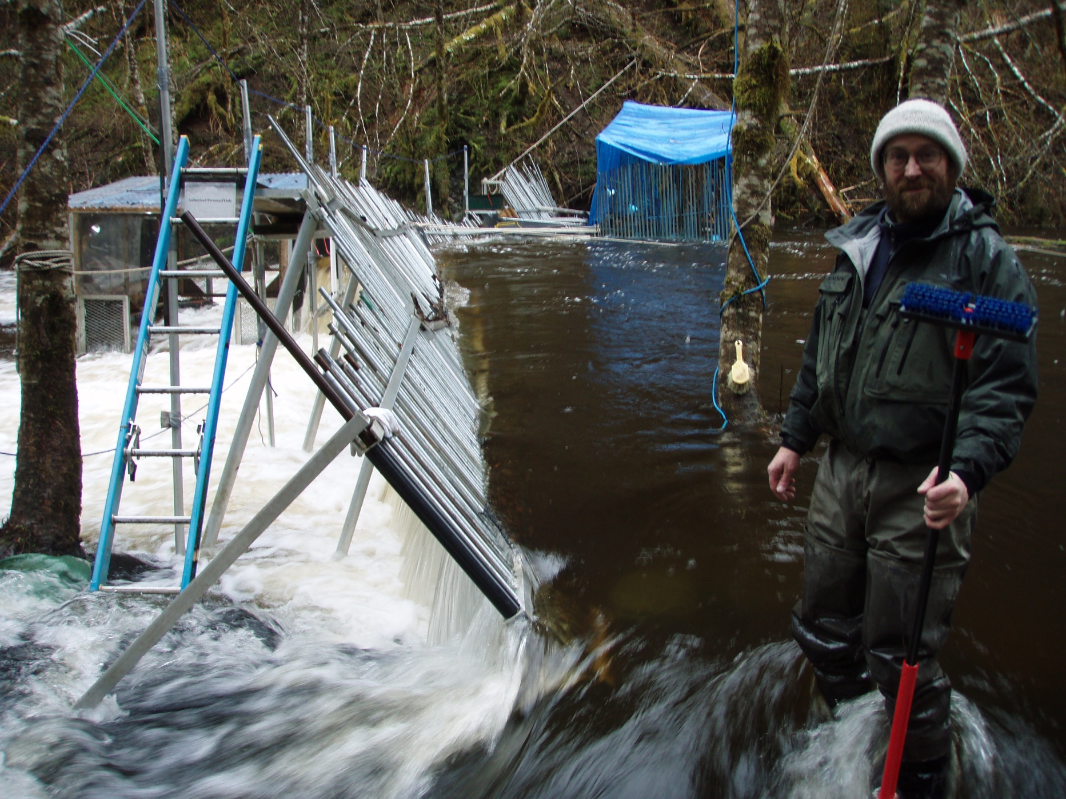
Sitkoh Creek: hydrologically dynamic system
Notes:
So, adult and smolt system-wide enumerations during 2003-2009, and the SPS model for Sitkoh Creek seem to indicate that production is low but sustainable….now, what happened to the fry production in 2007-2009?...
Here is a picture of the weir at a spring flood in April of 2008 about 400 CFS. These types of floods are common in the early spring

Slide 14
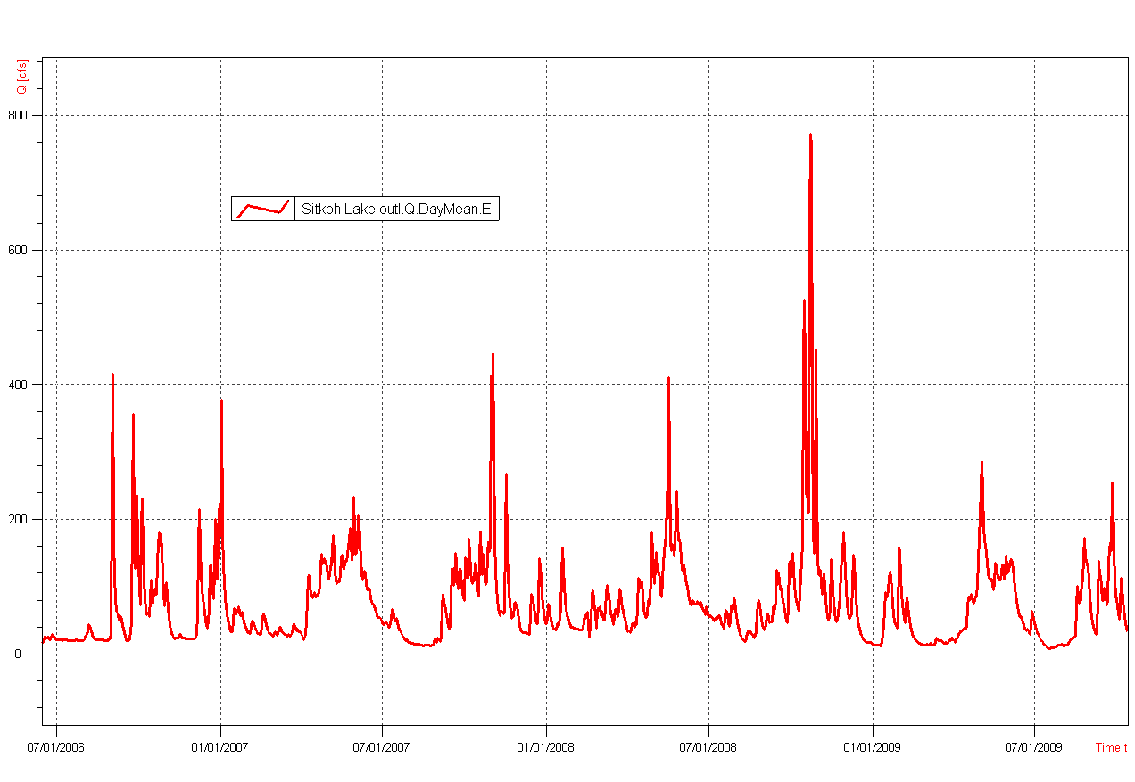
Sitkoh Creek: What happened to the 2007-2009 smolt?
2006-2009 fall floods appear moderate to normal
Fall 2008 ~ 800 CFS
Fall 2007
~400 CFS
Fall 2006
~400 CFS
400 CFS
Fall 2009
~250 CFS
Source: Jarrod Sowa, ADF&G Sportfish Aquatic Resources Group
Notes:
Here is a graph of stream discharge for 2006-2009. CFS on Y-axis, Date on X-axis
Probably more normal fall rain-on-snow flooding

Slide 15
2003-2005: extreme fall floods may flush fry and smolt
Fall 2005 ~ 2000 CFS !
Fall 2003
~700 CFS
Fall 2004 ~700 CFS
Source: Jarrod Sowa, ADF&G Sportfish Aquatic Resources Group
Notes:
Here is a graph of stream discharge for 2003-2005. CFS on Y-axis, Date on X-axis
During 2003-2005 stream gauges were washed out each fall by heavy flows, the largest flood occurred in November of 2005 when over seven inches of rain fell during a one week period (as recorded in Angoon). The magnitude of the stream flows in the Southeast Region during this event were over twice as large as any other recorded.

Slide 16
Factors influencing steelhead production in SE Alaska
smolt freshwater production
abiotic events - flow or temperature (Nehring and Anderson 1993), critical life history stage (Hooten et al. 1987),
2) smolt-adult marine survivals
variable marine survival hypothesis (Smith and Ward 2000)
3) repeat spawning :
- Sitkoh Ck: 21-44% repeat spawners (40% in Lohr and Bryant 1999),
- 80% females at Sitkoh Ck in 2009; even greater Reproductive Success
4) straying?
high numbers of untagged fish after 7 yrs of tagging, PIT recovery at Situk R. Yakutat, snorkel survey observation nearby in 2007 (Jeff Olsen…)
5) possible resident rainbow contribution
anadromy after 70 generations of isolation (Thrower and Joyce 2004)
Notes:
Follow slide

Slide 17
Alaskan steelhead sustained production is a
Balance between:
variable life-history the colder
older, hydrologically-
highly fecund, dynamic
more abundant, freshwater habitats
better-surviving, and
female repeat spawners variable marine
that produce better quality smolt environments
Notes:
Take home message (no surprise):
Biotic compensates for abiotic

Slide 18
Questions?
Notes:
Take home message

Slide 19
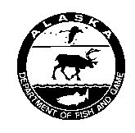
Acknowledgements
Funding for this project came from the U.S. Fish and Wildlife Service’s Federal Aid in Sport Fish Restoration Act, with matching funds coming from the State of Alaska’s Fish and Game Fund.
(16 USC 777-777K) under projects F-10-18 toF-10-23, Job R-1-9)
We would also like to acknowledge the following staff:
John DerHovanisian, Mark Schwan, Dan Reed, Randall Mullen, Bob Chadwick, Dale Brandenburger, Lee Close, Dirk Middleton, Rich Didrickson, Rob Pettett, Anthony Crupi, Peter Bangs, Kurt Kondzela, Carol Coyle, Randy Mullen, Judy Lum, Carrie Hoover, Jennifer Stahl, Troy Tydingco, Heather Riggs, Jason Shull, Jamie Clark, Ken and Karen Koolmo, Keith Pahlke, Rocky Holmes, Brian Frenette, Dick Callahan, Brian Glynn, Jeff Nichols, Jason Hass, Jarrod Sowa, Shawn Johnson, Kercia Schroeder, Monica Matz, Bob & Anne Chadwick, Tom Brookover, Kristen Munk, Christine Schmale, David Gregovich, and Doug Fleming.

Slide 20
Extra Slides

Slide 21
Area | Overall n | % range | # spawns
ocean maturing
SE Alaska - 5 systems (Lohr & Bryant 1999; Bain et al. 2003; Brookover and Harding 2003; Johnson 1996; B. Marston) | 2,010 | 11-70 | 1-5
SC Alaska - 2 systems (Gates and Palmer 2005, 2006) | 385 | 44-74 | 1-4
British Columbia - 4 systems (Withler 1966; Ward & Slaney 1988, McCubbing & Ward 2002, 2003, 2007, 2010) | 2,627 | 5-31 | 1-4
Washington - 7 systems (Busby et al. 1996; WDFW 1994; Seamons and Quinn 2010) | not cited Snow Ck: n=921 | 7-12 | 1-3
Columbia R. Basin - 3 systems (Howell et al. 1985; Long & Griffin 1937; Keefer et al. 2008) | 1,456 | 4-10 (~12% pre-dam) | 1-4
Oregon - 2 systems (Chapman 1958; Lindsay et al. 1991; Busby et al. 1996) | 1,348 | 11-14 | 1-5
California - 4 systems (Forsgren 1979;Harper 1980; Hallock 1989; Shapovalov &Taft 1954) | 4, 032 +/- | 17-23 | 1-4
Notes:
Ocean maturing in Alaska: Sept-July….Ocean maturing = winter run…

Slide 22
Area | sample size | % range | # spawns
stream maturing
SE Alaska - ? systems | trans-boundary rivers + ? others
SC Alaska - 2 systems (Lohr & Bryant 1999) | 591 | 11-38 | 1-3
British Columbia - 4 systems (Narver 1969, Withler 1966) | 279 | 3-7 | 1-2
Washington - 0 systems (Busby et al. 1996) | stream-maturing other than the Columbia?
Columbia R. Basin – 2 systems (Howell et al. 1985; Busby et al. 1996) | 1,057 | 3-7 | 1-2
Idaho - Clearwater River (Whitt 1954; Byrne pers comm) | ? | 0.85-? | 1-?
Oregon – Rogue R. (Chapman 1958; Lindsay et al. 1991; Busby et al. 1996) | 4,058 | 17-21 | 1-2
California - 0 systems (Busby et al. 1996) | stream-maturing in any systems?
Notes:
Stream-maturing….. July(or earlier…) -October

Slide 23
References Cited:
Bain, C., S.T. Elliott, R.E. Johnson and G. Woods. 2003. Situk River Steelhead: A Review of Historical Data through 1996. Alaska Department of Fish and Game, Fishery Manuscript No. 03-01, Anchorage
Berrigan, D. and E.L. Charnov. 1994. Reaction norms for age and size at maturity in response to temperature: a puzzle for life historians. Oikos. 70:3, 474-478
Burgner, R. L., J. T. Light, L. Margolis, T. Okazaki, A. Tautz, and S. Ito. 1992. Distribution and origins of steelhead trout (Oncorhynchus mykiss) in offshore waters of the North Pacific Ocean. Int. North Pac. Fish. Comm. Bull. 51, 92 p.
Busby, P.J., T.C. Wainwright, G.J. Bryant, L. Lierheimer, R.S. Waples, F.W. Waknitz & I.V. Lagomarsino. 1996. Status review of west coast steelhead from Washington, Idaho,
Oregon, and California. NOAA Tech. Memo., U.S. Dep. Commer. NMFS-NWFSC-27. 261 pp.
Chapman, D. W. 1958. Studies on the life history of Alsea River steelhead. Journal of Wildlife Management. 22(2):123-134.
Forsgren, H. L. 1979. Age, growth, origin and repeat spawning of winter steelhead (Salmo gairdneri) in Mad River, California. M.S. Thesis, Humboldt State Univ., Arcata, CA, 56 p.
Gates, K.S. and D.E. Palmer. 2006a. Abundance and run timing of adult steelhead trout in Crooked and Nikolai Creeks, Kenai Peninsula, Alaska, 2005. Alaska Fisheries Data Series Number 2006-5, March U.S. Fish and Wildlife Service.
Gates, K.S. and D.E. Palmer. 2006b. Abundance and run timing of adult steelhead trout in Crooked and Nikolai Creeks, Kenai Peninsula, Alaska, 2006. Alaska Fisheries Data Series Number 2006-13, November 2006. U.S. Fish and Wildlife Service.
Hallock, R. J. 1989. Upper Sacramento River steelhead, Oncorhynchus mykiss, 1952-1988. A report prepared for the U.S. Fish and Wildlife Service, Red Bluff, CA, 86 p.
Harper, W. G. 1980. Age, growth, and migration of coho salmon and steelhead trout in Jacoby Creek, California. M.S. Thesis, Humboldt State Univ., Arcata, CA, 104 p.
Hooten, R.S., B.R. Ward, V.A. Lewinsky, M.G. Lirette, and A.R. Facchin. 1987. Age and growth of steelhead in Vancouver Island populations. British Columbia Fisheries Technical Circular No. 77.
Howell, P., Jones, K., Scarnecchia, D., LaVoy, L., Kendra, W. and Ortmann, D. 1985. Stock assessment of Columbia River anadromous salmons Volume II: steelhead stock summaries stock transfer guidelines-information needs. Final Report to Bonneville Power Administration, Contract DE-A179-84BP12737, Project 83-335, Portland, OR: Bonneville Power Administration
Hendry A.P. and S.C. Stearns (eds). 2004. Evolution Illuminated, Salmon and their Relatives. Oxford University Press, Inc. 198 Madison Avenue, New York, New York
Johnson, R.E. 1996. Situk River steelhead trout studies, 1994. Alaska Department of Fish and Game, Fishery Data Series No 96-1, Anchorage
Jones, D. E. 1983. A study of cuthroat - steelhead in Alaska. Alaska Department of Fish and Game, Federal Aid in Fish Restoration and Anadromous Fish Studies, 1982-1983, Project AFS-42-10-A Juneau.
Keefer, M.L, Wertheimer, R.H., Evans A.F., Boggs C.T., Peery, C.A. 2008. Iteroparity in Columbia River summer-run steelhead(Oncorhynchus mykiss): implications for conservation. Canadian Journal of Fisheries and Aquatic Sciences, 26: 2592-2605.

Slide 24
References Cited (continued):
Lindsay, R. B., K. R. Kenaston, and R. K. Schroeder. 1991. Steelhead production factors. Oregon Dept. Fish and Wildlife, Annual Progress Report, 19 p. (Available from Oregon Department of Fish and Wildlife, P.O. Box 59, Portland, OR 97207)
Lohr, S.C. and M.D. Bryant. 1999. Biological characteristics and population status of steelhead (Oncorhynchus mykiss) in southeast Alaska. General Technical Report PNW-GTR-407. Portland, OR: U.S Department of Agriculture, Forest Service, Pacific Northwest Research Station.
Long, J.B. and L.E. Griffin. 1937. Spawning and migratory habits of the Columbia wild steelhead trout through the returning adult stage. Aquaculture. 88: 239-252.
Love, D.C. and R.D. Harding. 2008. Steelhead trout production studies at Sitkoh Creek, Alaska, 2003-2004. Alaska Department of Fish and Game, Fishery Data Series No. 08-44, Anchorage.
Love, D.C. and R.D. Harding. 2009. Steelhead trout production studies at Sitkoh Creek, Alaska, 2005-2006. Alaska Department of Fish and Game, Fishery Data Series No. 09-68, Anchorage.
McCubbing, D.J.F. 2002. Adult steelhead trout and salmonid smolt migration at the Keogh River, B.C. During winter and spring 2002. Province of British Columbia Habitat Conservation Trust Fund Contract No. CBIO3006
McCubbing, D.J.F. and B.R. Ward. 2003. Adult steelhead trout and salmonid smolt migration at the Keogh River, B.C. during spring 2003. Province of British Columbia Habitat Conservation Trust Fund Contract No. CBIO4051
McCubbing, and B.R. Ward. 2007. Adult steelhead trout and salmonid smolt migration at the Keogh River, B.C. during winter and spring 2007. Province of British Columbia Habitat Conservation Trust Fund Contract No. CBIO4051
McCubbing, and B.R. Ward. 2010. Adult steelhead trout and salmonid smolt migration at the Keogh River, B.C. during winter and spring 2009. Province of British Columbia Habitat Conservation Trust Fund Contract No. CBIO4051
McCusker, M.R., E. Parkinson, and E.B. Taylor. 2000. Mitochondrial DNA variation in rainbow trout (Oncorhybchus mykiss) across its native range: testing biogoegraphical hypotheses and their relevance to conservation. Molecular Ecology. 9, 2089-2108.
Montgomery, D.R. 2000. Coevolution of the Pacific salmon and Pacific Rim topography. Geology. 28(12): 1107-1110.
Narum S.R., J.S. Zendt, D. Graves, and W.R. Sharp. 2008. Influence of landscape on resident and anadromous life history types of Oncorhynchus mykiss. Canadian Journal of Fisheries and Aquatic Sciences. 65: 1013-1023.
Narver, D.W. 1969. Age and size of Steelhead trout in the Babine river, British Columbia. Journal of the Fisheries Research Board of Canada. 26(10): 2754-2760
Nehring, R.B. and R.M. Anderson. 1993. Determination of populations limiting critical salmonid habitats in Colorado streams using the Physical Habitat Simulation System. Rivers. 4: 1-19.
Pavlov, D.S., K.A. Savvaitova, K.V. Kuzishchin, M.A. Gruzdeva, A.Yu. Mal’tsev and J.A. Stanford. 2008. Diversity of Life Strategies and Population Structure of Kamchatka Mykiss Parasalmo mykiss in the Ecosystems of Small Salmon Rivers of Various Types. Journal of Ichthyology. 48(1): 37-44

Slide 25
References Cited (continued):
Riva-Rossi C., M.A. Pascual, J.A. Babluk, M. Garci’-A-Asorey and N.M. Halden. Intra-population variation in anadromy and reproductive life span in rainbow trout introduced
in the Santa Cruz River, Argentina. Journal of Fish Biology. 70, 1780–1797.
Seamons, T.R. and T.P. Quinn. 2010. Sex-specific patterns of lifetime reproductive success in single and repeat breeding steelhead trout (Oncorhybchus mykiss). Behavioral Ecology and Sociobiology. 64:505-513.
Shapovalof, L. and A.C. Taft. 1954. Life histories of the steelhead rainbow trout (Salmo gairdneri gairdneri) and silver salmon (Oncorhynchus kisutch). California Department of Fish and Game Bulletin Number 98: 1-303.
Smith, B.D., and B.R. Ward. 2000. Trends in wild adult steelhead (Oncorhynchus mykiss) abundance for coastal regions of British Columbia support the variable marine hypothesis. Canadian Journal of Fisheries and Aquatic Sciences. 57: 271–284
Thrower , F.P. and J. E. Joyce. 2004. Effects of 70 years of freshwater residency on survival, growth, early maturation, and smolting in a stock of anadromous rainbow trout from southeast Alaska. Pages 485–496 in M. J. Nickum, P. M. Mazik, J. G. Nickum, and D. D. MacKinlay, editors. Propagated fish in resource management. American Fisheries Society, Symposium 44, Bethesda, Maryland.
Ward, B.R., and P.A. Slaney. 1988. Life history and smolt-to-adult survival of Keogh River steelhead (Salmo gairdneri) and the relationship to smolt size. Canadian Journal of Fisheries and Aquatic Sciences. 45: 1110-1122.
Washington Department of Fish and Wildlife (WDFW). 1995. Correspondence and submissions to the ESA Administrative Record for west coast steelhead from Thom Johnson, WDFW Biologist, regarding Washington steelhead life history, abundance, and artificial propagation. Items dated 27, 29, and 31 March 1995; 7 April 1995; and 3 May 1995. (Available from Environmental and Technical Services Division, Natl. Mar. Fish. Ser., 525 N.E. Oregon Street, Suite 500, Portland, OR 97232.)
Whitt, C.R. 1954. The age, growth, and migration of steelhead trout in the Clearwater River, Idaho. Masters Thesis. University of Idaho Graduate School.
Withler, I.L. 1966. Variability in life history characteristics of steelhead trout (Salmo gairdneri) along the Pacific coast of North America. Journal of Fisheries Research Board of Canada 23:365-393.

