Slide 1
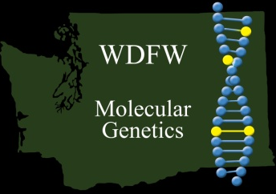

Genetic Stock Structure of Skagit River Basin
winter steelhead
Todd W. Kassler and Kenneth I. Warheit
Washington Department of Fish and Wildlife
March 13 - 15, 2012

Slide 2
Acknowledgements
Seattle City Light
  Ed Connor, Dave Pflug
Skagit River System Cooperative
  Eric Beamer, Bob Hayman, Pete Kairis, Jade Luckhurst, Jeff Meyer,
  Larry Wasserman
Upper Skagit Tribe
  Rebecca Bernard, Jon-Paul Shannahan
WA Department of Fish and Wildlife (WDFW)
  Brett Barkdull, Cheryl Dean, Curt Kraemer, Anne Marshall, Steve Stout
Wild Fish Conservancy
Bill McMillan

Slide 3
Background
Joint project between Seattle City Light, Skagit River
System Cooperative, Upper Skagit Tribe, WA Department of Fish
and Wildlife (WDFW), Wild Fish Conservancy
Project objective is to assess the genetic diversity of steelhead
and resident O.mykiss in the Skagit River basin
78 Collections were made – 2,634 individuals were analyzed
adults – 30 collections – 625 individuals
juveniles – 22 collections – 714 individuals
resident O.mykiss – 21 collections – 950 individuals
fishery samples – 5 collections – 345 individuals
Genetic analysis using 15 microsatellite DNA loci

Slide 4
Background
Individuals with cutthroat alleles were identified
Cutthroat alleles have been identified in previous analysis using
known cutthroat samples
If individual had only one cutthroat allele the genotype at the
locus was zeroed. If an individual had more than one cutthroat
allele the entire individual was dropped

Slide 5
Collections – Adults
Code Location Life Stage Total N
08DQ, 09BN, 10AO, 11BI upper Skagit River adults 81
09BM*, 10AS mid Skagit River adults 42
10LG mid Skagit R. ¼ pounders adults 10
10AQ Suiattle River adults 51
81AAA, 83AAA, 08DR, 08MS,
09DU, 10AR, 11BN Sauk River adults 148
10CQ, 11BK Finney Creek adults 53
08LF, 09CF, 10AN Marblemount Hatchery adults 151
10KA Marblemount early timed adults 18
10MZ Chilliwack Hatchery adults 71
* - collection included telemetry samples

Slide 6
Collections – Juveniles
Code Location Life Stage Total N
07MT, 10AZ upper Skagit River juveniles 68
09EI, 10AY lower Skagit River juveniles 48
07MU, 08MK,
09IY, 10BB County Line Ponds juveniles 74
07MS, 10BA Bacon Creek juveniles 57
09IZ, 10BC Goodell Creek juveniles 88
09EE, 10AV lower Cascade River juveniles 98
10AW Suiattle River juveniles 60
10AX Sauk River juveniles 50
10BK Diobsud Creek juveniles 47
09EH, 10AT Finney Creek juveniles 105

Slide 7
Collections – resident O. mykiss
Code Location Life Stage Total N
09ES, 10BF N.F. Cascade River residents 98
09EU, 10BG Big Creek (trib to Suiattle River) residents 96
09ET, 10BE Clear Creek (trib to Sauk River) residents 98
09EV, 10BD upper Finney Creek residents 85
09EL, 10AU Baker River above Baker Lake residents 74
06AF, 09MA, 10BH Ross Lake residents 135
02FB Roland Creek residents 97
05NG Dry Creek residents 62
09JA, 10BI Stetattle Creek residents 76
09JB, 10BJ Blackwater Creek residents 67

Slide 8
Collections – adults, juveniles, and residents
Location Adults Juveniles Residents
N.F. Cascade River 09DS, 10AP (4) 09EE (49) 09ES, 10BF (98)
10AV (49)
Suiattle River (Big Creek) 10AQ, 11BM (51) 10AW (60) 09EU (46)
10BG (50)
Sauk River (Clear Creek) 81AAA, 83AAA, 10AX (50) 09ET, 10BE (98)
09DU, 10AR,
11BN (130)
upper Finney Creek 10CQ, 11BK (53) 09EH (54) 09EU (46)
10AT (51) 10BD (48)

Slide 9
Laboratory Methods
DNA was extracted from an assortment of different tissue types
PCR amplification was performed using microsatellite loci
Amplified products were run through an ABI-3730 Genetic Analyzer
Microsatellite electropherograms were scored using GENEMAPPER software v.3.7
Microsatellite data was binned using SPAN allele naming

Slide 10
Comparisons for Data Analyses -
HW and Genotypic Differentiation
  Temporal collections were grouped
Adult collections - 9 groups
Juvenile collections - 14 groups
Resident collections - 16 groups
Adults and Juveniles
Adults, Juveniles, and Residents same watershed

Slide 11
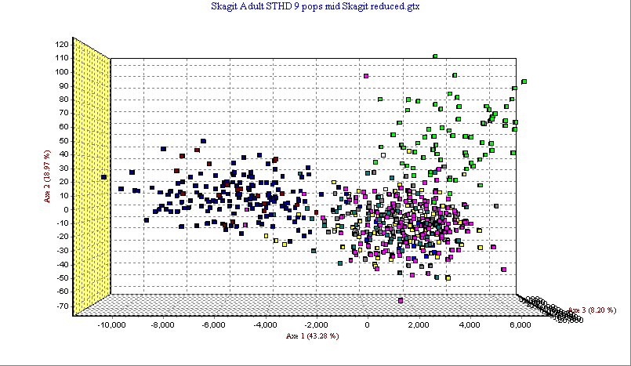
Chilliwack
Adult Collections - GENETIX
Marblemount
Skagit natural-origin

Slide 12
Adult Collections – Natural vs Natural
Adult Collections – Pairwise F_{ST}

Slide 13
Adult Collections – Natural vs Hatchery
Adult Collections – Pairwise F_{ST}

Slide 14
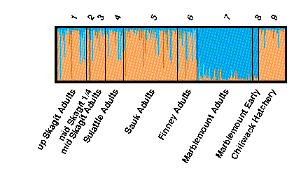
Adult Collections - STRUCTURE

Slide 15
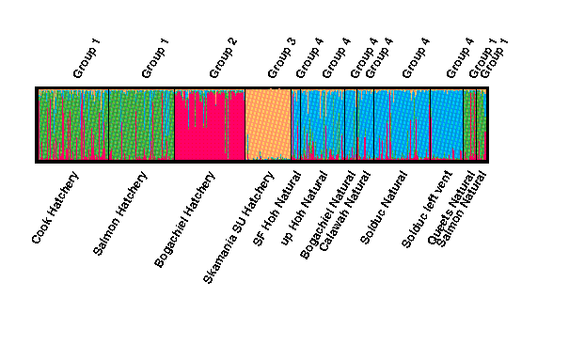
Figure 2. Structure plot showing percent membership of each individual steelhead and the population average into the groups that STRUCTURE found in the dataset. Individuals with more than one color in the bar likely have mixed ancestry. The group number identifies the collections with similar ancestry.
Adult Collections - STRUCTURE

Slide 16
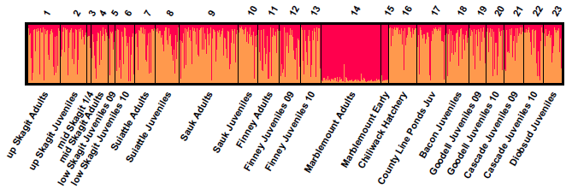
Adult / Juvenile Collections - STRUCTURE

Slide 17
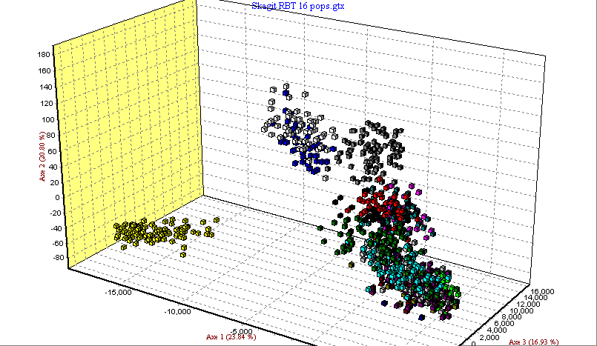
Big Cr.
Clear Cr.
Resident Collections - GENETIX
Baker/Finney
upper Skagit
Blackwater
Cascade

Slide 18
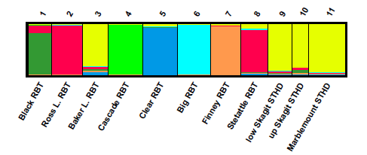
Resident Collections – STRUCTURE (K = 7)

Slide 19
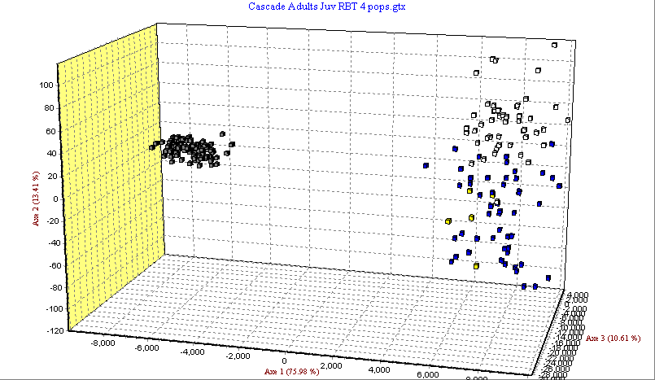
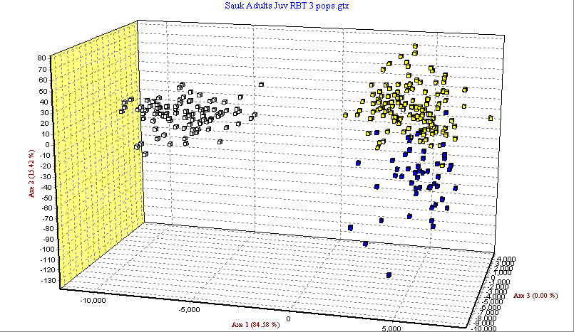
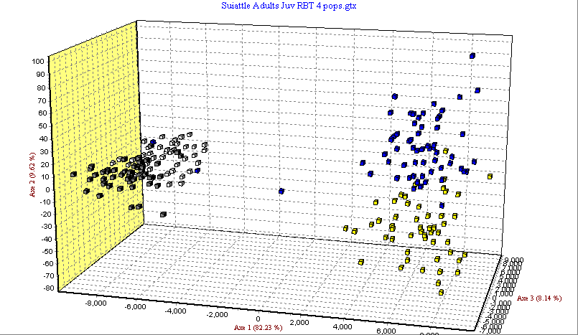
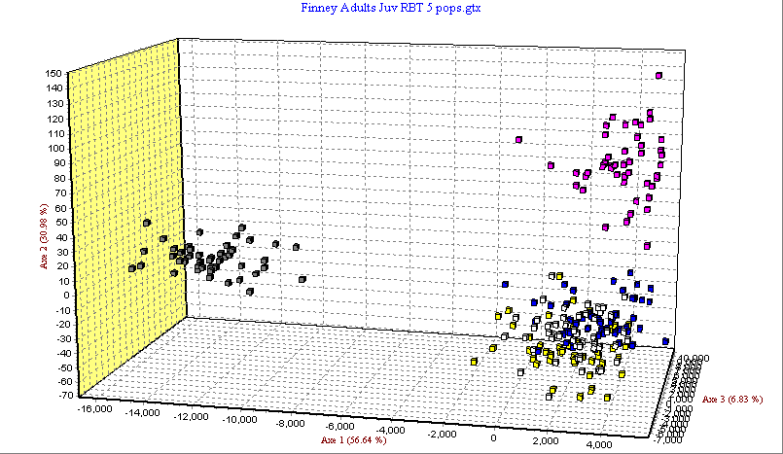
Adults, Juveniles, and Residents - GENETIX
Cascade
Sauk
Suiattle
Finney

Slide 20
Conclusions
Natural-origin Adult steelhead in the Skagit Basin are not differentiated
Natural and Hatchery-origin steelhead are differentiated
Juvenile steelhead in Skagit Basin are not differentiated from the Adult
collections
Percentage of hatchery ancestry in natural-origin collections
of Adult and Juvenile steelhead is about the same
Resident collections are differentiated to steelhead collections (Adults
and Juveniles)

