Slide 1

Effectiveness of alternative broodstock, rearing and release practices at Winthrop NFH
William Gale and Matt Cooper
-USFWS, Mid-Columbia River Fishery Resource Office
Chris Pasley
-USFWS, Winthrop National Fish Hatchery

Slide 2
How it began - Grand Coulee Mitigation
Built as mitigation for Grand Coulee Dam - Simple times
    Located on the Methow River in Winthrop, WA.
    Currently rears spring Chinook, coho and steelhead.
  Mitigation still critical to hatchery purpose and funding.

Slide 3
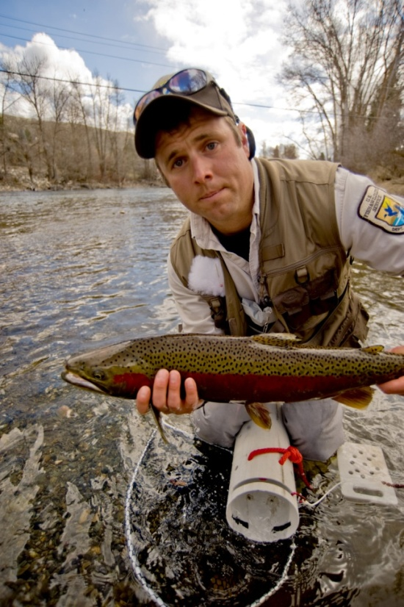
Then everything changed……
NOAA listings of spring Chinook salmon (endangered), and steelhead (threatened), Service listing of bull trout (threatened)
Hatchery Review:
  USFWS HRT Process
  HSRG Process
How do we meet the conflicting demands of mitigation, recovery and reform?

Slide 4
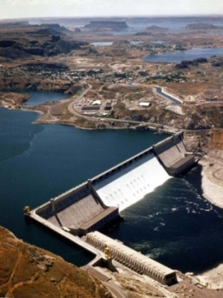
Steelhead in the Methow: Past Paradigm
Collection of adults at Wells Dam, brood for two programs.
Collection occurs in fall prior to spawning.
Collection at Wells Dam results in use of out of basin adults
This paradigm sacrifices population structure!!

Slide 5
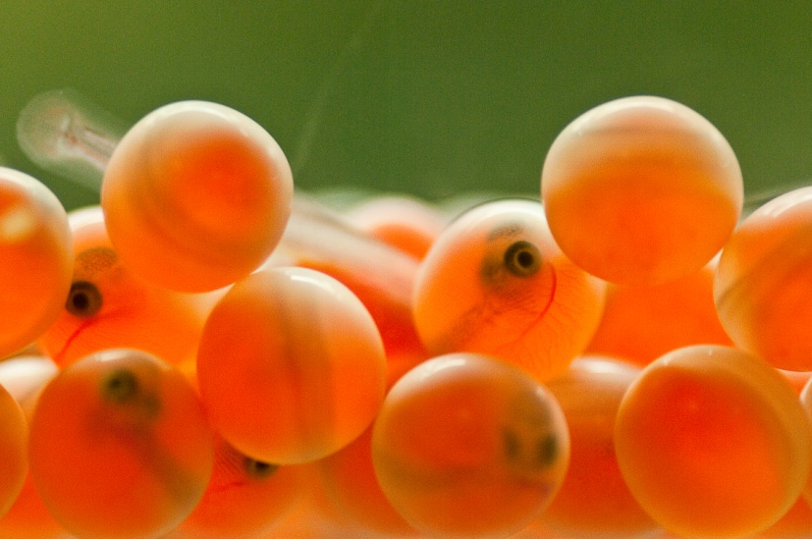
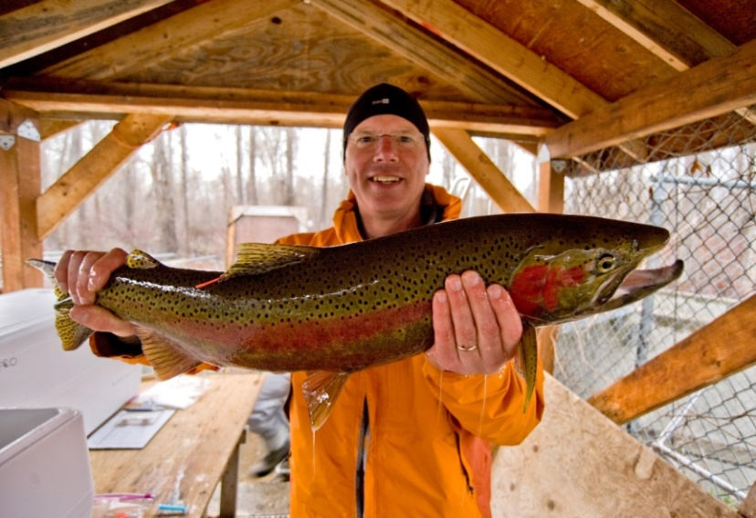
Hatchery Reform at WNFH
Transition to local broodstock.
  Collection in sync with natural spawning
  Precludes a yearling program due to cold water and later emergence.
Evaluation/Adoption of a two year smolt rearing program.

Slide 6
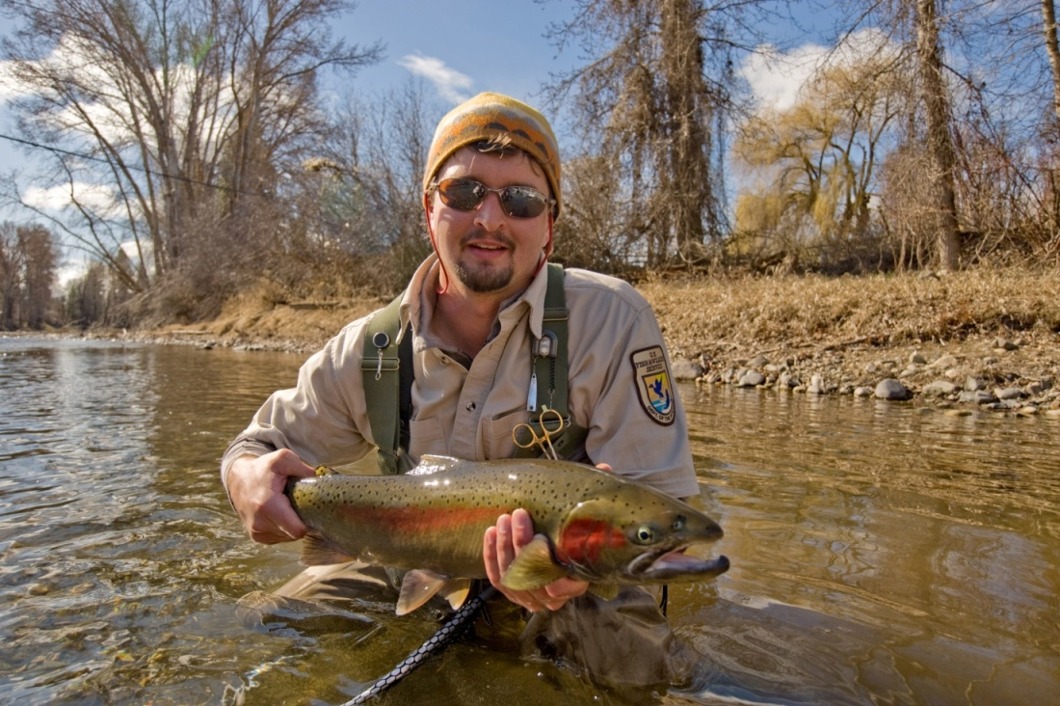
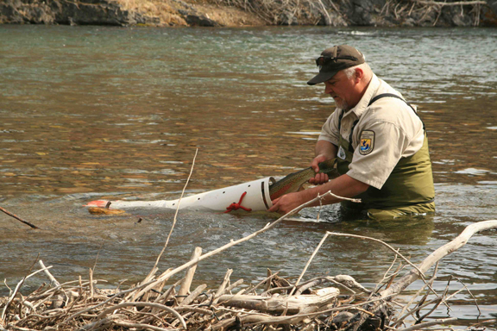
Transition to Local Brood
Began in BY 2008. Collection via angling to collect wild fish and volunteers to the hatchery ladder.
Goal is pNOB ≥ 0.5., 50k smolt program.
Angling is a viable means of collecting adults.
Limited to current program size.
Other techniques need to be evaluated. Increased angler involvement?

Slide 7
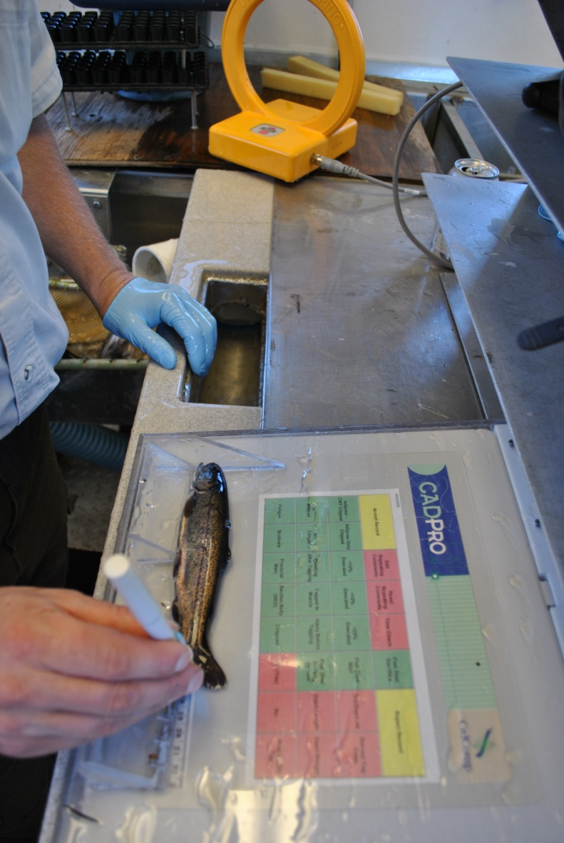
Evaluation of 2yr smolt rearing
Rear and release 2 groups of 50K annually (100K total).
S1 releases progeny of Wells Dam collection.
S2 releases progeny of local brood.
100% CWT, 15K PIT / group.

Slide 8
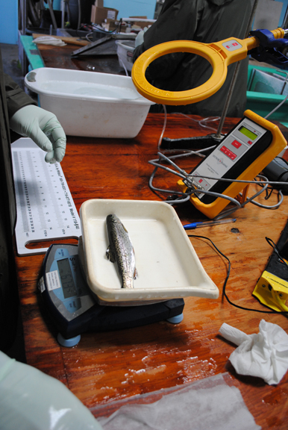
Evaluation of 2yr smolt rearing program
Following factors examined:
  Hatchery growth
  Post release survival and migratory behavior
  Residualism
  Age structure of adult returns

Slide 9
Hatchery Growth

Slide 11
Length Frequency at Release
2010
2011
187 ± 1 mm
194 ± 2 mm
159 ± 1 mm
214 ± 1 mm
Fork Length (mm)

Slide 12
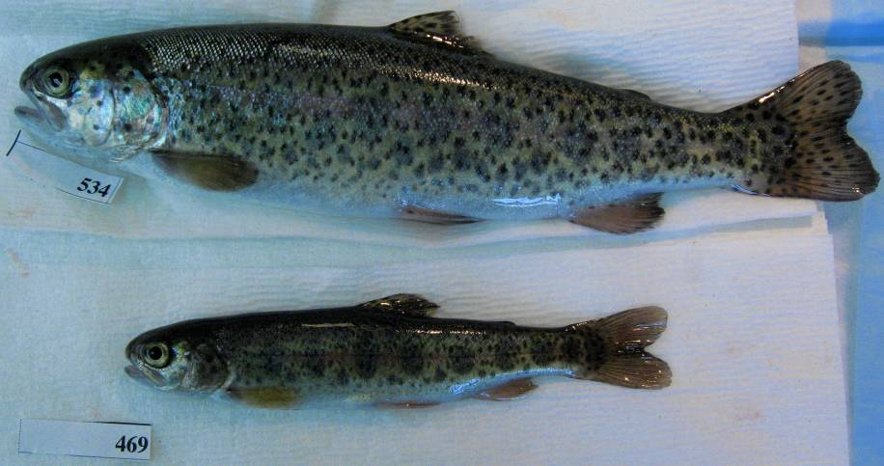
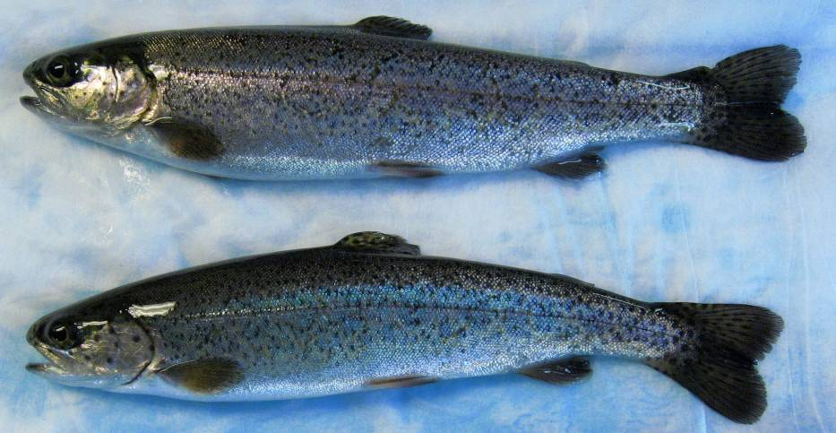
22 cm FL S2 Program
21.7 cm FL S1 Program

Slide 13
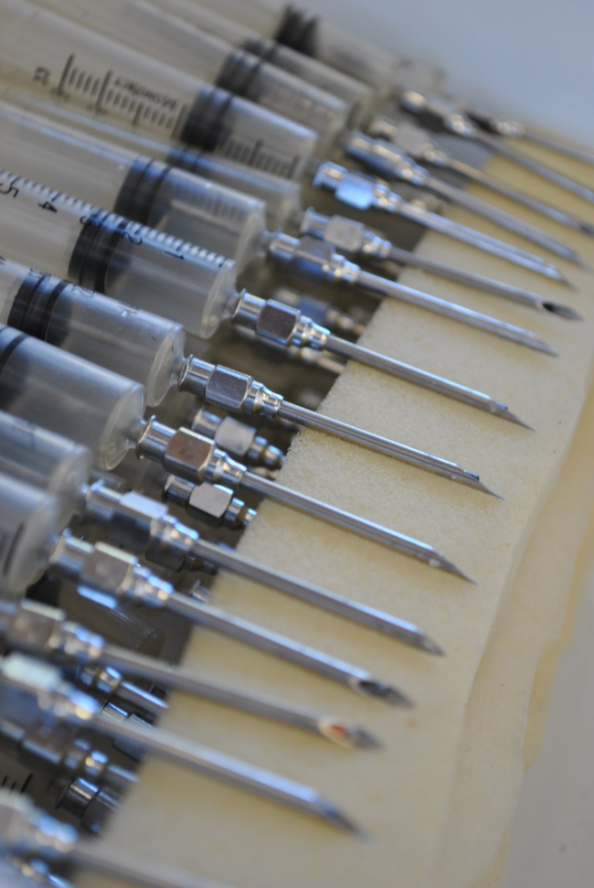
Mark-Recapture: Methods
S1 and S2 PIT tagged smolts released annually (≈15 K / group).
M-R models using mainstem Columbia River arrays.
Full models tested for GOF.
Parameters estimated using model averaging (AIC methods).
In addition to the standard assumptions this approach assumes that apparent survival estimates for the first reach is a combination of residualism and true mortality.

Slide 14
Mark Recapture: Downstream Detections
 | Unique PIT Detections
2010 Release Year | Winthrop | Rocky Reach Dam | McNary Dam | John Day Dam | Bonneville Dam
S1 | 14,841 | 5,474 | 382 | 389 | 1,643
S2 | 14,756 | 5,156 | 466 | 370 | 2,174
2011 Release Year
S1 | 14,698 | 2,559 | 364 | 891 | 241
S2 | 14,881 | 4,135 | 708 | 1,187 | 460

Slide 15
Apparent Survival
*
*

Slide 16
Travel Time
2010
2011
*
*
*
*
*

Slide 17
Residuals: Methods
Collections occurred in the summer/fall following release.
Sampling by e-fishing, angling, and seine.
Sampling focused on the area around WNFH.
Both side channel and mainstem habitat surveyed.
1- year Wells stock
2- year Methow stock

Slide 18
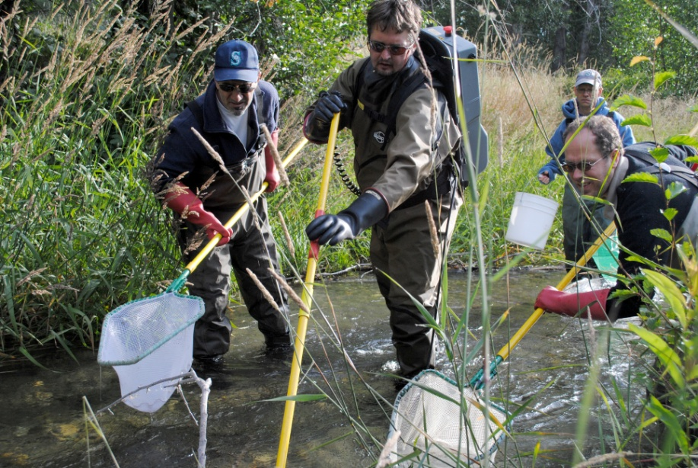
Occurrence of residuals by rearing group
2010 – n = 120, Spring Creek.
2011 - n = 230, Spring Creek and Methow River (6 km)

Slide 19
Residuals Sex Ratio
2010
2011
% Male
S1 = 113 samples
S2 = 7 samples

Slide 20
Conclusions
Results indicate that S2 performance is comparable or better than S1.
  S2’s have a higher survival after release and faster travel time than S1’s.
  Residual life history type differs and the frequency of residuals is likely higher in the S1 group.
To reach a comparable size different growth trajectories are needed, this impacts life history decisions.

Slide 21
Unanswered Questions
Can we use physiology to further categorize life history types (i.e. parr vs. maturing)
Will the age structure of adult returns differ? How will it compare to wild?
Can we use PIT arrays to describe/model residual movement/behavior and assess ecological impacts.
How do we know when we are locally adapted?

Slide 22
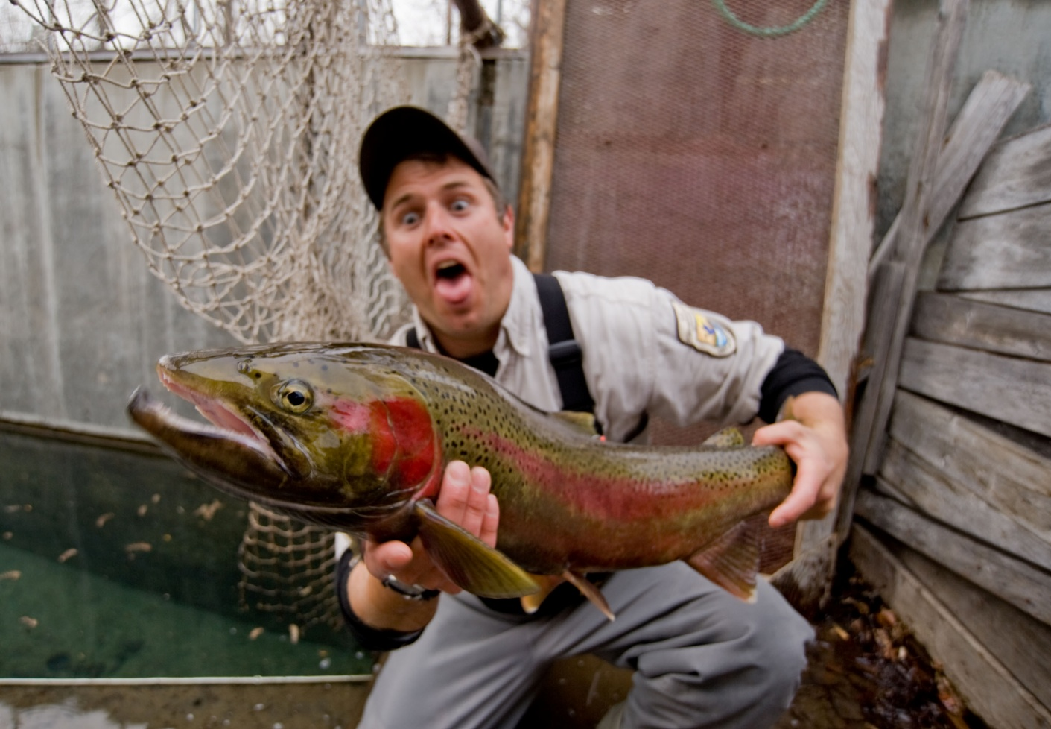
Questions?

Slide 23
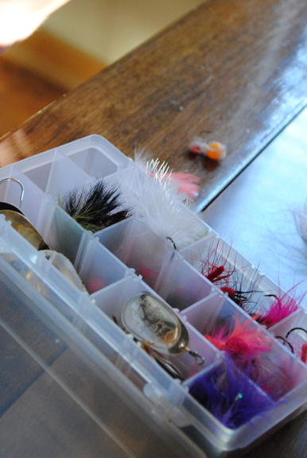
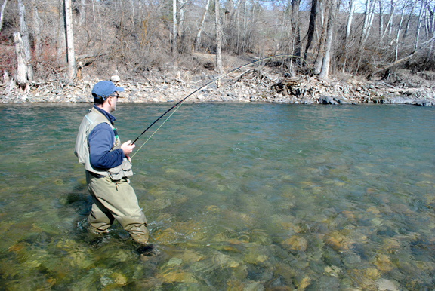
Acknowledgements
The Players:
  NOAA-Fisheries – Barry Berejikian, Chris Tatara, Don Larsen, Penny Swanson.
  UW – Mollie Middleton and Jon Dickey.
  FWS – M. Hall, R. Schmit,
  C. Hamstreet.
Cooperators:
  USGS and BOR
  WDFW
Funding: BPA, BOR, USFWS.

Slide 25
Mark-Recapture: Model Structure
S1
Φ₁
Φ₂
Φ₃
Φ₄
WNFH
Rocky Reach
McNary
John Day
Bonneville
p₁
p₂
p₃
p₄
S2
Φ₅
Φ₆
Φ₇
Φ₈
WNFH
Rocky Reach
McNary
John Day
Bonneville
p₅
p₆
p₇
p₈

Slide 26
Size at Release
Wild smolt data from WDFW: Snow et al, 2011.

