Slide 1
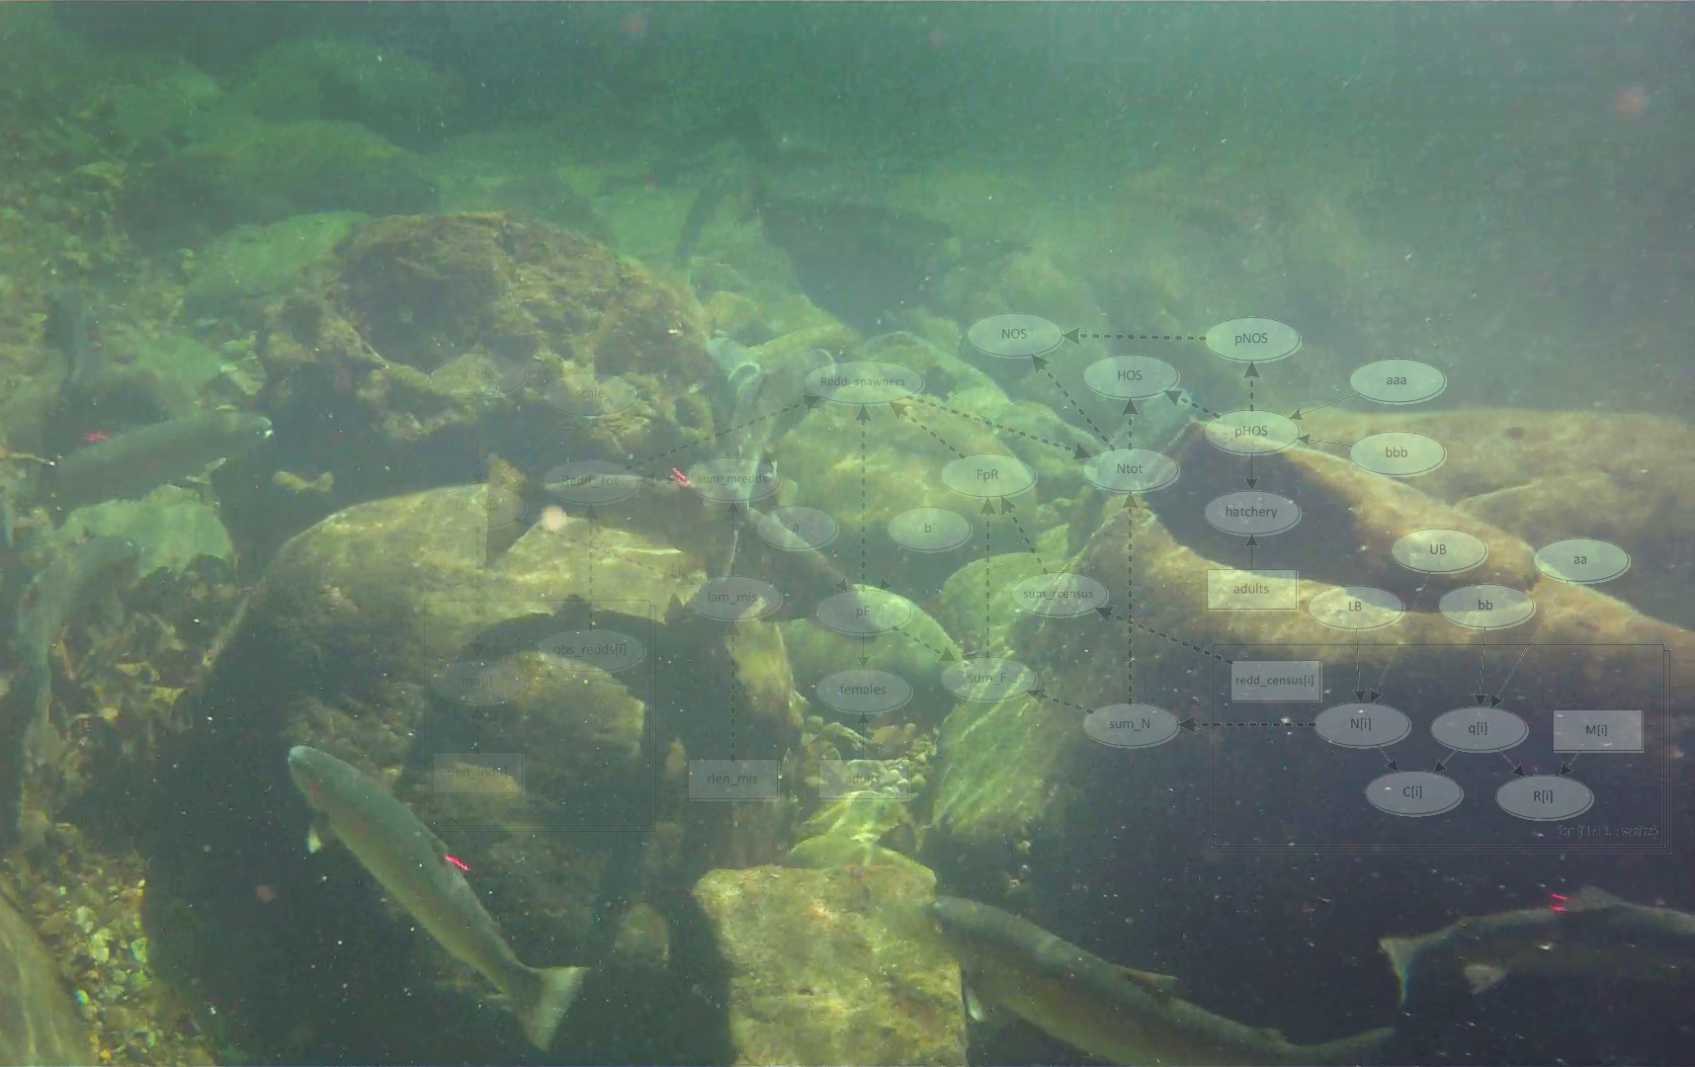
Directed Acyclic Graphs:
A tool to incorporate uncertainty in steelhead
redd-based escapement estimates
Danny Warren
Dan Rawding
March 14th, 2012

Slide 2
Outline
Coordinated Data Assessments Project
What’s a DAG?
Mill, Abernathy, Germany monitoring history
Redd Estimates
Using
DAGs
Escapement Estimates

Slide 3
Coordinated Data Assessments
Broad effort across numerous Columbia Basin entities
Goal to improve data timeliness, reliability, and transparency
Focused on 3 high-level indicators:
Natural Spawner Abundance
Smolt to Adult Ratio
Recruits per Spawner
Needs identified:
Improved data infrastructure
Better documentation
Standardized analytical methods
Notes:
A major impetus for this project grew out of another project in the Columbia Basin called the Coordinated Data Assessments. This was a basin wide project started in 2010 that involved both state and tribal entities and sought to see what the current state of data management and data sharing capabilities are.
It focused on 3 high-level VSP indicitators: NSA, SAR, and RpS, and looked at if and how the agencies were performing these calulations, where the data came from, and how it was stored.
Numerous gaps and needs were illuminated in the process, these include improved data management infrastructure and staffing. Better documentation of metadata, and standardized analytical techniques. My talk today gets mostly at this last point, as Washington is looking to adopt the use of DAGs in some of it’s analysis of high-level indicators.

Slide 4
So what’s a DAG?
Graphical representation of a statistical model
Explicitly depicts the data, equations, and statistical distributions
Easy to translate into code or statistical nomenclature
Accounts for all uncertainty in indicator estimates
SIMPLE DAG HEREA
DAG for % Female
a_LB
a_UB
b_LB
b_UB
pred_pF
a
b
pF[i]
females[i]
adults[i]
For(i IN 1 : sex_obs)
Notes:
Uses Nodes (ovals) and edges (arrows) and frames (boxes)
Several general core DAGs (redds, AUC, mark-recapture, weirs, etc) can be adapted to specific populations to estimate indicators
Reasons they provide an advantage:
Transparent
Repeatable
Deal with missing years, limited data
Good for time-series data
Coding is pretty easy
Free software tools
LaTeX will translate to statistical nomenclature

Slide 5
Bayesian Approach for Redd Estimates
Posterior Probability ~ Likelihood * Prior Distribution
Does not rely on normal distribution
Yeilds similar results to maximum likelihood as long as priors are vague.
Hierarchical modeling allows sparse or missing data borrow strength from other data
 | Age
Year | 3 | 4 | 5 | 6 | 7 | U
2005 | 5 | 78 | 46 | 3 | 0 | 34
2006 | 10 | 158 | 50 | 6 | 0 | 77
2007 | 8 | 65 | 34 | 0 | 0 | 46
2008
2009 | 12 | 35 | 14 | 0 | 0 | 28
2010
2011
Age data from Toutle River Fish Collection Facility

Slide 6
Redd-Based Escapement Estimate
Define Sampling Frame or Universe (potential spawning dist.)
Representative sampling design (SRS,GRTS,SYS,etc)
Estimate the redd denisty
Use goodness of fit (GOF) tests to check if the observed density fits the model
Total Redds = Obs redds + (redd density * unsurveyed distance)
Adults = Total redds
NOS = (1-pHOS) * Adults
Adults[age] = Adults * % by age
Females per redd
*
% Female
Notes:
Putting that all together, this is the approach we took to calculating escapement. [Go through each item quickly]

Slide 7
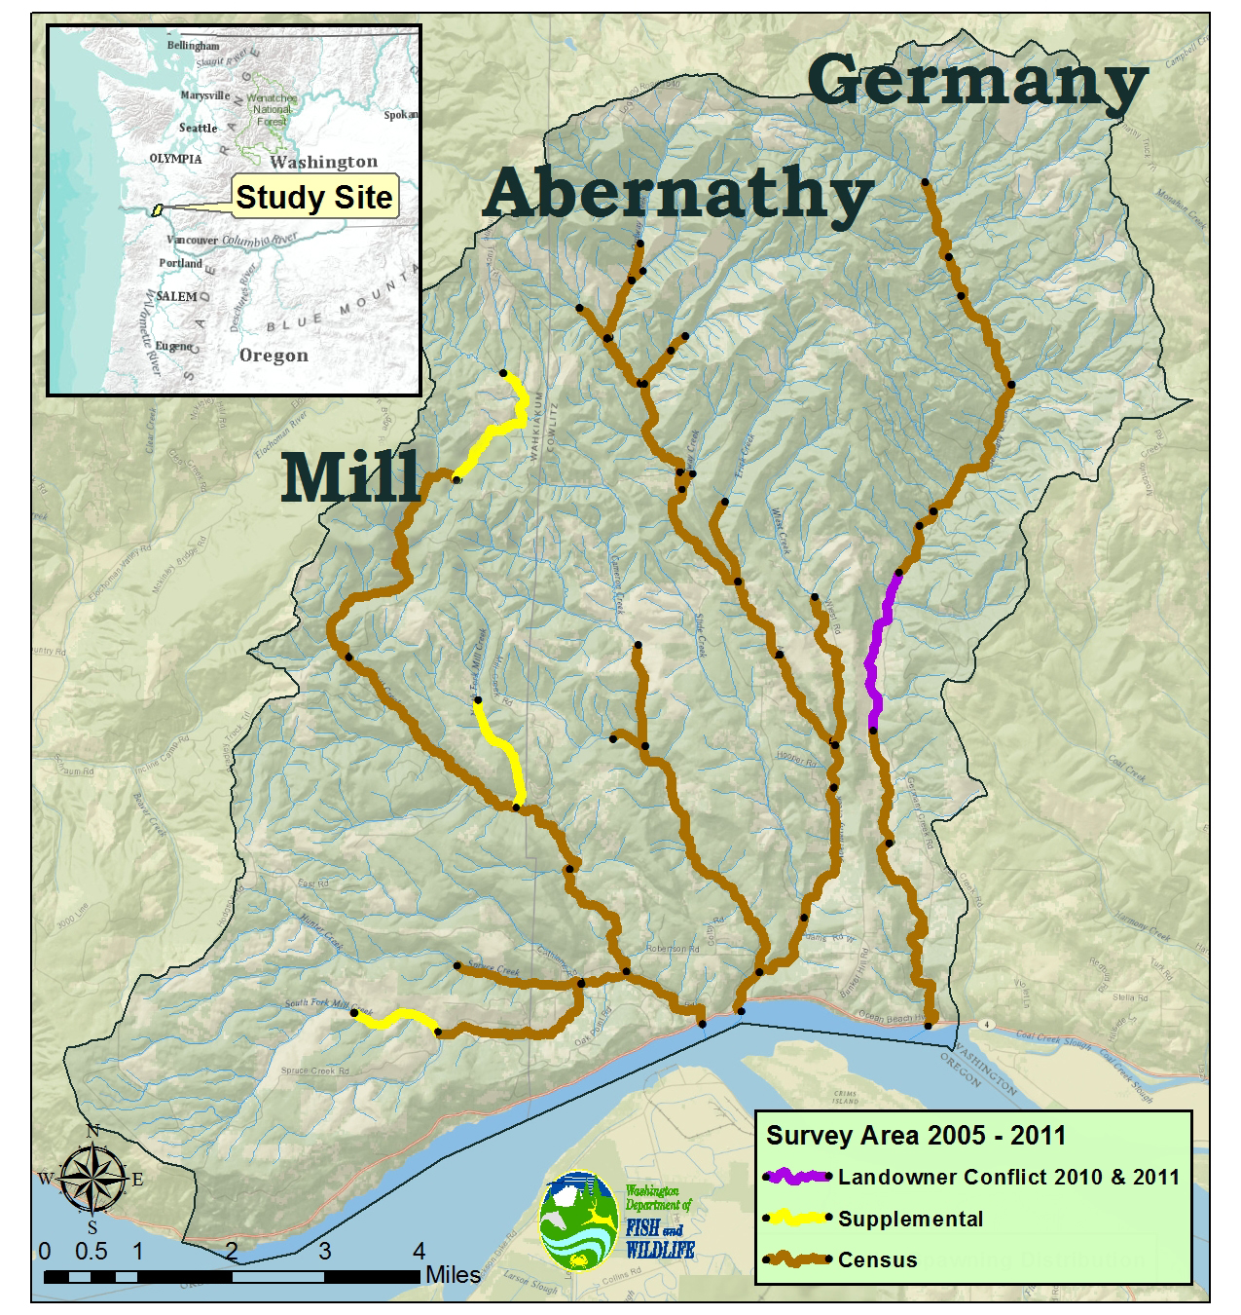
Redd Survey Design 2005-2011
Census on mainstems and some tributaries
One reach with landowner conflict
Several supplemental reaches near peak
Notes:
The Mill-Abernathy-Germany complex is centered at ~ RM 55 of the Columbia River. The combined watershed is 208 sq km. Since 2005 WDFW has performed census redd surveys along the mainstem of each stream, and in the major spawning tributaries.
In 2010 and 11 one reach in Germany except for one reach in Germany with landowner conflicts.
Beyond the census reaches, 3 additional reaches are surveyed near the peak where redds are occasionally seen.

Slide 8
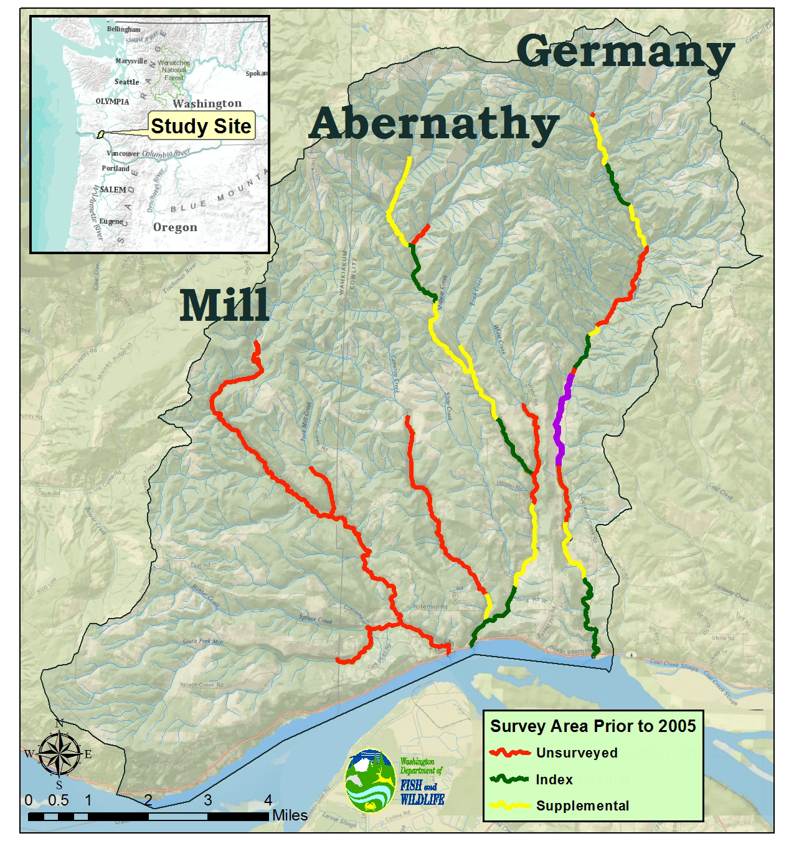
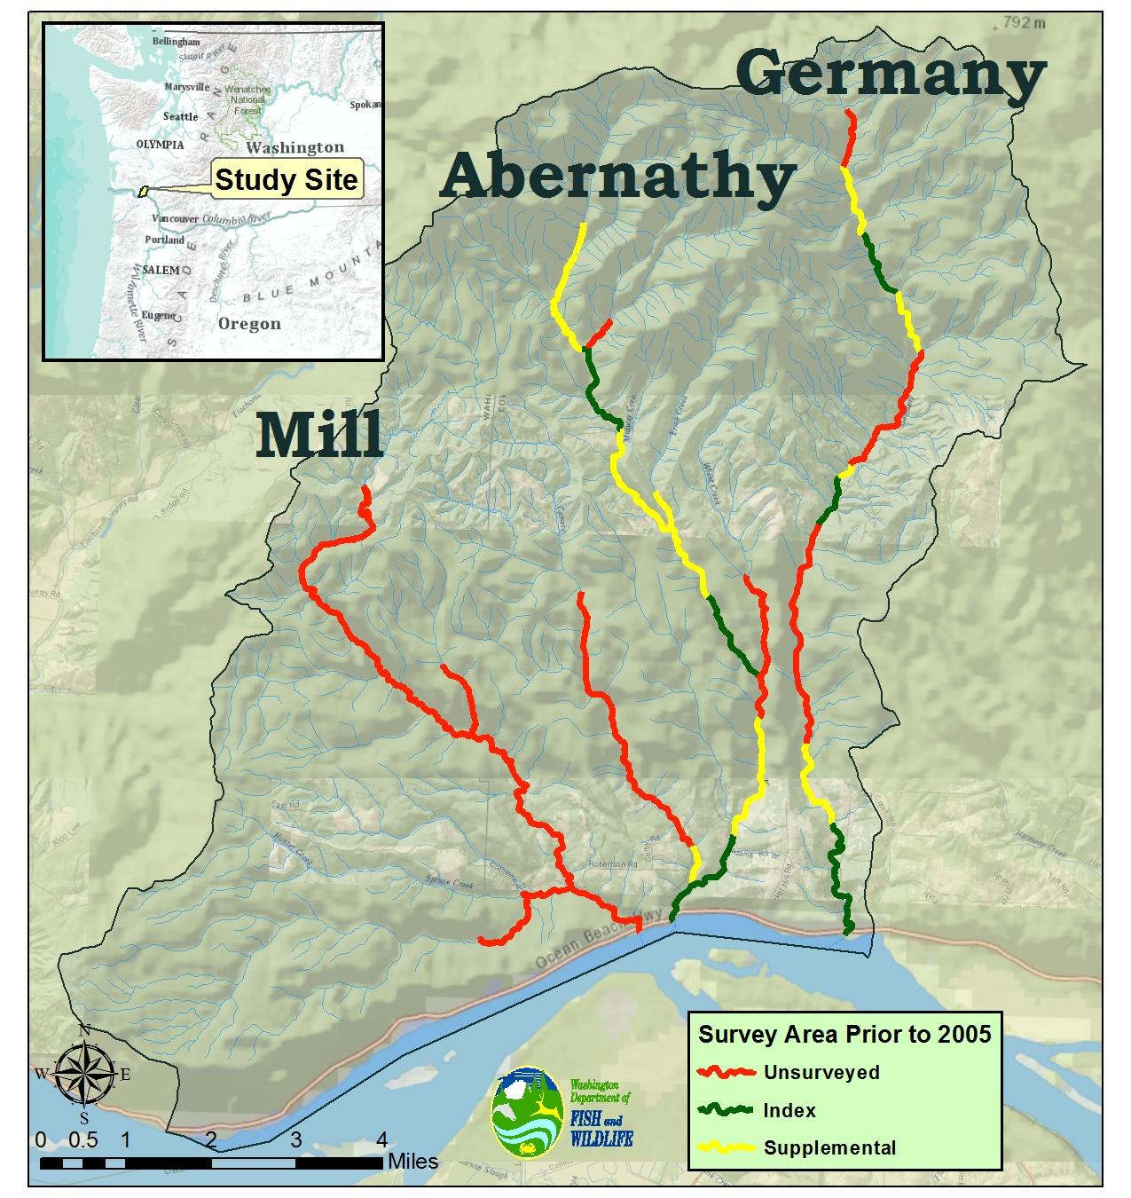
Redd Survey Design 1994-2004
Systematic approach to establish index reaches surveyed throughout season
Supplemental reaches surveyed near peak
Redd density expanded to unsurveyed reaches
No surveys or estimates in Mill Creek
Notes:
Prior to 2005 an index reach in the lower, mid, and upper sections of Abernathy and Germany were surveyed throughout the season.
Supplemental reaches were then surveyed at the peak.
Mill Creek not surveyed.

Slide 9
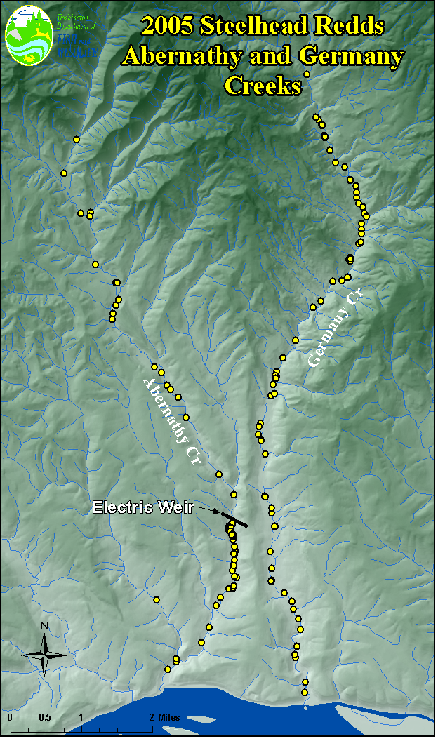
Steelhead Redd Locations
Redd locations are clumpy!
Some reaches have few redds.
Others have many, especially below the hatchery.
Notes:
Is clumpy or patchy the right word!?

Slide 10
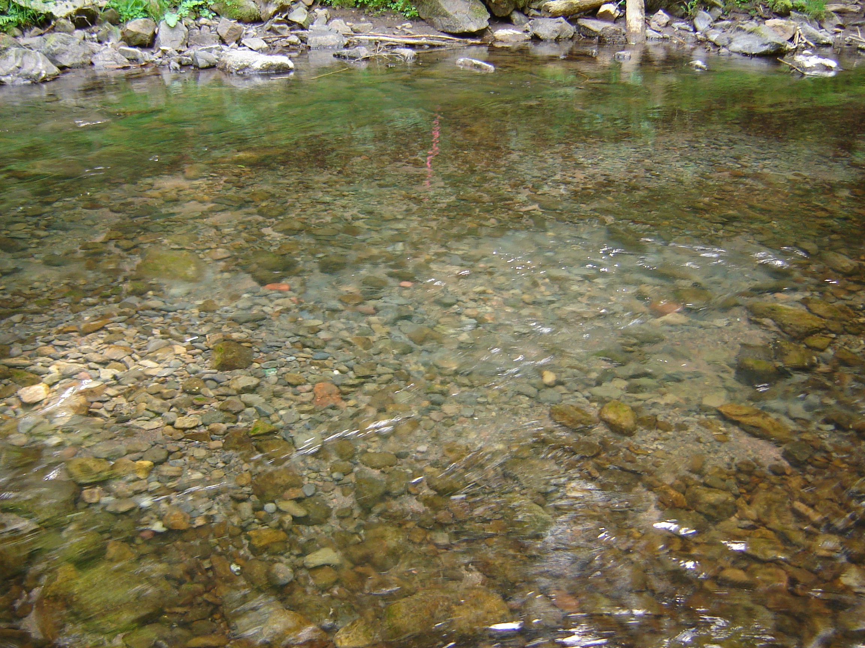
Notes:
Steelhead redd density data is not normally distributed!
Lot’s of 0’s
The other basic problem is missing data, mention that too!
Other confounding effects like the hatchery weir where density of redds if very high just below it.

Slide 11
Goodness of Fit
Bayesian p-value tests how well model fits observed data
 | p-Value for Distribution
 | Negative Binomial | Poisson | Truncated Normal
Mean | 0.47 | 0.02 | 0.16
Min | 0.41 | 0.00 | 0.09
Max | 0.52 | 0.26 | 0.40
p of 0.50 = Best fit
p of 0 or 1 = Poor fit
Summary of years 1994-2011

Slide 12
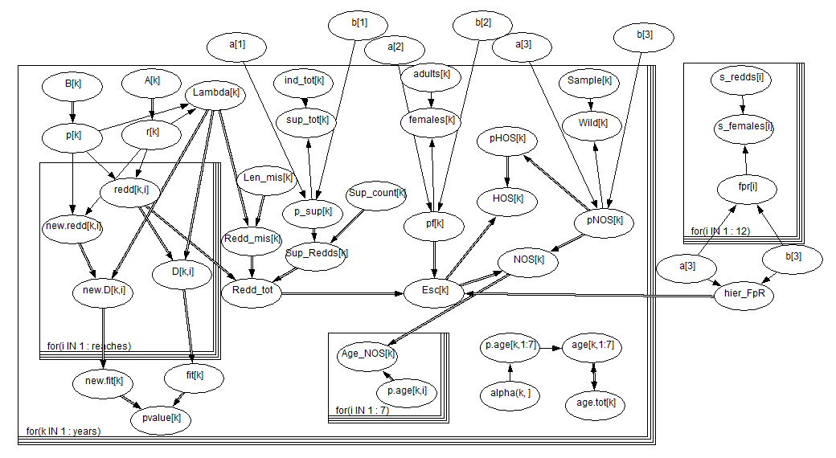
DAG used for analysis
Notes:
Mention that the frame loops years of data!
Redd density
Discrepancy function – GoF
Total Redds
% Female
% NOS
Females per Redd
Proportion at age
Total escapement and total NOS

Slide 13
WinBUGS Output
Also a text file with:
Mean and median
Standard deviation
95% CI
Sample iterations

Slide 14
Total Redds
Implementation of
census surveys
No error for complete census surveys!

Slide 15
Total Escapement

Slide 16
Patterns and Variability
Redd data in this basin follows a negative binomial distribution (not normal) in part due to hatchery effects.
 | CV
 | Pre-2005 | 2005-11
Total Redds | 14-33% | 0-6%
Total Escapement | 18-45% | 16-20%
NOS | 18-45% | 23-27%
Increasing
uncertainty
NOAA has proposed CV < 15% of escapement
Greatest sources of variability:
Females per Redd estimate CV = 13.5%
Sampling design CV = 14-33%
pNOS CV >25%

Slide 17
Discussion
There is a need for greater transparency and documentation of redd-based abundance estimates
Census survey design is ideal, but stratified sampling of high and low density areas would also lead to precise estimates
Hierarchical modeling is an effective tool for time-series data with gaps or limited data

Slide 18
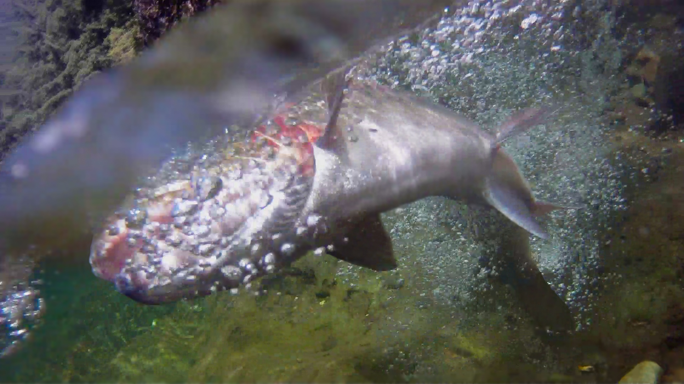
Questions?
Photo : Steve VanderPloeg

