Slide 1

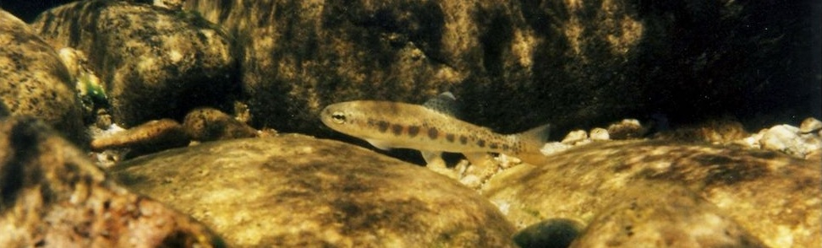
Implications of Differing Age Structure on Productivity of Snake River Steelhead Populations
Timothy Copeland, Alan Byrne, and Brett Bowersox
Idaho Department of Fish & Game
Notes:
STHD have a very flexible approach to life that complicates demographic assessments

Slide 2
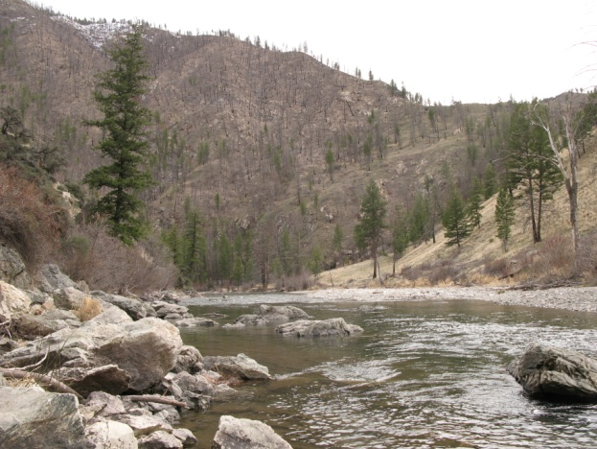
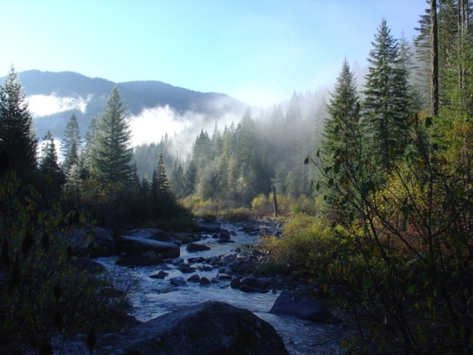
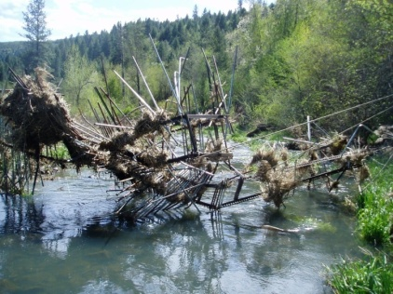
Snake River Steelhead
Environmental variability
  Elevation, land cover, hydrology
Logistical difficulties
  Spawn is near peak spring run-off
Few population-level data historically
Generic A/B run analysis
Notes:
In the Snake River, STHD spawn & rear over a wide range of conditions
Less than 1000’ to over 7000’; infertile granitic basins to spring-fed to basaltic bedrocks
Semi-desert to montane forests; large roadless areas
Spawning is near peak of hydrograph; hard to count redds or operate weirs
Data on aggregate DPS level & other stocks used for models & evaluations
In lieu of pop specific information, managers relied on a two stock classification system

Slide 3
Snake River Steelhead Life History
Emergence
(summer)
Residents
Spawn
(March-May)
Rear 1-5 yrs
Freshwater
?
Smolts
(May-June)
Returning adults
(July-October)
Kelts
Ocean
Grow 1-3 yrs
Notes:
Env’l variability leads to a broad suite of life history strategies

Slide 4
Snake River Steelhead Life History
Emergence
(summer)
Residents
Spawn
(March-May)
Rear 1-5 yrs
Freshwater
?
Smolts
(May-June)
Returning adults
(July-October)
Kelts
Ocean
Grow 1-3 yrs
Notes:
Here I will focus on age structure of the anadromous life history

Slide 5
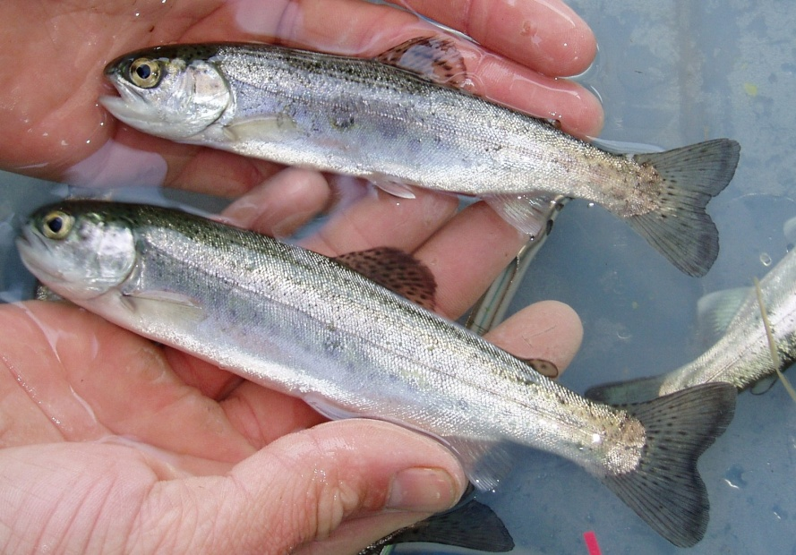
Question
What is effect of variable age structure on population productivity?
Notes:
Illustrate age structure complexity & how it may affect Snake R pops in different ways
Use available data in a heuristic exercise; “all else being equal”

Slide 6

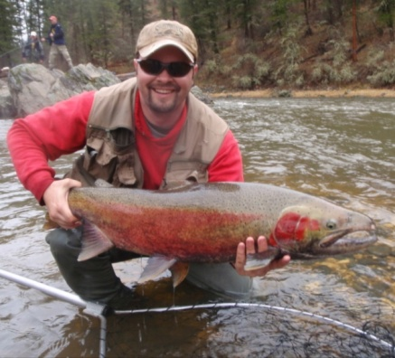
Steelhead Age Structure
Complicated tracking of cohorts
  Years in freshwater (1-5)
  Years in ocean (1-3)
Differential effects of selective pressures
Notes:
We have observed maiden spawners from 3 to 8 years; 12 of the 15 possible combinations
Spawners from the same cohort may return over 5 different years (or more!)

Slide 7

Model Assumptions
Conditions similar across populations
Females only
Life history inherited
Parr annual survival constant among ages
No temporal stochasticity
Notes:
To make problem tractable

Slide 8
Analysis Strategy
Leslie matrix model
Literature parameter estimates
Run Model with uniform age structure
Add complexity/ modify estimates
Aggregate age structure
Output Structure ~ Aggregate?
NO
YES
Next population
Population age structure
Constrain to
R/S = 1.0
Sensitivity analysis
Run Model with population age structure
Output R/S
Notes:
Construct a model w/annual time steps to encompass yr-specific life histories
Use parameter estimates from literature
Calibrate model with age data from the aggregate; constrain to R/S=1.0
Use calibrated model on pop-specific age compositions
Apply a few smell tests

Slide 9
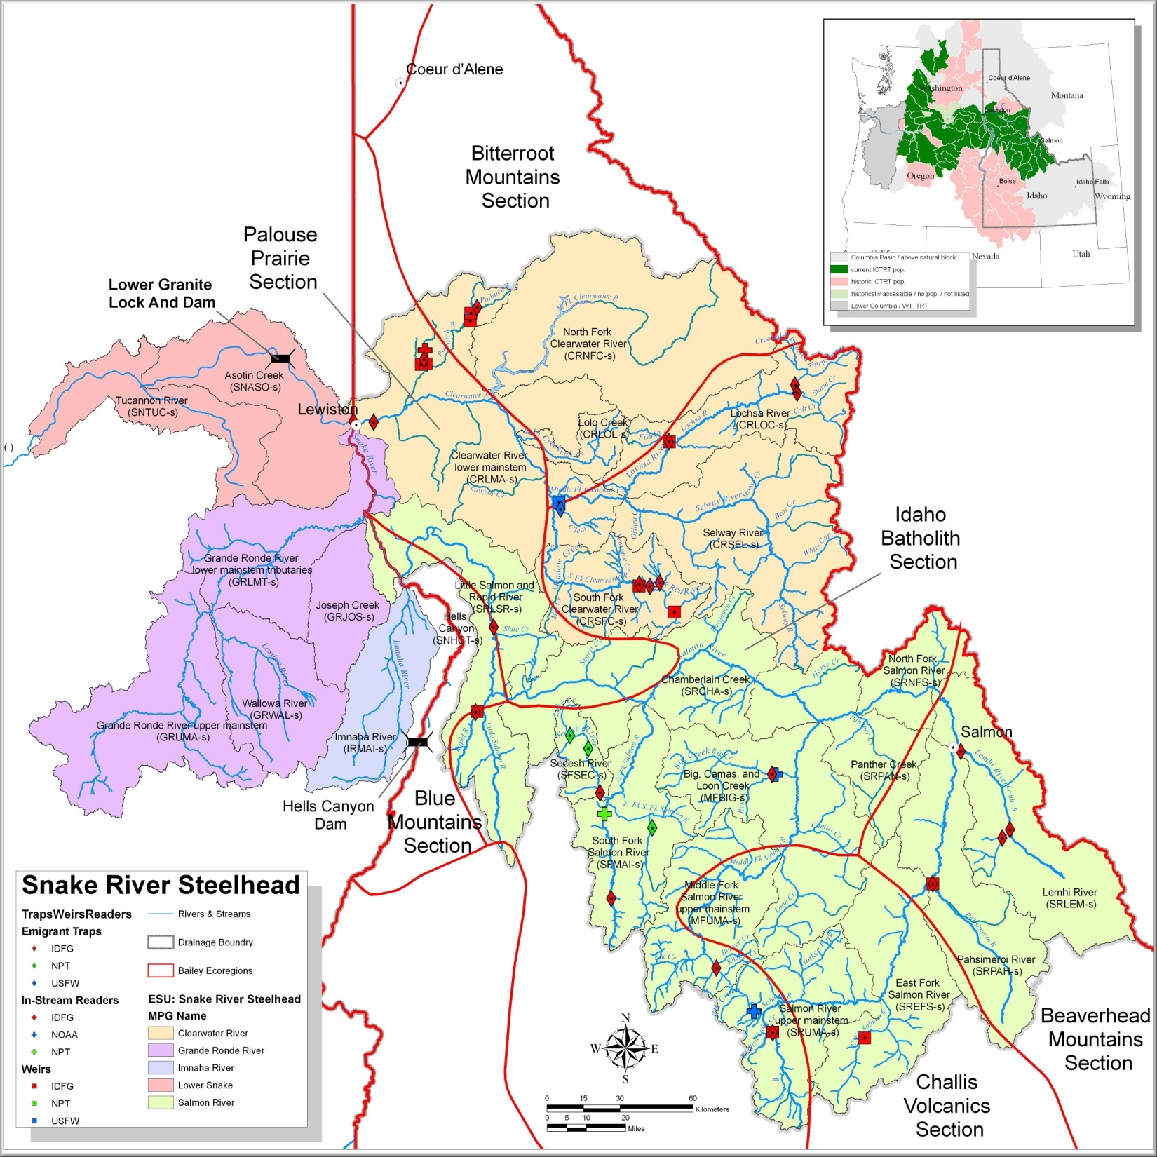
Adult Samples
Lower Granite Dam
Big Bear
EF Potlatch
Fish Creek
Rapid River
Big Creek
Pahsimeroi
Upper Salmon
Notes:
LGD was location of aggregate sample (2 yrs)
7 pop samples; Fish Creek & Big Creek are considered B-run pops

Slide 10
Base Parameter Estimates
Parameter | Estimate | Source
Egg-fry survival | 0.5 | Byrne et al 1992; Bjornn 1978
Freshwater survival | 0.3 | Byrne et al 1992; Bjornn 1978
1st yr ocean survival (S_{o1}) | 0.028 | Decade avg from CSS 2011 report
Ocean survival | 0.8 | Ricker 1976
Fecundity (1-ocean) | 3500 | Wild fish at Oxbow trap 1966-1968
Fecundity (2-ocean) | 5500 | Wild fish at NF Clearwater 1969-1971
Fecundity (3-ocean) | 6500 | Wild fish at NF Clearwater 1969-1971
Assume uniform initial age composition
Adjust parameters until age composition observed
Notes:
Start simple and add complexity
S_{o1} starts at LGD & lumps river emigration with 1st yr in ocean
Fecundities for wild fish in Idaho are scarce & dated
Tweak estimates until resulting age composition is close to observed aggregate

Slide 11
Observed Composition at LGD
(2009-2010 average)
Notes:
Notation here is (yrs in fw).(yrs in ocean)
Lump 5.1 into 4.1, occur only occasionally

Slide 12
Scenario 1: Base Parameters
Notes:
Obvious this yields a younger age comp than observed

Slide 13
Scenario 1: Base Parameters
Notes:
Focus on this view for other scenarios
Total age more impt for cohort tracking & productivity,

Slide 14
Age-Specific S_{o1} Schedules
Scenario 1
Scenario 2
Scenario 3
SURVIVAL (S_{o1})
Scenario 4
Scenario 5
SMOLT AGE
Notes:
The base scenario is inadequate (dashed line for reference in other scenarios)
Add complexity based size-specific ocean survival (Ward et al 1989) centered on 0.028
Make linear increase in survival based on mean smolt age = 2.5 (from LGD smolts)
Bley & Morings (1988) review suggested survival may triple with age
Assumed no further benefit for smolting after after age 3 & poor survival at age-1

Slide 15
Scenario 2: Linear S_{o1} Increase
Notes:
Improved model fit but still not satisfied

Slide 16
Scenario 3: Exponential S_{o1}
Notes:
Shifted too far

Slide 17
Scenario 4: Adjusted Linear S_{o1}
& 3-Ocean Survival
Notes:
Had too many 3-ocean adults, so cut back survival their last yr
This fit well

Slide 18
Scenario 5: Exponential S_{o1}, Adjusted as Above
Notes:
Fit was not as good as Scenario 4

Slide 19
Choose Scenario 4
Notes:
Note discrepancies greatest in 2.2 & 3.1; these are in same cohort

Slide 20
Model Parameters
Parameter | Estimate
Egg-fry survival | 0.1753
Parr survival | 0.3
S_{o1} – age-1 smolts | 0.0005
S_{o1} – age-2 smolts | 0.023
S_{o1} – age-3 & -4 smolts | 0.033
S_{o2} | 0.8
S_{o3} | 0.125
Fecundity (1-ocean) | 3500
Fecundity (2-ocean) | 5500
Fecundity (3-ocean) | 6500
Notes:
These are values that produced previous graph; changes were in ocean survivals
Last change was to egg/fry survival to achieve equilibrium
Thus interpretation of model output is productivity relative to the aggregate
Isolates effect of differing age structures

Slide 21
Model Parameters
Parameter | Estimate
Egg-fry survival | 0.1753
Parr survival | 0.3
S_{o1} – age-1 smolts | 0.0005
S_{o1} – age-2 smolts | 0.023
S_{o1} – age-3 & -4 smolts | 0.033
S_{o2} | 0.8
S_{o3} | 0.125
Fecundity (1-ocean) | 3500
Fecundity (2-ocean) | 5500
Fecundity (3-ocean) | 6500
Isolate relative effect of differing age structures
Notes:
We can address the question by holding all else constant

Slide 22
Productivity by Life History
Age category | Recruits/Spawner
1.1 | 0.09
1.2 | 0.12
2.1 | 1.27
2.2 | 1.60
3.1 | 0.55
3.2 | 0.69
4.1 | 0.16
4.2 | 0.21
Notes:
These are productivities at equilibrium or relative R/S (will come back to this later)

Slide 23
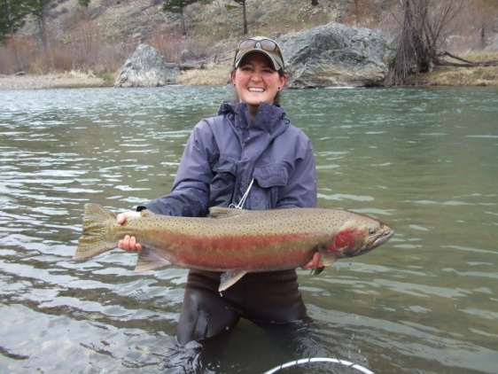

Population Age Structure
Population | Mean Age | # classes | Classes >10%
Pahsimeroi | 4.27 | 8 | 2.1, 2.2, 1.2
Upper Potlatch | 4.69 | 8 | 2.2, 2.1, 3.1
Big Bear | 4.71 | 7 | 2.2, 2.1
Upper Salmon | 4.69 | 8 | 2.1, 2.2, 3.1
Rapid River | 4.90 | 11 | 2.2, 2.1, 3.1
Fish Creek | 5.32 | 10 | 3.2,2.2,3.1
Big Creek | 5.45 | 7 | 3.2, 3.1, 2.2
Notes:
Gradient of age structures w/considerable overlap
We seeded model with these age compositions

Slide 24
Relative Population Productivity
Population | Recruits/Spawner
Pahsimeroi | 1.11
Upper Potlatch | 1.22
Big Bear | 1.21
Upper Salmon | 1.15
Rapid River | 1.02
Fish Creek | 0.92
Big Creek | 0.77
Mean age vs R/S: r = -0.82
Notes:
These are the straight-forward consequences of age structure
Note low elevation pops most productive

Slide 25
Productivity by Life History
Age category | Recruits/Spawner
1.1 | 0.09
1.2 | 0.12
2.1 | 1.27
2.2 | 1.60
3.1 | 0.55
3.2 | 0.69
4.1 | 0.16
4.2 | 0.21
Notes:
B run pops mostly 3.2, A runs 2.1 or 2.2
Are these results believable? Address in next 2 slides

Slide 26
Sensitivity Analysis
Changed basic rates +/-10%
  Egg/fry, parr, smolt, ocean survivals; fecundity
Aggregate productivity most sensitive to FW survival (79%-124%)
Relative age-specific fitness changed little
Adopting exponential S_{o1} schedule changed relative rankings
Notes:
Simple changes to vital rates just shifted aggregate productivity
Relative ranking of age categories was very stable
To favor a B-run life history, benefits for older smolts need to increase

Slide 27
Validation
Smolt S_{o1} survival schedule
  Most age 1 smolts near or less than 150 mm
  Benefit for larger smolts tied to timing
Penalty for 3-ocean adults
  Impacts upon river entry?
Measured R/S ratios
  Fish Creek 2003 & 2004 cohorts avg = 0.82
  Rapid River 2004 & 2005 cohorts avg = 1.07
Relative abundance at Lower Granite
Notes:
Does the model make sense & agree w/ independent evidence?
Few surviving age-1 smolts & evidence that SAR linked with timing, not length per se
Last item will be addressed by Mike Ackerman on Wed
Conclusion = model seems reasonable

Slide 28
Lochsa Emigrant Age Structure
Notes:
Example that age structure can vary significantly within a population
Different spawning aggregates may have disparate productivities (sources & sinks)
Here avg smolt age varies by almost a year

Slide 29
Some Ponderables
Model constrained to equilibrium w/limited data
S_{o1} begins at Lower Granite Dam
  Incorporates direct & latent migration effects
Consider basis for 3-ocean penalty
  Influence of growth & maturation?
Investigate age/size specific S_{o1} for Snake River populations
Correlation of FW & SW ages?
Effects of stochasticity on relative fitness?
Notes:
Some thoughts about model structure & issues to address
Items 3-5 should be important to understanding B-run life style
Model does not allow flexibility of life histories & that should be important; how much?
Purpose of model is to address a narrowly defined question w/short time window

Slide 30
Conclusions
Age structure leads to gradient of potential productivities
  Within-population variability
Older populations will be less productive
Older, larger smolts not realizing additional benefits
Notes:
Within-pop variability could be impt to resilience but likely reduces productivity
These are hypotheses that are logical consequences of the model

Slide 31
