Slide 1
Steelhead Viability Analysis: Addressing Life History Variability
Tom Cooney (NWFSC)
March 14, 2012

Slide 2
Topics
O. Mykiss diversity
VSP principles (hierarchical)
TRT VSP criteria
Modeling alternatives
Next steps

Slide 3
ESU Level Criteria
Viable Salmonid Population (VSP) Guidelines
  Consistent with historical setting, Multiple populations, some geographically widespread, some in close proximity to one another.
  All Populations within an ESU should not share the same catastrophic risk.
  Populations displaying diverse life histories/phenotypes should be maintained
  Some populations should exceed VSP guidelines.

Slide 4
ESU Viability Criteria (ICTRT)
An ESU would have a high probability of persistence if:
  At least one-half of the historical populations (minimum of 2) in each extant Major Grouping are meeting population viability criteria. (Major extirpated areas considered on a case by case basis.)
  High viability populations should include all major life history patterns and representative number of large/intermediate populations.
  At least one population in each extant strata should be rated at Very Low risk.
  The remaining extant populations are maintained – i.e., not in immediate danger of extinction
  Note: For some multi-population ESUs, there may be combinations of pop status across major groupings that could result in low risk without a requirement that all major groupings individually meet criteria – case by case consideration.

Slide 5
Population Viability
VSP Guidelines (McElhany et al., 2000) identify four basic components to consider:
  Abundance
  Productivity
  Spatial Structure
  Diversity

Slide 6
Population Criteria Concepts: Abundance/Productivity
 | Lower Columbia-Willamette | Puget Sound | Interior Columbia | Oregon Coast
Format | Population Change (PCC), viability curve | Planning Range compiled from Viability curve, VRAP assessments | Population viability curves incorporating minimum abundance threshold | Persistence criteria PP-1 productivity PP-2 persistence PP-3 critical abundance
Abundance |  |  | Recent 10 year geometric mean natural origin spawners | Pp3 Critical abundance: ave. density in lowest 3 of last 12 years.
Productivity | Natural origin returns relative to total parent spawning. | Natural origin returns relative to total parent spawning | Natural origin returns relative to total parent spawning. 20 yr geometic means from low to moderate parent esc | PP1:Natural origin returns relative to total parent spawning. geometric mean of escs below median (recent 12 years)
QET | Function of population size category |  | 50 spawners per year for four consecutive years | 2 variations: 1, 50 spawners per year for four consecutive years
RFT |  |  | 10 spawners in any return year
Modeling | Incorporates autocorrelation |  | Incorporates autocorrelation | PP-2 Average across four modeling approaches

Slide 7
Example Viability Curve: ICTRT

Slide 8
Population Level:
Spatial Structure Considerations
Spatial Structure refers to the geographic distribution of a population and the processes supporting that distribution.
Basic rationale:
  Multiple spawning reaches within a population provides protection against local catastrophic loss
  Some production areas may be inherently more productive than others – potentially serving as sources to a broader range of areas after prolonged periods of low survival, etc.

Slide 9
Population Criteria: Diversity Considerations
Traits and Life History strategies
  Loss of major life history strategies
  Reductions/changes in traits
Genetic Characteristics
  Direct measures
  Indirect: Influences of artificial production
Dispersal and Gene Flow Effects
  Gaps in spawning
  Selective effects of human activities
  Spawning distribution vs habitat types

Slide 10
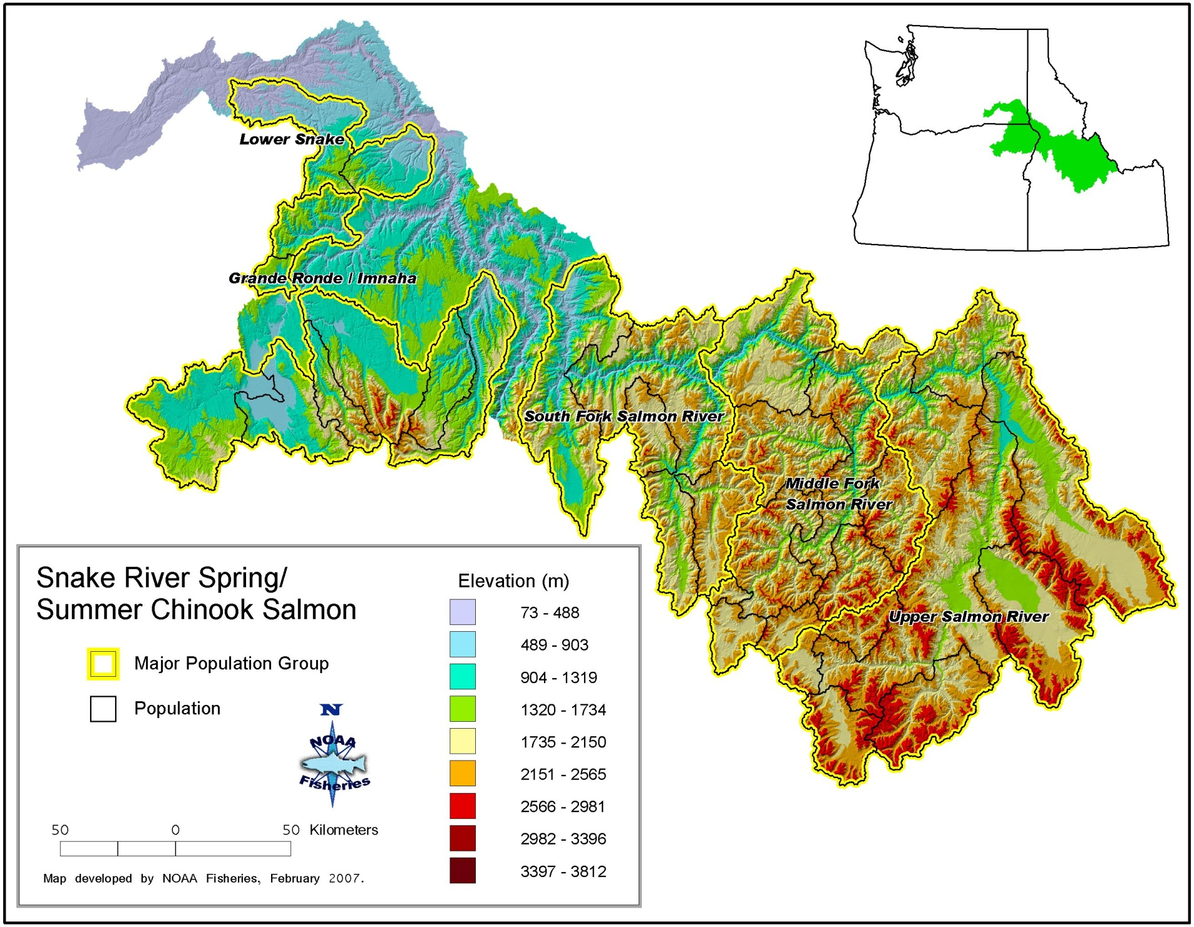

Slide 11
Using Models
Model types
  Conceptual
  Quantitative
    Simple PVA
    State-dependent
    Genetic
    Meta population models
    Linked models

Slide 12
LFH Models
Assumptions: explicit and implicit
Key uncertainties: O. mykiss LFH models
  Relative smolting rates: role of genetic component
  Spawning timing: overlap between anadromous and residents in a watershed
  Juvenile capacity: degree of interaction, segregation in time and depth??
  Local area summer refuges
  Downstream migration survival
  Applicable SARs

Slide 13
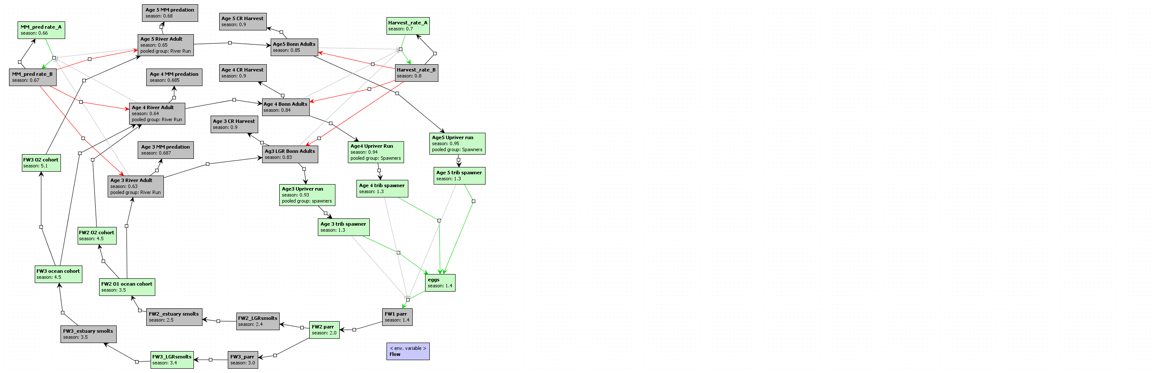
Generic Steelhead

Slide 14
Considerations
David (So. Calif): spatial considerations – patchiness vs short term catastrophes, intermitent access, temperature regimes, need for longer time series on key drivers and responses to develop more credible models
Richs talk: relative migrant production a function of particular crosses, may not be constants but a function of past history, leads to the possibility that in some cases residency might be subsidized by a dominant anadromous form, in others residency may be more prevalent and supporting anadromy
Tim C: age analyses: PVA analyses for Snake Basin steelhead populations should explicitly incorporate age structure assumptions consistent with information on emergence and juvenile growth conditions in a given setting

Slide 15
David SEAK talk: Iteroparity in small alskan stream, iteroparity appears to be a key life history trait allowing populations to be sustaing under conditions that result in relatively low egg to smolt survivals and high average smolt to adult survivals
Jeffs SEAK discussion: insight into dispersal patterns at finer scales, discussion of the roles the two different migratory types might play in maintaining inter/intra population diversity

Slide 16
More detailed O. mykiss life history models: opportunties, limitations and applications
Adapt to regional settings
  State dependent life history models
  Cohort reconstruction paired with juvenile production
Treat as hypothesis frameworks, primary use is to ‘test’ rule sets behind viability benchmarks and indices
Identify and pursue opportunities for validating results at either the component or population level
Contribute to recovery planning – tributary habitat protection/restoration

Slide 17
Next Steps
Compare results from modeling approaches
  Cohort based smolt reconstructions
  State dependent modeling (e.g. Satterthwaite et al., 2010)
  Parr density based modeling
Key sensitivity analyses
  Juvenile density models: size based habitat partitioning, temperature and flow assumptions
  Alternative assumptions/data on migrant production and survival rates

Slide 18
Key Questions
Spawning timing
Emergence
Age 0 density dependent interactions
  Growth
  Mortality
Age 1 density dependent interactionsS]
Smolts and SARs
  Smolting rates as a function of parentage
  Relative SARs as a function of parentage
  Downstream mortalities: natural vs anthropogenic

Slide 19
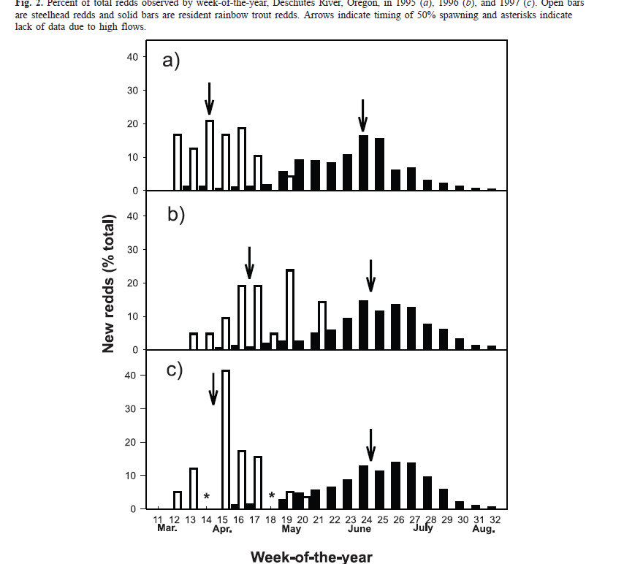
From: Zimmerman & Reeves 2007 CJFAS

Slide 20
