Slide 1
Contribution of Resident O. mykiss to Anadromous Populations and Vice Versa: Implications for Recovery Strategies and VSP Analysis
Richard W. Carmichael
Jim Ruzycki
Mike Flesher
Oregon Dept. of Fish & Wildlife
Funded by the USFWS

Slide 2
Presentation Outline
Background for resident-anadromous investigations
Anadromous -resident breeding studies
Anadromous -resident maternal origin investigation
Conclusions
Considerations for anadromous-resident production relationships, viability and recovery strategies

Slide 3
Background
Grande Ronde and Imnaha Basin Steelhead listed as threatened under Federal ESA in 1997 as components of the Snake River ESU
Population viability criteria are assessed for listing status and delisting under ESA, resident O. mykiss could be considered for all of the viability indicators. However only currently considered in Diversity.
Productivity(ability to maintain replacement given the range of environmental conditions projected for the next 100 years)
Abundance(absolute and trends over time)
Diversity(normative complexity and balance of life history strategies and genetic characteristics)
Spatial Distribution(range and pattern of spawning distribution)

Slide 4
Background
Resident and anadromous forms of O. mykiss considered independent in earliest listings and status assessments. The 2004 revised proposed ESA listing included resident fish and then it was changed again.
Understanding the relationship of resident and anadromous forms is important for understanding status and potentially for recovery strategies.
In those cases where resident and anadromous fish are reproductively linked creating one population, understanding productivity, abundance, diversity, and distribution are challenging and complex.

Slide 5
Observations
Significant anthropogenic habitat changes that have influenced the natural life history patterns as well as the production relationships between resident and anadromous O. mykiss.
Significant numbers of hatchery steelhead offspring residualize and become resident.
Natural origin resident rainbow males are often observed with spawning steelhead females.
Substantial spatial and temporal overlap in spawning distribution of resident and anadromous forms in some locations.

Slide 6
Objectives
Determine life-history composition of O. mykiss in Grande Ronde River basin.
Quantify resident parent contribution to anadromous life history.
Quantify anadromous parent contribution to resident life history.
Assess the potential for establishing steelhead broodstock from resident O. mykiss.

Slide 7
Approaches
Conduct breeding experiments with known origin steelhead and resident rainbow parents to assess offspring migration success, migrant characteristics, physiology, and precocious development.
Determine maternal origin of wild juvenile and adult steelhead and resident adult rainbow trout using otolith microchemistry analysis.

Slide 8
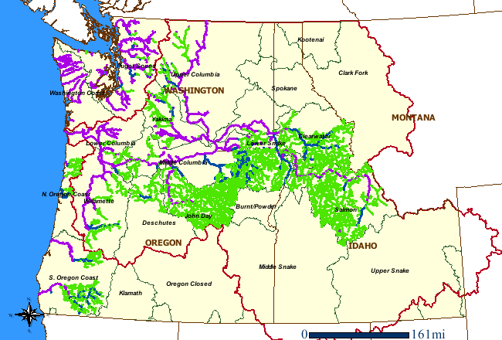
Notes:
For those not familiar with the Grande Ronde basin, it is located in NE Oregon.

Slide 9
Breeding Experiments
Collected mature adults
Wild residents
Wallowa stock
Artificially bred
Rb female X Rb male
Rb female X Sts male
Sts female X Sts male
Sts female X Rb male
Reared at Irrigon Hatchery – One year accelerated smolt program
Measured physiology
PIT tagged
Released at Wallowa Hatchery and monitored detections at Lower Granite Dam(295 km) to estimate migratory offspring proportions

Slide 10
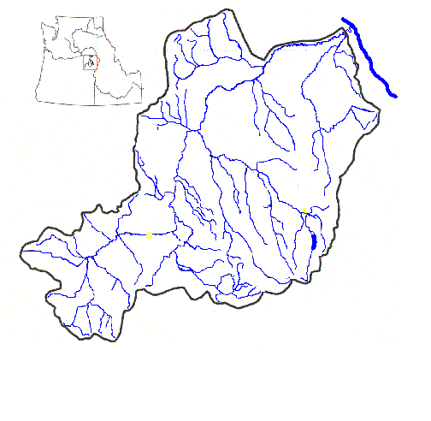
Snake River
Grande Ronde
River basin
Enterprise
La Grande
Sources of resident adults
Release site

Slide 11
Parental Stock & Numbers
Brood Year | Cross | # Females | # Males | Stock
1998 | RbXSts | 2 | 3 | Deer Cr.
 | StsXRb | 1 | 1
 | StsXSts | 2 | 2 | Wallowa Hatchery
1999 | RbXRb | 2 | 9 | Wallowa R.
 | RbXSts | 2 | 4
 | StsXRb | 2 | 5
2000 | RbXRb | 3 | 12 | Sumac, Deer
 | RbXSts | 2 | 4
 | StsXRb | 4 | 8
 | StsXSts | 4 | 4

Slide 12
Parental Stock & Numbers (cont.)
Brood Year | Cross | # Females | # Males | Stock
2001 | RbXRb | 3 | 4 | Prarie Cr.
 | RbXSts | 3 | 2
 | StsXRb | 2 | 2
 | StsXSts | 2 | 2
2002 | RbXRb | 4 | 6 | Prarie Cr.
 | RbXSts | 3 | 2
 | StsXRb | 2 | 5
 | StsXSts | 2 | 2
2003 | RbXRb | 3 | 3 | Prarie Cr.
 | StsXRb | 1 | 2
 | StsXSts | 1 | 1

Slide 16
Length Frequency At Release and Recapturet Release and

Slide 17
n = 4889
n = 2709
n = 2791
n = 2669

Slide 18
Breeding Experiment Conclusions
RbxRb showed different physiological patterns
RbxRb were smaller and more variable at release
StsxSts had the lowest condition factor
RbxRb had lowest survival to dams, StsxSts were highest, and crosses were intermediate
There appeared to be a maternal influence
Larger fish were detected at dams at greater rates

Slide 19
Maternal Origin Microchemistry Methods Background
Strontium (Sr) metabolically equivalent to calcium (Ca)
Sr concentration greater in ocean vs. freshwater (FW)
Nutrients derived from environment reflected in otoliths
Nutrients (Sr & Ca) transferred from mother to eggs
Sr/Ca ratios from growth regions in otoliths reflect environmental growth history and maternal origin
High Sr/Ca ratios reflect anadromous mothers
Low Sr/Ca ratios reflect resident mothers & FW growth
Notes:
We identified maternal origin by examining the Sr/Ca ratio in fish otoliths. Strontium is chemically similar to calcium and is therefore utilized in metabolic processes at a standard rate equivalent to its concentration in the environment. Sr levels are usually higher in the marine environment compared to freshwater habitats. Because Sr and Ca are used similarly in metabolic processes the concentrations in the environment are reflected in deposits in fish’s otoliths. Mothers transfer nutrients to their eggs. Otoliths begin to develop in the embryo stage when the yolk is used for nutrition. The core region reflects the mother’s nutrient/environmental history. A region ~ 400um from the core reflects a zone where growth occurred during freshwater residence as a parr. High Sr/Ca ratios indicate environments high in Sr (i.e. marine). Low Sr/Ca ratios indicate environments low in Sr (i.e. most freshwaters).

Slide 20
Sample Design Sample known origin resident and anadromous fish and unknown origin fish at four life-history stages primarily at three locations in the Grande Ronde basin
Life History Stages
Locations
Age-0 juveniles
Resident adults
Migrating smolts
Anadromous adults
Upper Grande Ronde
Catherine Crk.
Lookingglass Crk.
Other locations for anadromous adults
Notes:
To investigate O. mykiss life history using otolith microchemistry analysis, we sampled four life-history stages including anadromous and resident adults, emigrating smolts which were identified by the smolt characteristics of silvery color, deciduous scales, fusiform body shape, and within a certain size category. We also sampled “unknown” origin age-0 fish. These fish were sampled primarily at three locations where we have been collecting fish for other projects.

Slide 21
Fish Collection Sites
Snake River
Grande Ronde
River basin
Enterprise
La Grande
Anadromous adults
Smolts
Resident adults, Age-0
Known resident pop.
Notes:
We collected smolts and adults where we had rotary screw traps and weirs. These sites included Lookingglass Creek, Catherine Creek, and the Upper Grande Ronde. Resident adults and age-0 fish were collected from areas above these traps and weirs. We also collected additional anadromous adults at weirs on Deer Creek and Little Sheep Creeks.

Slide 22
Sample Sizes
Site | Age-0 | Resident adults | Smolts | Anad. adults
Lookingglass Crk. | 32 | 48 | 22 | 8
Upper Grande Ronde | 39 | 40 | 56 | 28
Catherine Crk. | 68 | 31 | 46 | 59
Beaver Crk. (known residents) | 8 | 15 | -- | --
Deer Crk. | -- | -- | -- | 27
Little Sheep Crk. | -- | -- | -- | 17
Notes:
These are the numbers of samples at each life stage and area we had analyzed.

Slide 23
Discriminating life-history samples in the field
Smolts were captured in the Spring in migrant traps and were identified by size, morphology, and coloration.
> 130 mm but < 250 mm FL
Fusiform shape
Deciduous scales
Silvery color with lack of parr marks
Resident adults were fish collected during the summer above weirs
> 180 mm FL
Mature gonads
Age-0 fish were collected in Summer and < 100 mm FL
Adults collected in the spring at adult trapping facilities
Notes:
We used several criteria while in the field to determine whether we were sampling smolts and resident adults.

Slide 24
Sample Analysis
Otoliths dissected from all fish
Otoliths analyzed at OSU
Otoliths sectioned and polished
Electron microprobe
Sr & Ca elemental concentrations
Notes:
Otoliths are dissected from each fish collected. We had the dissected otoliths analyzed at Oregon State University following techniques and recommendations developed by Eric Volk of Washington Fish & Wildlife. Otoliths were cut and polished to reveal the core region. Elemental analysis was then conducted using an electron microprobe. The microprobe uses an electron beam to vaporize a point on the otolith releasing the individual elemental components. Strontium and calcium elemental concentrations were used to distinguish maternal origin.

Slide 25
Otolith Schematic Diagram
Core region represents growth from mothers nutrients (i.e. marine or freshwater).
Freshwater growth region approximately 400 um from core (corresponds to parr life stage).
Three samples taken in each growth region and t-tests used to detect differences.
FW growth
600 um
Core
Notes:
We took three replicate samples from the core region and the freshwater growth zone. These were then compared with one-tailed t-tests to determine statistical differences between zones.

Slide 26
Discrimination Criteria for Sr/Ca comparisons
We used a two-criteria method for life stages other than parr, only Core sample available.
Known samples used as guide for discrimination criteria.
Sr/Ca ratios were required to fall within a certain range.
In general, an otolith Sr/Ca Core ratio had to be < 1 to be classified as freshwater origin.
t-tests between Core and FW values then used to determine significance differences
For example: an adult steelhead concluded to be from a anadromous mother needed a core ratio greater than 1 and a core greater than the FW growth region value.

Slide 27
Decision Process (Post Parr)
1. Is the freshwater Sr/Ca ratio < 1?
Yes → go to step 2
No → examine the core to FW ratio, if core greater - anadromous
2. Is the core ratio > 1?
Yes → go to step 3
No → go to step 4
3. Is the core ratio > freshwater ratio ?
Yes → anadromous
4. Is the core ratio significantly > freshwater ratio (α = 0.05)?
Yes → anadromous
No → go to step 5
5. Is the core ratio < FW ratio?
Yes → resident mother

Slide 28
Data rejected if core
equal to or less than FW
if core significantly > FW = Anadromous
Anadromous
Resident
Core > FW = Anadromous

Slide 29
Resident Mother
Notes:
Here the samples that appear to discriminate from the others are highlighted. These are likely fish that came from resident mothers. There may be others from resident mothers that aren’t circled but they reared in environments with high Sr.

Slide 30
Age-0 Maternal Origin (one criteria)
Location | % Anadromous
Lookingglass Ck. | 87%
Catherine Ck. | 79%
Upper Grande Ronde | 85%
Notes:
Here are the percentages from the graphs you just saw. Of all the age-0 fish we sampled, 13-21% came from anadromous mothers.

Slide 32
Smolt Maternal Origin
results
Location | % Resident
Lookingglass Ck. | 21.0%
Catherine Ck. | 9.5%
Upper Grande Ronde | 10.5%
Notes:
These are the statistical results from the smolts captured at the rotary screw traps. The data is consistent showing that 1/3 of the smolts migrating out of the system came from resident mothers.

Slide 34
16.7%

Slide 35
Anadromous Adult Maternal Origin
Location | % Resident
Lookingglass Ck. | 0%
Catherine Ck. | 0%
Upper Grande Ronde | 0%
Deer Ck. | 16.7%
Little Sheep Ck. | 7.7%
Notes:
Finally, the statistical results from our anadromous adult samples. Again, the data is fairly consistent among areas showing that approximately 20% of the returning adult steelhead came from resident mothers!

Slide 38
Resident Adult Maternal Origin
Location | % Anadromous
Lookingglass Ck. | 94.3%
Catherine Ck. | 82.6%
Upper Grande Ronde | 84.6%
Notes:
These are results from statistical comparisons among resident adult fish that were sampled. In some areas almost half of the mature resident fish sampled had anadromous mothers.

Slide 39
Water Chemistry Analysis
Location | Sr/Ca ratio
Lookingglass Ck. | 1.38
Catherine Ck. | 2.20
Upper Grande Ronde | 2.57
Little Sheep Ck. | 1.74

Slide 40
Maternal Origin Conclusions
There is considerable linkage between the resident and anadromous life history forms with both producing crossover offspring.
The microchemistry technique has some limitations when applied in the Grande Ronde River.
Distance traveled from ocean by female affects Sr concentration of nutrients supplied to egg. Grande Ronde females spend 8 months or more in fresh water which reduces Sr levels transferred to offspring.
High Sr in freshwater can also confound results.
We attempted to account for these limitations with our discrimination criteria.
Small sample sizes and variability in core and FW area ratios

Slide 41
Recovery Strategy Considerations
Steelhead are listed due to depressed productivity and altered diversity resulting from man induced environmental habitat alterations.
Reduced steelhead productivity has likely favored expression and productivity of resident O. mykiss in some populations.
Viability criteria emphasize the importance of natural balance in both life history expression and production by life history types for long term population persistence.
Strategic guidance for recovery actions places highest priority on maintaining high quality habitats that have unaltered natural processes and restoring healthy habitat conditions and natural processes in habitats that have high potential across the entire life cycle.

Slide 42
Recovery Strategy Considerations
Strategic guidance also emphasizes restoring natural balances in life history expression and anadromous resident production relationships.
One could argue that many of our current observations of resident-anadromous relationships are in severely altered systems that have unnatural balances in life history expression and production.

Slide 43
Considerations for Viability
What was the normative balance in production flow between life life history strategies.
How have man induced environmental changes altered the productivity of each life history type, the production flow between life history types and the balance in life history expression.
Modeling the viability influence is complex and requires estimates of abundance, fecundity, spawner distribution, proportional pairings, egg survival, parr survival, proportion of offspring that residualize or smolt, smolt to adult survival, resident subadult to adult survival, and resident adult to adult survival.
Due to the complex nature of the interactions, we would expect highly variable relationships between populations that reside in different geographic areas and in divergent habitat types.

Slide 44
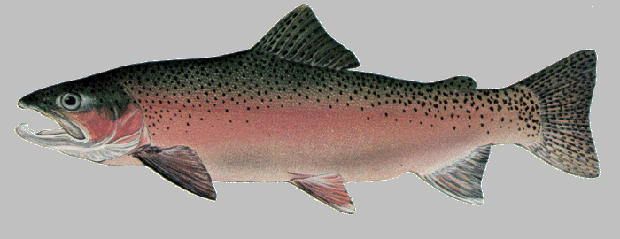
SMOLTIFICATION
RESIDUALIZATION
RESIDENCY
ANADROMY
REPRODUCTION

Slide 45
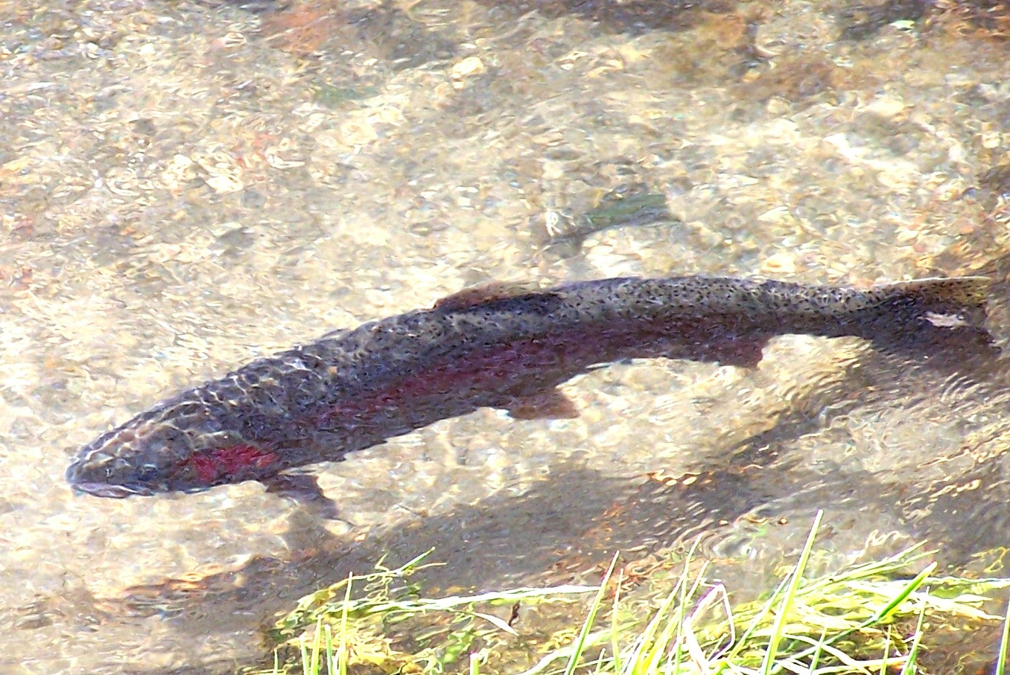
Questions
Questions

